Slide 1


Slide 2

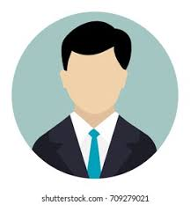
Deep Features for Age-Invariant Face Recognition
Corresponding Author (S):Dr. Rupali Kute , Riya Huddar
Paper id:6859
Institution: Maharashtra Institute of Technology, Pune

Slide 3

Index
Abstract
Introduction
Survey
Comparative table
Problem statement
Methodology / architecture / flow of work
Result and discussion
Conclusion & Future Scope
Reference

Slide 4
Abstract
The performance of a face recognition algorithm is affected as facial appearance undergoes a lot of changes with age. These changes may be due to natural or behavioral causes. Thus, the development of a robust age-invariant face recognition (AIFR) system is essential.
Training a model from scratch requires a huge dataset and is also computationally expensive. The Transfer learning approach has provided solutions to these problems.

Slide 5
Introduction
Age-invariant face Recognition aims at recognizing a person accurately regardless of changes in their appearance due to age or behavior.
It has become quite popular and has found applications in several fields such as criminal detection, security, and access-related applications.
For carrying out the AIFR task, it is essential to use a comprehensive database with specific features
The models used for transfer learning are already trained using large datasets, and the weights learned are retained from the original training, which can change as per the application. Some modifications that are made to the model are: Freezing, discarding, or adding some layers.
In this paper, we have compared the performance of three pre-trained models FaceNet, VGG-Face and OpenFace on two datasets: FG-NET and MORPH owing to their advantages.

Slide 6
Survey
With the advent of the FG-NET database, research aimed at interpreting the changes in the appearance of faces concerning age were largely benefitted.[11] Today some of the widely used databases for AIFR tasks are YGA, Burt’s Caucasian Face, Gallagher’s Web-Collected, FG-NET, LHI Face, HOIP Face, Iranian Face, MORPH, AI&R Asian Face, WIT-DB and PAL, etc. However, some of them have drawbacks.
FaceNet was developed by researchers from Google for the recognition of faces in 2015.[13]
In [9] a large dataset consisting of 2.6M images of 2,622 subjects is generated. A deep CNN architecture called VGG-Face is also proposed.
The implementation of the OpenFace model for face recognition is proposed in [2].

Slide 7
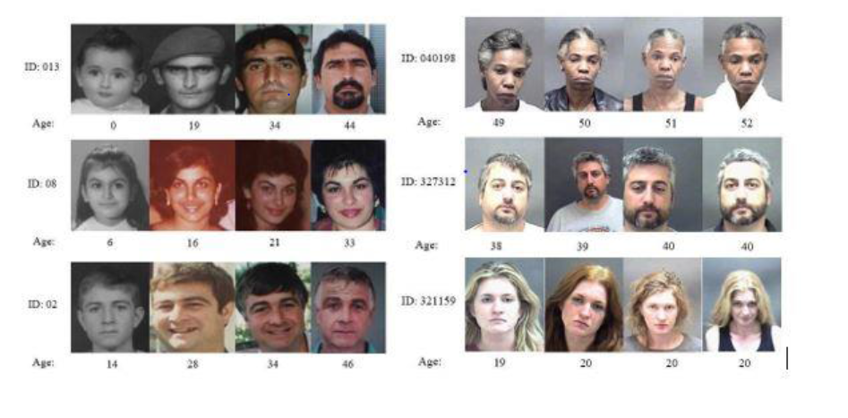
Comparative Table
Model | Training Datasets
FaceNet | 8M different identities
VggFace | VGGFace dataset(2.6M)
OpenFace | 500k images from combining the two largest labeled face recognition datasets for research, CASIA-WebFace [YLLL14] and FaceScrub [NW14].

Slide 8
Problem statement
Face Recognition is an essential requirement in today’s world. Today, whether it’s a case of security or arranging photos of different people in separate folders, face recognition is the only tool to do this automatically without human involvement.
The system should also be able to recognize a particular person at any age. Age Invariant Face Recognition is the solution to this requirement.
The performances of three specific models which are trained on face data: FaceNet, VGG-Face, and OpenFace have been evaluated on two databases: the entire FG-NET database and 1,000 randomly selected identities of the MORPH database.

Slide 9
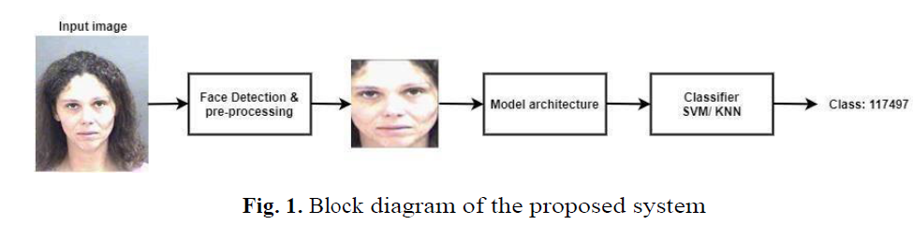
Methodology / architecture / flow of work
Dlib is used for detecting faces, and OpenCV to crop and transform the image generating aligned 96 x 96 x 3 face images
These bounding boxes cannot be fed directly to the model as the faces can be under different poses and illumination.
dlib makes use of OpenCV’s 2D affine transformation for this purpose, affine transfor-mation normalizes the face for comparison and finally crops the image to 96×96 pixels. This pre-processing step is crucial for the overall performance of the model. These images are then used to train and test the model performance. transformation

Slide 10
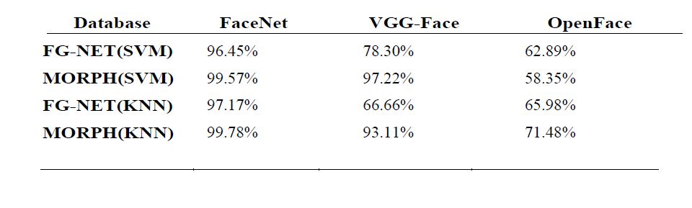
Result and discussion
The performance of the pre-trained models on the FG-NET and MORPH databases can be seen in Table 1. As shown, the accuracy of the FaceNet model is higher than that of the other two models.
All the experiments in this project have been conducted on Google Collaboratory without using GPU.

Slide 11
Conclusion & Future Scope
This comparative study proved that the FaceNet model provides the highest accuracy on both datasets while VGG-Face is the second most accurate model. The effect on the performance when using two classifiers: KNN and SVM on the three models is also studied.
The accuracy when using the SVM classifier is better on VGG-Face while the KNN classifier is more accurate on FaceNet and OpenFace model.
The accuracy of models can be further improved by tuning the different parameters like the number of convolution or dense layers in the model architecture. The future scope of this project is to enhance the performance of the models by using fine-tuning.

Slide 12
References
Amos, B. and B. Ludwiczuk (2016). Pittsburgh, PA.
Omkar, M., A. Parkhi, A. Vedaldi, and Zisserman (2015). Deep Face Recognition. Proceedings of the British Machine Vision Conference (BMVC) 12, 41–42.
Panis, G., A. Lanitis, N. Tsapatsoulis, and T. F. Cootes. Overview of research on facial aging using the FG-NET aging database. IET Biometrics 5 (2), 2016–2016.
Schroff, F., D. Kalenichenko, and J. Philbin (2015). FaceNet: A unified embedding for face recognition and clustering. In 2015 IEEE Conference on Computer Vision and Pattern Recognition (CVPR), pp. 815–823.

Slide 13
THANK YOU!

