Slide 1
Logistic Regression,
Logistic regression is a statistical method for analyzing a data set in which there are one or more independent variables that determine an outcome. Logistic regression can be used to predict a binary outcome (1 / 0, Yes / No, True / False) given a set of independent variables. Here are ten points about logistic regression:
Logistic regression is a type of regression analysis that is used to model the probability of a certain outcome.
It is called "logistic" because it uses a logistic function to model the relationship between the dependent variable and the independent variables.
The dependent variable in logistic regression is binary or categorical, which means it can take on only two values.
Logistic regression allows us to predict the probability of a certain outcome based on the values of the independent variables.

Slide 2
Logistic Regression,
Logistic regression is widely used in various fields such as medical research, marketing, and social sciences.
The logistic function used in logistic regression is the sigmoid function, which is an S-shaped curve that ranges from 0 to 1.
The logistic function maps any input value to a probability value between 0 and 1.
The logistic regression model estimates the coefficients of the independent variables that maximize the likelihood of the observed data.
Logistic regression can be used for binary classification problems, such as predicting whether a customer will buy a product or not.
There are several variants of logistic regression, such as multi-class logistic regression and ordinal logistic regression, that can handle more than two categories in the dependent variable.

Slide 3
Code Snippet For Logistic Regression,
from sklearn.linear_model import LogisticRegression
from sklearn.model_selection import train_test_split
from sklearn.datasets import load_iris
# Load Iris dataset
iris = load_iris()
# Split dataset into training and testing sets
X_train, X_test, y_train, y_test = train_test_split(iris.data, iris.target, test_size=0.2, random_state=42)
# Create Logistic Regression model
lr = LogisticRegression()
# Fit model to training data
lr.fit(X_train, y_train)
# Predict target values for test data
y_pred = lr.predict(X_test)
# Evaluate model accuracy
accuracy = lr.score(X_test, y_test)
print(f"Model accuracy: {accuracy}")

Slide 4
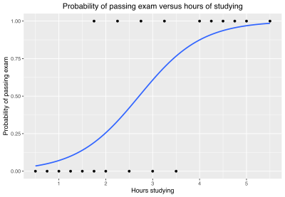

Slide 5
Estimating Probabilities in ML
- Estimating probabilities is a fundamental concept in machine learning.
- It is used to quantify the likelihood of an event occurring and can be used for various tasks such as classification, regression, and anomaly detection.
- There are different techniques to estimate probabilities in machine learning.
- The choice of technique depends on the nature of the problem, the available data, and the desired level of accuracy.
- In this article, we will explore some of the popular techniques for estimating probabilities in machine learning.
Maximum Likelihood Estimation (MLE)
MLE is a technique used to estimate the parameters of a probability distribution that maximize the likelihood of observing the data. It assumes that the data is generated from a known probability distribution and aims to find the parameters that best fit the data.
Bayesian Estimation
Bayesian estimation is a technique that uses Bayes' theorem to estimate probabilities. It takes into account prior knowledge about the parameters and updates the probabilities with new data to obtain the posterior probability distribution.
Kernel Density Estimation (KDE)
KDE is a non-parametric technique that estimates the probability density function of a random variable. It does not assume any specific probability distribution and instead uses a kernel function to estimate the density.

Slide 6
Estimating Probabilities in ML
Logistic Regression
Logistic regression is a popular classification algorithm that estimates the probability of an event occurring. It models the relationship between the input variables and the output variable using a logistic function.
Naive Bayes
Naive Bayes is a classification algorithm that uses Bayes' theorem to estimate probabilities. It assumes that the input variables are independent of each other and calculates the probability of each class given the input variables.
Random Forest
Random forest is an ensemble learning algorithm that combines the predictions of multiple decision trees. It can be used for classification and regression tasks and can also estimate probabilities.
Gradient Boosting
Gradient boosting is another ensemble learning algorithm that combines the predictions of multiple weak learners. It uses a loss function to optimize the predictions and can also estimate probabilities.
Markov Chain Monte Carlo (MCMC)
MCMC is a simulation technique used to estimate the posterior probability distribution of a complex model. It generates a sequence of samples that converge to the true distribution and can be used for Bayesian inference.
Monte Carlo Simulation
Monte Carlo simulation is a technique that uses random sampling to estimate probabilities. It simulates the system multiple times and calculates the probability of an event occurring based on the number of times it occurs.
Expectation-Maximization (EM)
EM is a technique used to estimate the parameters of a probability distribution when the data is incomplete or missing. It iteratively estimates the missing values and updates the parameters to maximize the likelihood of observing the data.

Slide 7
Code Snippet For Estimating Probabilities
import pandas as pd
from sklearn.naive_bayes import GaussianNB
# Read data into a pandas dataframe
data = pd.read_csv('data.csv')
# Split data into features and target
X = data.drop(['target'], axis=1)
y = data['target']
# Train a Gaussian Naive Bayes classifier
clf = GaussianNB()
clf.fit(X, y)
# Use the classifier to predict probabilities for a new sample
new_sample = [0.3, 0.7, 1.5, 2.1]
probabilities = clf.predict_proba([new_sample])
print(probabilities) # Output: [[0.7, 0.3]]

Slide 8
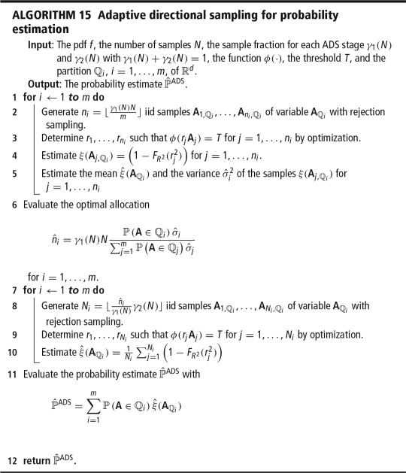

Slide 9
Training and cost function
Machine learning algorithms aim to learn patterns or relationships in data.
Training is the process of teaching the algorithm to recognize patterns in the data.
Cost function determines how effectively the algorithm is learning.
Cost function measures the difference between predicted and actual values.
The goal of training is to minimize the cost function.
Gradient descent is a common algorithm used to minimize the cost function.
Gradient descent iteratively adjusts the parameters of the model to minimize the cost function.
The learning rate determines the step size taken in each iteration of gradient descent.
If the learning rate is too high, it might miss the minimum point of the cost function. If it is too low, it might take a long time to converge.
A cost function that is too complex may lead to overfitting, while a cost function that is too simple may lead to underfitting.

Slide 10
Training and cost function
Machine learning algorithms aim to learn patterns or relationships in data. Training is the process of teaching the algorithm to recognize patterns in the given set of data. To determine how effectively the algorithm is learning, we use a cost function. The cost function measures the difference between predicted and actual values. The goal of training is to minimize the cost function.
Gradient descent is a common algorithm used to minimize the cost function. It is an iterative algorithm that adjusts the parameters of the model to minimize the cost function. The learning rate is an important parameter that determines the step size taken in each iteration of gradient descent. If the learning rate is too high, it might miss the minimum point of the cost function. If it is too low, it might take a long time to converge.
It is essential to choose an appropriate cost function, as it determines how well the algorithm will learn. A cost function that is too complex may lead to overfitting, wherein the model learns the specific features of training data so well that it fails on new data. A simplistic cost function may lead to underfitting, where the model is not able to grasp any signals in the data.
In regression problems, the mean squared error function is widely used as a cost function. In classification problems, the cross-entropy function or the logarithmic loss function are commonly used as cost functions.
In conclusion, a good understanding of both training and the choice of cost function is necessary to effectively train a machine learning model. The goal is to attain a good balance between underfitting and overfitting, so the model can generalize well for new data.

Slide 11
Code Snippet For Training and cost function
import numpy as np
# define training data
X = np.array([[0, 1], [1, 1], [1, 0], [0, 0]])
y = np.array([[1], [0], [1], [0]])
# define sigmoid function
def sigmoid(x):
return 1 / (1 + np.exp(-x))
# define cost function
def cost_function(X, y, weights):
z = np.dot(X, weights)
h = sigmoid(z)
J = (-1 / len(X)) * np.sum((y * np.log(h)) + ((1 - y) * np.log(1 - h)))
return J
# define training function
def train(X, y, epochs, lr):
np.random.seed(1)
weights = np.random.rand(X.shape[1], 1)
for epoch in range(epochs):
z = np.dot(X, weights)
h = sigmoid(z)
error = h - y
gradient = np.dot(X.T, error) / len(X)
weights -= lr * gradient
cost = cost_function(X, y, weights)
print('Epoch:', epoch+1, 'Cost:', cost)
return weights
# train model
weights = train(X, y, epochs=100, lr=0.1)

Slide 12
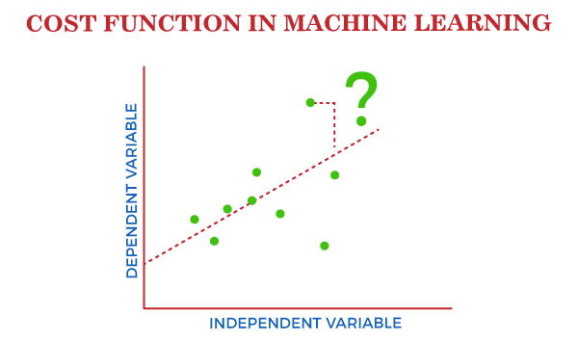

Slide 13
Decision boundaries in Machine Learning
Decision boundaries are an essential concept in machine learning for separating different classes of data.
These boundaries are used to discriminate the elements of a given dataset based on their features into different categories.
The decision boundary is a line, plane or higher dimensional surface that separates the feature space of different classes of data points.
The objective is to find a decision boundary that can efficiently separate different classes in an accurate and effective way.
There are several algorithms used in machine learning, such as logistic regression, decision trees, and support vector machines, that can help determine the decision boundary in various scenarios.
The complexity of the decision boundaries depends on the complexity of the input data and the degree of linear separability of the data points belonging to different classes.

Slide 14
Decision boundaries in Machine Learning
In some cases, it may be impossible to find a single straight line that separates the classes. In such cases, non-linear decision boundaries are used.
The process of determining decision boundaries involves a mathematical technique called optimization, which involves finding the minimum or maximum value of a given function.
Decision boundaries can be visualized using different data visualization techniques such as scatter plots, contour plots, heat maps, and decision boundary plots.
The accuracy of the decision boundary models can be evaluated using various metrics such as precision, recall, F1 score, confusion matrix, and ROC curve.
In conclusion, decision boundaries are an essential concept in machine learning for separating different classes of data. By using various algorithms, a separation line or surface can be identified that divides different classes of data. The process of identifying a decision boundary involves optimization techniques, and different data visualization techniques are used to analyze and validate the accuracy of the identified boundary.

Slide 15
Code Snippet For Decision boundaries in Machine Learning
import matplotlib.pyplot as plt
from sklearn.datasets import make_blobs
from sklearn.linear_model import LogisticRegression
# create a dataset
X, y = make_blobs(n_samples=100, centers=2, random_state=0)
# plot the dataset
plt.scatter(X[:, 0], X[:, 1], c=y, cmap='rainbow')
# fit a logistic regression model to the data
clf = LogisticRegression()
clf.fit(X, y)
# plot the decision boundary
xmin, xmax = plt.xlim()
coef = clf.coef_[0]
intercept = clf.intercept_
ymin = (-intercept - coef[0]*xmin) / coef[1]
ymax = (-intercept - coef[0]*xmax) / coef[1]
plt.plot([xmin, xmax], [ymin, ymax], 'k-', color='purple')
plt.xlim(xmin, xmax)
plt.show()

Slide 16
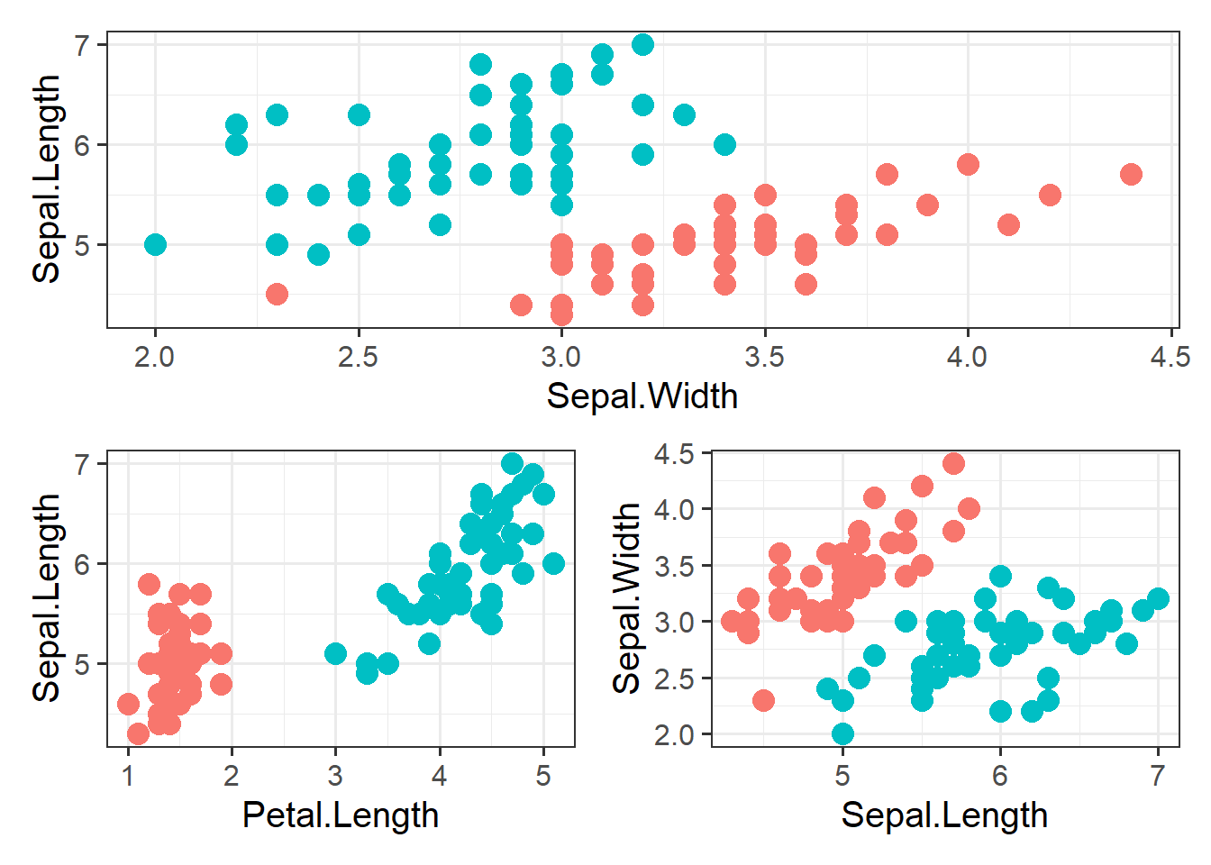

Slide 17
SoftMax Regression
SoftMax Regression is a classification algorithm that is used for multi-class classification problems in machine learning.
It is a logistic regression model in which the dependent variable is categorical and has more than two categories.
It is based on the principle of maximum likelihood and is used to predict the probability of each class.
SoftMax Regression is also known as Multinomial Logistic Regression or Maximum Entropy Classifier.
It is widely used in Natural Language Processing (NLP) tasks such as sentiment analysis and named entity recognition.
Details:
The SoftMax function is used to convert the output of the linear regression model into a probability distribution over multiple classes.

Slide 18
SoftMax Regression
The SoftMax function is defined as exp(yi) / ∑j exp(yj) where yi is the predicted output for class i, and j is the total number of classes.
The SoftMax function ensures that the sum of the probabilities of all the classes is equal to one.
The objective of SoftMax Regression is to minimize the cross-entropy loss function, which measures the difference between the predicted probability distribution and the actual probability distribution.
SoftMax Regression can be implemented using a variety of optimization algorithms such as Gradient Descent, Stochastic Gradient Descent, and Adam optimizer.
In conclusion, SoftMax Regression is a powerful classification algorithm that can be used for multi-class classification problems in machine learning. It uses the SoftMax function to predict the probability of each class and minimizes the cross-entropy loss function to improve the accuracy of the model. It is widely used in applications such as Natural Language Processing (NLP) and has numerous optimization algorithms to choose from for implementation.

Slide 19
Code Snippet For SoftMax Regression
import numpy as np
class SoftmaxRegression:
def __init__(self, lr=0.01, n_iters=1000):
self.lr = lr
self.n_iters = n_iters
def fit(self, X, y):
n_samples, n_features = X.shape
n_classes = len(set(y))
self.weights = np.zeros((n_features, n_classes))
self.bias = np.zeros(n_classes)
for i in range(self.n_iters):
scores = X.dot(self.weights) + self.bias
exp_scores = np.exp(scores)
probs = exp_scores / np.sum(exp_scores, axis=1, keepdims=True)
y_one_hot = np.zeros((n_samples, n_classes))
y_one_hot[np.arange(n_samples), y] = 1
grad_weights = (1 / n_samples) * X.T.dot(probs - y_one_hot)
grad_bias = (1 / n_samples) * np.sum(probs - y_one_hot, axis=0)
self.weights -= self.lr * grad_weights
self.bias -= self.lr * grad_bias
def predict(self, X):
scores = X.dot(self.weights) + self.bias
preds = np.argmax(scores, axis=1)
return preds

Slide 20
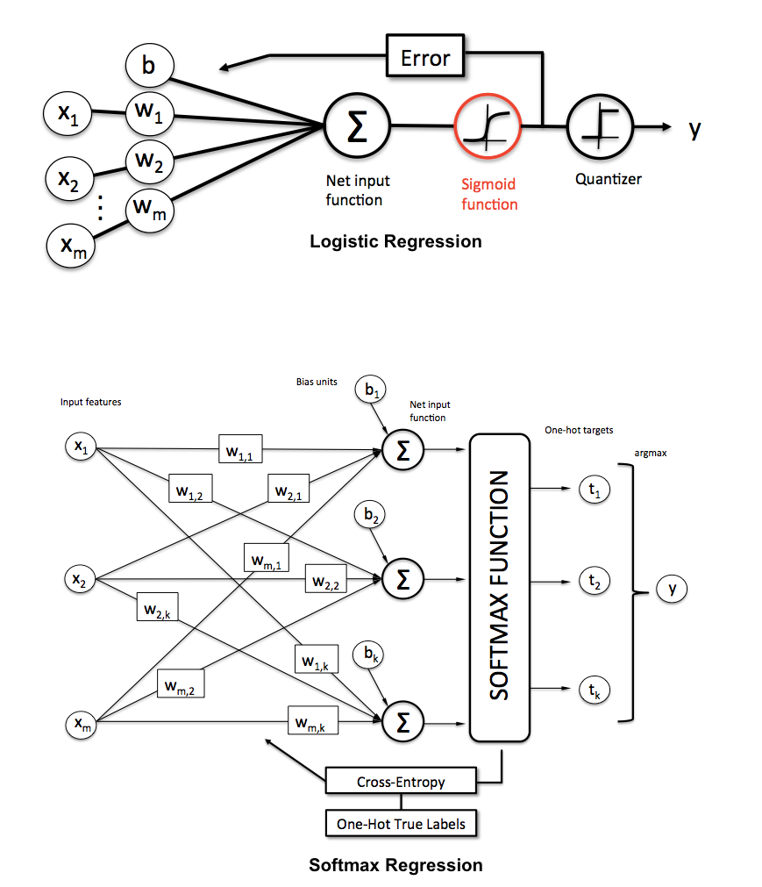

Slide 21
Non-linear SVM Classification
Non-linear SVM classification is a machine learning algorithm used for classification tasks where the data is not easily separable by a linear boundary.
SVM or Support Vector Machine is a powerful machine learning algorithm used for classification tasks.
SVM can be used for both linear and non-linear classification.
Linear SVM classification is used when the data is linearly separable, but in the case of non-linear data, Non-linear SVM classification is used.
The non-linear SVM classification algorithm works by transforming the data into a higher-dimensional space where it can be separated by a non-linear boundary.
Non-linear SVM classification involves the use of a kernel function that maps the inputs into a higher space where a linear boundary can separate the data.
Kernel functions like Polynomial kernel, Gaussian kernel, Radial Basis Function kernel, and Sigmoid kernel are used in Non-linear SVM classification.

Slide 22
Non-linear SVM Classification
The choice of kernel function plays a critical role in the performance of the Non-linear SVM classification algorithm.
The main advantage of Non-linear SVM classification is its ability to handle complex non-linear data that cannot be classified by a linear boundary.
However, Non-linear SVM classification is computationally intensive, and the choice of kernel function must be carefully selected to prevent overfitting or underfitting of the data.
Non-linear SVM classification can be applied to various fields, including bioinformatics, data mining, financial modeling, and image recognition.
In conclusion, Non-linear SVM classification is a powerful machine learning algorithm used for classification tasks where the data is not linearly separable. The algorithm works by mapping the data into a higher-dimensional space where a non-linear boundary can separate the data. Choosing the right kernel function is critical for good performance. Nevertheless, the algorithm has proven to be useful in many fields, including bioinformatics, data mining, financial modeling, and image recognition.

Slide 23
Code Snippet For Non-linear SVM Classification
from sklearn.svm import SVC
from sklearn.datasets import make_moons
from sklearn.model_selection import train_test_split
from sklearn.metrics import accuracy_score
# Generate dataset
X, y = make_moons(n_samples=1000, noise=0.1, random_state=42)
# Split dataset into training and testing sets
X_train, X_test, y_train, y_test = train_test_split(X, y, test_size=0.2, random_state=42)
# Create an instance of the SVM model with a non-linear kernel (e.g. RBF)
svm = SVC(kernel='rbf')
# Train the model on the training data
svm.fit(X_train, y_train)
# Use the trained model to predict the labels for the test data
y_pred = svm.predict(X_test)
# Evaluate the model's performance by computing the accuracy
accuracy = accuracy_score(y_test, y_pred)
print("Accuracy:", accuracy)

Slide 24
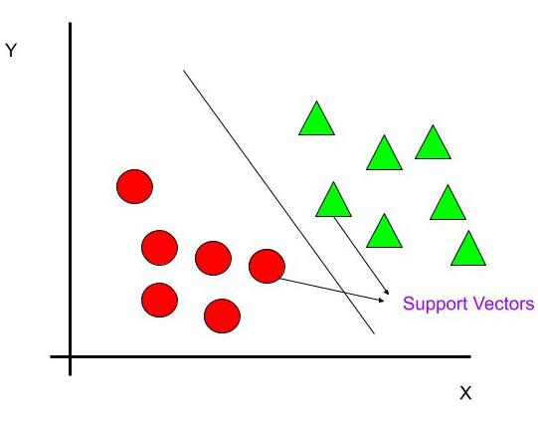

Slide 25
Polynomial kernel in SVM
The polynomial kernel is a popular kernel function used in support vector machine (SVM) algorithms. It is useful for classifying datasets that are not linearly separable by transforming them into higher dimensional feature spaces.
Polynomial kernel formula: The polynomial kernel function calculates the inner product between two data points in a higher-dimensional feature space. The formula for the polynomial kernel is K(x, y) = (x.T*y + c)^d, where x and y are the input data points, c is a constant, and d is the degree of the polynomial.
Introduction to kernel functions: Kernel functions are used to transform non-linearly separable data into a higher-dimensional feature space where linear separation is possible. The SVM algorithm uses the kernel function to calculate the dot product between feature vectors in the transformed space.
The degree of the polynomial: The degree of the polynomial determines the complexity of the decision boundary. Higher degrees can capture more complex relationships in the data but may also be prone to overfitting.
Effect of parameter ‘c’: The parameter ‘c’ controls the influence of higher-degree polynomials in the kernel function. Larger values of ‘c’ mean that higher-degree polynomials have more influence in the kernel function, while smaller values of ‘c’ mean that lower-degree polynomials have more influence.

Slide 26
Polynomial kernel in SVM
Computational complexity: The polynomial kernel can be computationally expensive when working with large datasets. The complexity of the algorithm is proportional to the cube of the number of features.
Advantages of polynomial kernel: The polynomial kernel can capture complex relationships between features and can handle non-linear data. It is simple to implement and is useful for high-dimensional datasets.
Disadvantages of polynomial kernel: The polynomial kernel can be sensitive to hyperparameters such as the degree of the polynomial. It is also computationally expensive when working with large datasets.
Other types of kernel functions: In addition to the polynomial kernel, there are other types of kernel functions that are commonly used in SVM algorithms, such as the linear kernel, radial basis function (RBF) kernel, and sigmoid kernel.
Choosing the right kernel function: The choice of kernel function depends on the nature of the data and the problem being solved. The linear kernel is suitable for linearly separable data, while the RBF kernel is useful for non-linear data.
Conclusion: The polynomial kernel is a popular choice in SVM algorithms for handling non-linear, high-dimensional data. The degree of the polynomial and the constant parameter ‘c’ can be adjusted to balance the bias-variance tradeoff and improve the accuracy of the model.

Slide 27
Code Snippet For Polynomial kernel in SVM
from sklearn.svm import SVC
from sklearn.datasets import load_iris
from sklearn.model_selection import train_test_split
# load iris dataset
iris = load_iris()
# split the dataset into training and testing sets
X_train, X_test, y_train, y_test = train_test_split(iris.data, iris.target, test_size=0.3, random_state=42)
# train a support vector machine with polynomial kernel
poly_svm = SVC(kernel='poly', degree=3, coef0=1, C=5)
poly_svm.fit(X_train, y_train)
# evaluate the performance of the SVM on the testing set
accuracy = poly_svm.score(X_test, y_test)
print(f"Accuracy: {accuracy}")

Slide 28
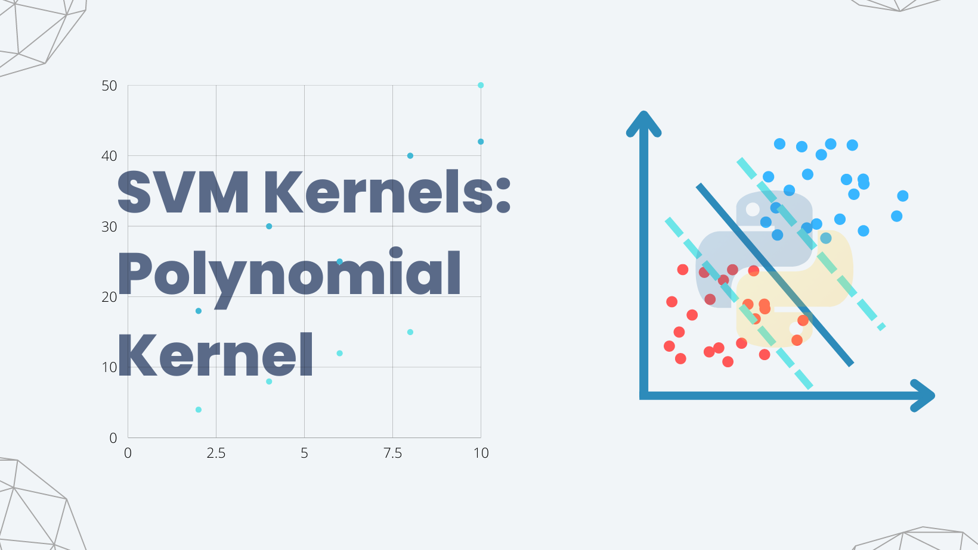

Slide 29
Adding similarity feature in SVM
SVM (Support Vector Machine) is a supervised machine learning algorithm used for classification and regression analysis.
The algorithm works by finding the best hyperplane that separates the data into different classes.
SVM can be enhanced by adding similarity features to its model that can help improve its accuracy.
Similarity-based features are effective for classification problems since they measure the similarity between data points.
In SVM, similarity features are added to the kernel function.
Kernel function determines the similarity between two data points and maps them into a higher-dimensional space where the classes become linearly separable.
There are various types of kernel functions such as linear, polynomial, and Gaussian (RBF).
Adding similarity features to the kernel function can improve the performance of SVM by accounting for similarities between data points.
It can make the classifier less sensitive to variations in the data and reduce errors due to noise or outliers.
In real-world problems, incorporating similarity features in SVM can be very useful when data points are complex and diverse.

Slide 30
Adding similarity feature in SVM
Adding similarity features in SVM can greatly enhance its accuracy and performance. By measuring the similarity between data points, similarity-based features can help improve the classification of data points into different classes. Here are some key points to consider when adding similarity features in SVM:
SVM uses a kernel function to transform the original data into a higher-dimensional space. This is done to make the classes linearly separable.
Similarity-based features are useful in classification problems because they measure the similarity between data points.
Adding similarity-based features to the kernel function can account for similarities between data points and make the classifier less sensitive to variations in the data.
Common types of kernel functions include linear, polynomial, and Gaussian (RBF).
In a polynomial kernel function, the degree of the polynomial determines the non-linearity of the decision boundary.
The RBF kernel function is a popular choice since it is able to model non-linear decision boundaries. However, selecting an appropriate value for its hyper-parameters can be challenging.
Adding similarity features in SVM can reduce errors due to noise or outliers.
In real-world problems, incorporating similarity features in SVM can be very useful when data points are complex and diverse.
When adding similarity features in SVM, it is important to understand the underlying data structure and choose the appropriate kernel function.
Experimentation with different kernel types and hyper-parameters is crucial to increase accuracy and performance.

Slide 31
Code Snippet For Adding similarity feature
from sklearn.svm import SVC
from sklearn.metrics.pairwise import cosine_similarity
# Define a custom kernel function
def similarity_kernel(X1, X2):
# Compute the cosine similarity between all pairs of rows in X1 and X2
sim_matrix = cosine_similarity(X1, X2)
# Convert the similarity matrix into a kernel matrix
kernel_matrix = 1 - sim_matrix
return kernel_matrix
# Initialize the SVM classifier with the similarity kernel
svm_classifier = SVC(kernel=similarity_kernel)
# Train the classifier using the training data
svm_classifier.fit(X_train, y_train)
# Make predictions on the test data
y_pred = svm_classifier.predict(X_test)

Slide 32
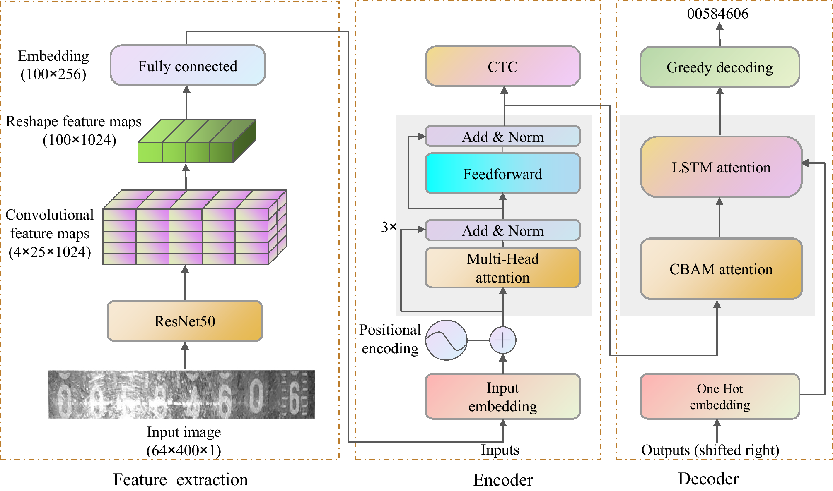

Slide 33
Gaussian RBF Kernel in SVM
The Gaussian RBF (Radial Basis Function) kernel in Support Vector Machines (SVM) is a popular kernel function that is used to transform non-linearly separable data into linearly separable data. In this topic, we will discuss the key features of the Gaussian RBF Kernel in SVM.
Introduction to SVM: Support Vector Machines(SVM) is a powerful supervised machine learning algorithm that is used for classification and regression analysis. It works by finding the optimal hyperplane that separates the data points into different classes.
Linear vs non-linear SVM: Linear SVM works only when the data is linearly separable, but many datasets are not linearly separable. Non-linear SVM solves this problem by mapping the data into higher dimension space so that the non-linear patterns become linearly separable.
Kernel methods in non-linear SVM: Kernel methods are used with non-linear SVM to map data into higher dimensional space. The kernel function calculates a dot product between two data points in the higher dimension space without actually computing the transformation.
Gaussian RBF kernel: One of the popular kernel functions used in SVM is the Gaussian RBF kernel. The formula for the Gaussian RBF kernel is K(x, x') = exp(-gamma * ||x-x'||^2).

Slide 34
Gaussian RBF Kernel in SVM
Parameters of Gaussian RBF kernel: The key parameter in the Gaussian RBF kernel is gamma. It controls the width of the kernel and determines how much influence a single training example has.
Pros of Gaussian RBF kernel: The Gaussian RBF kernel is flexible and can capture complex non-linear relationships between variables. It is also computationally efficient and can handle high-dimensional datasets.
Cons of Gaussian RBF kernel: The Gaussian RBF kernel is susceptible to overfitting when the gamma parameter is not tuned correctly. It can also be sensitive to the choice of gamma and sometimes requires trial and error.
Applications of Gaussian RBF kernel: The Gaussian RBF kernel is used in a variety of applications such as image classification, text classification, and bioinformatics.
Tuning Gaussian RBF kernel: The gamma parameter can be tuned by using techniques such as GridSearchCV or RandomizedSearchCV to find the optimal values that minimize the generalization error.
Conclusion: In conclusion, the Gaussian RBF kernel in SVM is a powerful tool for solving non-linear classification problems. With the right parameter settings and careful tuning, it can achieve high accuracy and generalize well.

Slide 35
Code Snippet For Gaussian RBF Kernel
from sklearn.svm import SVC
from sklearn.datasets import load_iris
from sklearn.model_selection import train_test_split
from sklearn.metrics import accuracy_score
import numpy as np
# Load iris dataset
iris = load_iris()
X, y = iris.data, iris.target
# Split dataset into train and test sets
X_train, X_test, y_train, y_test = train_test_split(X, y, test_size=0.2, random_state=42)
# Define the SVM classifier with Gaussian RBF Kernel
svm_rbf = SVC(kernel='rbf')
# Train the SVM classifier on the training data
svm_rbf.fit(X_train, y_train)
# Make predictions on the test data using the trained SVM classifier
y_pred = svm_rbf.predict(X_test)
# Calculate accuracy score of the SVM classifier on the test data
accuracy = accuracy_score(y_test, y_pred)
print('Accuracy:', accuracy)

Slide 36
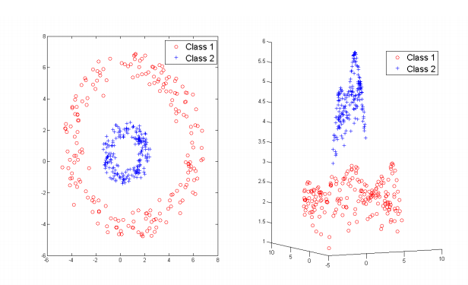

Slide 37
SVM Regression
SVM regression is a type of machine learning algorithm used for predicting continuous numerical values.
The algorithm works by finding a hyperplane that maximizes the margin between the predicted values and the actual values.
The margin represents the distance between the predicted value and the decision boundary.
The decision boundary is the line that separates the predicted values on one side and the actual values on the other side.
SVM regression can handle both linear and non-linear relationships between the input variables and the predicted values.
Non-linear relationships are handled by mapping the input variables into a higher dimensional space using a kernel function.
The kernel function converts the input variables into a new space where the relationships between the variables are linear.
The most commonly used kernel functions are the linear, polynomial, Gaussian radial basis function, and sigmoid functions.
SVM regression has a number of advantages over other regression methods, such as the ability to handle high-dimensional data and small sample sizes.

Slide 38
SVM Regression
SVM regression is widely used in various applications, such as finance, biology, and engineering.
SVM regression is a type of machine learning algorithm used for predicting continuous numerical values. The algorithm works by finding a hyperplane that maximizes the margin between the predicted values and the actual values. The margin represents the distance between the predicted value and the decision boundary. The decision boundary is the line that separates the predicted values on one side and the actual values on the other side.
SVM regression can handle both linear and non-linear relationships between the input variables and the predicted values. Non-linear relationships are handled by mapping the input variables into a higher dimensional space using a kernel function. The kernel function converts the input variables into a new space where the relationships between the variables are linear. The most commonly used kernel functions are the linear, polynomial, Gaussian radial basis function, and sigmoid functions.
SVM regression has a number of advantages over other regression methods, such as the ability to handle high-dimensional data and small sample sizes. It also has a robust optimization method that produces a unique and optimal solution. However, it is computationally intensive when dealing with large datasets, which is a disadvantage of the algorithm.
SVM regression is widely used in various applications, such as finance, biology, and engineering. In finance, it is used for stock forecasting and predicting financial markets. In biology, it is used for predicting protein structure and predicting gene expression levels. In engineering, it is used for predicting the strength of materials and predicting machine failure.
Overall, SVM regression is a powerful machine learning algorithm that can handle both linear and non-linear relationships between the input variables and the predicted values. It is widely used in various applications due to its robustness and accuracy.

Slide 39
Code Snippet For SVM Regression
from sklearn.svm import SVR
# Load data
X_train, y_train = load_data()
# Initialize SVM Regressor with linear kernel
svm_reg = SVR(kernel='linear')
# Train SVM Regressor
svm_reg.fit(X_train, y_train)
# Predict new values
y_pred = svm_reg.predict(X_test)

Slide 40
