Slide 1
Machine fault diagnosis agent using ibm watsonx.ai
IBM AICTE PROJECT
Presented By : Riya
College Name : JIMS Engineering Management Technical Campus
Department : AIML

Slide 2
OUTLINE
Problem Statement
Proposed System/Solution
System Development Approach
Algorithm & Deployment
Result
Conclusion
Future Scope
References

Slide 3
Problem Statement
Traditional machine fault diagnosis often depends on manual checks and rule-based systems, which can be quite tedious and error-prone. As machines become more complex, there's an increasing demand for smart, automated solutions that can sift through machine data and recommend appropriate maintenance or safety measures based on signs like unusual vibrations, temperature spikes, or strange noises.

Slide 4
Proposed Solution
Harness the power of IBM watsonx.ai to create a smart agent that engages with users, pinpointing potential faults and recommending maintenance steps for machines.
This agent utilizes advanced language models along with tailored tools for efficient search and data retrieval.
It effortlessly integrates with user inquiries and taps into external data sources.

Slide 5
System Approach
Programming Language:
Python 3.11
Libraries:
IBM watsonx.ai (ibm_watsonx_ai, langchain_ibm)
LangGraph, LangChain Core
Requests, JSON, OS, getpass
API Usage:
IBM Cloud watsonx.ai Foundation Models API

Slide 6
Algorithm & Deployment
Credential Management:
Discover how to secure your API authentication with IBM Cloud API keys.
Model:
Meta-Llama-3-70B Instruct, featuring adjustable inference parameters.
Agent Creation:
create_react_agent is designed for reasoning and taking action.
The toolbox features search capabilities, web crawling, and access to resources like Wikipedia and DuckDuckGo.
Deployment:
Hosted through the IBM watsonx.ai Python SDK; executed within a specific project or space context.

Slide 7
Result
We successfully got the agent up and running to tackle user questions about machine faults.
For instance, it can provide diagnosis suggestions for unusual CNC machine vibrations or issues like overheating in hydraulic pumps.
The agent takes in user input, smartly picks the right tools, and delivers responses in a clear markdown or structured format.

Slide 8
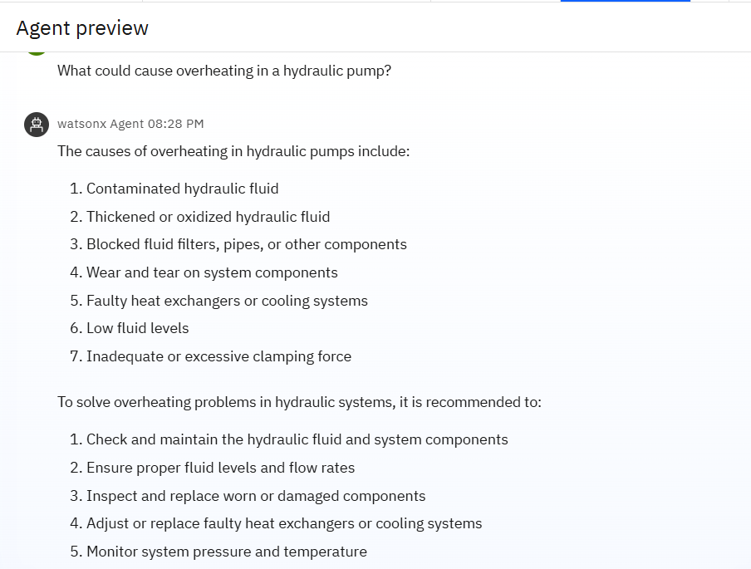
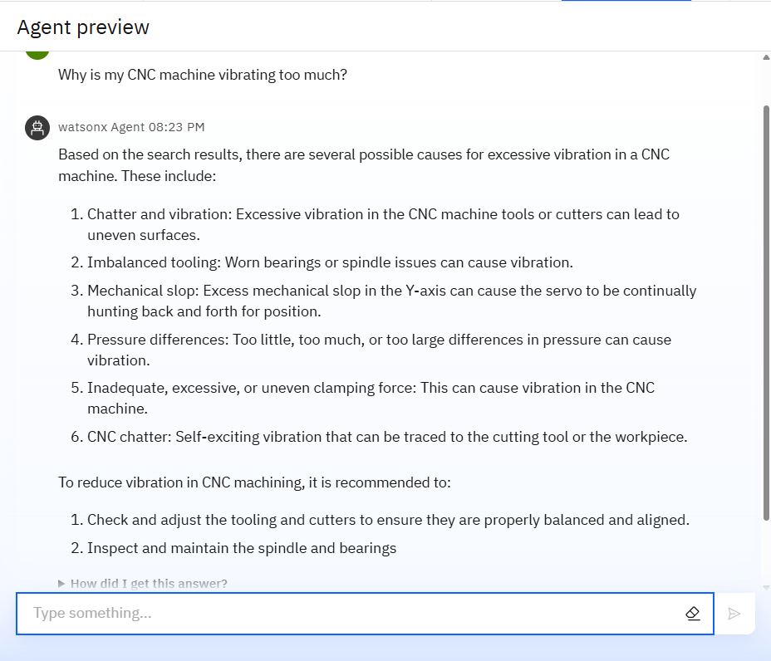
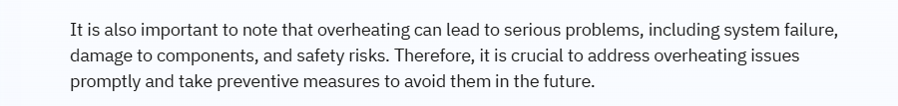
Results

Slide 9
Conclusion
The Machine Fault Diagnosis Agent showcases how cutting-edge language models and tool integration can deliver practical insights for industrial equipment.
Its adaptable architecture makes it easy to expand by adding more diagnostic tools or integrating additional data.
It also suggests maintenance steps, safety precautions, and provides references for further troubleshooting.

Slide 10
Future scope
Integrate IoT machine data to provide real-time diagnostics based on sensor readings.
Broaden the knowledge base to include a wider variety of machine types and fault conditions.
Utilize historical maintenance data to offer predictive maintenance suggestions.
Implement voice-activated interfaces for a hands-free experience.

Slide 11
References
Discover the IBM watsonx.ai documentation and API references, along with the LangChain and LangGraph libraries. Dive into research focused on using AI for machine fault diagnosis and predictive maintenance.

Slide 12
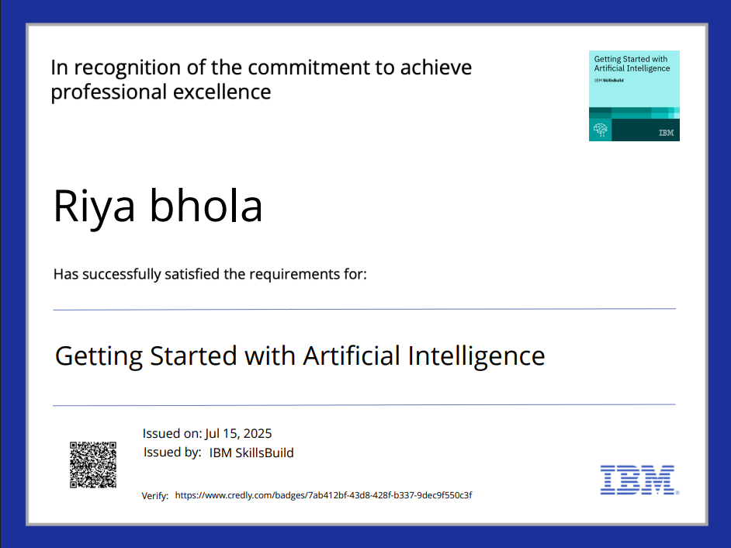
IBM Certifications

Slide 13
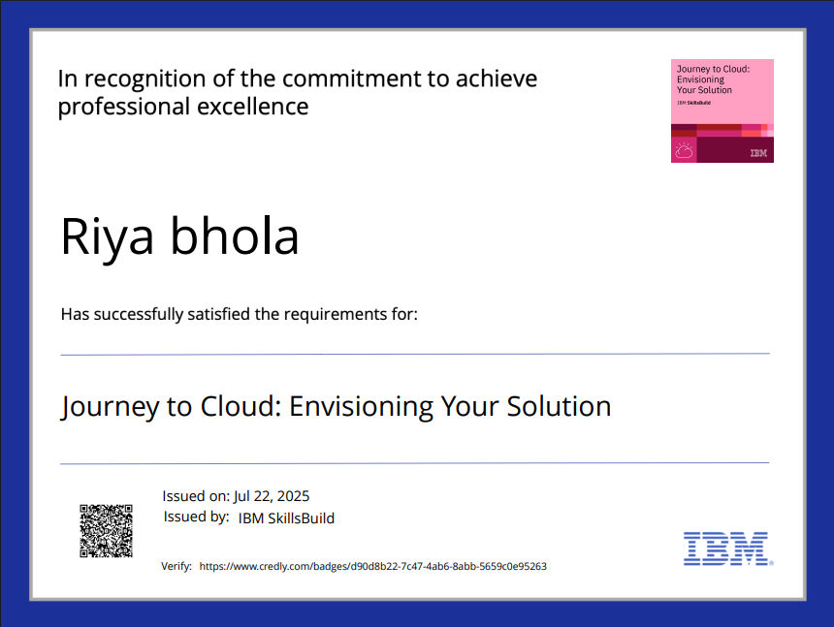
IBM Certifications

Slide 14
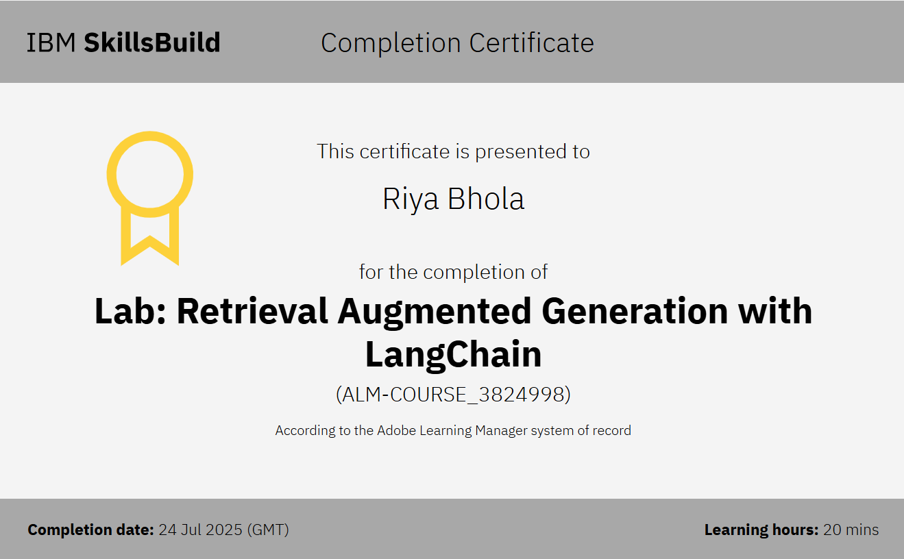
IBM Certifications

Slide 15
THANK YOU

