Slide 1
BlinkIT Grocery Sales & Performance
Dashboard
Power BI Dashboard
- By Riya Nemade.

Slide 2
Project Overview
Objective:
To analyze BlinkIT grocery sales data to uncover actionable insights that help optimize performance, identify top-selling items, Sales by outlet type, Outlet size ,Outlet Location Type and improve customer satisfaction.
Tools Used:
Power BI | DAX | SQL

Slide 3
Problem Statement
KPI:
Total Sales
Average Sales
No of Items
Average Rating
Business Requirement
Total Sales by Fat Content.
Total Sales by item Type.
Fat Content by Outlet for Total Sales.
Total Sales by Outlet Establishment.
Sales by Outlet Size.
Sales by Outlet Location

Slide 4
Dataset Summary
Columns Used:
Item type
Item Fat Content
Item Identifier
Outlet Established Year
Outlet Identifier
Outlet Location Type
Outlet Size
Outlet Type
Item Visibility
Item Weight
Sales
Rating

Slide 5
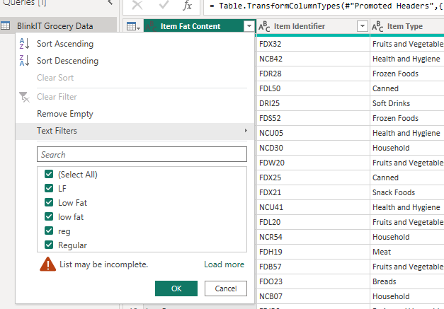
Data Cleaning
Checked for null and inconsistent values
Standardized categorical fields (like Item Fat Content)
Converted column headers and data types properly

Slide 6
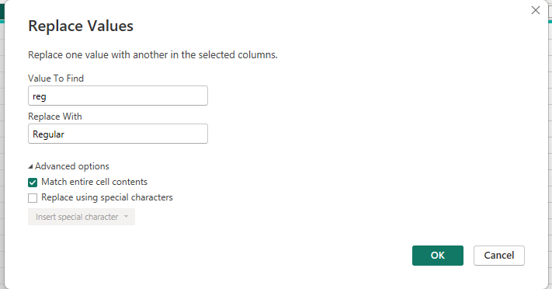
Data Cleaning
Standardized categorical fields (like Item Fat Content)
Standardizing 'reg' to 'Regular' for consistent labeling

Slide 7
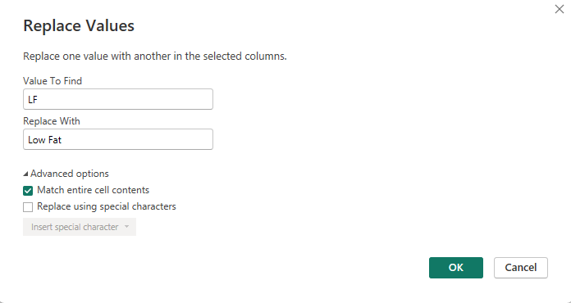
Data Cleaning
Standardized categorical fields (like Item Fat Content)
Standardizing ‘LF' to ‘Low Fat' for consistent labeling

Slide 8
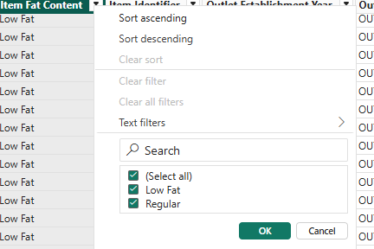
Data Cleaning
Fixing Inconsistencies in Categorical Columns
The Item Fat Content column had inconsistent labels: "low fat", "Low Fat", "LF" → all converted to ""Low Fat" "reg"→ standardized to "Regular"

Slide 9
KPI Summary (Cards in Power BI)
💰 Total Sales : 1.20M
💰 Average sales : 140.99
📦 No of items : 9K
⭐ Avg Rating : 3.92

Slide 10
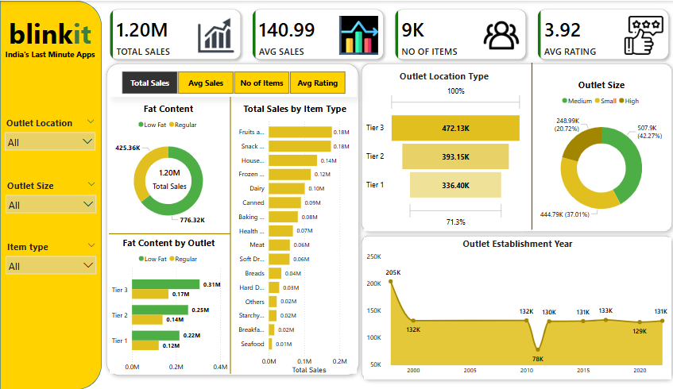
Dashboard

Slide 11
Business Insights
Supermarket Type1 generated the highest total sales of ₹1,095,000, which is:
38.6% higher than Supermarket Type3 (₹790,000)
56.7% higher than Grocery Store (₹700,000)
Fruits and Vegetable and Snacks Foods are the highest-selling categories:
Fruits and Vegetable contribute ₹1,78,124 to total sales .
Snacks contribute ₹1,75,433 .
Low Fat item has higher sell than Regular.
Tier 3 outlets outperform Tier 1 by 40.3% in Total Sales
High-size outlets generated the highest revenue of ₹507.9K (42.7% of total).
Outlet established in 2000 had highest sales: 205k
Post 2010 show consistent revenue( ~130k annually), except dip in 2011 (78k)

Slide 12
Conclusion
This Power BI dashboard provided a comprehensive analysis of outlet-level sales performance, uncovering key business insights:
Tier 3 outlets generated the highest revenue, outperforming Tier 1 by over 40%, highlighting strong sales in less urbanized markets.
High-size outlets contributed the largest share of revenue, Fruit and vegetable is the highest sell item
Outlets established in 2000 recorded peak sales (₹205K), reinforcing the value of long-standing brand presence.
Through interactive visualizations, filters, and slicers, the dashboard empowers stakeholders to make data-driven decisions around outlet expansion, size optimization, and operational improvements.

