Slide 1
Car Sales Analysis Dashboard
A Power BI Project – Data-Driven Insights for Automotive Growth
- By Riya Nemade

Slide 2
Project Objective & Tools
🎯 Objective:
The objective of this dashboard is to analyze year-to-date car sales to uncover performance trends, evaluate sales by brand, region, body type, and customer preference. The dashboard provides actionable insights to help improve dealership targeting, optimize inventory, and boost profitability.
🛠️Tools:
Power BI | Power Query | DAX | Excel

Slide 3
Business Problems
Which car brands generate the most sales?
Which body styles and colors are most preferred?
Which regions have the highest car sales?
What are the average price and units sold per brand?
What are weekly sales trends telling us?

Slide 4

📊 Year-to-Date KPI Summary
DAX Formula
💰 YTD Total Sales = TOTALYTD(SUM(car_data[Price($)]),
'Calendar'[Date])
📈 YOY Sales Growth =
[Sales Difference]/[PYTD Total Sales]
⚖️ Sales Difference =
[YTD Total Sales]-[PYTD Total Sales]
📅 MTD Sales = TOTALMTD(SUM(car_data[Price ($)]),'Calendar'[Date])
Insights: YTD Sales reached $371.2M with a 23.59% increase from last year and sale difference is 70.84M of previous Year — reflecting strong growth momentum in the automotive sector.”

Slide 5

📊 Year-to-Date KPI Summary
DAX Formula
💵 YTD Avg Price =
TOTALYTD([Avg Price],'Calendar'[Date])
📈 YOY Avg Price Growth =
[Avg Price Diff]/[PYTD Avg Price]
⚖️ Avg Price Diff =
[YTD Avg Price]-[PYTD Avg Price]
📅 MTD Avg Price =
TOTALMTD([Avg Price],'Calendar'[Date])
Insights: The average selling price YTD is $28K, slightly down by 0.79%, indicating a shift toward Low

Slide 6

📊 Year-to-Date KPI Summary
DAX Formula
🚗 YTD Cars Solds = TOTALYTD(COUNT(car_data[Car_id]),
'Calendar'[Date])
📈 YOY Cars Sold =
[Cars Sold Diff]/[YTD Cars Solds]
⚖️ Cars Sold Diff =
[YTD Cars Solds]-[PYTD Cars Sold]
📅 MTD Cars Sold = TOTALMTD(COUNT(car_data[Car_id]),
'Calendar'[Date])
Insights: Car unit sales reached 13.3K with 19.73% YoY growth. Monthly sales (MTD) are 1.92K.— showing rising demand Year On Year

Slide 7
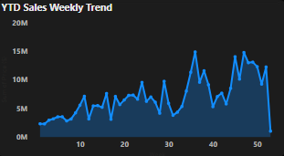
📈 Weekly Sales Trend Analysis
📌 Insights: Peak weekly sales exceeded $14M in Week 36. Sales show a positive seasonal pattern, peaking around mid-year.

Slide 8
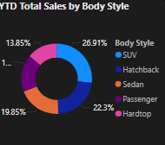
🚘 Top-Selling Car Body Styles
📌 Insights:SUVs lead the market share, followed by Sedans and Hatchbacks. SUVs account for 26.91% of total sales

Slide 9
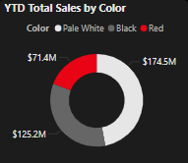
🎨 Preferred Car Colours
📌 Insights: Pale White dominates, contributing over $174.5M of all car sales. Red is least preferred.

Slide 10
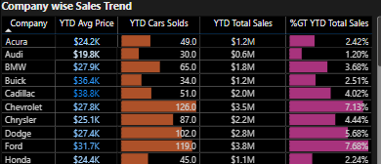
🏆Top Car Brands by Sales
📌 Insights: Chevrolet leads in highest car sold. Cadillac had high average selling price but lower units sold with lower total sales. Ford had high in all like Avg price , car sold and total revenue also.

Slide 11
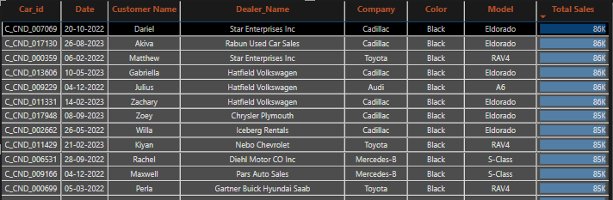
🚗 High-Value Car Sales Overview
📌 Insights:The Cadillac Eldorado appears 5 times among top transactions, all priced at $86K or $85K.
All Top Selling cars listed were sold in Black color.

Slide 12
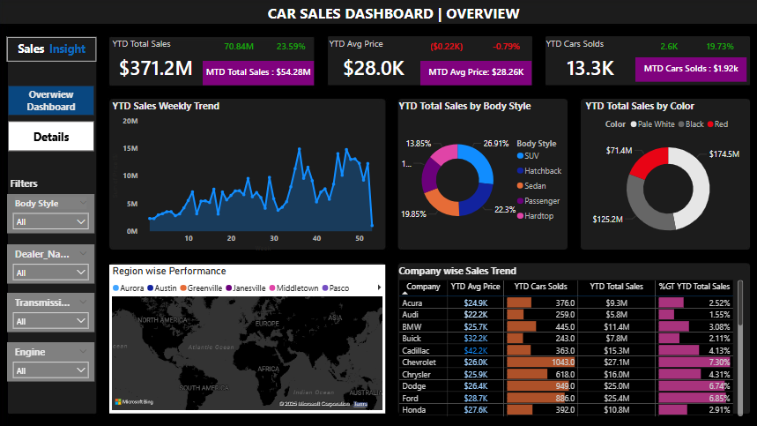
Dashboard

Slide 13
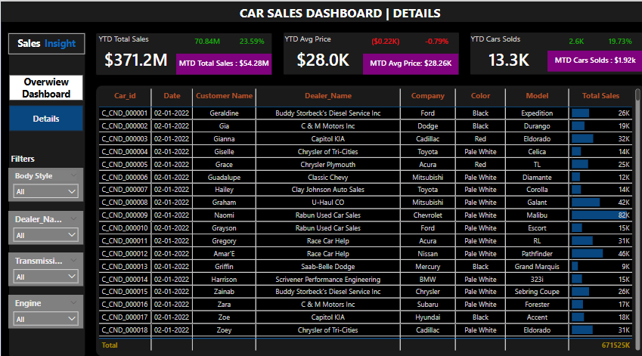
Dashboard

Slide 14
💡Business Insights
SUVs lead with 26.91% market share.
Pale White is the most preferred color (47.02%), while 100% of high-value cars were sold in black.
Week 36 is the high sale week in year.
Ford & Chevrolet lead highest sales and car sold.
Star Enterprises inc was the leading dealer with 86K highest Total Revenue.

Slide 15
Conclusion
The Car Sales Analysis Dashboard provided a 360° view of automotive sales performance using interactive Power BI visuals and KPIs. Through this project, we uncovered critical business insights across brands , Colour, regions, and customer behavior patterns.

