Slide 1
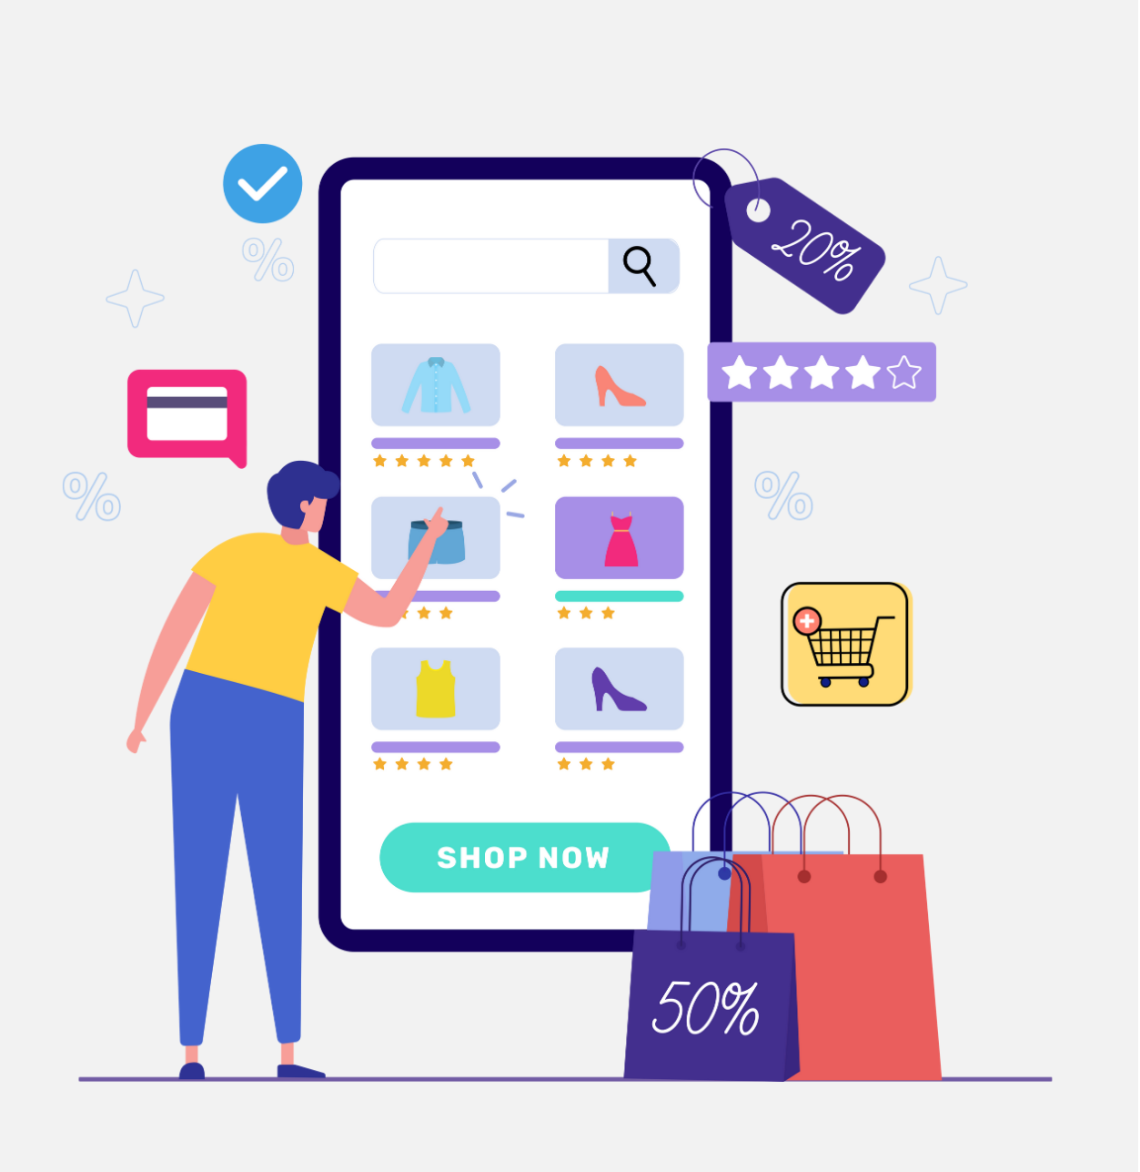

Case Study-Fashion
E-commerce Sales Analysis
Riya Hemant Nemade
Data Analyst

Slide 2
Agenda
Introduction
Market Growth
Project Objective
Problem Statement
Data Overview
Insights
Recommendations

Slide 3

Introduction
Fashion is not just a product—it's an experience, an expression of identity, and one of the fastest-evolving global industries. With digital transformation, the fashion industry has seen a massive shift toward online shopping, driven by convenience, affordability, and variety.
👗 Why This Analysis is Important
Fast Adoption: Consumers today are more trend-conscious and make quick purchase decisions through online platforms.
Convenience First: Online platforms like Flipkart, Amazon, and Myntra offer home delivery, easy returns, and size filters, making fashion accessible to every household.
Competitive Edge: For fashion retailers, understanding customer behavior, seasonal trends, and channel performance is critical to staying ahead of the curve.

Slide 4

Market Growth
The Indian online fashion market is projected to grow at 18–20% CAGR, reaching ₹2.5 lakh crores by 2027.
More than 50% of Gen Z and millennials shop fashion online at least once a month.
Return and refund trends directly affect profit margins, hence monitoring them is key.
🛍️ Customer Perspective
Personalized recommendations
Quick delivery & easy return
Trendy and budget-friendly options

Slide 5
Project Objective
The objective of this analysis is to explore and interpret sales data from multiple fashion e-commerce platforms for the year 2023, covering both men’s and women’s product categories. By identifying high-performing segments, seasonal patterns, and platform-specific trends, this project aims to generate actionable insights that can optimize sales planning, reduce returns, and guide targeted marketing strategies for 2024.

Slide 6

Problem Statement
The fashion e-commerce industry is booming, but rising competition, shifting customer preferences, and high return rates are making it harder for brands to stay ahead. In 2023, with countless orders across platforms, categories, and regions, key questions emerged: Which products truly drive revenue? What triggers returns? When do sales peak — and why do they dip?
Without clear visibility into customer behavior and sales trends, brands risk making decisions in the dark. This analysis aims to uncover what worked (and what didn’t) in 2023 to help fashion retailers plan smarter and grow stronger in 2024.

Slide 7
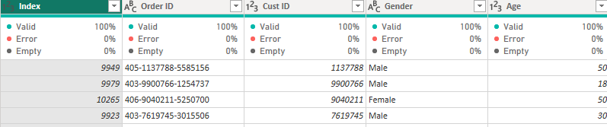
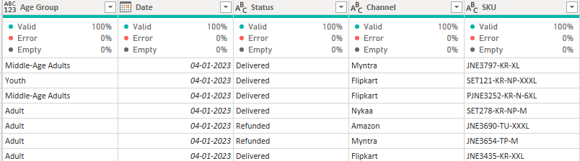
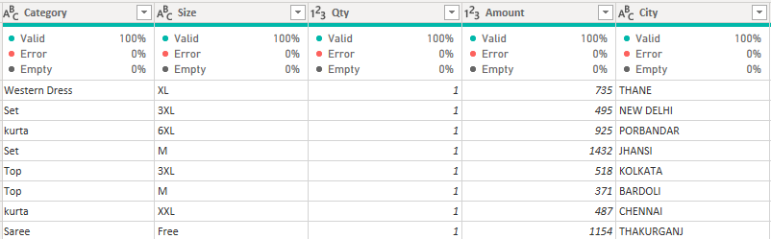
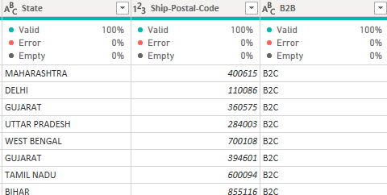
Data Overview
📊 Total Records: 30,000+ transaction-level entries
📁 Key Columns:

Slide 8
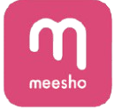

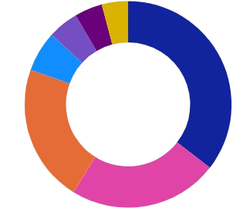





Market Share of Top Fashion E-commerce Platforms
4.38%
4.1%
Other
Amazon dominates the online fashion space with a 35.5% share, followed by Myntra (23.3%) and Flipkart (21.6%).
This indicates that the top 3 platforms collectively capture over 80% of the market, making them key players for targeted fashion sales strategies.
4.79%
35.5%
6.29%
21.6%
23.3%

Slide 9
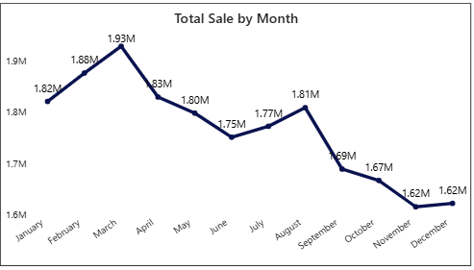
Monthly Sales Fluctuation Pattern
Sales peaked in March at ₹1.93M, followed by a slight dip in April.
August saw a mild recovery at ₹1.81M, but a steady decline from September to December hints at seasonality or lower consumer demand in the latter half of the year.

Slide 10


Gender-wise Online Fashion Engagement
Women lead online fashion shopping, making up 64.05% of the user base, compared to 35.95% male users.
This highlights a significant gender trend, prompting brands to tailor more female-focused campaigns and collections for better engagement.
35.95%
64.05%

Slide 11

Sales Contribution by Age Category
Adults between 25–40 are clearly our top buyers, contributing over 40% of total sales.
Middle-aged customers also hold strong at 30%, while the younger group shows potential.
Senior customers make up the smallest share, but that also means an opportunity to reach an underserved segment.
Youth
17.43%
Adult
40.32%
Middle-Age
30.12%
Senior
12.13%

Slide 12
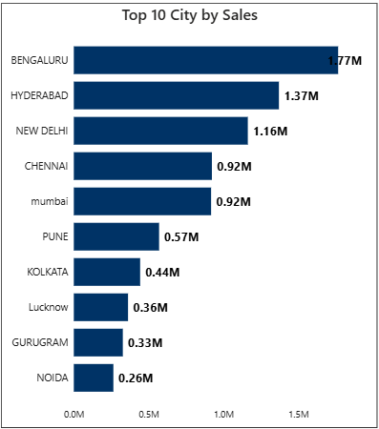
City-wise Sales Performance:
Top 10 Contributors
Bengaluru clearly leads the way with ₹77M in sales, showing a strong customer base and demand.
New Delhi (₹1.61M) and Hyderabad (₹1.37M) follow, reflecting consistent urban engagement.
Meanwhile, cities like Pune, Kolkata, and Noida have room to grow—opening doors for future expansion and localized marketing efforts.

Slide 13
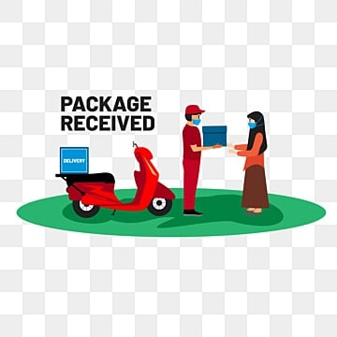
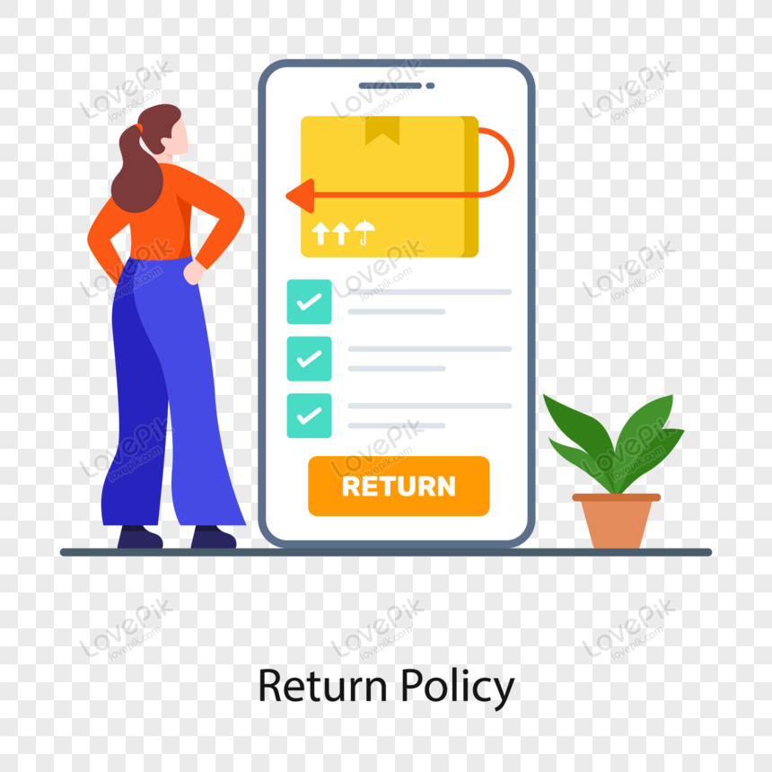

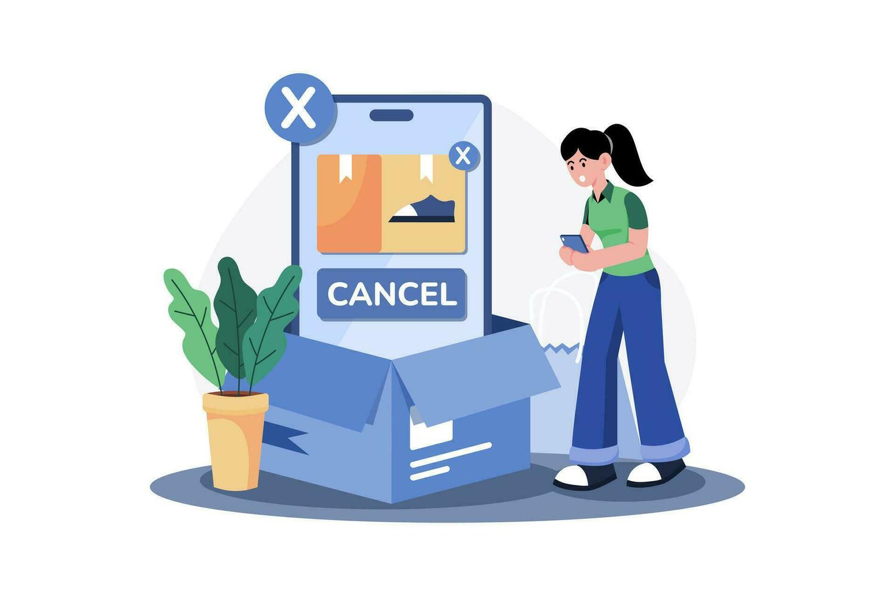
From Cart to Customer: Order Status Summary
The majority of orders were successfully delivered(93%), reflecting strong operational efficiency.
Returns (3.4%) and cancellations (2.28%) remain minimal, while refunds are very rare at just 1.25%, indicating overall customer satisfaction.
Delivered
93.08%
Returned
3.4%
Refunded
1.25%
Cancelled
2.28%

Slide 14

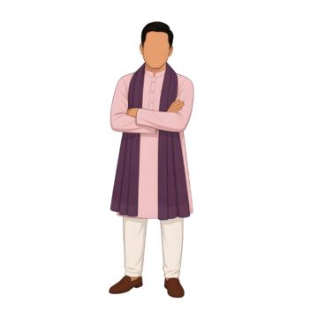

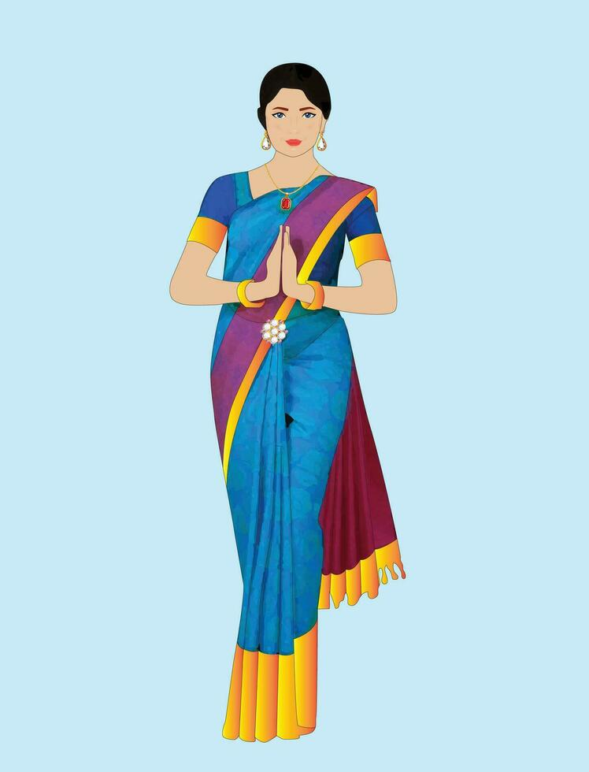
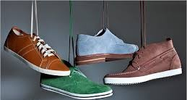


Best-Selling Fashion Categories
Ethnic sets and kurtas are the top choices, making up over 70% of total sales.
Western dresses are picking up pace, while jeans and footwear see lower demand.
Kurta
23.42%
Western Dress
14.87%
Set
49.62%
Saree
4.77%
Jeans
1.27%
Footwear
1.07%
Top
5.6%

Slide 15
Insights
Adults (26–45 years) account for the highest share of sales (40.32%), followed by Middle-aged (30.12%), Young (17.43%), and Seniors (12.13%).
Sets (49.62%) and Kurtas (23.42%) dominate overall sales. Categories like Jeans and Footwear have significantly lower traction.
Most orders are successfully delivered (93.08%), but returns (3.4%), refunds (1.25%), and cancellations (2.28%) indicate post-order issues
Sales steadily increase from January to March, then drop during April to July, pick up slightly in August, and decline again from September onwards.
Bengaluru leads all cities by a wide margin, followed by Hyderabad and Delhi. Smaller cities like Surat, Lucknow, and Pune also show growing interest.
Female shoppers accounted for 65% of total revenue.

Slide 16

Recommendation
Prioritize best-selling categories (Sets, Kurtas) in stock planning, marketing, and homepage features.
Monitor return/cancellation trends monthly and work on improving post-order experience.
Localize marketing strategies like Localized campaigns and faster delivery in top cities can maximize returns.
Leverage customer demographics (age, city, gender) for targeted ad strategies and loyalty offers.
Align seasonal campaigns with peak sales months and Plan major launches, influencer collaborations and discounts around these high-traffic months.

Slide 17
Thank You!

