Slide 1

Electric Vehicle Market Analysis
Presented By – Riya Nemade

Slide 2

Project Overview
The rise of Electric Vehicles (EVs) represents a major shift in the automotive industry — driven by environmental concerns, government incentives, and the push toward sustainable mobility. As EV adoption grows, understanding market trends becomes essential for manufacturers, policymakers, and service providers.
This project aims to analyze real-world EV registration data to identify meaningful patterns in vehicle adoption, geographic distribution, battery range performance, pricing trends, and brand competitiveness.

Slide 3
Project Workflow
Understanding the Problem
Data Cleaning & Preprocessing
Dashboard Design in Excel
PPT Presentation
SQL Validation
Insight Extraction

Slide 4
Tools & Technologies Used
Excel:
Power Query for data cleaning.
Pivot Tables for analysis.
Slicers, KPIs, charts, and formatting for dashboard visuals.
SQL:
Used for validating data analysis logic.
SELECT, GROUP BY, CASE and filters to extract insights.
Presentation:
Power Point.

Slide 5

Let’s Dive into Business Insights

Slide 6

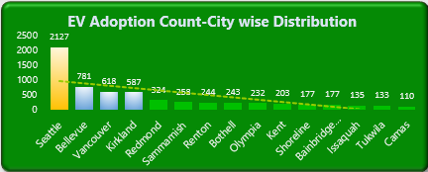


Which Cities Are Leading the EV Movement?
Insights :-
Seattle alone accounts for 33% of total EV registrations showing a strong urban shift. EV companies can prioritize such high-adoption zones for faster scaling.
Recommendation :-
Brands and service providers should keep expanding in high-performing cities like Seattle. But to reach wider audiences, they should launch awareness campaigns or EV trial programs in underperforming regions.

Slide 7

Clean Fuel Eligibility: Are EVs Aligned with Policy Goals?
Insights :-
Only 4 out of every 10 EVs in this dataset qualify for clean fuel programs meaning nearly 60% may be missing out on incentives. This points to either policy mismatch or a need for better dealership support.
Recommendation :-
There’s a need to simplify the eligibility process. EV companies, dealerships, and government bodies should work together to help buyers understand the benefits and get them registered correctly.

Slide 8
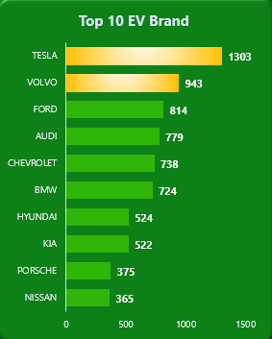
Which EV Brands Are Winning the Market?
Insights :-
Tesla accounts for over 18% of EV registrations, followed by Volvo, Ford, and Chevrolet. The brand’s early entry and reputation clearly give it a market advantage.
Recommendation :-
Old fuel-based car companies need to move faster if they want to stay in the game. Meanwhile, new and growing EV brands have a great chance to grow by offering better prices, longer battery life, and smart features that people are now looking for.

Slide 9
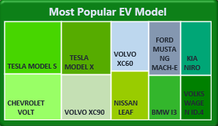
Top Performing EV Models: Which Ones Drive Demand?
Insights :-
Tesla Model S and Model X dominate in popularity, but newer models from Ford and Kia are also picking up — which shows customers are open to exploring new options.
Recommendation :-
Car dealers and online EV platforms should promote variety. Offering comparisons, customer reviews, and budget-friendly filter options can help buyers make confident choices and open up space for newer models to grow.

Slide 10

Is the Current EV Range Enough for Everyday Use?
Insights :-
Most EVs offer an average range of just 54 km, showing they’re mainly used for city driving. This could limit long-distance travel unless supported by better charging infrastructure.
Recommendation :-
This opens up opportunities for EV-based delivery services, shared mobility, and city ride-hailing apps. At the same time, manufacturers should keep improving battery range to make EVs practical for longer trips too.

Slide 11
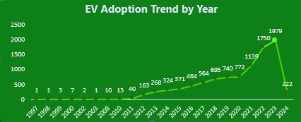
EV Adoption Trends (1997–2024): Growth, Peak & Market Shifts
Insights :-
There’s steady growth in EV adoption from 2018 to 2023, but a dip in 2024. It might be linked to global supply chain issues or temporary policy slowdowns.
Recommendation :-
Companies should use this slowdown to build stronger infrastructure, diversify battery sourcing and push for supportive local policies.

Slide 12

Are EVs Truly Affordable?
Insights :-
The average listed MSRP is $3,688, which appears too low. Even so, over 80% of vehicles fall into the ‘Below 30K’ category, proving affordability is driving adoption.
Recommendation :-
Companies should ensure complete and accurate price data. Meanwhile, manufacturers should continue focusing on value-for-money models, which are driving adoption in cost-sensitive markets.

Slide 13
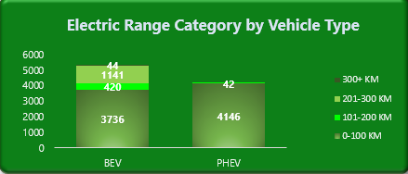
Is the Current EV Range Sufficient for Consumer Needs?
Insights :-
BEVs (Battery Electric Vehicles) dominate the lower range category (0–100 km), especially compared to PHEVs. Very few vehicles cross the 300 km range threshold.
Recommendation :-
Most EVs are suitable only for city commutes. Manufacturers and policymakers should invest in extending range capacity and educating users on charging options to make EVs viable for longer travel.

Slide 14
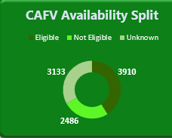
How Effectively Are EVs Aligned with Clean Fuel Policies?
Insights :-
A large portion of vehicles either don’t qualify or have unknown eligibility for Clean Alternative Fuel Vehicle (CAFV) programs.
Recommendation :-
This shows a gap in awareness or documentation. Government agencies should collaborate with manufacturers and dealerships to ensure proper classification and better communication about benefits to EV buyers.

Slide 15
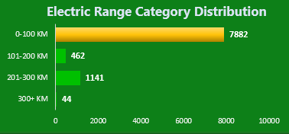
Majority of EVs Offer Short Range
Insights :-
Nearly 80% of EVs fall into the 0–100 km category. Longer-range EVs are still rare in the current population.
Recommendation :-
This trend could slow wider EV adoption. Businesses working on EVs must strategically plan for range and support users with city-specific charging infrastructure.

Slide 16
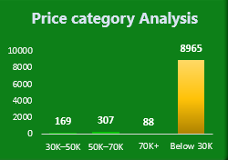
EV Affordability : Pricing Trend & Segment Focus
Insights :-
Most EVs are priced below $30,000, showing a strong push toward affordability likely due to subsidies or local manufacturing efforts.
Recommendation :-
Companies should continue targeting this segment while offering a few premium models. EV manufacturers should also explore installment or leasing options to capture a price-sensitive audience.

Slide 17
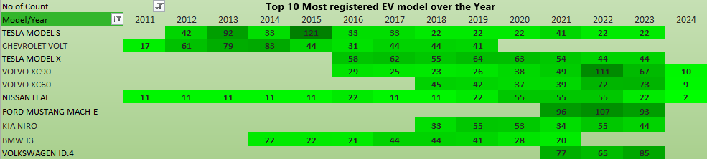
Which EV Models Are Driving Market Demand Each Year ?
Insights :-
Tesla Model S consistently tops the chart, followed by Chevrolet Volt and other early-mover models like Nissan Leaf and BMW i3. There's a visible increase post-2018 in newer entries like Ford Mach-E and Kia Niro.
Recommendation :-
This trend confirms Tesla's brand strength and reveals rising competition. Car dealers should expand inventory of these fast-moving models and track year-wise popularity to manage stock effectively.

Slide 18
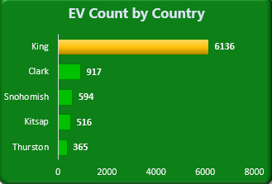
Where Should EV Businesses Expand Most?
Insights :-
King County has the highest EV adoption, with massive lead over others. Clark and Snohomish follow but are far behind.
Recommendation :-
Companies looking to set up charging stations or EV showrooms should prioritize King County and expand marketing efforts in low-performing counties like Thurston and Kitsap.

Slide 19

Thank You

