Slide 1
NSW Government Virtual Internship Program
Data Analysis Case Study
Analyse workforce data and report on trends in part-time working.
Riya Saji Mathew

Slide 2

Objectives
The objective of this study is to analyse the following:
Trends over time in male and female employment, including any notable changes.
The current representation of part time employees in the sector and in each Cluster.
The current representation of male and female part time employees as a proportion of the respective male and the female workforce in the sector and in each cluster.
Change in these two above statistics over the last 4 years.
Projection of what the representation will be by 2025 if the current trends continue

Slide 3
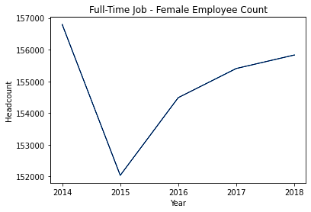
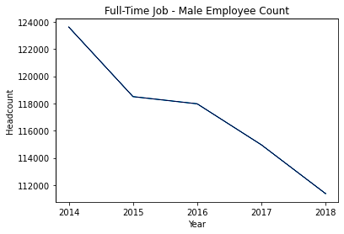
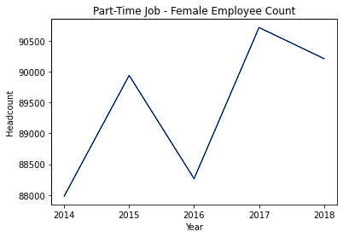
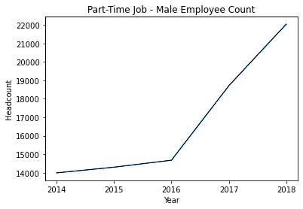
Trends over time in Male & Female Employment
Full-time employment demonstrates higher prevalence compared to part-time positions over the years.
Part-time employment experienced a steady increase for both men and women over the years.
Male full-time employment witnessed a significant decrease, whereas male part-time employment exhibited a remarkable increase over the years.

Slide 4
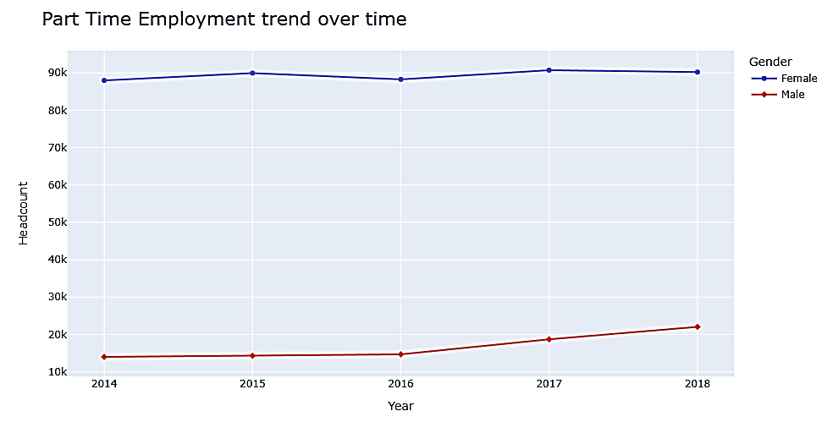
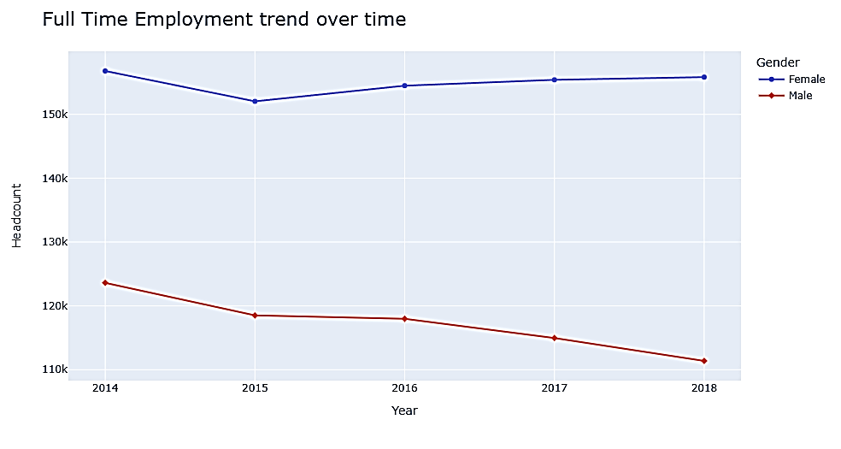
Trends over time in Full-Time & Part-Time Employment
Female employees outnumbered male employees in both full-time and part-time employment, indicating higher female representation.
Male part-time employment showed an increase over time, while full-time employment declined.
The data reveals a trend of higher female representation in the workforce and a shift towards more males opting for part-time positions.

Slide 5
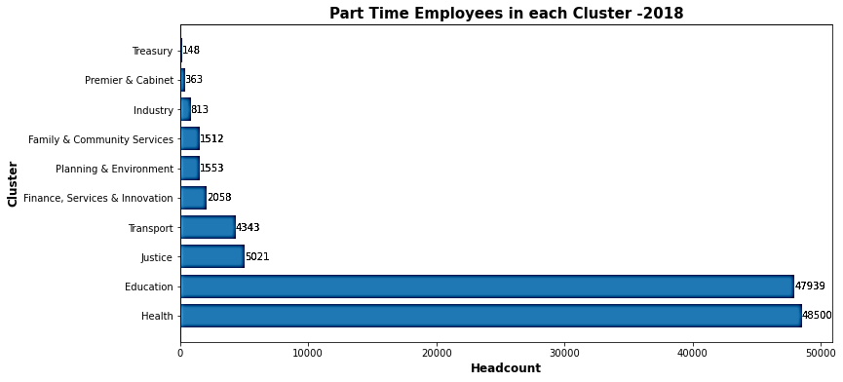
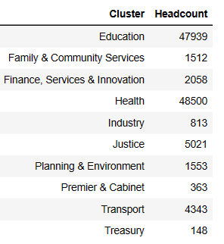
Part-Time Employee Count per Cluster
In 2018, the Health sector exhibited the highest number of part-time employees, with the Education sector following closely behind.
Conversely, the Treasury sector demonstrated the lowest count of part-time employees during the same year.

Slide 6
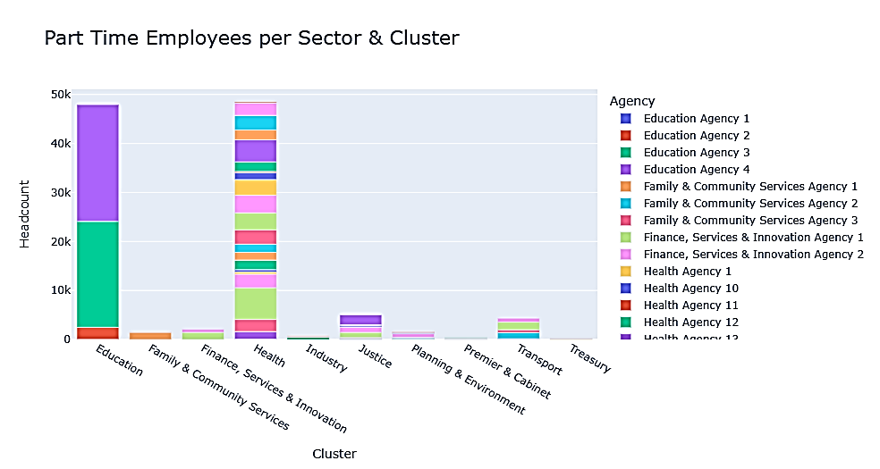
Part-Time employees in the sector and in each Cluster
The Health sector stands out as the primary employer of part-time workers, with the Education sector closely trailing behind.
Additionally, the Health sector comprises a larger number of agencies that employ part-time workers compared to other sectors.
These findings underscore the prominent role of the Health sector in offering part-time employment opportunities and its significant presence in terms of agency-based part-time employment.

Slide 7
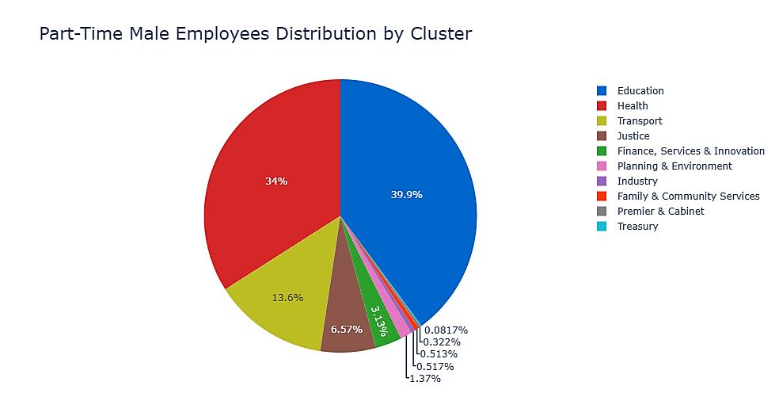
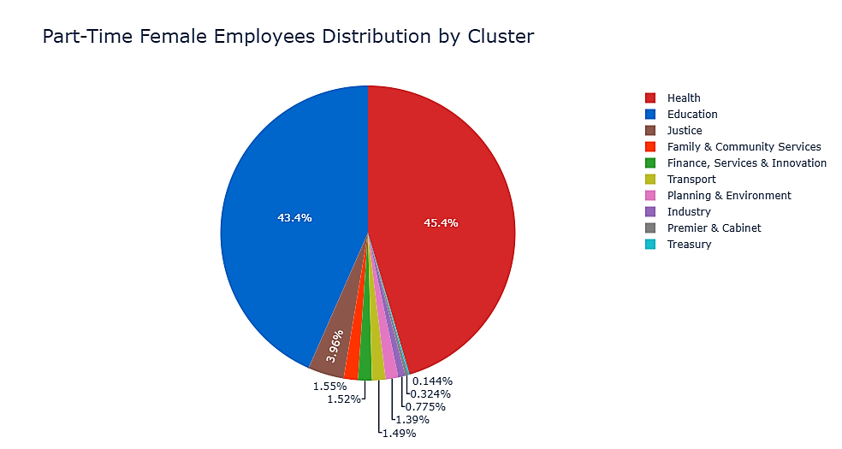
Male v/s Female Part Time Distribution by Cluster
Education sector: 39.9% male part-time employees, highest representation.
Health sector: 34% male-part time employees, significant presence.
Treasury sector: 0.0817% male [art-time employees, lowest proportion.
Health sector: Highest female part-time employment (45.4%), followed by Education sector (43.4%).
Treasury sector: Lowest female part-time employment (0.144%).
Significant concentration of female part-time workers in Health and Education sectors.

Slide 8
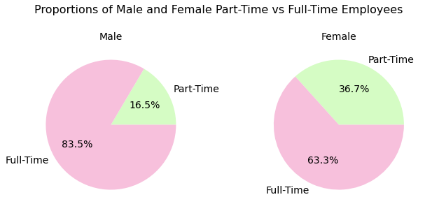

Male v/s Female Employment
Full-time employment: Male employees comprise 83.5%, while female employees account for 63.3%.
Part-time employment: Male employees represent 16.5%, whereas female employees make up 36.7%.
Full-time work has a higher headcount compared to part-time work in both cases.
Female employees have a greater presence in part-time positions, while males are more prevalent in full-time roles.

Slide 9
Change in part time & full time employee statistics over the last 4 years.
Across various sectors, part-time employment has shown both increasing and decreasing trends over the years.
Female employees generally outnumbered males in part-time positions, indicating potential gender imbalances in workforce distribution.
The fluctuations observed in some sectors suggest a need for careful workforce planning and management to address the changing demands.
The steady increase in part-time jobs in certain sectors indicates positive growth opportunities for flexible employment options.

Slide 10
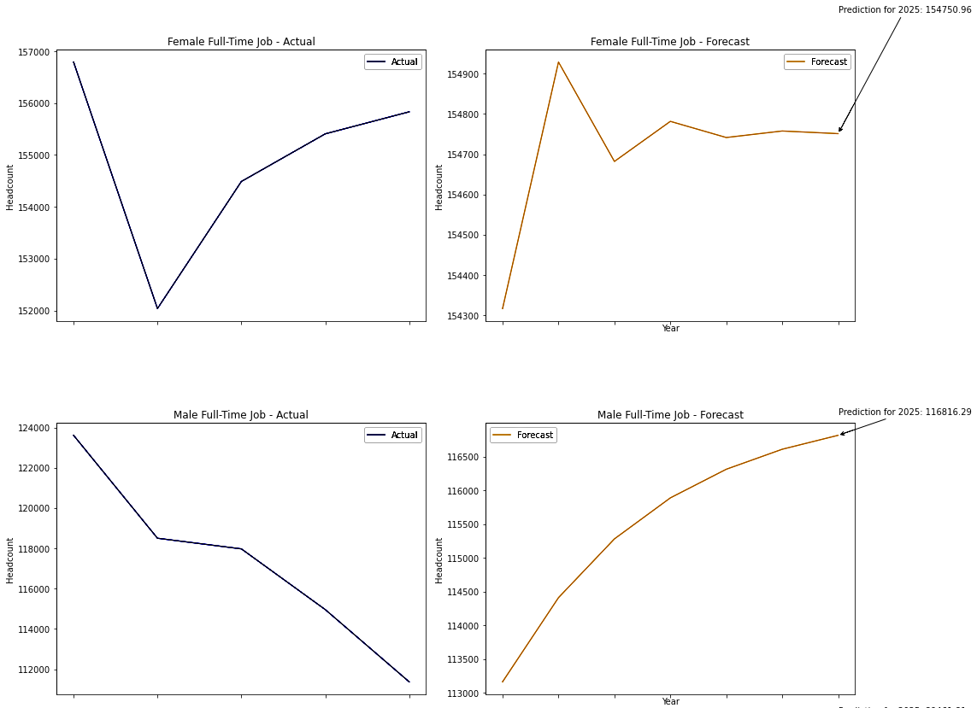
Projection of what the representation will be by 2025 if the current trends continues
Female full-time job predicted to decline: 157,000 (2014) ➔ 154,750.96 (2025).
Fluctuating trend: 154,300 (2019) ➔ 154,950 (2020) ➔ 154,700 (2021) ➔ 154,750 (2022).
Stable from 2022 to 2025 around 154,750.96.
Male full-time job declines: 124,000 (2014) ➔ 112,000 (2018).
Predicted increase: 112,000 (2018) ➔ 116,816.29 (2025).
Steady rise: 113,000 (2019) ➔ 116,816.29 (2025).

Slide 11
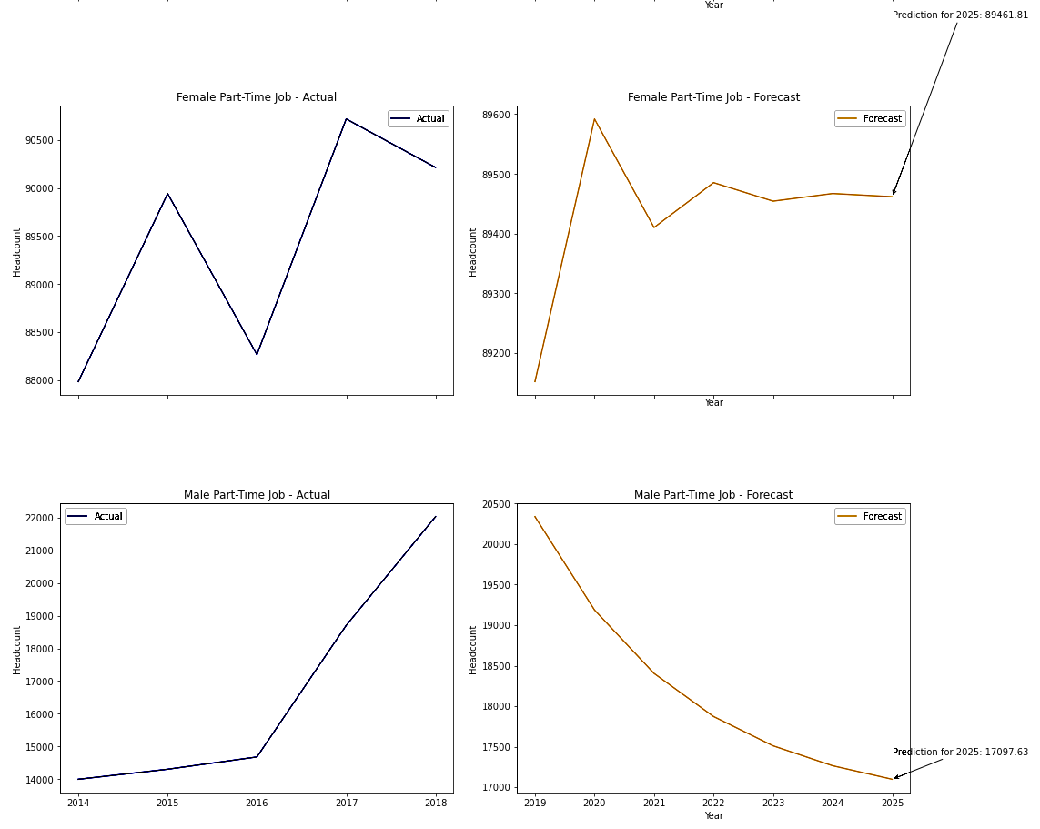
Female part-time job opportunities increased from 87,983 in 2014 to 90,216 in 2018.
A slight decline was observed in 2019, with numbers dropping to 89,000.
Subsequently, the trend fluctuated, reaching 89,600 in 2020 and then decreasing to 89,400 in 2021.
The figures are expected to stabilize around 89,450 and then settle at 89,461.81 in 2025.
Male part-time jobs increased from 14,000 in 2014 to 22,000 in 2018.
Predicted to decline steadily, reaching 17,097.63 by 2025.
Overall, a downward trend in male part-time employment.

Slide 12
Results
1. Employment Trends:
Across different sectors, full-time employment remains dominant, but there is a steady and consistent increase in part-time positions. This suggests a growing interest in flexible work arrangements to accommodate diverse employee needs.
2. Gender Representation:
Female employees consistently outnumbered male employees in both full-time and part-time positions. This highlights the need to promote gender equality and address potential gender imbalances in the workforce.
3. Part-Time Employment:
The Health sector emerged as a significant employer of part-time workers, indicating a focus on offering flexible job opportunities. Conversely, the Treasury sector demonstrated the lowest count of part-time employees, suggesting a potential area for improving workforce utilization.

Slide 13
4. Predictions:
Female full-time job: The data indicates a slight decline from 157,000 in 2014 to 154,750.96 in 2025, with fluctuations in intervening years (154,300 in 2019, 154,950 in 2020, 154,700 in 2021, and 154,750 in 2022).
Male full-time job: A significant decline is predicted, from 124,000 in 2014 to 112,000 in 2018, with a steady increase projected to 116,816.29 in 2025 (113,000 in 2019, 116,816.29 in 2025).
Female part-time job: The opportunities increased from 87,983 in 2014 to 90,216 in 2018. The data indicates fluctuations, with a slight decline in 2019 (89,000) and subsequent variations (89,600 in 2020, 89,400 in 2021). The data predicts a stabilization at around 89,450 and then settling at 89,461.81 in 2025.
Male part-time job: Opportunities increased from 14,000 in 2014 to 22,000 in 2018. The data predicts a steady decline to 17,097.63 in 2025.
Overall, these insights highlight the importance of continuous monitoring, strategic planning, and gender-inclusive policies to ensure a balanced and diverse workforce representation in various sectors. The findings indicate potential growth opportunities in part-time employment and emphasize the significance of addressing gender disparities to promote workforce diversity and equity.

