Slide 1


Microsoft Power BI

Slide 2
Home
Project Statement Context:
Blinkit, a quick-commerce platform, enables users to order groceries and essentials for delivery in minutes. For businesses operating at this scale, effective data management and visualization are crucial for monitoring performance, identifying trends, and optimizing operations.
Managing and analyzing a large volume of data related to orders, inventory, delivery times, customer feedback, and operational metrics can be overwhelming. Without a centralized dashboard, decision-making becomes inefficient, impacting overall performance and customer satisfaction.
Develop a comprehensive dashboard to consolidate and visualize key performance indicators (KPIs) such as:
a. Number of daily/weekly/monthly orders.
b. Delivery time trends and bottlenecks.
c. Inventory status and restocking requirements.
d. Customer satisfaction ratings and feedback analysis.
e. Revenue and profit margins.
2. Enable real-time updates and dynamic filtering for interactive data exploration.
3. Provide actionable insights to improve operational efficiency and customer experience.
Challenges :
Goals:
Notes:
pageNavigator
No alt text provided
shape
No alt text provided

Slide 3
Home
Target Audience:
Expected Outcomes:
• Business stakeholders looking for high-level summaries of performance.
• Operations managers requiring granular data for process optimization.
• Data analysts and engineers exploring the backend data for advanced insights.
1. Intuitive charts and graphs (e.g., bar charts, line graphs, and pie charts) for quick understanding.
2. Drill-down capabilities for detailed data exploration.
3. Filters to segment data by time periods, regions, or product categories.
4. Export options to share reports with team members.
• A user-friendly dashboard that empowers stakeholders to make data-driven decisions.
• Increased operational efficiency through enhanced data visibility.
• A template or framework that can be adapted to similar quick-commerce businesses.
The Blinkit Dashboard Project is an excellent opportunity to learn about:
• Advanced data visualization techniques using Power BI.
• Integrating real-world datasets for meaningful analysis.
• Solving business challenges through technology and analytics.
Key Features:
Why This Project:
Notes:
pageNavigator
No alt text provided
shape
No alt text provided

Slide 4
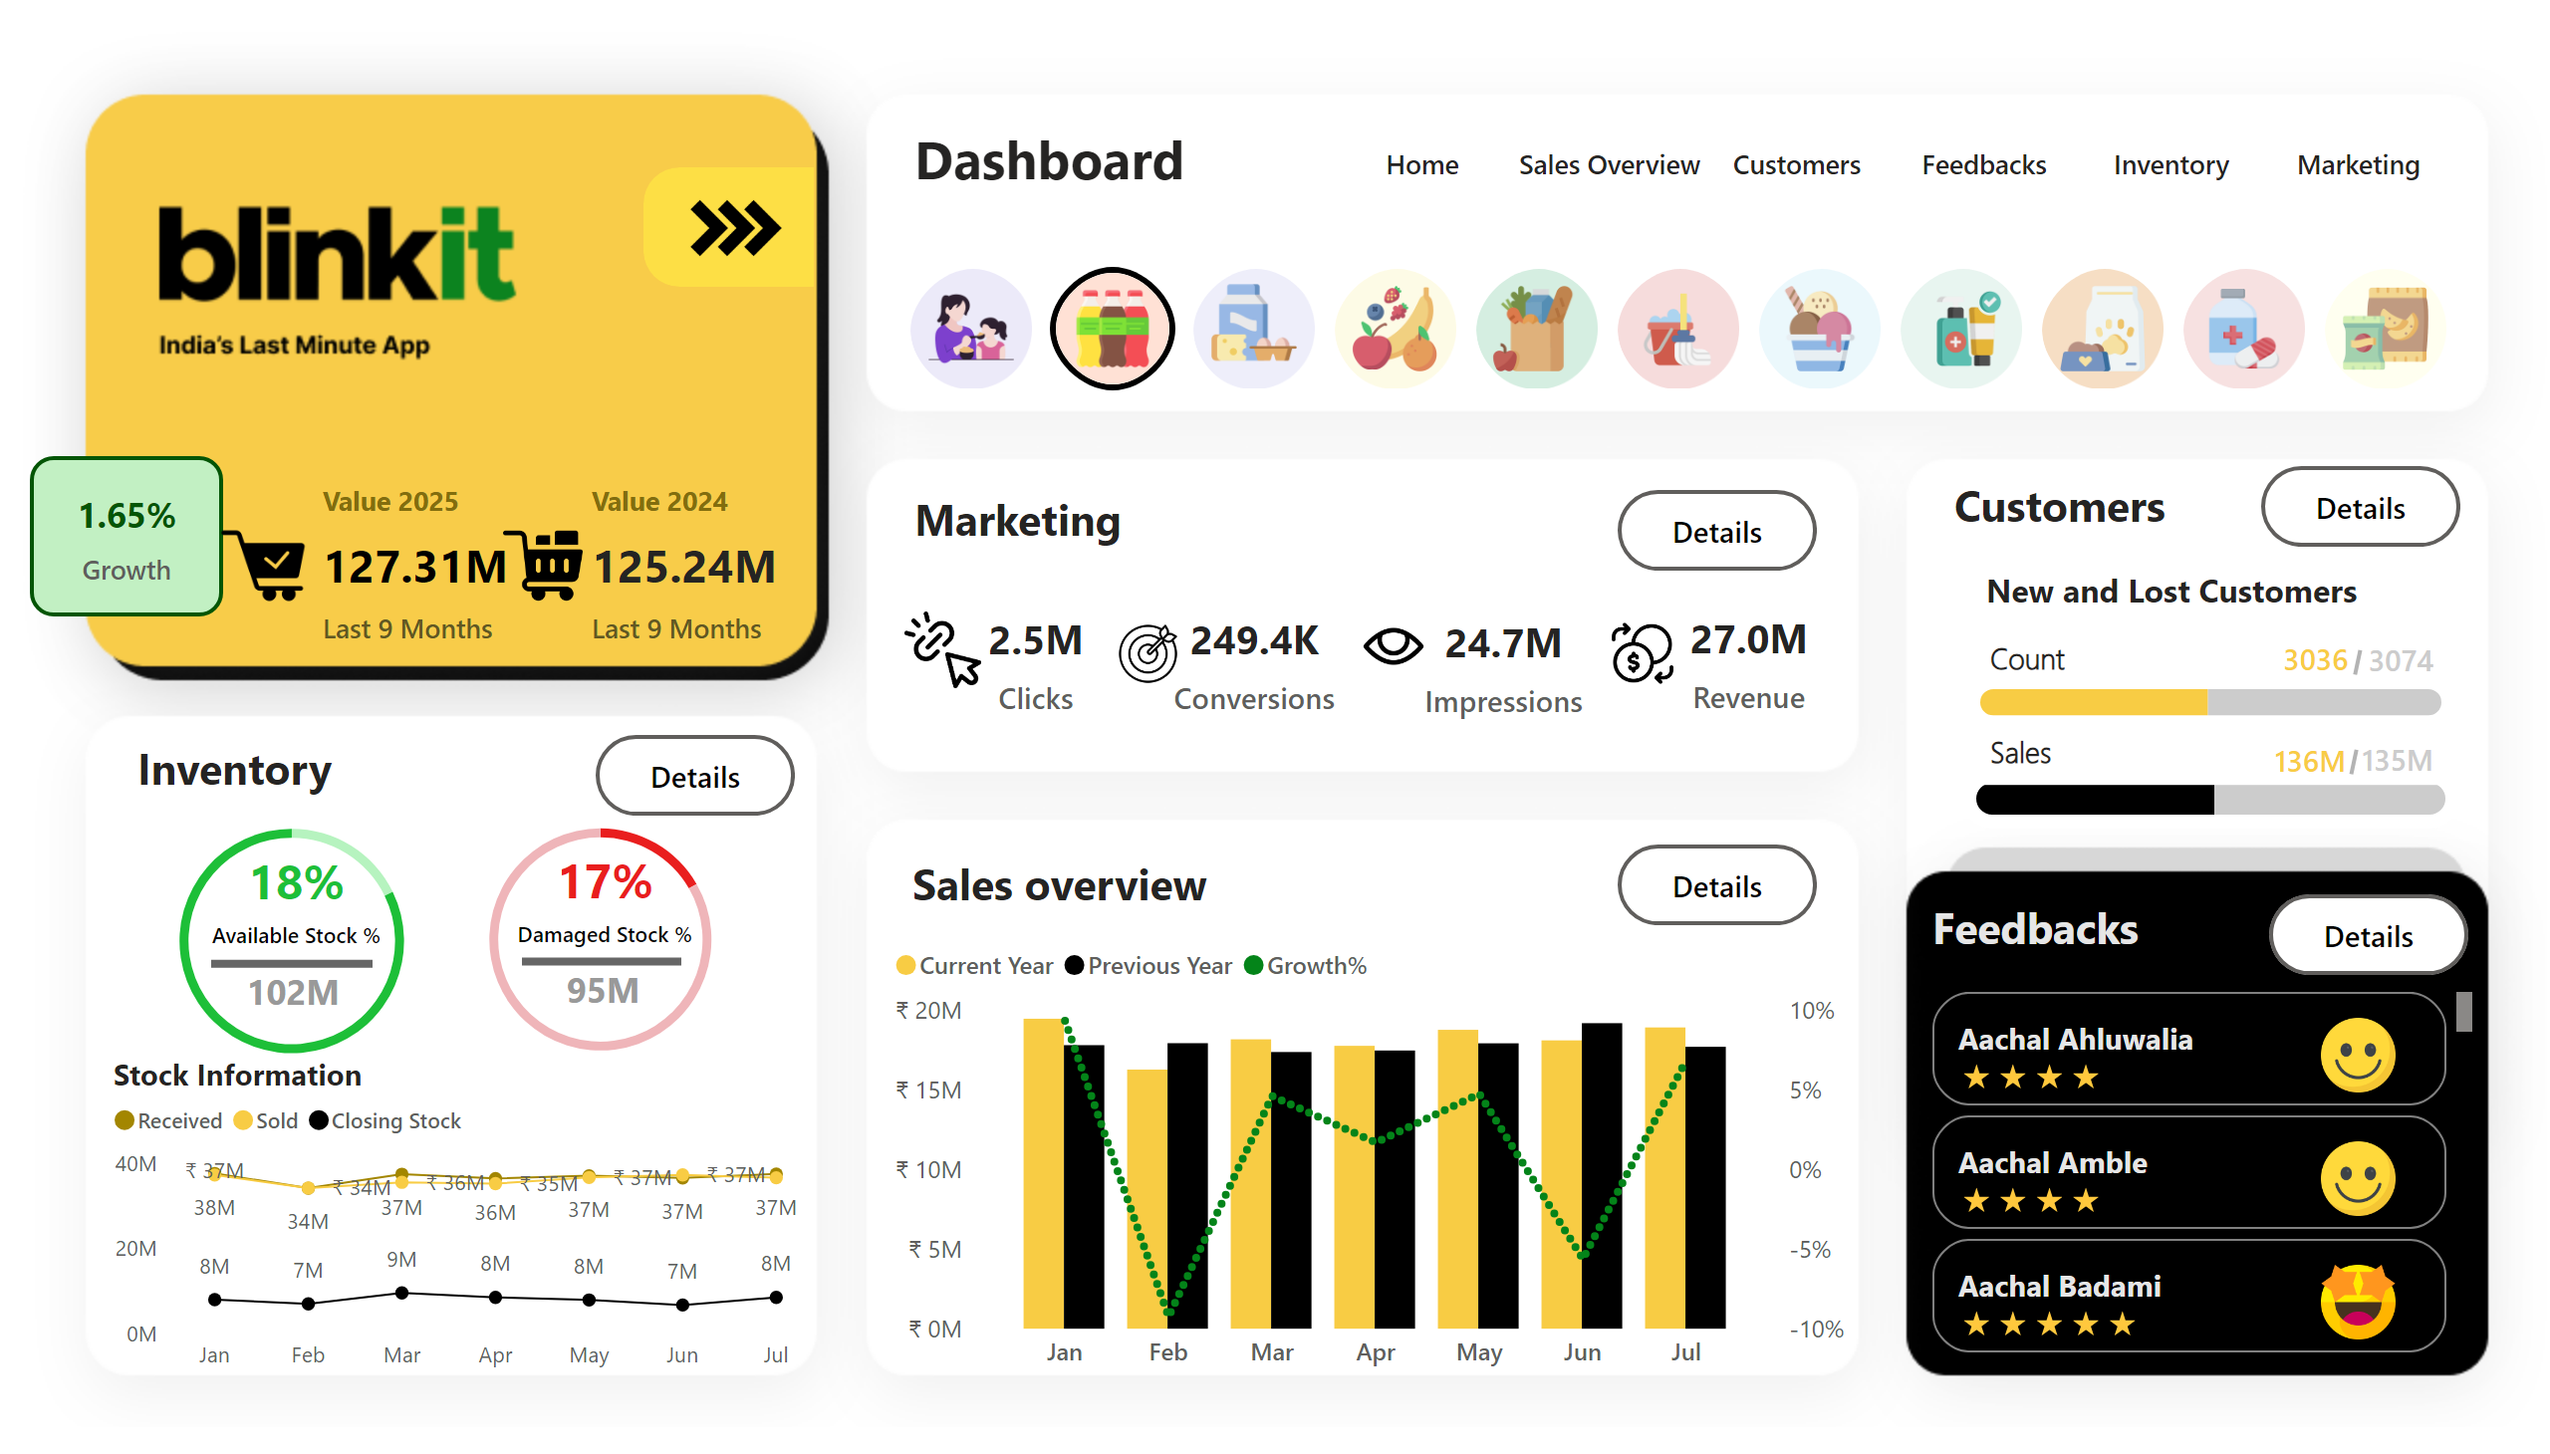
Dashboard
Notes:
slicer
No alt text provided
advancedSlicerVisual
No alt text provided
textbox
No alt text provided
advancedSlicerVisual
No alt text provided
advancedSlicerVisual
No alt text provided
shape
No alt text provided
slicer
No alt text provided
slicer
No alt text provided
slicer
No alt text provided
slicer
No alt text provided
slicer
No alt text provided
advancedSlicerVisual
No alt text provided
shape
No alt text provided
Sales by Month
No alt text provided
textbox
No alt text provided
image
No alt text provided
image
No alt text provided
cardVisual
No alt text provided
card
No alt text provided
shape
No alt text provided
image
No alt text provided
image
No alt text provided
pageNavigator
No alt text provided
image
No alt text provided
card
No alt text provided
image
No alt text provided
card
No alt text provided
image
No alt text provided
card
No alt text provided
image
No alt text provided
card
No alt text provided
textbox
No alt text provided
actionButton
No alt text provided
actionButton
No alt text provided
actionButton
No alt text provided
actionButton
No alt text provided
actionButton
No alt text provided
hundredPercentStackedBarChart
No alt text provided
shape
No alt text provided
textbox
No alt text provided
card
No alt text provided
card
No alt text provided
shape
No alt text provided
hundredPercentStackedBarChart
No alt text provided
card
No alt text provided
card
No alt text provided
shape
No alt text provided
shape
No alt text provided
textbox
No alt text provided
textbox
No alt text provided
textbox
No alt text provided
textbox
No alt text provided
card
No alt text provided
shape
No alt text provided
card
No alt text provided
Payment Method
No alt text provided
card
No alt text provided
shape
No alt text provided
card
No alt text provided
Payment Method
No alt text provided
textbox
No alt text provided
Stock Information
No alt text provided
textbox
No alt text provided
advancedSlicerVisual
No alt text provided
advancedSlicerVisual
No alt text provided

Slide 5
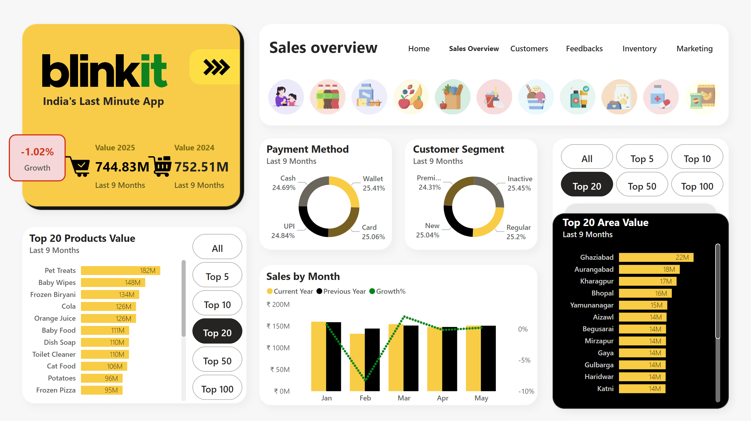
Sales Overview
Sales Overview Page
1. Revenue by Product Category (Column Chart)
- Data Shown: Total revenue from each product category.
- Business Implication: Helps optimize pricing and promotions.
2. Monthly Sales Trends (Line Chart)
- Data Shown: Sales performance trends over time.
- Business Implication: Assists in forecasting and strategy adjustments.
3. Average Order Value (KPI Card)
- Data Shown: Average revenue per order.
- Business Implication: Helps create upselling and cross-selling strategies.
Notes:
advancedSlicerVisual
No alt text provided
slicer
No alt text provided
advancedSlicerVisual
No alt text provided
textbox
No alt text provided
advancedSlicerVisual
No alt text provided
advancedSlicerVisual
No alt text provided
shape
No alt text provided
slicer
No alt text provided
slicer
No alt text provided
slicer
No alt text provided
slicer
No alt text provided
slicer
No alt text provided
advancedSlicerVisual
No alt text provided
shape
No alt text provided
advancedSlicerVisual
No alt text provided
Payment Method
No alt text provided
Customer Segment
No alt text provided
Sales by Month
No alt text provided
Top 20 Area Value
No alt text provided
Top 20 Products Value
No alt text provided
advancedSlicerVisual
No alt text provided
image
No alt text provided
textbox
No alt text provided
textbox
No alt text provided
image
No alt text provided
image
No alt text provided
cardVisual
No alt text provided
card
No alt text provided
shape
No alt text provided
image
No alt text provided
image
No alt text provided
pageNavigator
No alt text provided

Slide 6
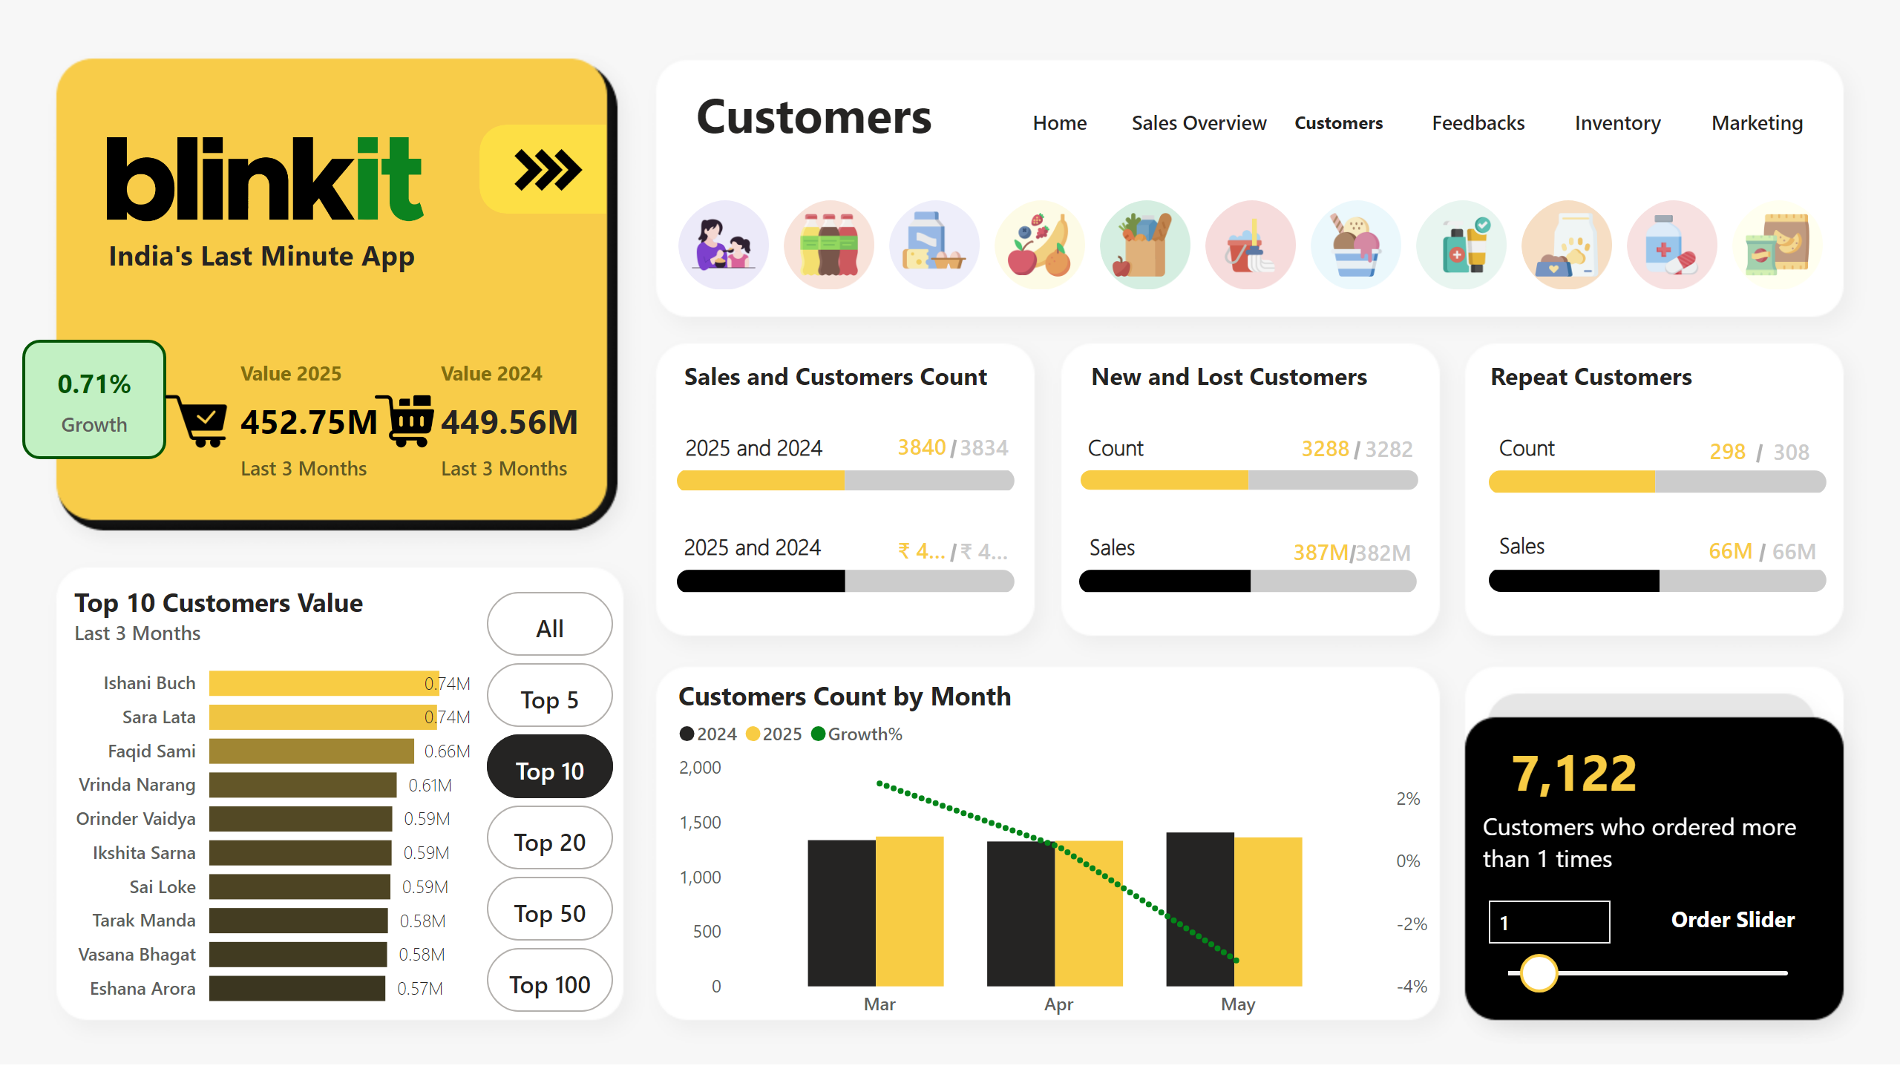
Customers
Customer Page
1. Customer Retention Rate (Gauge Chart)
- Data Shown: Percentage of customers placing repeat orders.
- Business Implication: Helps assess loyalty programs and customer engagement strategies.
2. Top Customers by Revenue (Table)
- Data Shown: Ranked list of highest revenue-generating customers.
- Business Implication: Identifies key customers for personalized offers and better engagement.
3. Customer Feedback Trends (Word Cloud/Sentiment Analysis)
- Data Shown: Extracts insights from customer reviews.
- Business Implication: Helps businesses improve services based on customer perceptions.
Notes:
hundredPercentStackedBarChart
No alt text provided
textbox
No alt text provided
textbox
No alt text provided
shape
No alt text provided
textbox
No alt text provided
shape
No alt text provided
hundredPercentStackedBarChart
No alt text provided
hundredPercentStackedBarChart
No alt text provided
shape
No alt text provided
Top 10 Customers Value
No alt text provided
advancedSlicerVisual
No alt text provided
image
No alt text provided
textbox
No alt text provided
textbox
No alt text provided
Customers Count by Month
No alt text provided
shape
No alt text provided
textbox
No alt text provided
hundredPercentStackedBarChart
No alt text provided
textbox
No alt text provided
shape
No alt text provided
textbox
No alt text provided
hundredPercentStackedBarChart
No alt text provided
shape
No alt text provided
textbox
No alt text provided
hundredPercentStackedBarChart
No alt text provided
slicer
No alt text provided
textbox
No alt text provided
card
No alt text provided
shape
No alt text provided
card
No alt text provided
card
No alt text provided
textbox
No alt text provided
textbox
No alt text provided
shape
No alt text provided
card
No alt text provided
card
No alt text provided
shape
No alt text provided
card
No alt text provided
card
No alt text provided
shape
No alt text provided
card
No alt text provided
card
No alt text provided
shape
No alt text provided
card
No alt text provided
card
No alt text provided
shape
No alt text provided
card
No alt text provided
card
No alt text provided
shape
No alt text provided
image
No alt text provided
image
No alt text provided
cardVisual
No alt text provided
card
No alt text provided
slicer
No alt text provided
advancedSlicerVisual
No alt text provided
textbox
No alt text provided
advancedSlicerVisual
No alt text provided
advancedSlicerVisual
No alt text provided
shape
No alt text provided
slicer
No alt text provided
slicer
No alt text provided
slicer
No alt text provided
slicer
No alt text provided
slicer
No alt text provided
advancedSlicerVisual
No alt text provided
shape
No alt text provided
shape
No alt text provided
image
No alt text provided
image
No alt text provided
advancedSlicerVisual
No alt text provided
pageNavigator
No alt text provided

Slide 7
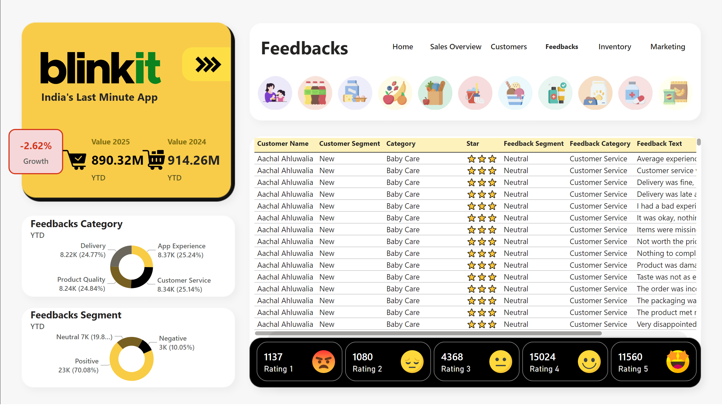
Feedbacks
Customer Feedback Page
1. Customer Feedback Trends (Word Cloud/Sentiment Analysis)
Data Shown: Extracts and categorizes customer reviews into positive, neutral, or negative sentiments.
Business Implication: Helps businesses understand customer perceptions and improve services accordingly.
2. Common Issues (Bar Chart or Table)
Data Shown: Displays frequently reported issues (e.g., late deliveries, app issues, product quality).
Business Implication: Identifies key pain points and allows management to prioritize solutions.
3.Net Promoter Score (NPS) (Gauge Chart)
Data Shown: Measures customer loyalty by categorizing respondents into Promoters, Passives, and Detractors.
Business Implication: Indicates overall customer satisfaction and helps track improvements over time.
4.Average Response Time (KPI Card)
Data Shown: Tracks the average time taken to respond to customer queries or complaints.
Business Implication: Helps businesses enhance support efficiency and improve response times.
Notes:
advancedSlicerVisual
No alt text provided
tableEx
No alt text provided
image
No alt text provided
textbox
No alt text provided
textbox
No alt text provided
Feedbacks Category
No alt text provided
Feedbacks Segment
No alt text provided
image
No alt text provided
image
No alt text provided
cardVisual
No alt text provided
card
No alt text provided
slicer
No alt text provided
advancedSlicerVisual
No alt text provided
textbox
No alt text provided
advancedSlicerVisual
No alt text provided
advancedSlicerVisual
No alt text provided
shape
No alt text provided
slicer
No alt text provided
slicer
No alt text provided
slicer
No alt text provided
slicer
No alt text provided
slicer
No alt text provided
advancedSlicerVisual
No alt text provided
shape
No alt text provided
shape
No alt text provided
image
No alt text provided
image
No alt text provided
advancedSlicerVisual
No alt text provided
pageNavigator
No alt text provided

Slide 8
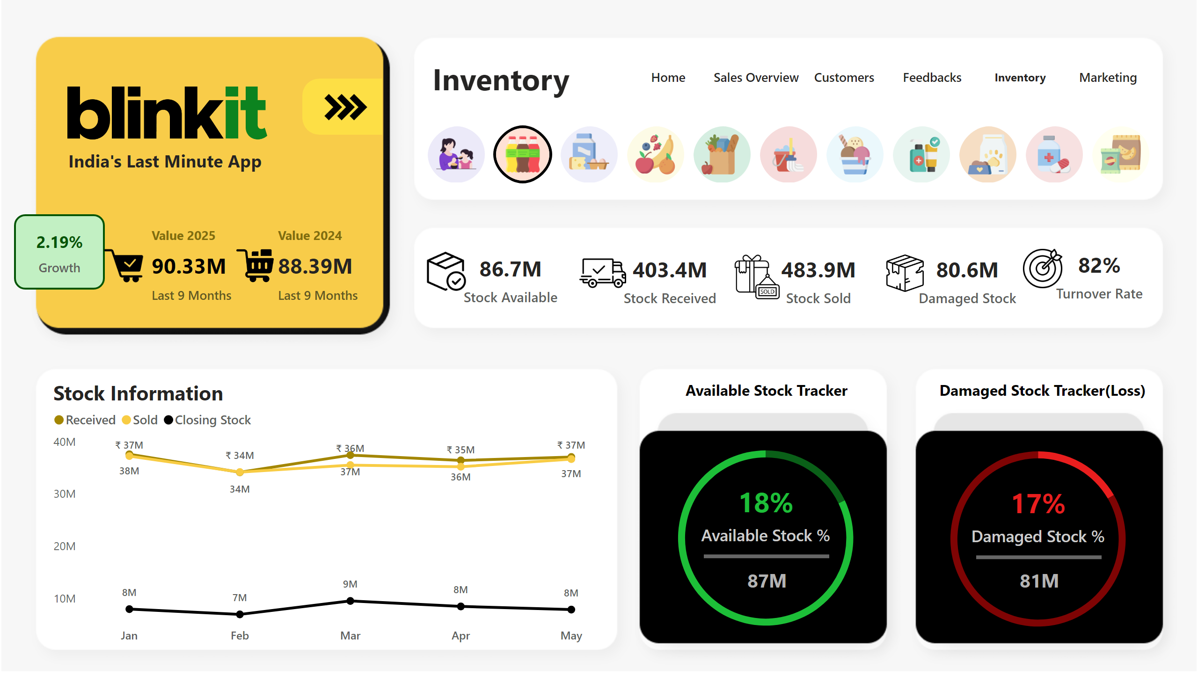
Inventory
Inventory Page
1. Stock Levels by Product Category (Bar Chart)
- Data Shown: Current stock availability across categories.
- Business Implication: Helps prevent stockouts and optimize inventory management.
2. Inventory Turnover Ratio (KPI Card)
- Data Shown: Measures how efficiently inventory is replaced over time.
- Business Implication: Helps optimize stock replenishment cycles.
3. Low Stock Alerts (Heatmap/Table)
- Data Shown: Identifies products nearing stock depletion.
- Business Implication: Ensures timely reordering to avoid lost sales.
Notes:
card
No alt text provided
image
No alt text provided
image
No alt text provided
textbox
No alt text provided
textbox
No alt text provided
image
No alt text provided
image
No alt text provided
cardVisual
No alt text provided
card
No alt text provided
Stock Information
No alt text provided
card
No alt text provided
Payment Method
No alt text provided
shape
No alt text provided
card
No alt text provided
card
No alt text provided
Payment Method
No alt text provided
shape
No alt text provided
card
No alt text provided
shape
No alt text provided
shape
No alt text provided
image
No alt text provided
card
No alt text provided
image
No alt text provided
card
No alt text provided
image
No alt text provided
card
No alt text provided
image
No alt text provided
card
No alt text provided
slicer
No alt text provided
advancedSlicerVisual
No alt text provided
textbox
No alt text provided
advancedSlicerVisual
No alt text provided
advancedSlicerVisual
No alt text provided
shape
No alt text provided
slicer
No alt text provided
slicer
No alt text provided
slicer
No alt text provided
slicer
No alt text provided
slicer
No alt text provided
advancedSlicerVisual
No alt text provided
shape
No alt text provided
shape
No alt text provided
image
No alt text provided
image
No alt text provided
advancedSlicerVisual
No alt text provided
pageNavigator
No alt text provided

Slide 9
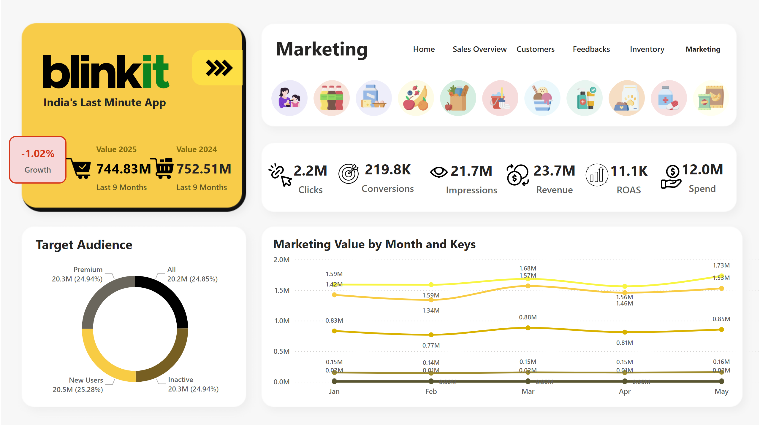
Marketing
Marketing Page
1. Campaign ROI Analysis (Bar/Funnel Chart)
- Data Shown: Compares marketing investment vs. generated revenue.
- Business Implication: Helps allocate budget efficiently and improve future campaigns.
2. Customer Acquisition by Channel (Pie Chart)
- Data Shown: Percentage of new customers acquired via different channels.
- Business Implication: Identifies most effective acquisition channels.
3. Marketing Spend by Region (Stacked Bar Chart)
- Data Shown: Budget allocation across different regions.
- Business Implication: Determines the effectiveness of regional campaigns.
Notes:
Marketing Value by Month and Keys
No alt text provided
Target Audience
No alt text provided
image
No alt text provided
textbox
No alt text provided
textbox
No alt text provided
image
No alt text provided
image
No alt text provided
cardVisual
No alt text provided
card
No alt text provided
image
No alt text provided
card
No alt text provided
image
No alt text provided
card
No alt text provided
image
No alt text provided
card
No alt text provided
image
No alt text provided
card
No alt text provided
image
No alt text provided
card
No alt text provided
image
No alt text provided
card
No alt text provided
slicer
No alt text provided
advancedSlicerVisual
No alt text provided
textbox
No alt text provided
advancedSlicerVisual
No alt text provided
advancedSlicerVisual
No alt text provided
shape
No alt text provided
slicer
No alt text provided
slicer
No alt text provided
slicer
No alt text provided
slicer
No alt text provided
slicer
No alt text provided
advancedSlicerVisual
No alt text provided
shape
No alt text provided
shape
No alt text provided
image
No alt text provided
image
No alt text provided
pageNavigator
No alt text provided
advancedSlicerVisual
No alt text provided

