Slide 1

Bachelor OF TECHNOLOGY IN civil ENGINEERING
Presented by
Riya Vishwakarma 2103070
Satyam 2103106
Vishal Kumar 2103089
Aditya Prakash pal 2103101
Under Guidance of
Dr. Lini Dev K.
Assistant professor
Dept. of Civil Engg., NITP.

Slide 2
Project Topic
Experimental Analysis of Soil Strength Parameters using Red Mud

Slide 3
Introduction
Rapid industrialization has produced massive amounts of solid and liquid industrial waste.
Agriculture has also led to waste that affects the environment and ultimately human beings.
In India, about 4.43 million tonnes of hazardous waste are generated annually and 9.173 billion tonnes globally.
An industrial waste called red mud (RM) is considered as strengthening agent in the project.

Slide 4
Table of contents
Introduction
Results and Discussions
Conclusion

Slide 5
EFFECTS OF INDUSTRIAL AND AGRICULTURAL WASTE
Land degradation
Global warming
Surface water contamination
Industrial Waste
leads to
Methane gas
Sub-surface water contamination
Human health
Soil health
Animal health

Slide 6
APPLICATION OF INDUSTRIAL AND AGRICULTURAL WASTE
Adsorbents
Industrial Waste
can be used in
Recycling
Construction
Bio based oil

Slide 7
Red Mud
Red mud is a potentially valuable solid waste with a global deposit of 4BT.
It is generated by extracting alumina from bauxite.
Process includes Milling & desilication, Digestion & clarification, Precipitation and calcination.
It is highly alkaline and toxic.
Methods and research's for the use of RM.
Chemical and acid treatments were made to make it more effective.

Slide 8
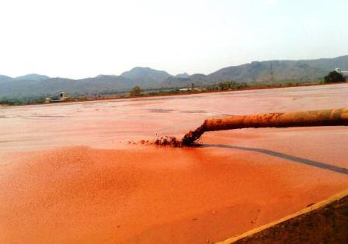
Figure 1. Red Mud Lake (Al Circle)

Slide 9
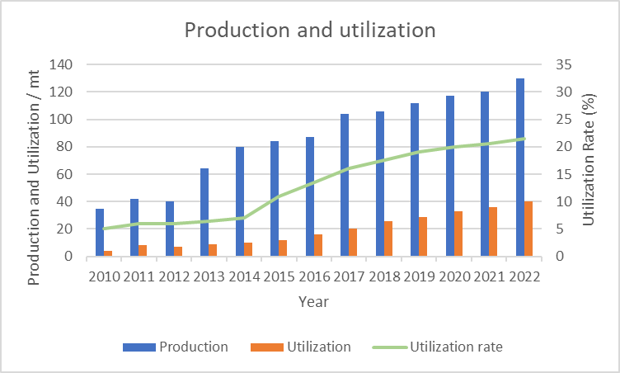
Figure 2. Graphical representation of the production, utilization and utilization rate of red mud (Wang,2021)

Slide 10
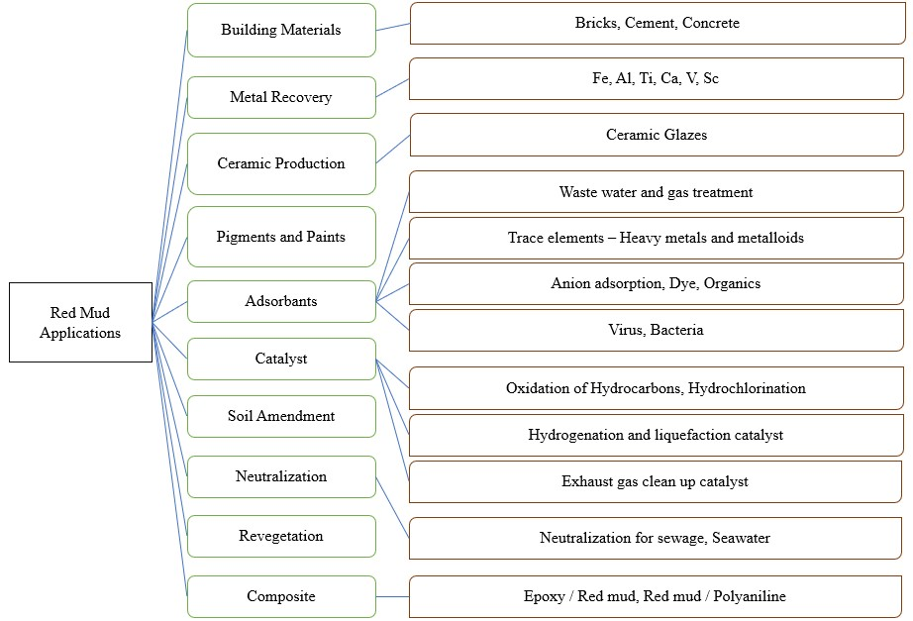
Application of Red Mud
Figure 3. Various applications of red mud

Slide 11
Sample Collection
Red mud is collected from HINDALCO Ind. Ltd., Muri, Jharkhand.
Soil is collected from PMCH, Patna, Bihar.

Slide 12
Results and Discussions

Slide 13
Particle Size Distribution Curve of red mud
Soil Type | Percentage
Gravel | 0 %
Sand | 29.35 %
Silt | 57.15 %
Clay | 13.5 %
Figure 4. Particle size Distribution curve of red mud

Slide 14
PROPERTIES OF RED MUD COLLECTED FROM HINDALCO
Specific Gravity | 3.086
Liquid Limit (%) | 38.79
Plastic Limit (%) | 35.56
Free swell index (%) | 10%
pH | 11.38
Maximum Dry density, MDD (g/cc) | 2.078
OMC (%) | 33.05
Void Ratio, e | 0.485
Cu | 30.63
Cc | 0.615

Slide 15
Particle Size Distribution Curve of Soil
Soil Type | Percentage
Gravel | 0 %
Sand | 20.174 %
Silt | 31.87 %
Clay | 47.95 %
Figure 7. Particle size Distribution curve of Soil

Slide 16
Proctor Test of Soil

Slide 17
CBR Test of Soil

Slide 18
Triaxial Test of soil
c | 24 kPa
ϕ | 11.48°

Slide 19
Properties of Soil collected from PMCH
Specific Gravity | 2.43
Liquid Limit (%) | 35.95
Plastic Limit (%) | 22.72
Free swell index (%) | 10%
pH | 8.56
Maximum Dry density, MDD (g/cc) | 1.86
OMC (%) | 17.8
Void Ratio, e | 0.306
Type of Soil (USCS) | CL
UCS (kPa) | 166.6
Failure Strain (%) | 10.52

Slide 20
Cont.
Cohesion, c | 24 kPa
Angle of internal friction, ϕ | 11.48°
Compression Index, Cc | 0.16
Recompression Index, Cr | 0.022
Permeability, k | 1.1847 x 10⁻⁷
CBR (@ 2.5 mm Penetration) | 8.296 %

Slide 21
Properties of Mixes Containing Soil and Red Mud
Mixes | Composition | Specific Gravity, G | Liquid Limit, LL | MDD (g/cc) | OMC (%) | pH
Mix 1 | Soil + 15% RM | 2.512 | 35.4 | 1.756 | 19.14 | 9.99
Mix 2 | Soil + 20% RM | 2.585 | 34 | 1.804 | 14.3 | 10.22
Mix 3 | Soil + 25% RM | 2.6 | 32.4 | 1.782 | 17.15 | 10.32

Slide 22
UCS of Mixes Containing Soil and Red Mud
 |  | Unconfined Compressive Strength (kPa)
 |  | Curing Period
Mixes | Composition | 1 Day | 7 Days | 14 Days | 28 Days | 56 Days
Soil | - | 166.6 | 166.6 | 166.6 | 166.6 | -
Mix 1 | Soil + 15% RM | 252.798 | 278.07 | 369.51 | 433.74 | -
Mix 2 | Soil + 20% RM | 414.29 | 432.65 | 667.94 | 865.01 | -
Mix 3 | Soil + 25% RM | 257.69 | 242.71 | 297.2 | 357.44 | -

Slide 23
Variation of LIQUID LIMIT WITH Red Mud

Slide 24
Variation of MDD and OMC with Red mud

Slide 25
Variation of stress-strain graph of mix 2

Slide 26
CONCLUSION
The specific gravity of the soil increased with the addition of red mud, enhancing the soil's overall density and strength characteristics.
The highest MDD was observed at a 20% red mud (RM) addition, indicating optimal compaction and strength at this percentage.
The least OMC was recorded at 20% RM addition, suggesting better water absorption and soil stabilization at this proportion.
The liquid limit decreased as the percentage of red mud increased, contributing to improved soil plasticity and reduced swelling potential.
The highest UCS value was achieved at 20% RM addition, with a 419% improvement compared to the natural soil, demonstrating superior strength and load-bearing capacity.
The addition of 20% red mud provided the best overall results, making it suitable for various applications such as brick manufacturing, and as a material for subgrade and subbase layers in road construction and other engineering works.

Slide 27
Reference
IS 2720 , Indian Standard Methods of Tests for Soil.

Slide 28
Thank you

