Slide 1


CAPSTONE SUBMISSION
POPULATION HEALTH INTELLIGENCE & PREVENTIVE CARE OPTIMIZATION
Predicting chronic disease early, so we can intervene before it becomes expensive
Data Science Training Program | Capstone Project
Team: Riya Chaudhari : Data Science Lead,
Janhavi Bagret : Analytics and Visualization Lead ,
Sweta Raj : Data Engineering Lead
Delivery date: 28 Oct 2026
Team Name: Team RCB

Slide 2
SECTION 01
BUSINESS PROBLEM
02
THE PROBLEM
10.4%
Chronic disease is usually found after members have already moved into higher-risk, higher-cost states. Reactive care means more hospital stays, worse outcomes, late interventions and wellness programs aimed at the wrong people.
of 9,982 members (1,036) develop a chronic condition within 12 months
5.5%
We answer four questions: Population Health (who is at risk?), Clinical (which indicators matter?), Financial (where does cost concentrate?) and Member Experience (what are members telling us?).
of members (547) drive about 42% of total cost (from segment averages)
THE LEADERSHIP QUESTION
What interventions should Kaiser Permanente implement today to reduce future chronic disease burden while improving member wellness and controlling healthcare costs?

Slide 3
SECTION 02
DATA SOURCES & ARCHITECTURE
03
FIVE INTEGRATED DATASETS
FROM RAW DATA TO DECISIONS
1
Member Master
10,150 rows
STEP 1
STEP 2
Age, gender, region, plan
Clean
Integrate
2
Wellness Program
15,285 rows
810 duplicates removed; IDs, 38 region spellings and sentinel values standardised
Joined on Member_ID into one Gold dataset: 34,553 rows x 64 columns
Exercise, smoking, diet, screening
3
Clinical Screenings
15,285 rows
BMI, glucose, HbA1c, BP, cholesterol
STEP 3
STEP 4
Member-level
Analyse & model
4
Claims & Utilization
15,285 rows
Visits, costs, medications
Latest snapshot per member: 9,982 unique members
SQL, statistics, EDA, ML, clustering, NLP, RAG
5
Member Feedback
15,285 rows
Survey comments, ratings

Slide 4
SECTION 03
DATA PREPARATION & SQL: WELLNESS
04
810
duplicate rows removed
38 to 9
region spellings unified
12,510
missing values handled
60
orphan records per table fixed
AVG SESSIONS ATTENDED, BY PROGRAM STATUS
AVG SCREENINGS COMPLETED, BY STATUS
QUARTERLY PROGRAM ENROLLMENTS
Engaged members screen more: completers average 3.2 screenings against 2.0 for non-enrolled (+61%).
Dropouts are the opportunity: 4,786 members left a program after only 8 sessions on average.
Enrollment grew about 19x, from 80 in Q1 2023 to 1,512 in Q4 2025. Screening reach is 100% in all 9 regions.

Slide 5
SECTION 03
SQL FINDINGS: RISK, COST & UTILIZATION
05
AVG COST BY AGE CATEGORY ($)
AVG COST BY RISK GROUP ($)
AVG COST BY CHRONIC CONDITIONS ($)
TOP 20 MEMBERS
DISEASE BURDEN DRIVES COST
AGE AND RISK BOTH MATTER
Each costs $144K to $333K, about $3.8M combined: prime case-management candidates.
Members with 4 chronic conditions cost about 5x those with none.
Seniors cost 2.9x young adults; high clinical risk costs 44% more than low risk.

Slide 6
SECTION 04
STATISTICAL INSIGHTS
06
Descriptive statistics
Distributions & outliers
HYPOTHESIS RESULTS
Hypothesis | p-value | Result
BMI higher in members who develop disease | 0.0002 | Supported
Family history raises disease risk | <0.001 | Supported
Wellness enrollment changes visits | 0.0005 | Yes, but enrolled visit more
Exercise frequency vs cost | 0.022 | Significant, tiny effect (r = -0.01)
Screening participation lowers cost | 0.113 | Not supported
Glucose higher in disease group | 0.310 | Not supported
BMI 28.8 · Glucose 96 · Cholesterol 187 · Visits 5.3 a year
BMI and glucose have a long high tail; costs are extremely skewed.
Costs average $5.7K, pulled up by a few very large claims.
High readings and high costs sit in a small, targetable group.
Correlations
6 hypotheses tested at alpha = 0.05
Pairwise correlations among BMI, glucose, HbA1c, exercise, costs and visits are all below 0.02.
4 supported, 2 not. Family history of diabetes (p<0.001) and BMI (p=0.0002) clearly separate members who develop disease.
No single metric explains risk, so we model them together.
Takeaway: lifestyle and family history matter; screening alone has not yet shown a cost effect.

Slide 7
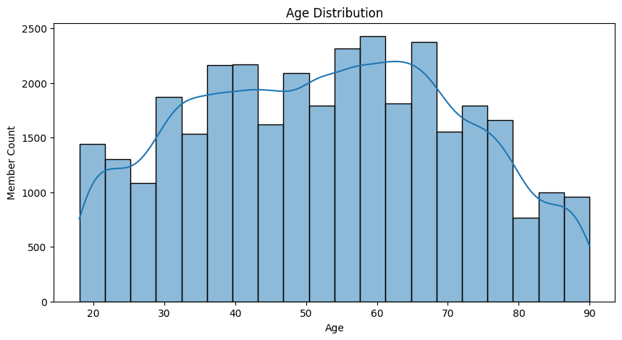
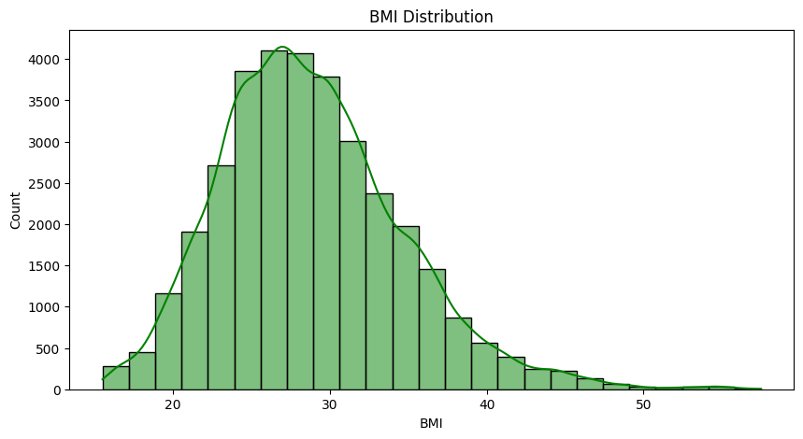
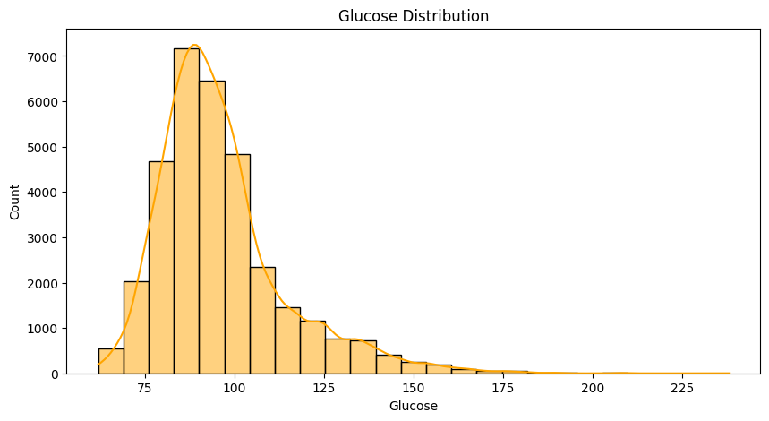
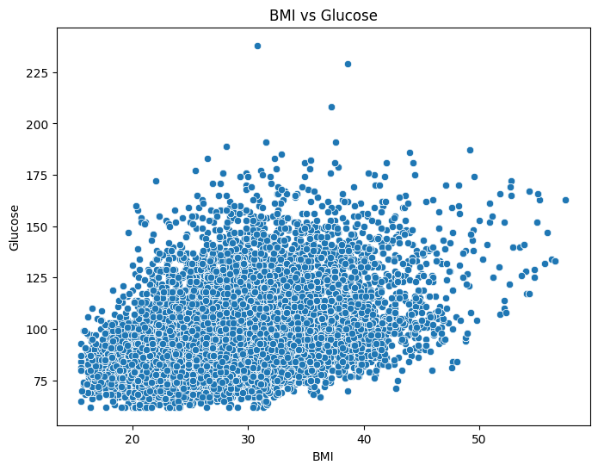
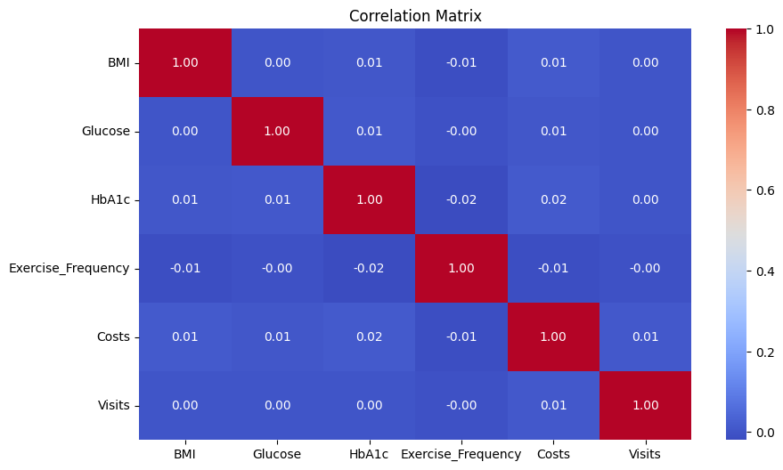
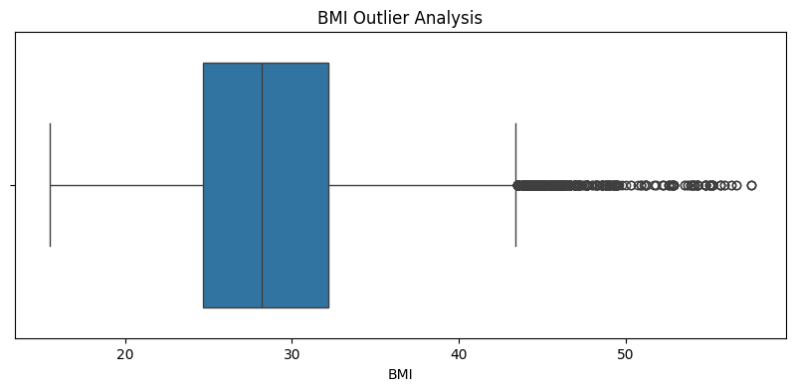
SECTION 05
EDA FINDINGS
07
Age: members span 18-90, with a heavy 55-70 core
BMI: centred near 28; a large share is overweight or obese
Glucose: most are normal, with a prediabetic and diabetic tail
BMI vs glucose: glucose climbs as BMI rises
Correlation matrix: no single metric dominates
BMI outliers: the high-BMI tail is the early-warning group
Key EDA insight Disease risk builds gradually across weight, glucose and age rather than from one trigger. Costs are the sharpest skew: the median member costs about $2.5K, while the top claims reach $2.9M.

Slide 8
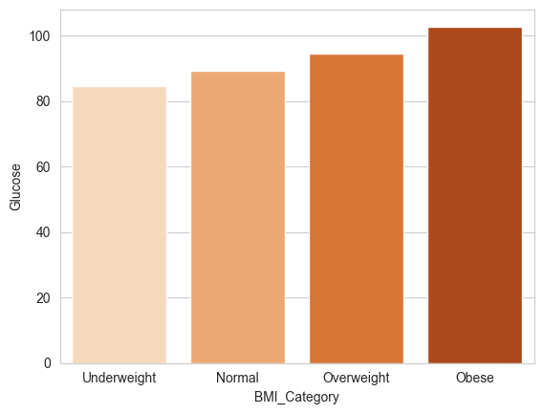
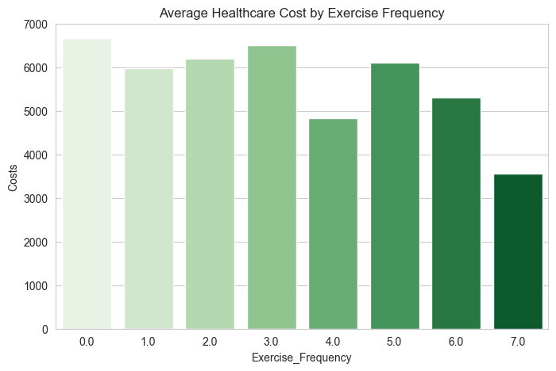
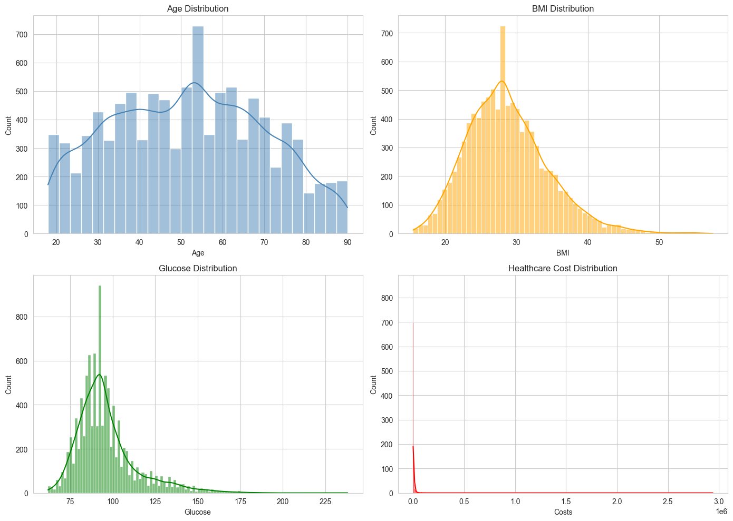
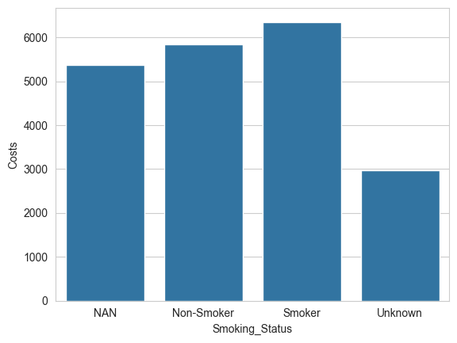
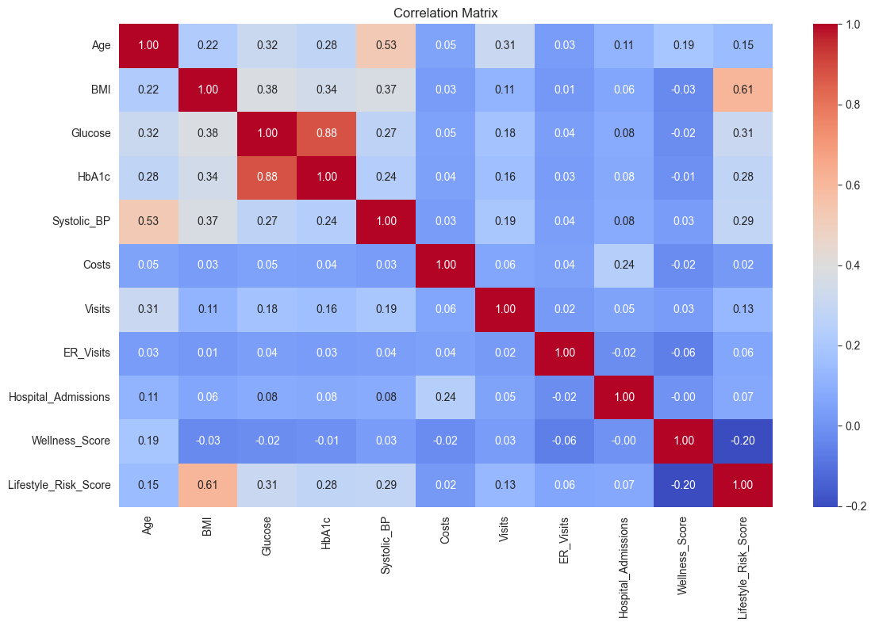
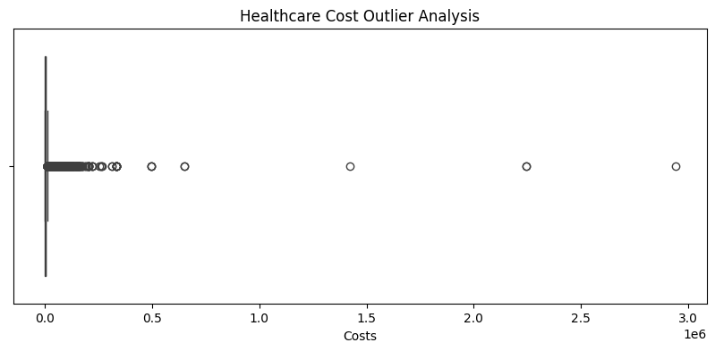
SECTION 05
EDA FINDINGS
06
Paste your chart
screenshot here
BMI vs Glucose
Exercise Frequency vs Cost
Age, BMI, cost & glucose distributions
Paste your chart
screenshot here
Paste your chart
screenshot here
Smoking & Screening vs Cost
Correlation matrix & heatmap
Key EDA insight – We get insights on how Exercise Frequency, Age, BMI, Glucose, Smoking_status affect the utilization cost of Organization
Extremely rightly skewed
90 % members may cost - $1000 - $20000

Slide 9
SECTION 06
FEATURE ENGINEERING
08
Engineered feature | Logic | Why it matters
Wellness Score | Composite score combining exercise behavior, diet quality and preventive screening participation. | Supports identification of members likely to benefit from preventive wellness programs.
Lifestyle Risk Score | Composite risk measure based on smoking behavior, obesity risk and physical inactivity | Targets the Active Lifestyle program
Preventive Compliance Score | (Screening 100 + 10 x screenings done + 20 x risk assessment) / 3 | Finds non-compliant members
Chronic Disease Risk Index | Mean of normalised BMI, glucose, HbA1c, systolic BP, cholesterol | One composite clinical risk signal
Diabetes Risk Flag | High if glucose >= 126 or HbA1c >= 6.5; moderate if >= 100 / 5.7 Identifies members exhibiting prediabetic or diabetic clinical indicators | Early warning for the diabetes program
Utilization Risk Score | Measures healthcare-resource consumption during visits, admissions and medications. | Identify High-cost populations
Five supporting features | Cost per visit, BP stage, family risk, age band, engagement level | Context for cost and risk models
62 features in total, all built from the five source tables and tied to a preventive action.
Cost per Visit | Blood Pressure Stage | Age | Engagement Level | BMI | Glucose |Chronic Condition Count |Gender | Smoking_status
* These are other selected features

Slide 10
SECTION 07
HOW WE PREDICT DISEASE RISK
09
THREE QUESTIONS, ANSWERED IN SEQUENCE
1 Will they develop it?
2 Which disease?
3 How urgent?
Yes / No within 12 months
Diabetes · Hypertension · Both · None
Risk tier from predicted probability
10.4% yes (1,036 of 9,982)
436 · 575 · 25 · 8,946
Low <20% · Moderate 20-50% · High 50-75% · Very High 75%+
THE PIPELINE BEHIND IT
1
One row per member
2
Build the targets
3
Guard against leakage
4
Encode
34,553 records to 9,982 members
From future-outcome flags
Future flags kept out of inputs
123 model inputs
5
Split 80 / 20
6
Balance classes
7
Train & tune
8
Score & route
Stratified: 7,985 train, 1,997 test
SMOTE on training data only
5 models, hyperparameter search
Risk tier, segment, campaign

Slide 11
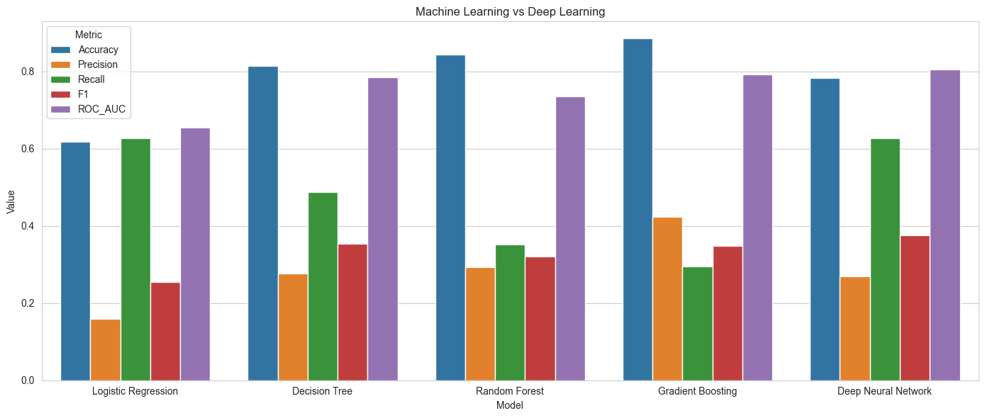
SECTION 08
DISEASE PREDICTION MODELS
10
WILL THE MEMBER DEVELOP A CHRONIC DISEASE WITHIN 12 MONTHS?
MODEL PERFORMANCE COMPARISION
Model | Accuracy | Precision | Recall | F1 | ROC-AUC
Logistic Regression | 0.618 | 0.160 | 0.628 | 0.254 | 0.655
Decision Tree | 0.815 | 0.278 | 0.488 | 0.354 | 0.786
Random Forest | 0.845 | 0.293 | 0.353 | 0.320 | 0.736
Gradient Boosting | 0.885 | 0.424 | 0.295 | 0.348 | 0.793
Neural Network | 0.784 | 0.269 | 0.628 | 0.376 | 0.805
Shaded = best in column. Only about 10% of members develop disease, so catching them (recall) is the hard part.
BEST MODEL
VALIDATION
BUSINESS IMPLICATION
Neural Network ranks best overall (ROC-AUC 0.825, accuracy 0.78). It also catches the most at-risk members (recall 0.63).
Stratified 80/20 hold-out, SMOTE on training data only, and hyperparameter tuning for each model.
Use predicted probability to tier members: screen widely with the high-recall model, focus outreach with the high-precision one.
Notes:
Binary model results supplied by the team. The earlier 4-class disease-type model (about 0.98 accuracy) had Develops_Chronic_Disease_12M among its inputs, so its scores are not shown. Cross-validation (CV_Recall) is not populated in the notebook.

Slide 12
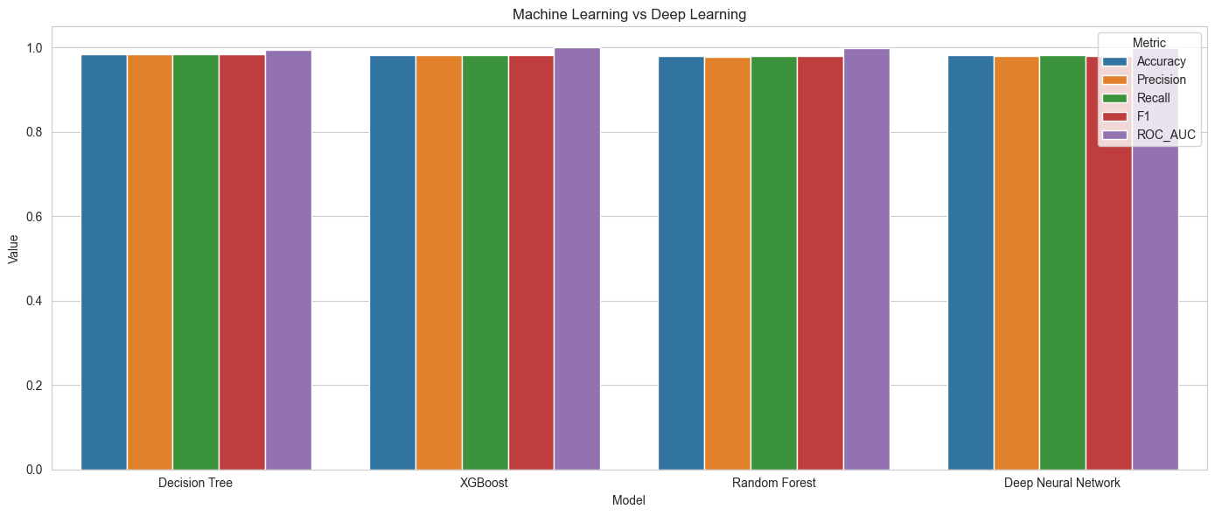
SECTION 08
DISEASE TYPE PREDICTION
10
WILL THE MEMBER DEVELOP A CHRONIC DISEASE WITHIN 12 MONTHS?
MODEL PERFORMANCE COMPARISION
Model | Accuracy | Precision | Recall | F1 | ROC-AUC
Decision Tree | 0.981 | 0.980 | 0.981 | 0.980 | 0.9905
Random Forest | 0.981 | 0.9792 | 0.981 | 0.97 | 0.9990
Xtreme Gradient Boosting | 0.983 | 0.9828 | 0.983 | 0.982 | 0.9996
Neural Network | 0.979 | 0.9798 | 0.9790 | 0.9790 | 0.9993
Shaded = best in column. Only about 10% of members develop disease, so catching them (recall) is the hard part.
BEST MODEL
XGBoost ranks best overall –
F1 score : 0.982 | Accuracy 0.983
It also catches the most at-risk members Recall : 0.983).
Disease Type | Count | Percentage
Both | 20 | 0.25%
Diabetes | 349 | 4.37 %
Hypertension | 460 | 5.76 %
None | 7156 | 89.62 %
BUSINESS IMPLICATION
Use predicted probability to tier members: screen widely with the high-recall model, focus outreach with the high-precision one.
VALIDATION
Stratified 80/20 hold-out, SMOTE on training data only, and hyperparameter tuning for each model.
Results reflect the strong predictive signal present within clinical, wellness, and utilization indicators. External validation is recommended prior to real-world deployment.
Notes:
Binary model results supplied by the team. The earlier 4-class disease-type model (about 0.98 accuracy) had Develops_Chronic_Disease_12M among its inputs, so its scores are not shown. Cross-validation (CV_Recall) is not populated in the notebook.

Slide 13
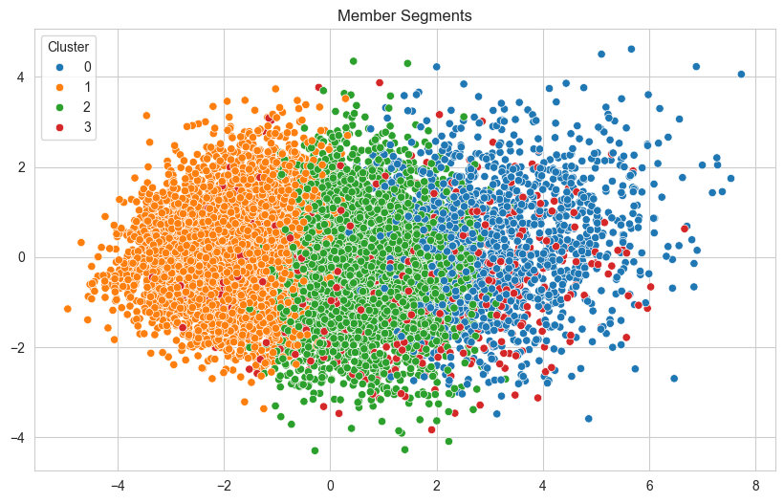
SECTION 09
POPULATION SEGMENTATION
11
Segment | Size | Key characteristics | Recommended action
Healthy Low-Risk | 4,091 (41%) | Youngest (39), lowest cost ($2.3K), 0.2 conditions | Maintain wellness engagement
Emerging Risk | 3,940 (39%) | Age 58, BMI 30, elevated BP and lifestyle risk | Lifestyle and diabetes-prevention programs
High-Risk Chronic | 1,404 (14%) | Age 66, glucose 126, HbA1c 6.3, BMI 33, 4.7 medications | Disease management and monitoring
High-Cost Utilization | 547 (5.5%) | $45K average cost, 1 admission per member | Care coordination and case management
SEGMENTS ON A PCA MAP
Blue: High-Risk Chronic
Orange: Healthy
Green: Emerging
Red: High-Cost
Risk rises left to right.
5.5% of members drive about 42% of spend. The 39% in Emerging Risk is the largest chance to prevent progression. K-Means (silhouette 0.155) edged hierarchical (0.151), so we use K-Means.

Slide 14
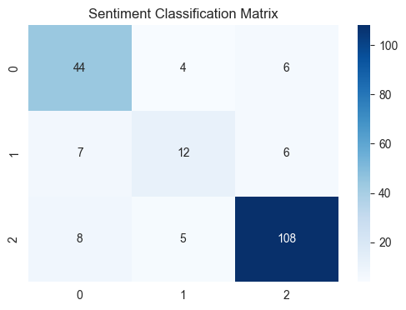
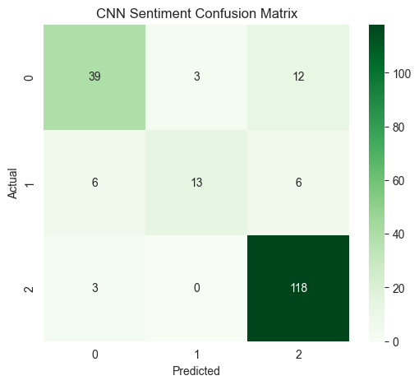
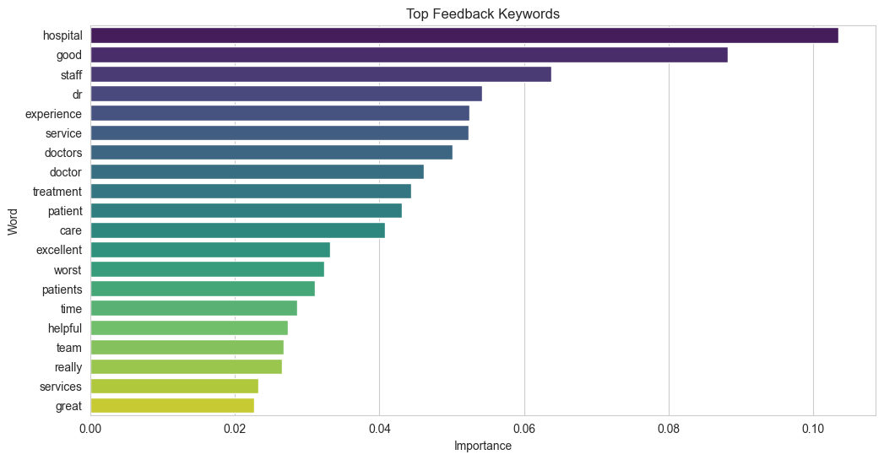
SECTION 10
NLP INSIGHTS
12
SENTIMENT OF 996 MEMBER REVIEWS
TF - IDF
CNN
FIVE TOPICS FOUND
WHAT MEMBERS PRAISE
Billing & Administration
Doctors and clinical care
Treatment quality
Helpful, supportive staff
Overall care experience
Sentiment is aligned to ratings (4-5 positive, 3 neutral, 1-2 negative). A CNN classifier reaches 85% accuracy; TF-IDF with logistic regression, 82%.
Service Quality & Doctors
Emergency Services & Wait Time
Clinical Care & Surgery
WHAT FRUSTRATES THEM (COMMON CONCERNS)
Appointment Scheduling & Access
Appointment scheduling
Waiting times
Billing and cost
Emergency services
Insight: clinical quality is the strength. The biggest chances to improve experience are operational: scheduling, waiting and billing.

Slide 15
SECTION 11
KNOWLEDGE MANAGEMENT ASSISTANT (RAG)
13
HOW THE PREVENTIVE HEALTH ASSISTANT WORKS
EXAMPLE QUERY
1
Knowledge base
9 documents (31 pages): CDC, WHO and our playbooks
Member: age 57, BMI 34.5, glucose 182, current smoker, hypertension. Segment: High-Risk Chronic. Risk tier: Very High (probability 0.84).
2
Chunking
85 chunks, 1,000 characters each
Needs: diabetes prevention, smoking cessation, weight management, screenings, care actions.
3
Embeddings
BGE-small sentence embeddings
EXAMPLE AI RESPONSE
4
Vector database
FAISS index, saved locally
Risk summary: very high risk of chronic disease; age, glucose, hypertension and obesity drive it.
Programs: Diabetes Prevention, Active Lifestyle, Care Management.
Care actions: medication review, care coordination, close monitoring.
If the knowledge base lacks an answer, it says so rather than guessing.
5
Retriever
Top 7 passages (MMR)
6
LLM
Llama 3, grounded in retrieved text
The member's ML risk tier, probability and segment go into every prompt, so advice is personal and grounded.

Slide 16
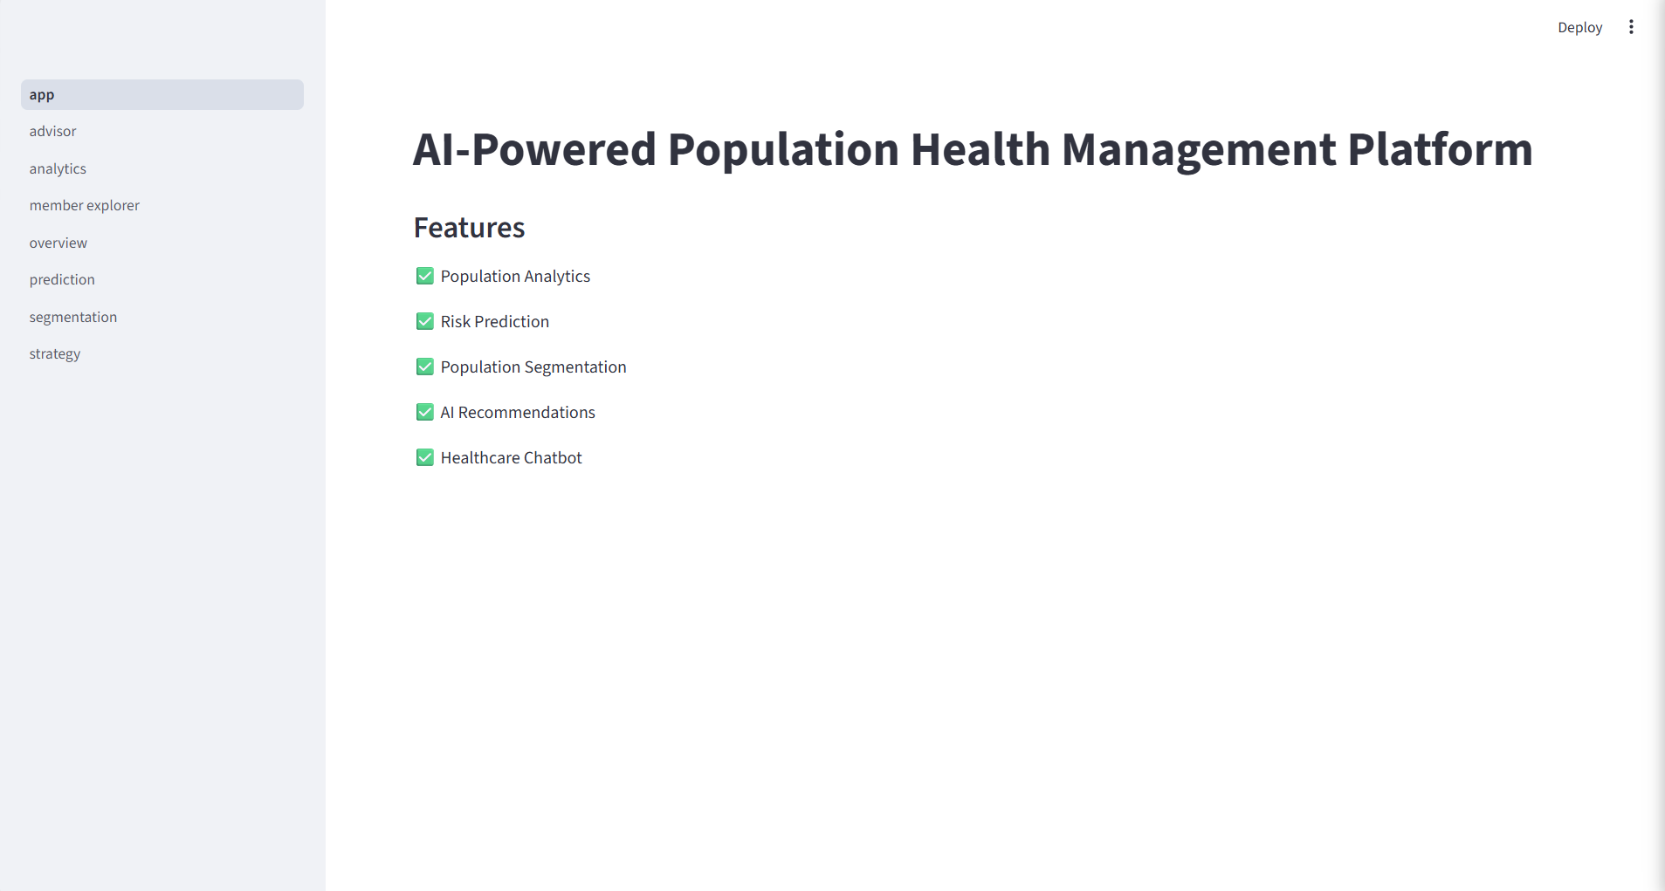
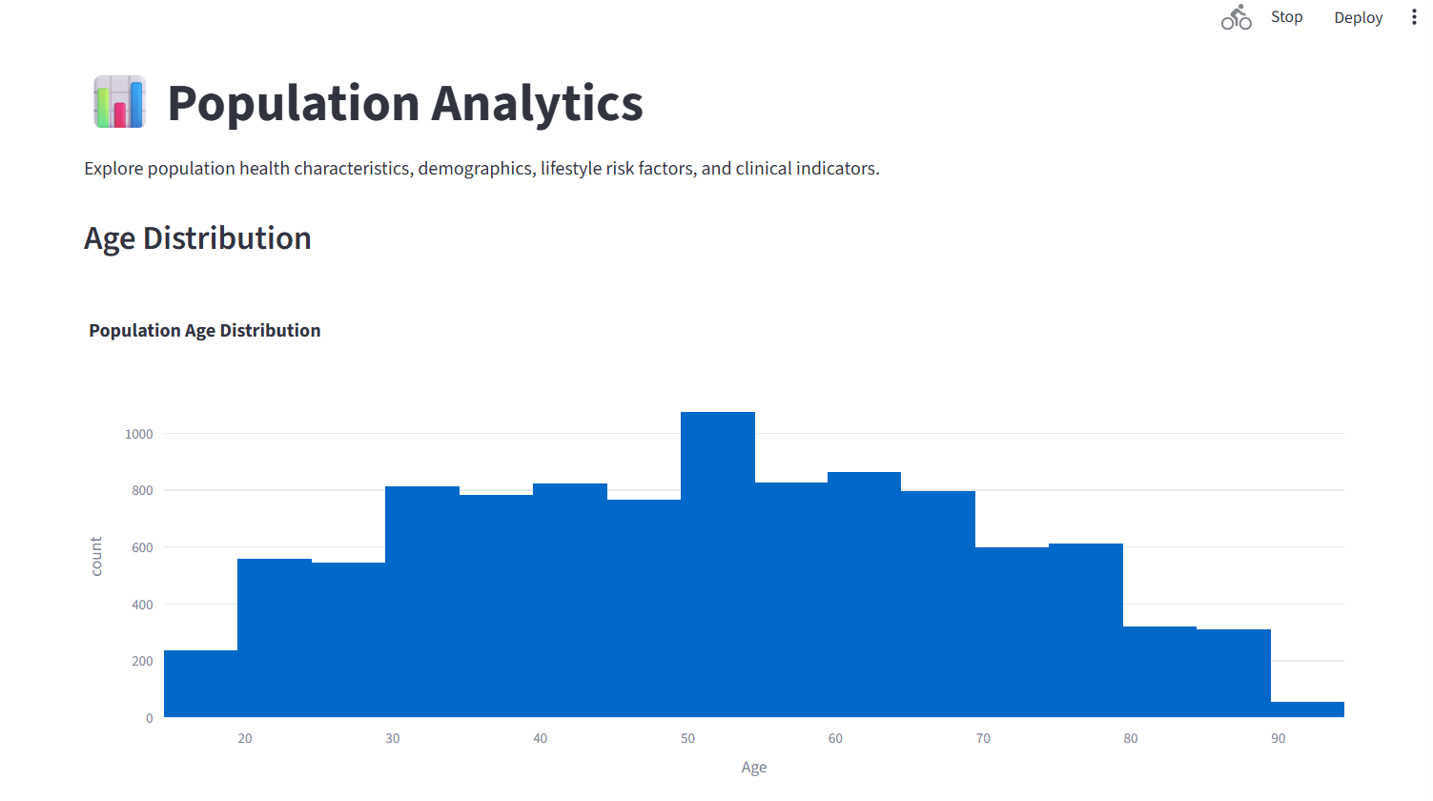
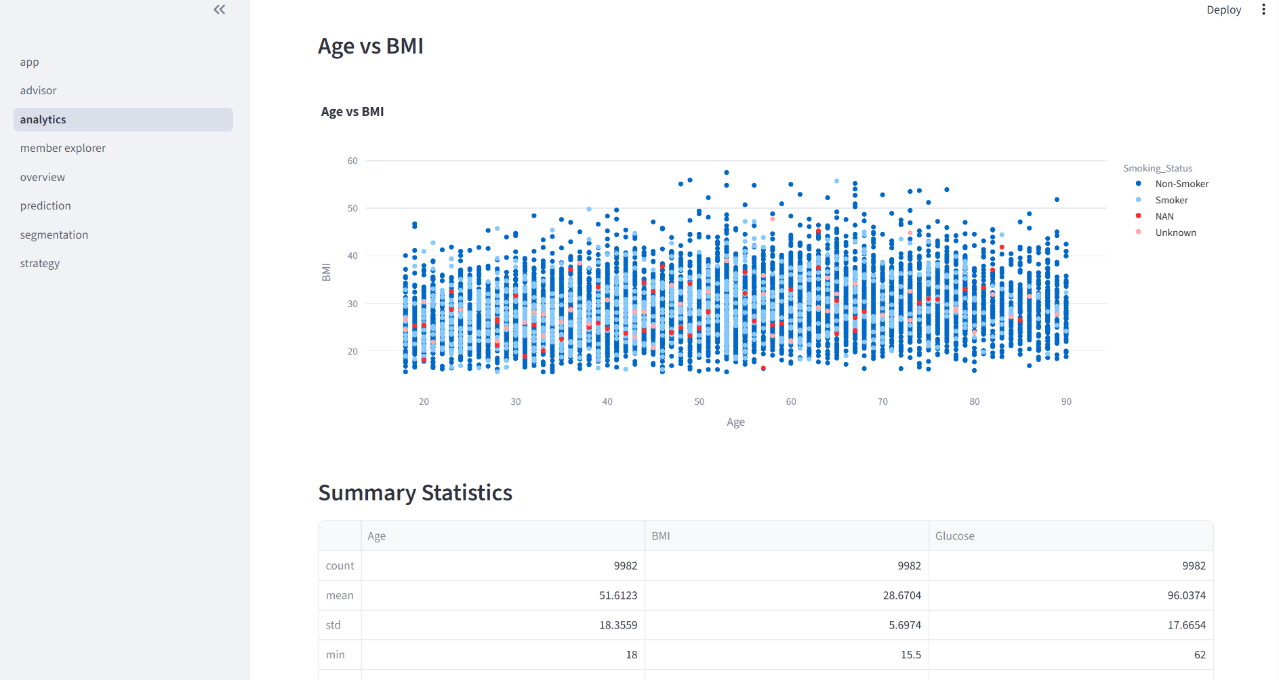
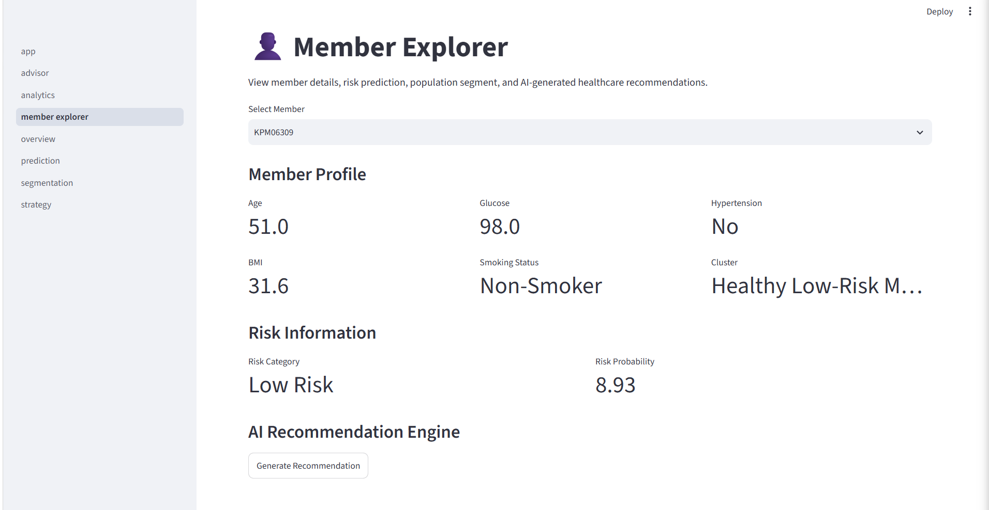
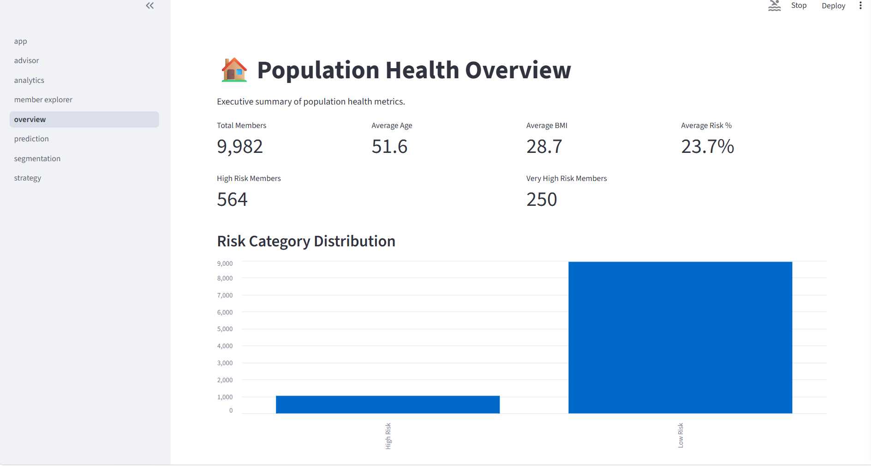
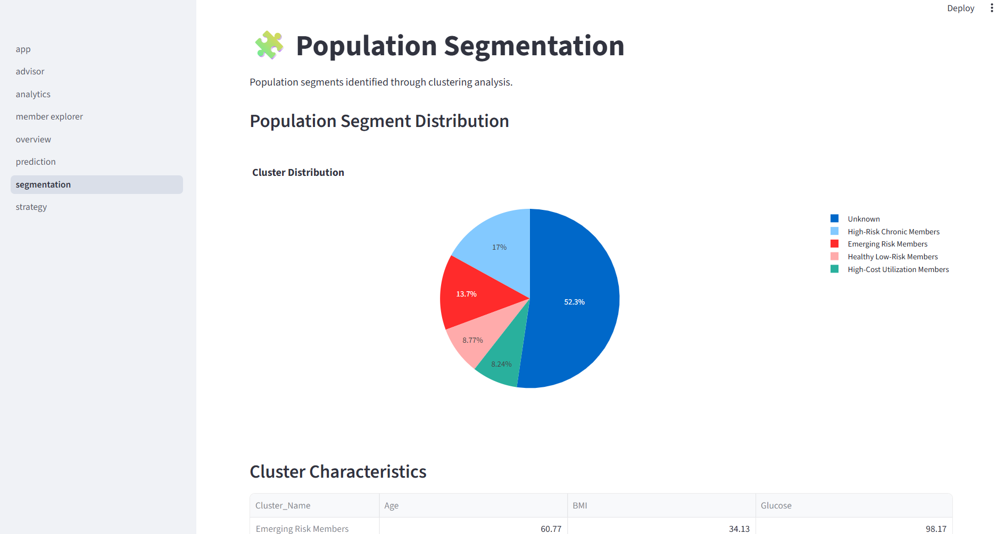
RAG DASHBOARD

Slide 17
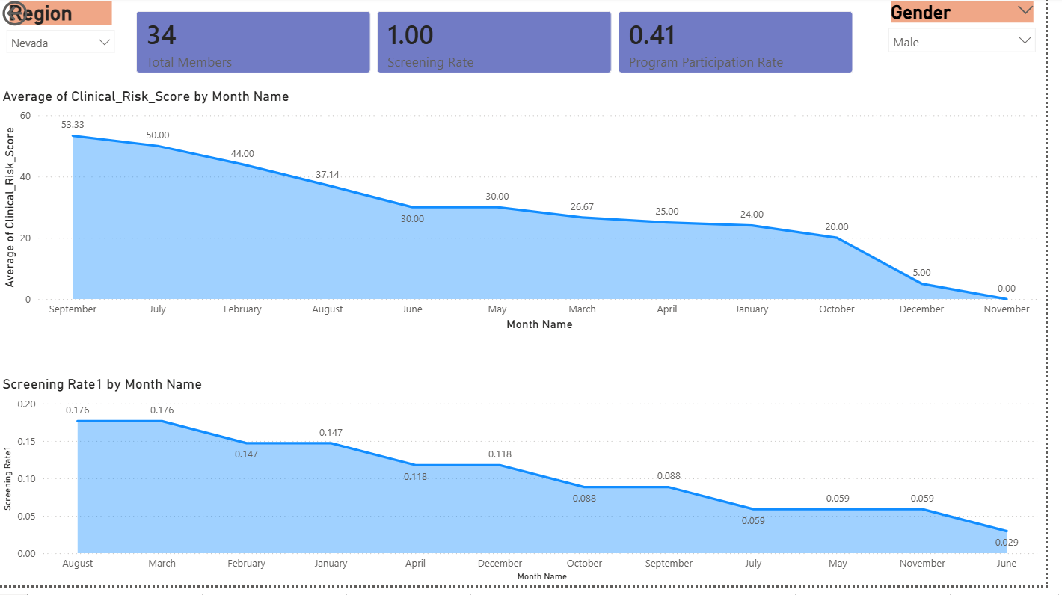
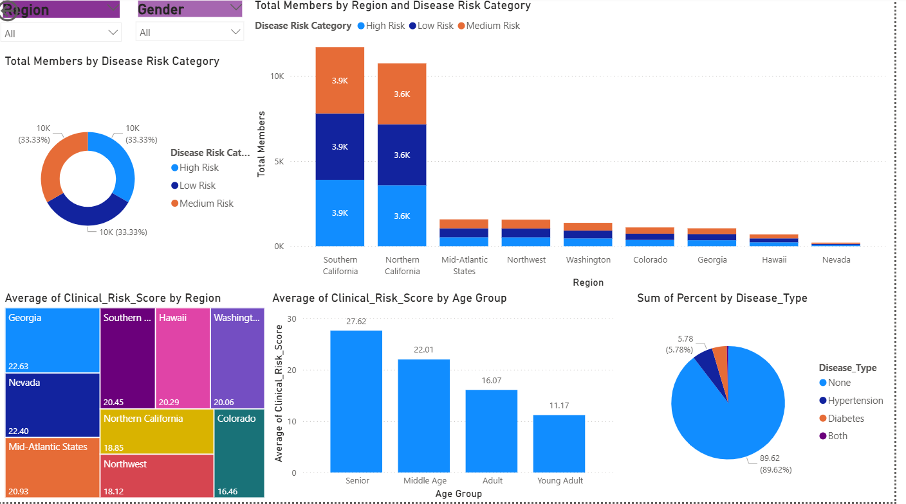
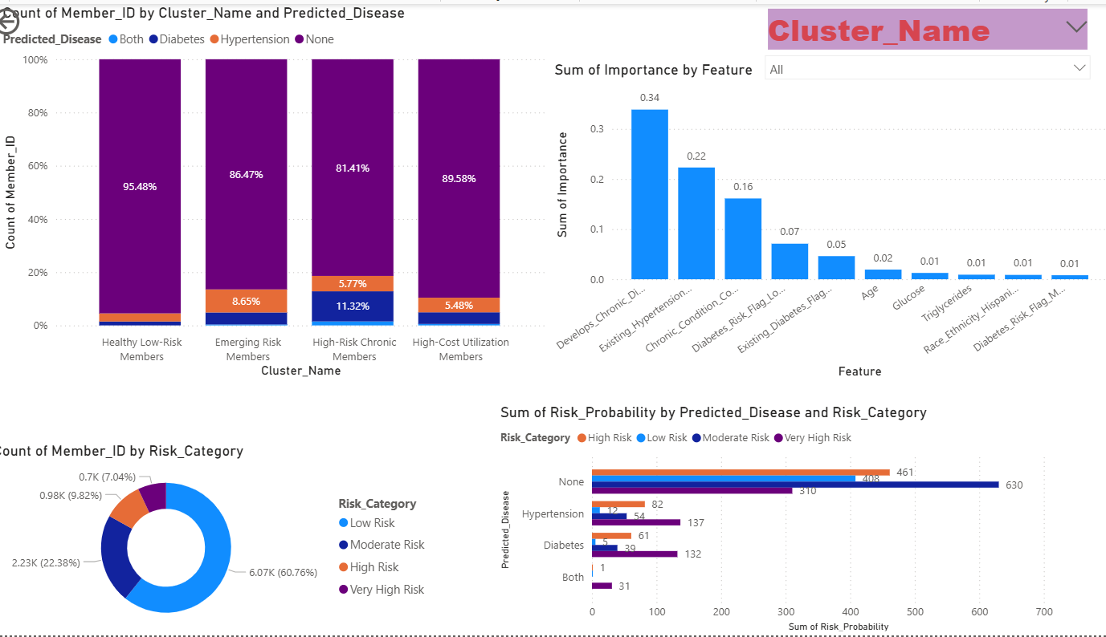
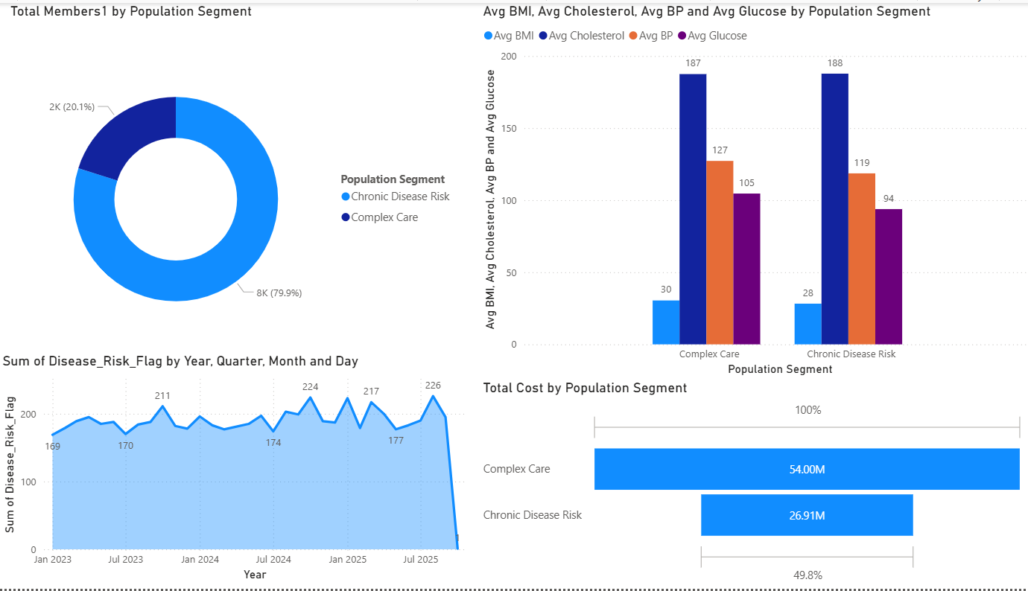
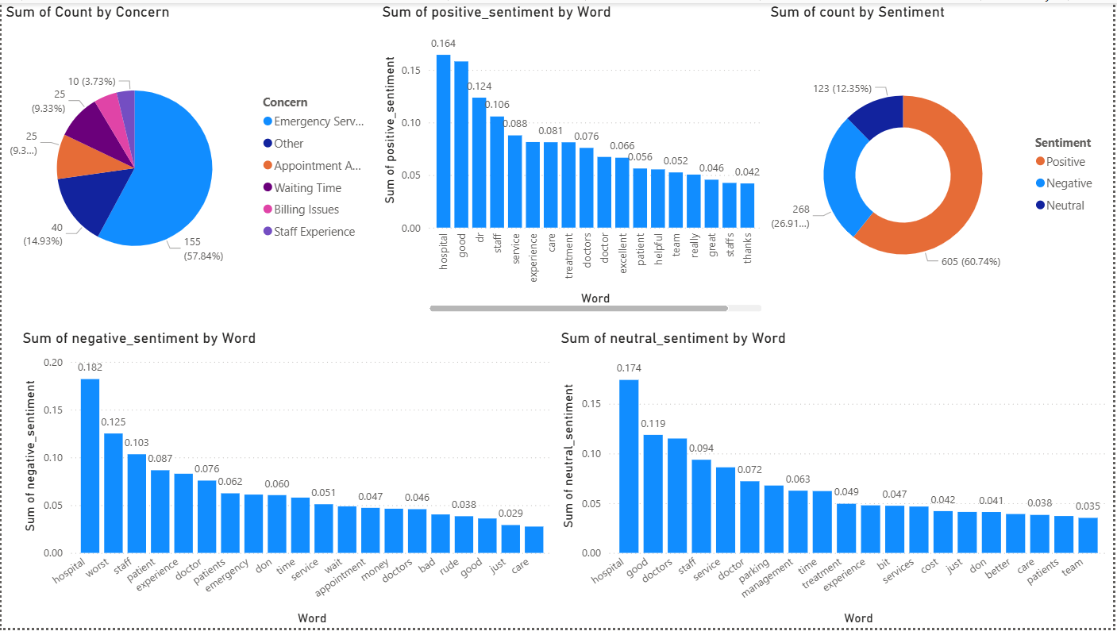
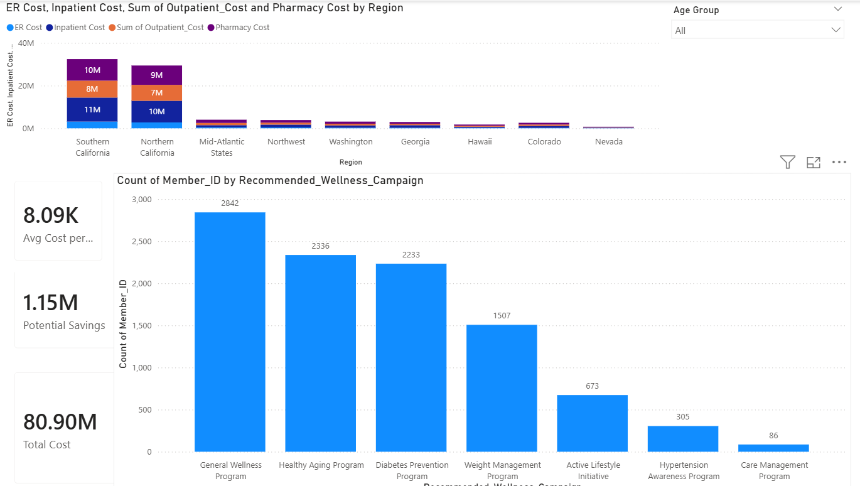
SECTION 12
POWER BI DASHBOARD DEMO
14
Population Overview
Risk Distribution
Disease Prediction
PAGE 1
PAGE 2
PAGE 3
What population are we managing?
Who is at risk?
Why are they at risk?
Dashboard screenshot to be added
Dashboard screenshot to be added
Dashboard screenshot to be added
Population Segments
Feedback Insights
Cost Optimization
PAGE 4
PAGE 5
PAGE 6
Which groups need different interventions?
What are members telling us?
Where should resources be invested?
Dashboard screenshot to be added
Dashboard screenshot to be added
Dashboard screenshot to be added

Slide 18
SECTION 13
RECOMMENDATIONS & BUSINESS IMPACT
15
What interventions should Kaiser Permanente implement today to reduce future chronic disease burden while improving member wellness and controlling healthcare costs?
1
Act on Emerging Risk first
2
Coordinate care for high cost
3
Manage chronic disease
3,940 members (39%). Lifestyle and diabetes-prevention programs before progression.
547 members drive ~42% of spend. Case management and care coordination.
1,404 High-Risk Chronic members: monitoring, medication review, disease management.
4
Fix the member experience
5
Raise program participation
6
Deploy the AI assistant
Faster appointment scheduling, shorter waits, clearer billing.
Target the right campaign per member: diabetes, active lifestyle, healthy aging, hypertension.
Give care managers and members grounded, personalised preventive guidance.
Business impact High-cost members account for roughly $25M of $59M; every 10% reduction there is about $2.5M (illustrative, from segment averages).

Slide 19
Thank You :)
Questions & Discussion

