Slide 1
Retail Sales Analysis
Data Analytics Internship Project
Submitted by: Riya Baliyan | Internship Studio

Slide 2
Project Overview
• Objective: Analyze retail sales data to extract business insights
• Dataset: Online Retail Dataset (UK-based online retailer)
• Tech Stack: Python (pandas, matplotlib, seaborn), SQL (SQLite), Excel
• Output: Data Cleaning, SQL Analysis, Visualizations, Excel Dashboard, Business Insights
• Approach: 4-phase methodology — Collection, Cleaning, Analysis, Reporting

Slide 3
Methodology - 4 Phase Approach
Phase 1 – Data Collection: Downloaded the Online Retail Dataset and established the analytical environment using Python and SQLite.
Phase 2 – Data Cleaning: Removed missing values and duplicate records, converted date fields, and created calculated metrics for analysis.
Phase 3 – Data Analysis: Performed customer, product, country, and sales trend analysis using Python and SQL queries.
Phase 4 – Reporting: Developed visualizations, Excel dashboards, and a PowerPoint presentation containing key business insights.

Slide 4
Dataset Overview
Total Records: 541,909 transactions before cleaning.
Records After Cleaning: 406,829 valid transactions.
Time Period: December 2010 to December 2011.
Unique Customers: 4,338 customers.
Countries Covered: 38 countries.
Products: More than 4,000 unique retail products.
Data Fields: Invoice Number, Product Code, Description, Quantity, Invoice Date, Unit Price, Customer ID, and Country.

Slide 5
Key Performance Indicators
£8.91 Million
38
22,190
Total Revenue
Countries Served
Total Orders
4,338
£401.60
517,645
Total Customers
Avg Order value
Items Sold

Slide 6
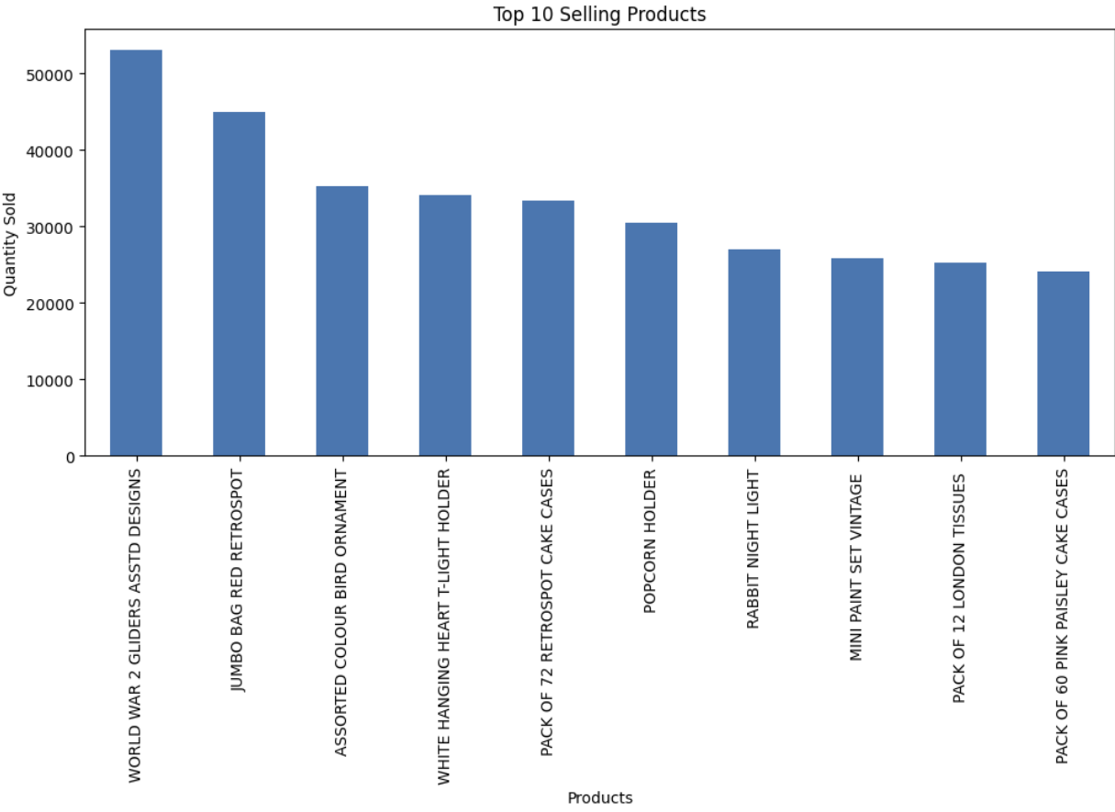
Sub-Category Deep Dive
Top sub-categories drive majority of revenue. Some categories show high sales but lower profit margins.

Slide 7
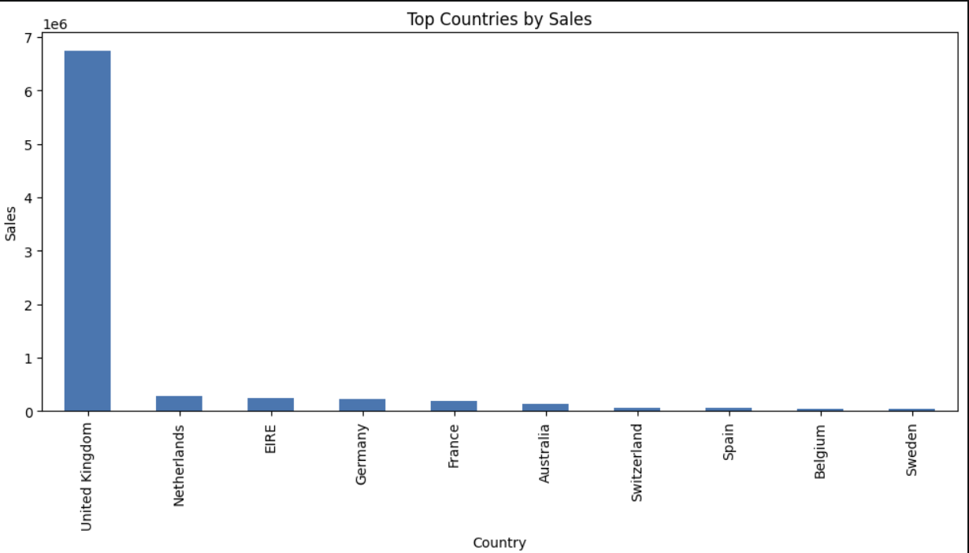
Regional Sales Distribution
Sales are relatively distributed among different countries.

Slide 8
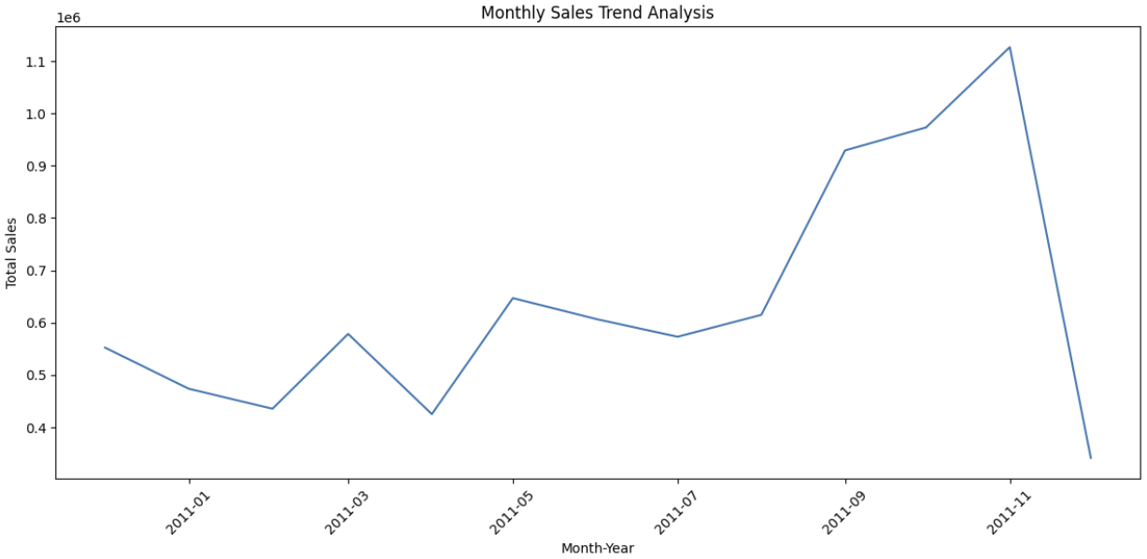
Sales Trends Over Time
Yearly sales were peaked in the year 2011

Slide 9
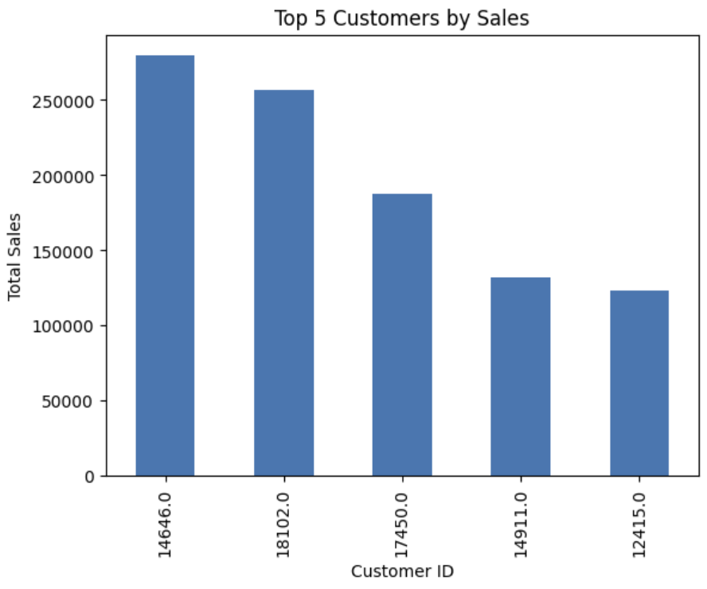
Top Customers & Segments
A relatively small group of customers generates a substantial proportion of total revenue.

Slide 10
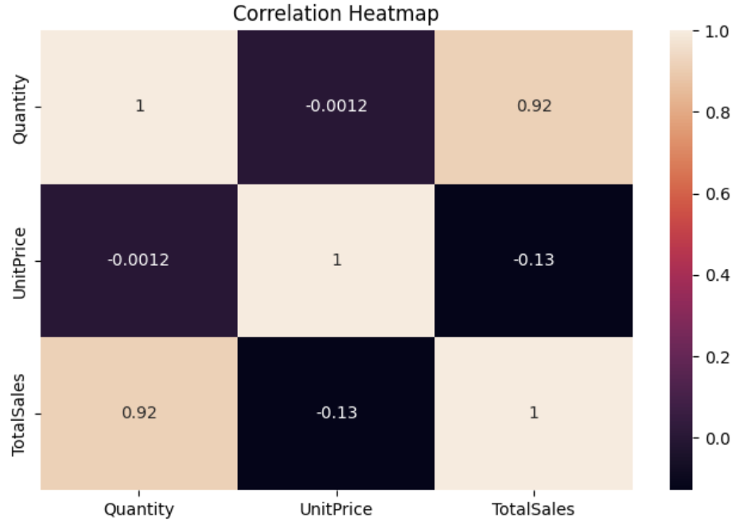
Correlation Analysis
Revenue is strongly influenced by product quantity and unit price.

Slide 11
Key Insights
Revenue exceeded £8.9 million during the analysis period. The United Kingdom emerged as the dominant market while November recorded the highest monthly sales. Top-performing products and loyal customers contributed significantly to overall business success. Seasonal demand patterns were clearly visible throughout the year.

Slide 12
Recommendations
Strengthen customer retention programs for high-value customers and increase marketing efforts around top-performing products. Focus inventory planning on periods of high seasonal demand and expand promotional activities within strong international markets such as Germany, France, and the Netherlands.

Slide 13
Conclusion
Successfully analyzed more than 541,000 retail transactions using a structured analytical approach. The project demonstrates practical application of Python, SQL, Excel, and data visualization techniques to generate actionable business insights and support data-driven decision making.

Slide 14
Thank You!

