Slide 1
Riya Bhimani
Presented By
Email : riyabhimani.me@gmail.com

Slide 2
Project-1 : Calculator Built In Java
Abstract :
This project presents the development of a simple, user-friendly Calculator application built using Java. The calculator is designed to perform basic arithmetic operations, including addition, subtraction, multiplication, and division, with an intuitive graphical user interface (GUI) created using Swing. The objective of the project is to provide users with a functional calculator that emulates the behavior of a standard physical calculator, allowing for real-time calculation inputs and results display.

Slide 3
Project-1 : Calculator Built In Java
Objective:
The objective of this project is to develop a fully functional calculator application using Java, providing basic arithmetic functionalities such as addition, subtraction, multiplication, and division. The calculator will be designed with a simple graphical user interface (GUI) for ease of use, utilizing Java's Swing or JavaFX libraries. The application aims to offer accurate calculations, support for decimal numbers, and handle invalid inputs gracefully. Future iterations may include advanced features like scientific functions, memory storage, and history tracking.

Slide 4
Project-1 : Calculator Built In Java
Introduction:
Calculators are essential tools for performing mathematical operations, ranging from simple arithmetic to complex equations. This project aims to create a basic calculator application that allows users to execute simple calculations easily. Java, a widely-used programming language, is chosen for this project due to its platform independence and robust libraries for GUI development. The application will focus on providing a smooth user experience while ensuring that all calculations are accurate and efficient

Slide 5
Project-1 : Calculator Built In Java
Methodology:
Requirements Gathering: Identify the core features and functionality of the calculator.
Design: Create a user-friendly interface using Java Swing components (buttons, text fields, etc.).
Implementation:
1)Create a main class to handle the application logic.
2)Implement methods for each arithmetic operation.
3)Use event listeners to capture user input and trigger calculations.
Testing: Conduct thorough testing to ensure all operations perform correctly and handle edge cases (e.g., division by zero).
Documentation: Provide clear comments in the code and create a user guide

Slide 6
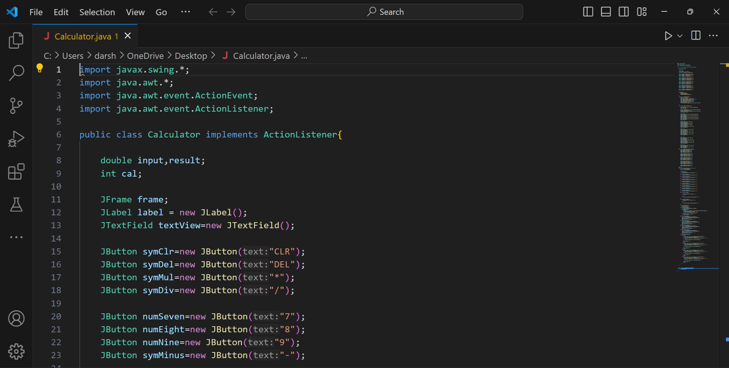
Project-1 : Calculator Built In Java

Slide 7
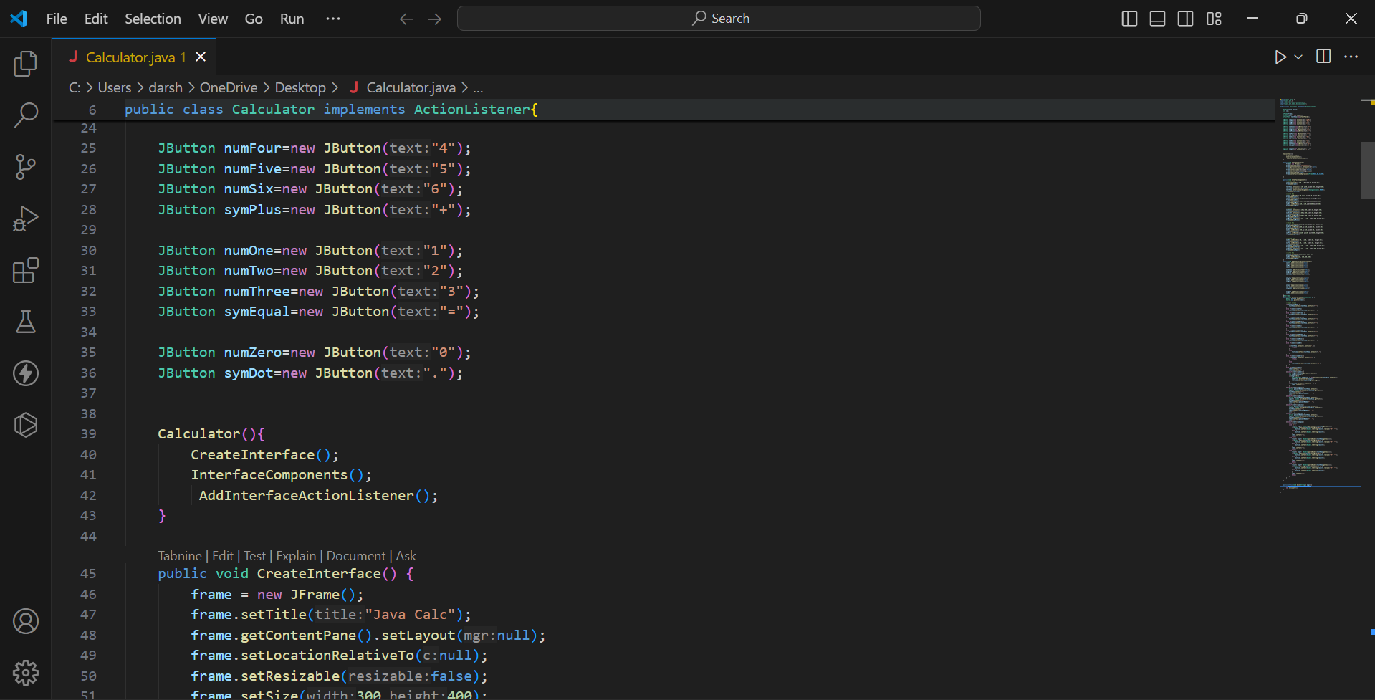
Project-1 : Calculator Built In Java

Slide 8
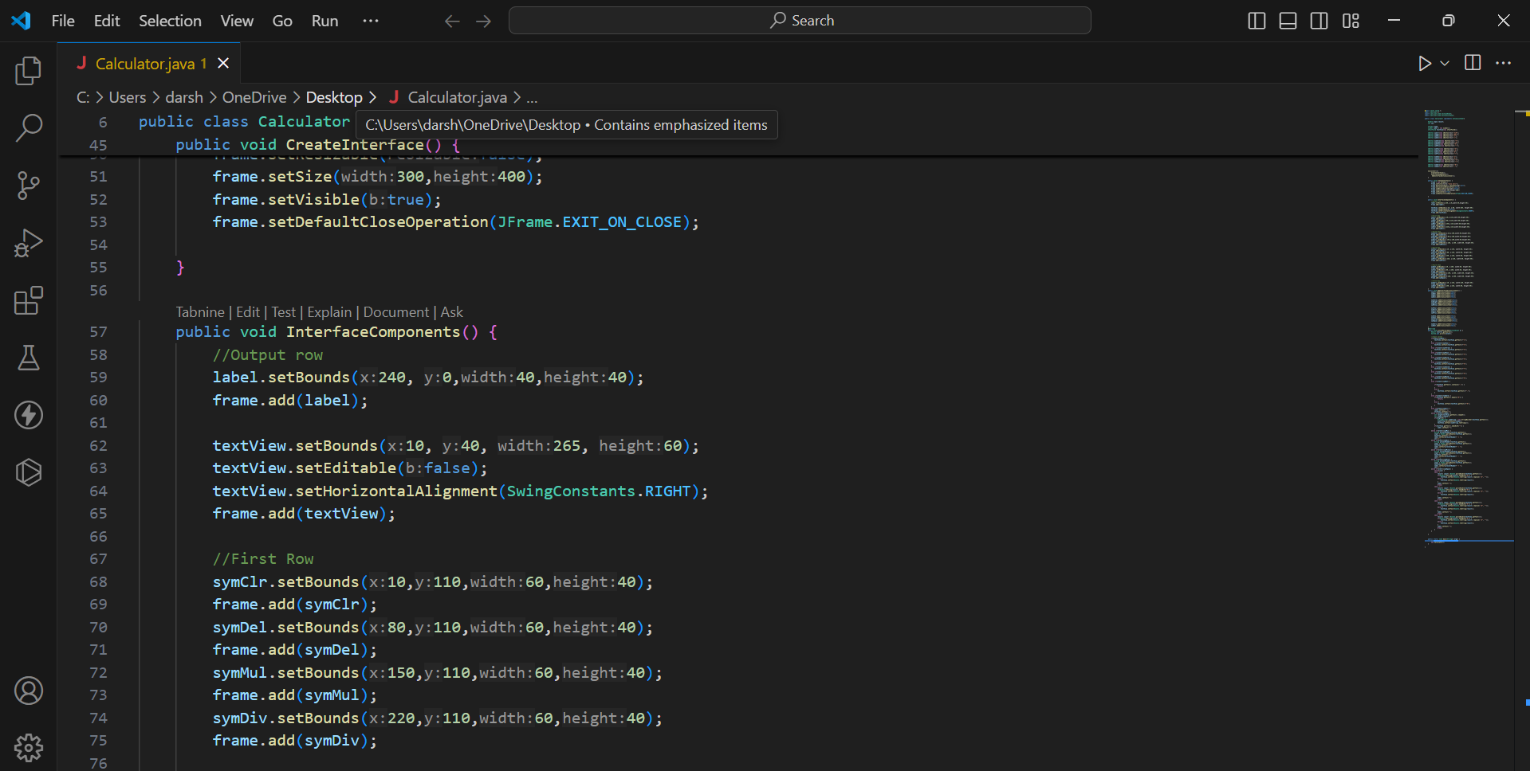
Project-1 : Calculator Built In Java

Slide 9
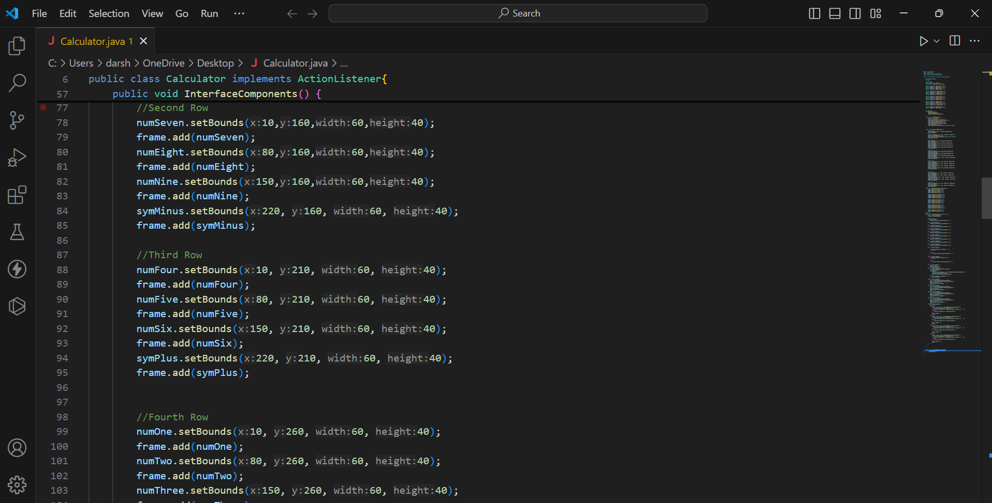
Project-1 : Calculator Built In Java

Slide 10
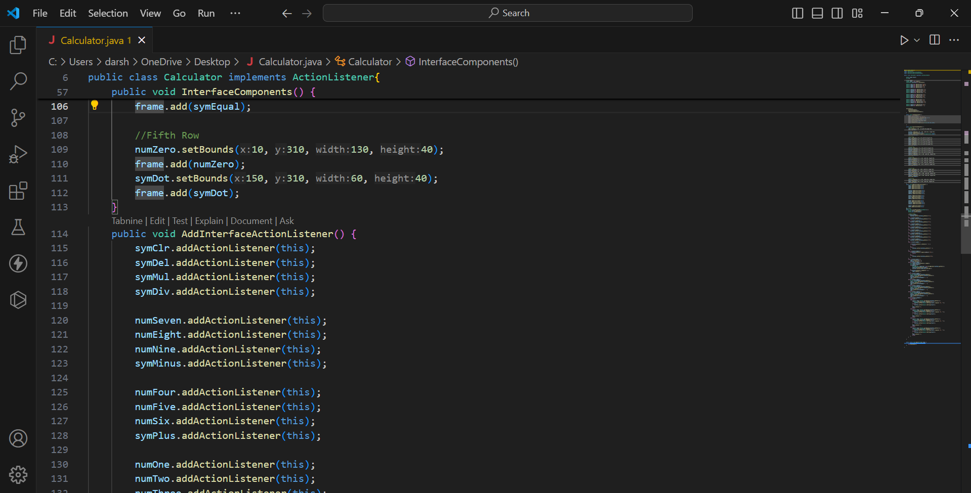
Project-1 : Calculator Built In Java

Slide 11
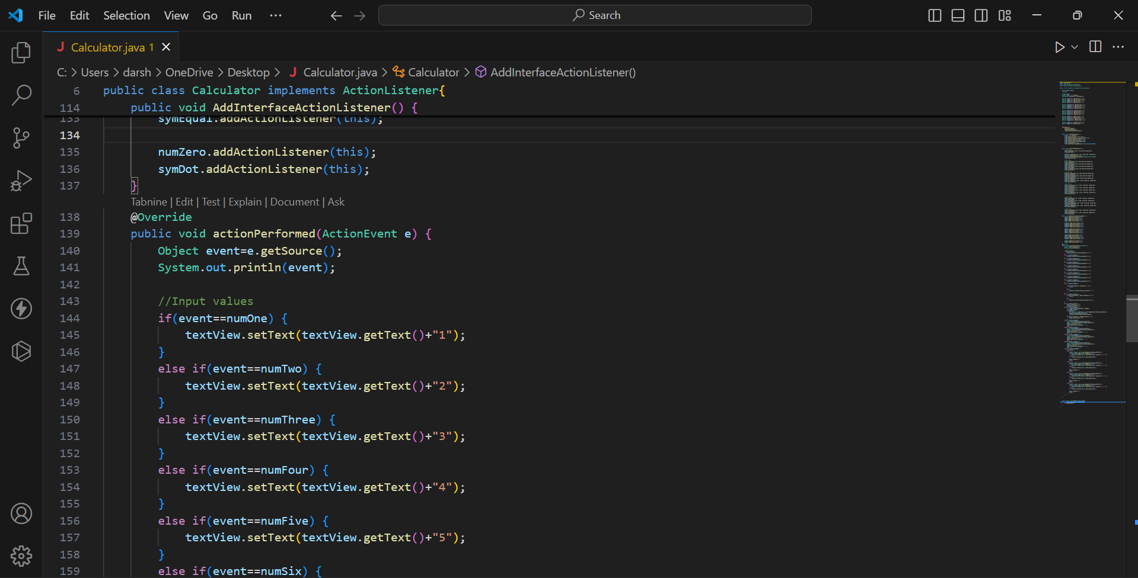
Project-1 : Calculator Built In Java

Slide 12
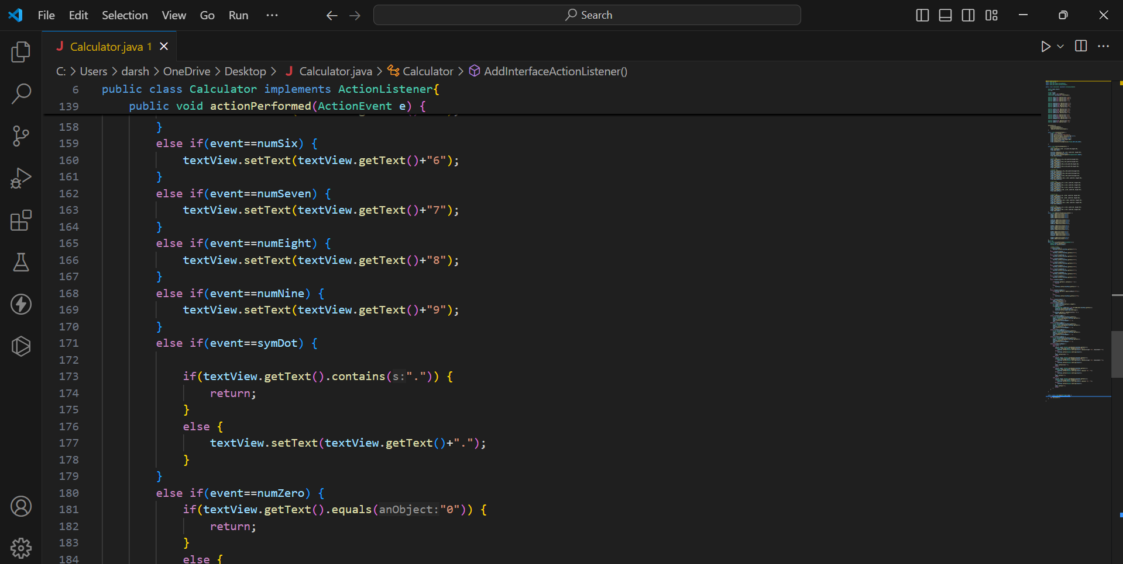
Project-1 : Calculator Built In Java

Slide 13
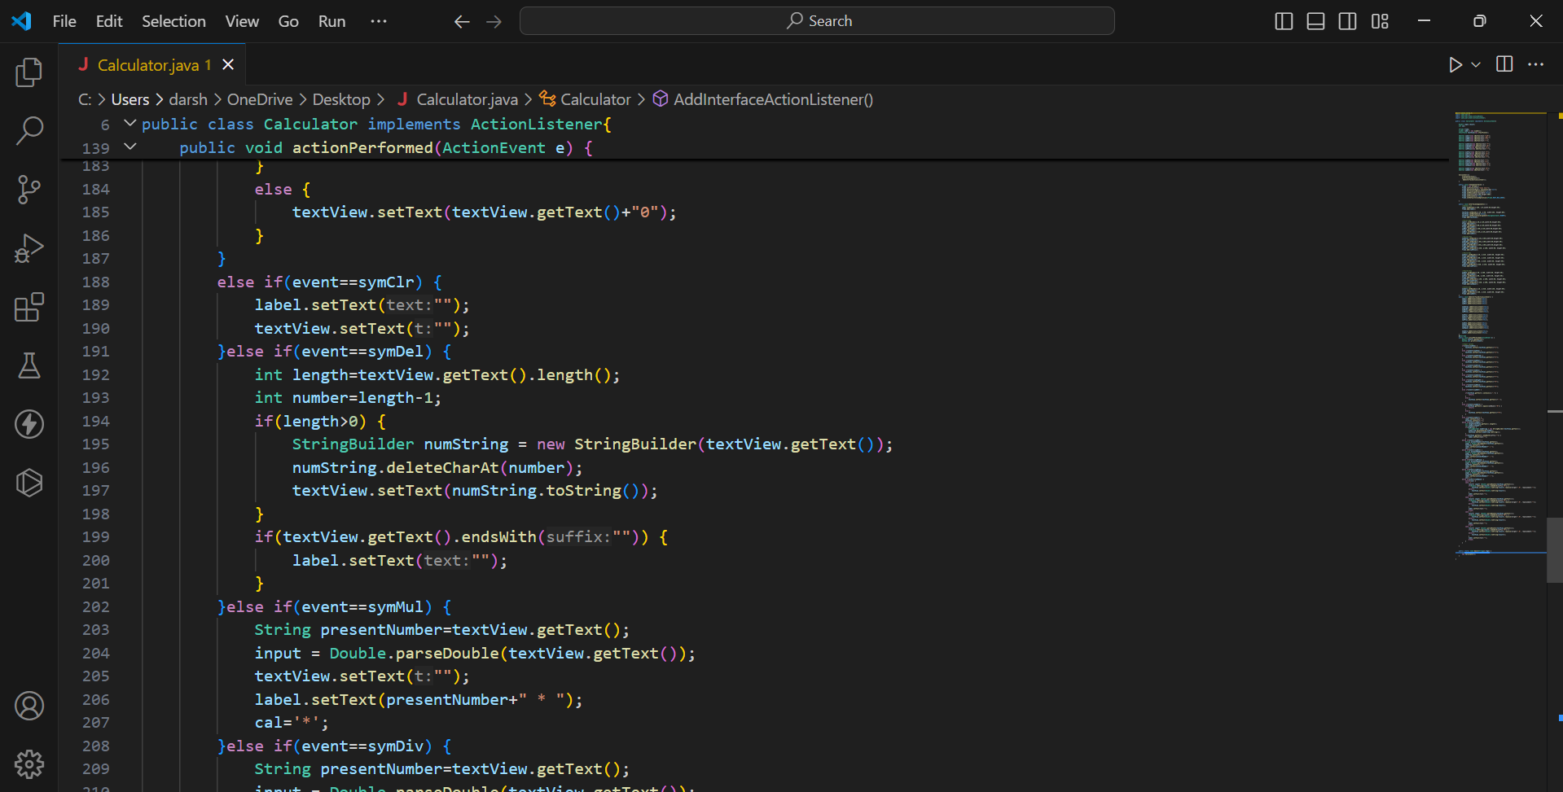
Project-1 : Calculator Built In Java

Slide 14
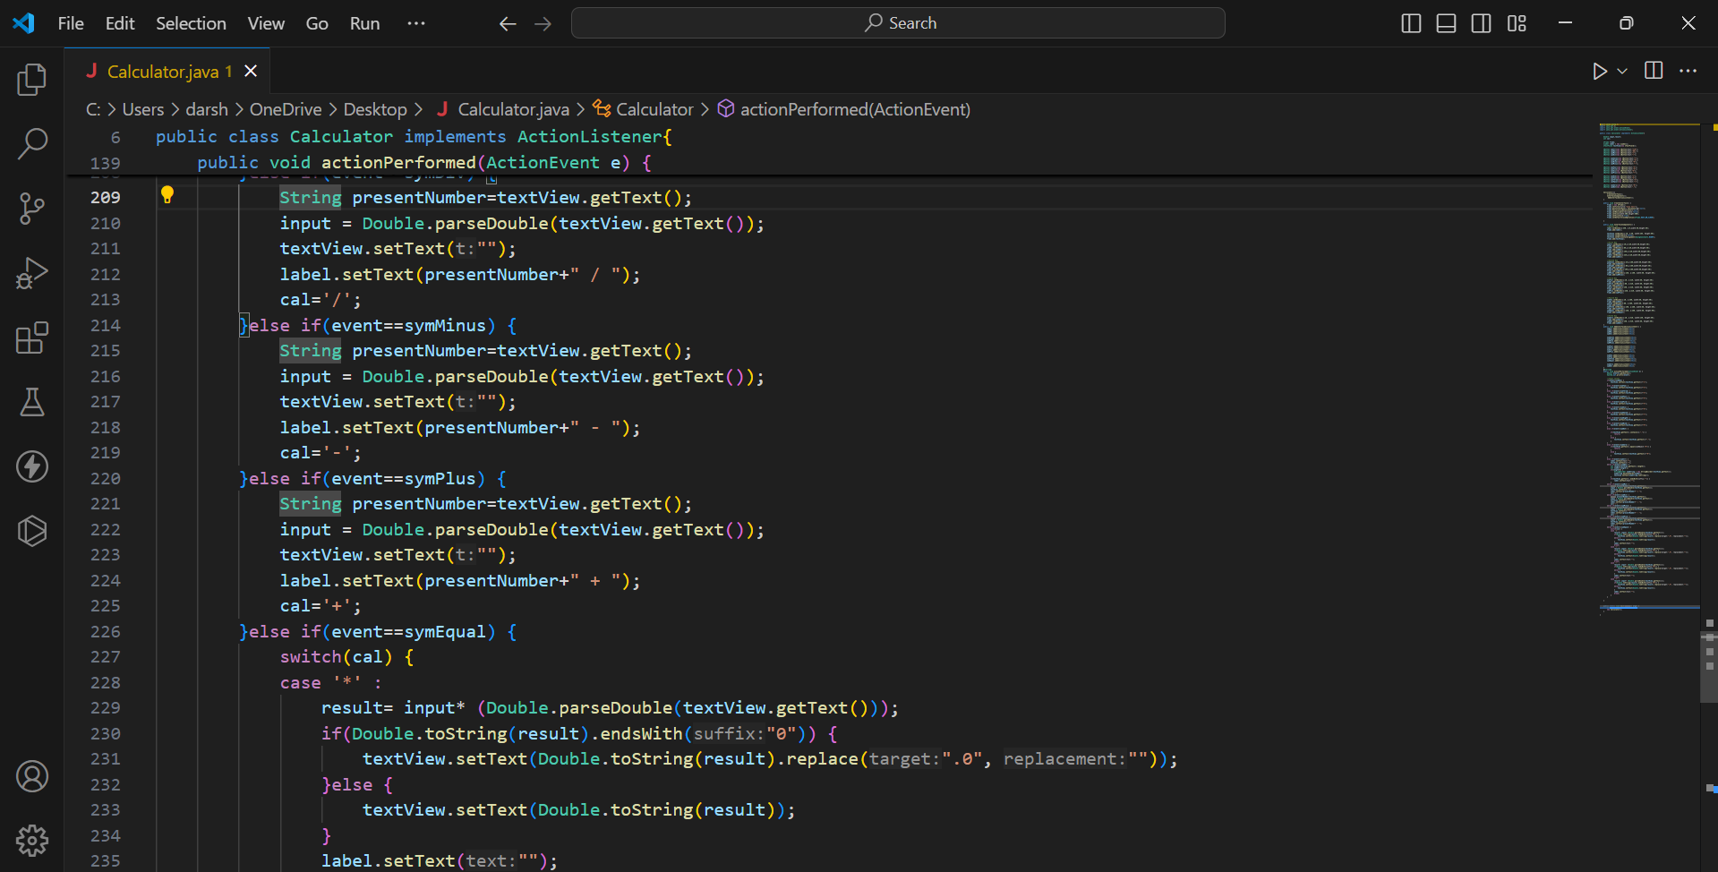
Project-1 : Calculator Built In Java

Slide 15
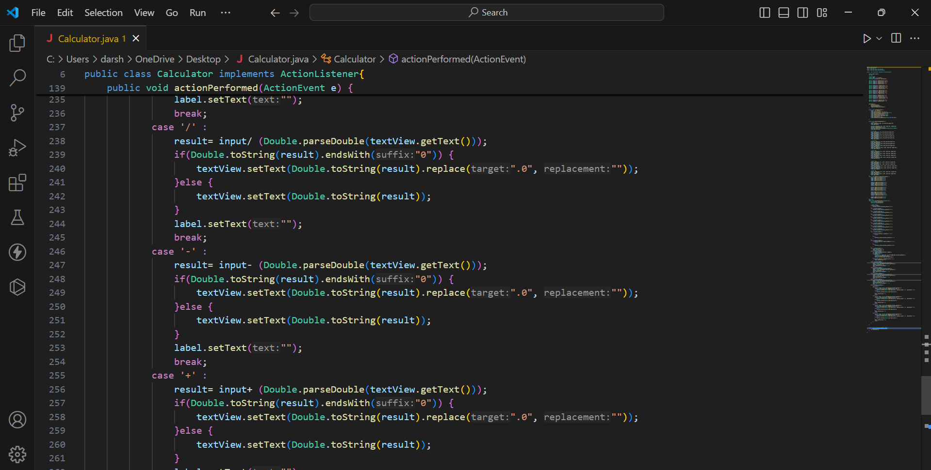
Project-1 : Calculator Built In Java

Slide 16
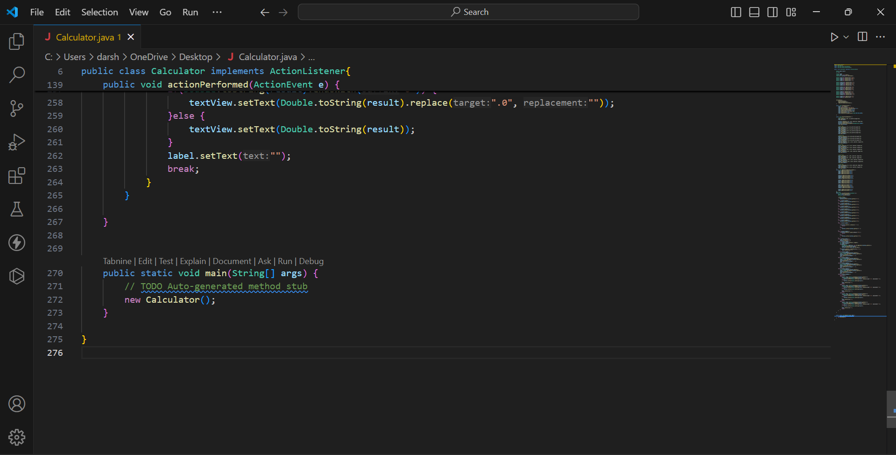
Project-1 : Calculator Built In Java

Slide 17
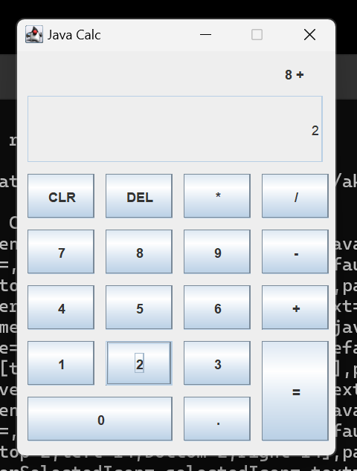
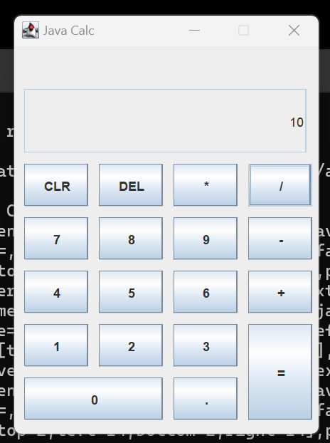
Project-1 : Calculator Built In Java

Slide 18
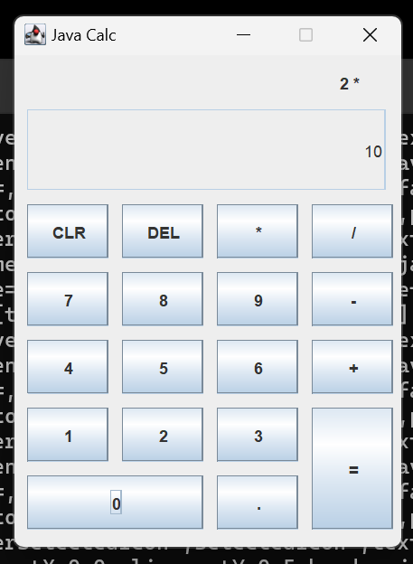
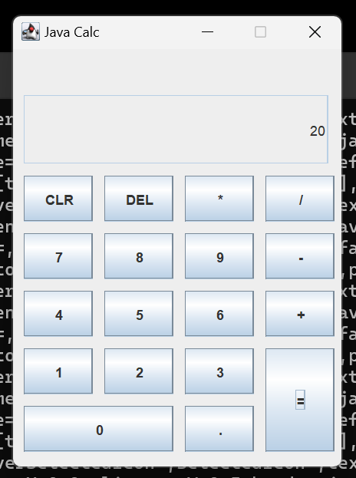
Project-1 : Calculator Built In Java

Slide 19
Project-1 : Calculator Built In Java
Conclusion:
The development of the Calculator application in Java demonstrates a successful implementation of a basic arithmetic tool with a user-friendly graphical user interface (GUI). The project effectively integrates Java's Swing library for front-end design and follows object-oriented programming (OOP) principles for backend logic, making the application modular and easy to maintain. The calculator performs fundamental arithmetic operations accurately, while handling potential errors such as division by zero gracefully.

