Slide 1

LAB-9
Wireshark
Computer Networks (CN)
DU #2301CS501
Prof. Maulik D Trivedi
Computer Engineering
maulik.trivedi@darshan.ac.in
+91-9998265805
Disclaimer: The images used in this presentation are sourced solely for educational and nonprofit purposes. The author of this presentation asserts no ownership or copyright claims over them."

Slide 2
What is Wireshark?
Wireshark is a free and open-source network protocol analyzer used to capture and inspect network packets travelling across a network. It helps students understand how data is transmitted between devices and is widely used for troubleshooting, protocol analysis, and cybersecurity.
Supports real-time packet capture and offline analysis of saved capture files (.pcap / .pcapng).
Provides a graphical interface to monitor and analyse network communication between devices.

Slide 3
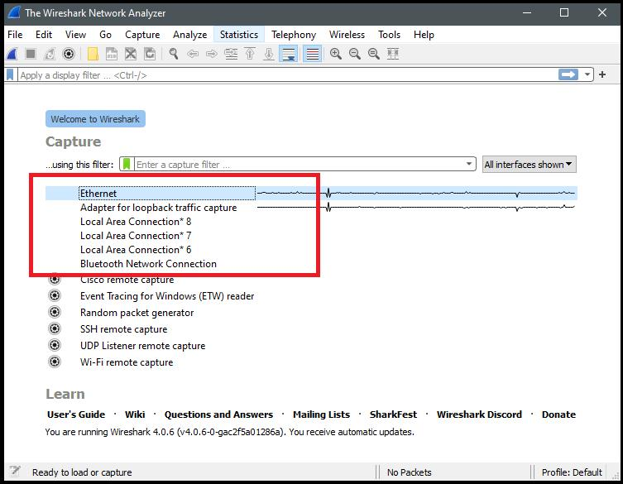
Starting Packet Capture

Slide 4
Starting Packet Capture
Steps
Open Wireshark.
Select the active network interface (Ethernet or Wi-Fi).
Click the Start Capturing Packets button.
Generate network traffic by browsing a website or using the ping command.
Click the Stop button to finish the capture.
Example:
  ping google.com
This generates ICMP packets that can be analysed in Wireshark.

Slide 5
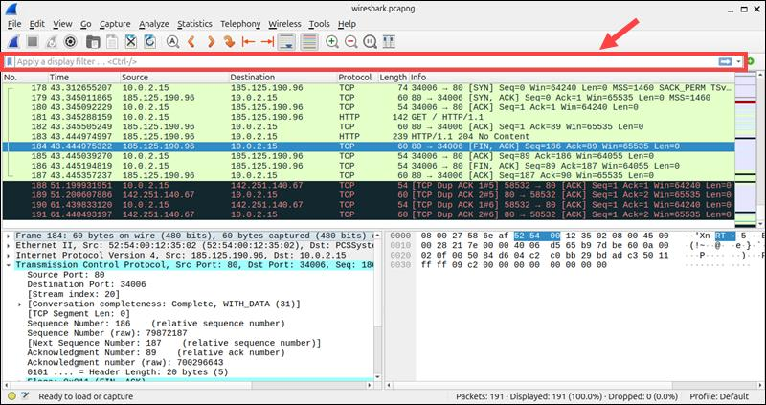
Display Filter Syntax

Slide 6
Display Filter Syntax
Common Display Filters
  http
  tcp
  udp
IP Address Filters
  ip.addr == 192.168.1.10
  ip.src == 192.168.1.10
  ip.dst == 192.168.1.20
Port Filters
  tcp.port == 80
  tcp.port == 443
  udp.port == 53

Slide 7
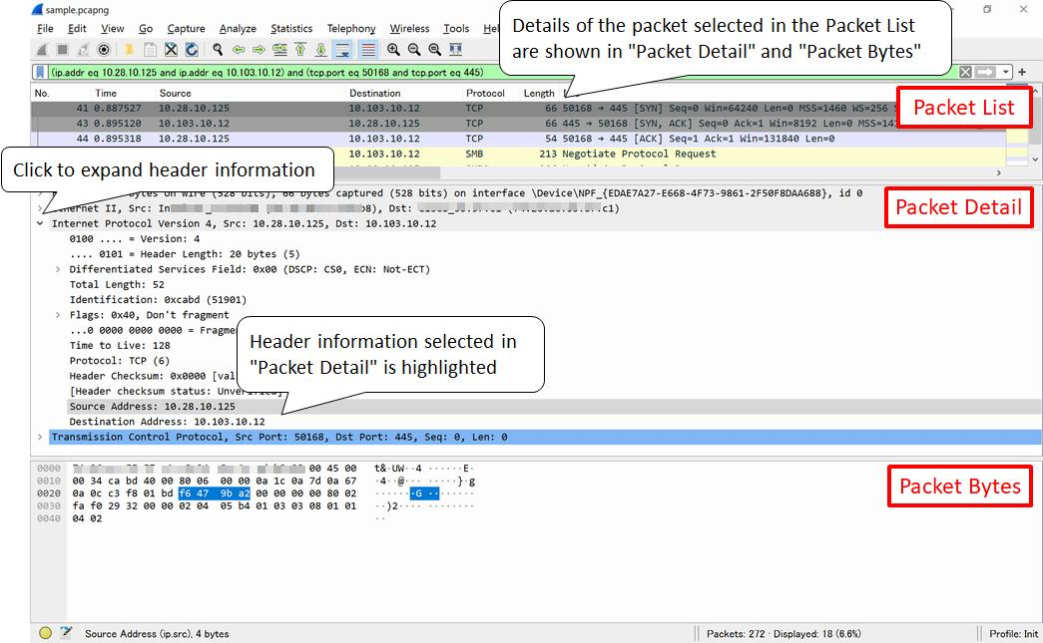
Advanced Filtering

Slide 8
Advanced Filtering
TCP Filters
  tcp.flags.syn == 1
  tcp.flags.ack == 1
  tcp.analysis.retransmission
DNS Filters
  dns
  dns.qry.name
  dns.flags.response == 1
Combining Filters
  tcp && ip.addr == 192.168.1.15
  dns && ip.src == 192.168.1.5

Slide 9
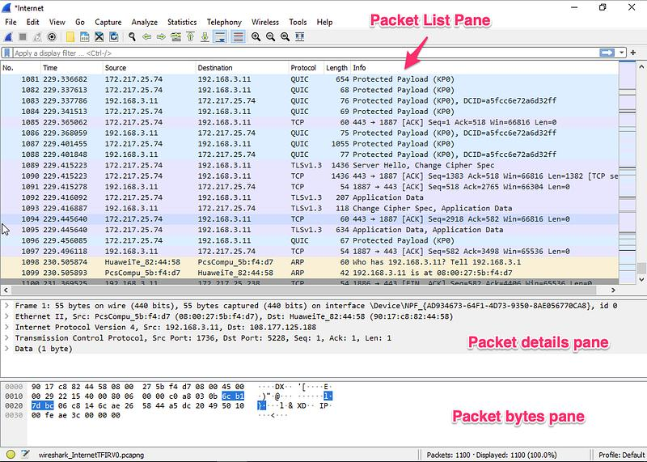
Packet Analysis

Slide 10
Packet Analysis
Information Available in Every Packet
  Frame Number
  Time Stamp
  Source IP Address
  Destination IP Address
  Protocol
  Packet Length
  Packet Details
  Packet Bytes (Hex View)
Example:
  Source IP : 192.168.1.10
  Destination IP : 142.250.183.78
  Protocol : TCP
  Destination Port: 443

Slide 11
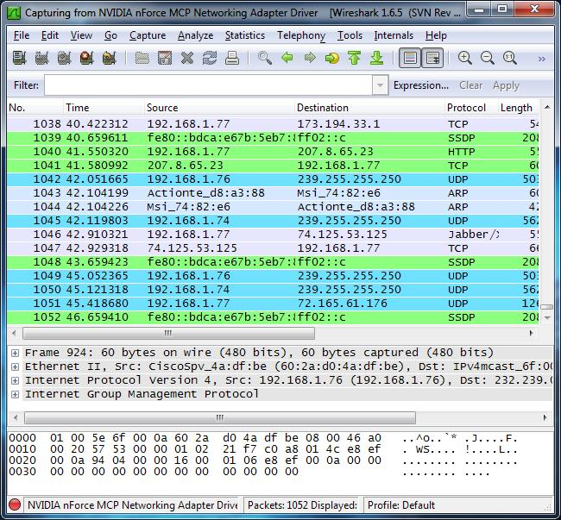
What Do Packet Colours Mean in Wireshark?

Slide 12
What Do Packet Colours Mean in Wireshark?
Wireshark uses different colours to make it easier to identify network protocols and potential issues at a glance. The colours are based on predefined colouring rules and can be customised.
Colour | Meaning
Green | TCP traffic (normal TCP packets)
Light Blue | DNS queries and responses
Black | Bad TCP packets or errors (retransmissions, checksum issues, etc.)
Purple | UDP traffic
Yellow | HTTP or web-related traffic (depending on colouring rules)
White | Packets that do not match any colouring rule

Slide 13
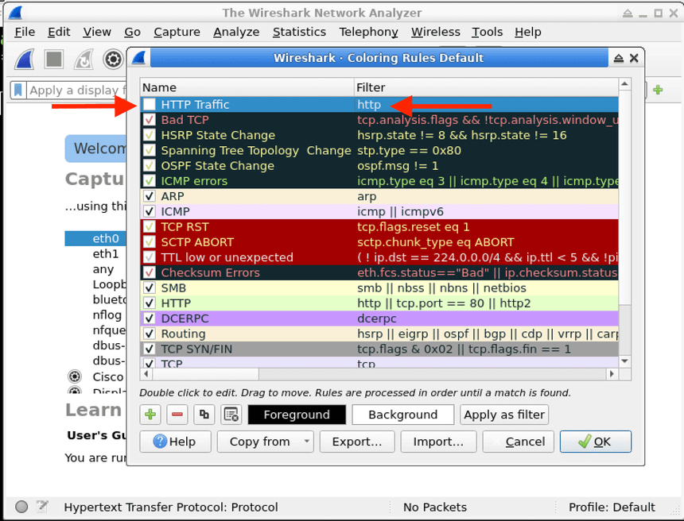
What Do Packet Colours Mean in Wireshark?

Slide 14
Thank you

