Slide 1

AMERICARN INTERNATIONAL UNIVERSITY-BANGLADESH
Course Name: SOFTWARE ENGINEERING
Course Teacher: DR.MD.RAZIB HAYAT KHAN

Slide 2
Web Based Reservation System
Group Member
Riyad,MD.Jahidul Islam [19-41121-2]
Anjum,Md.Tasnim [19-41136-2]
Abdullah Al Alid [19-40096-1]

Slide 3
Idea Generate
We students sometimes face problems for reserving slot for indoor games, outdoor game and muktomoncho. Also, Faculty members generally face problems when they need to book class room for extra class. After that, If we students need to apply for fund so that we can work on interesting project, the process of applying is not so easy. Next, if someone accidentally lost his/her id card, The process of retrieve new id card is quite difficult. Again, if there is not available important books in library the process of applying for bringing new books in library is also hard. That’s why we are working on it by developing a web base system.

Slide 4
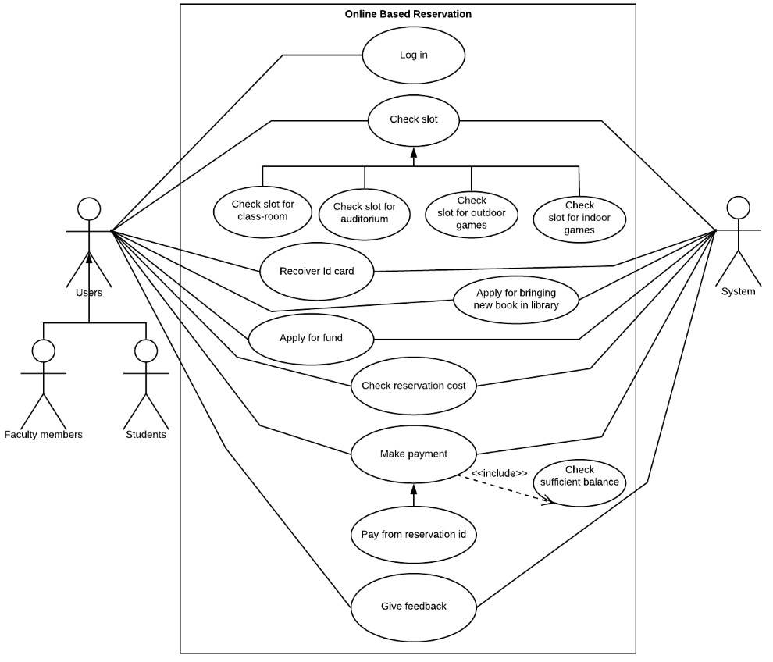
Uml Use Case Diagram

Slide 5
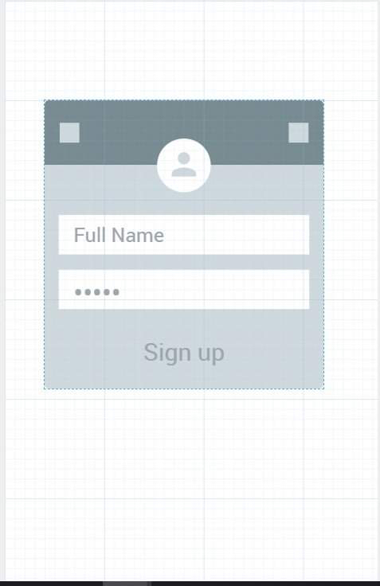
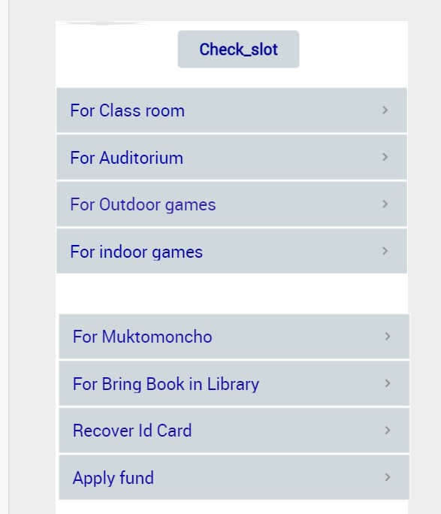
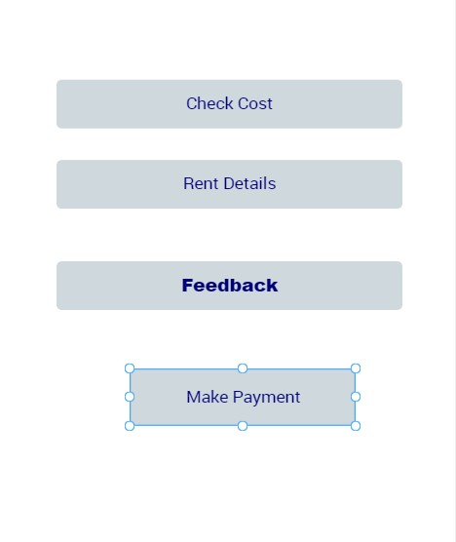
Mock Design

Slide 6
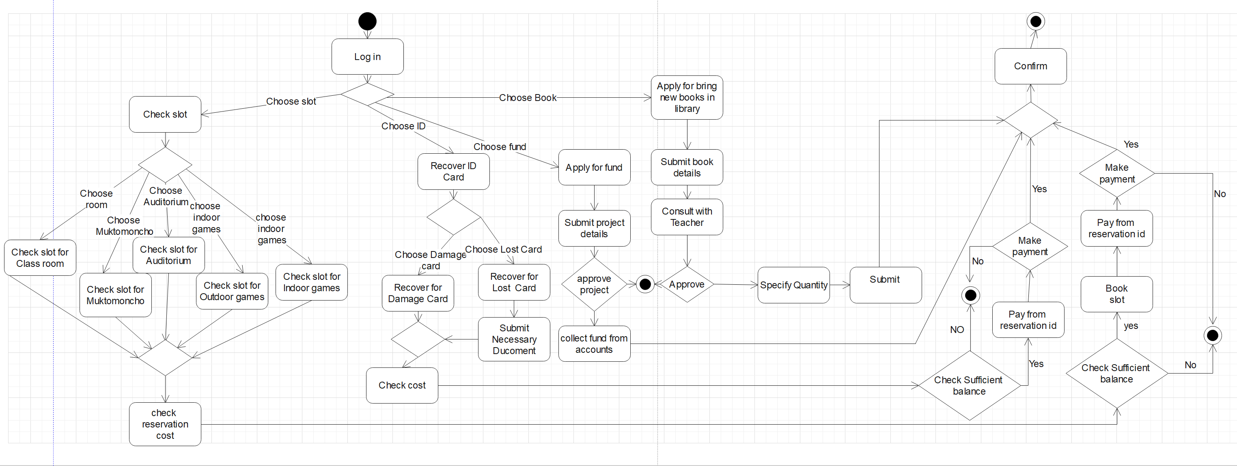
Activity Diagram

Slide 7
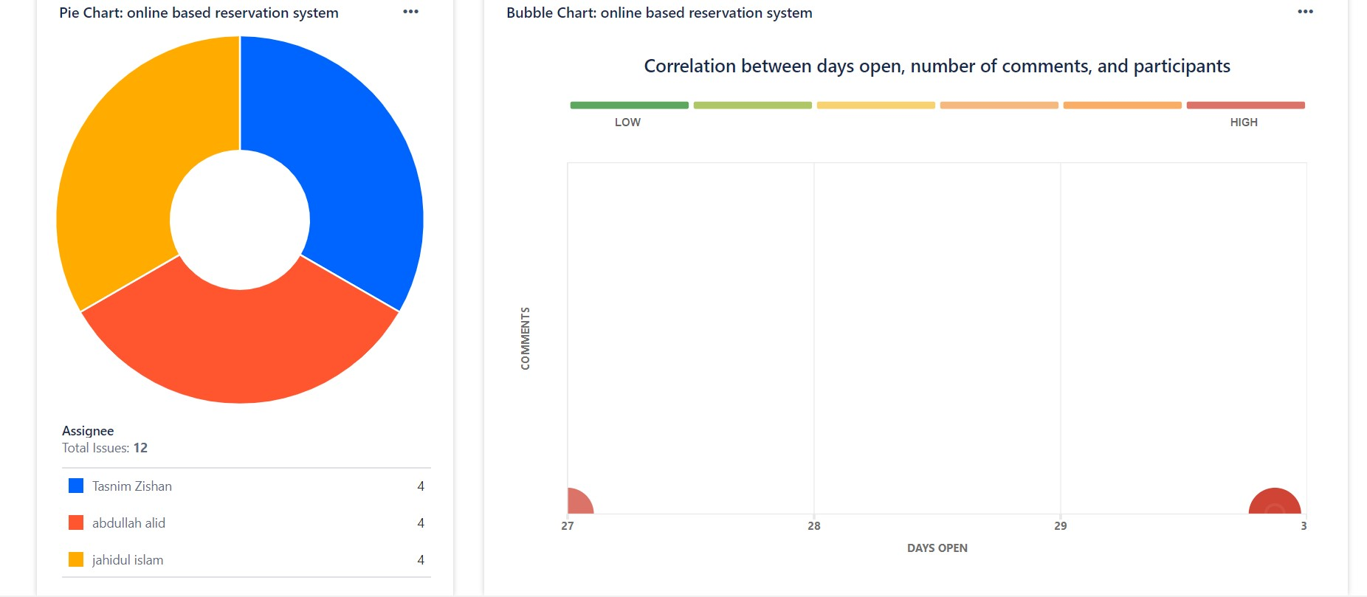
Jira

Slide 8
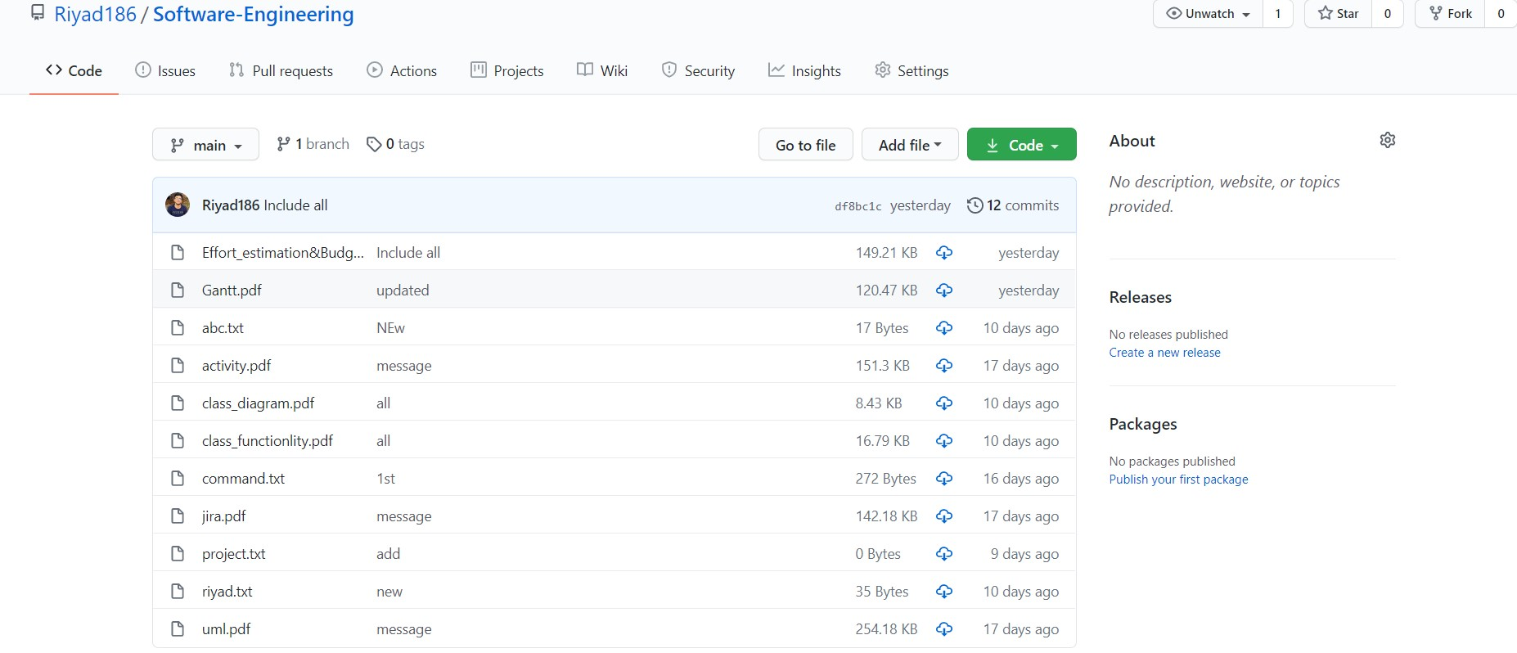
Git

Slide 9
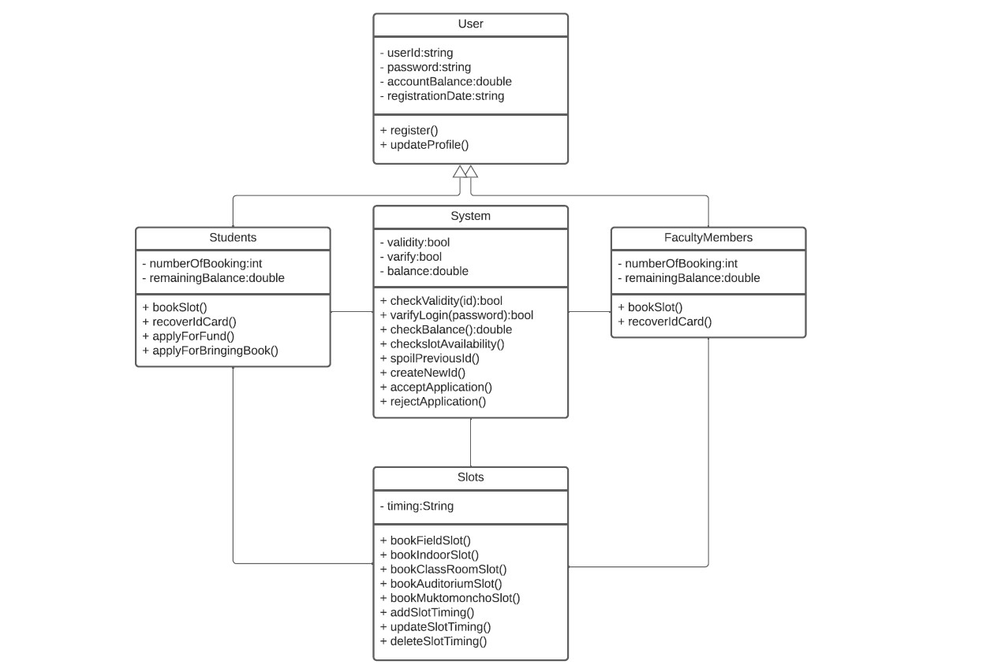
Class Diagram

Slide 10
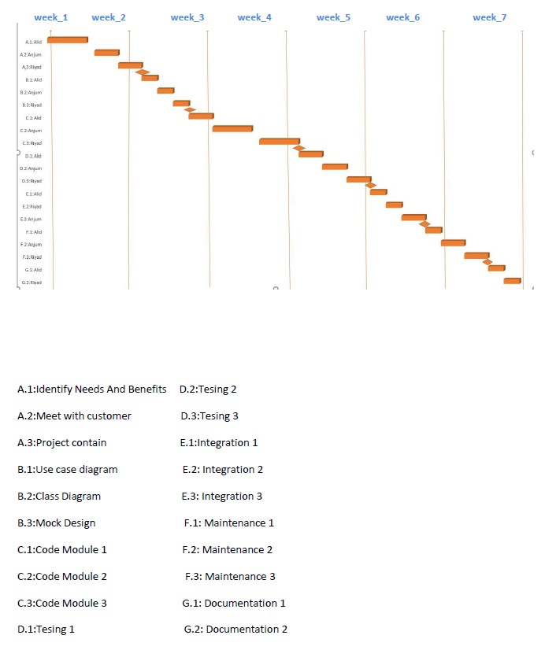
Gantt Chart

Slide 11
Effort Estimation &Budgeting
Effort = PM = Coefficient*(SLOC/1000)^P
=2.4(15000/1000)^1.05
=41
Development time = DM = 2.50*(PM)^T
=2.50*(41)^.38
=10
Required number of people = ST = PM/DM
=41/10
=4
Designing & Coding=> 10*22*8 [10 month,22 days , 8h]
=1760 h
Total sal(dev)= 1760*1100 [1h salary =1100tk]
=1936000 tk [4 dev salary] (1 dev sal=484000)
Per month salary=(484000/10)
=48400 tk(1 dev)
Requirement Analysis 15*8*600 [15 days, 600 per h sal]
=72000 tk

Slide 12
Maintenance
2*4*6*2500 [per week 2h, 6mon]
=120000 tk
Travel Expense
10*5000
=50000 tk
Office Rent
20000*10=200000 [per month 20000]
Utilities Expenses
3500*10=35000
Training/Hardware
3000*10
=30000
Cost=1936000+72000+120000+50000+200000+35000+3000
=2416000 tk
Profit margin= 241600*15%
=362400 tk
Pay bill (client)= 2778400 tk

Slide 13
Thank you

