Slide 1
MY DAY
Shahriar Hasan Anik (170042002)
Riyad-E-Al Muhafiz (170042036)
Shadid Intisar Quasem (170042059)
1

Slide 2
OVERVIEW
In our daily life we use many applications:
-Weather
-RSS Feeder
-To-do lists
But need separate apps
How about a one single app for your daily needs?

Slide 3
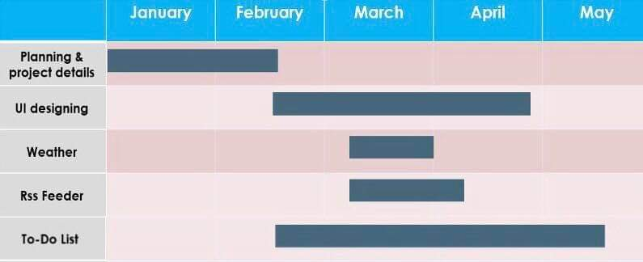
Project Timeline

Slide 4
Completed Works
Weather Update
RSS Feeder

Slide 5
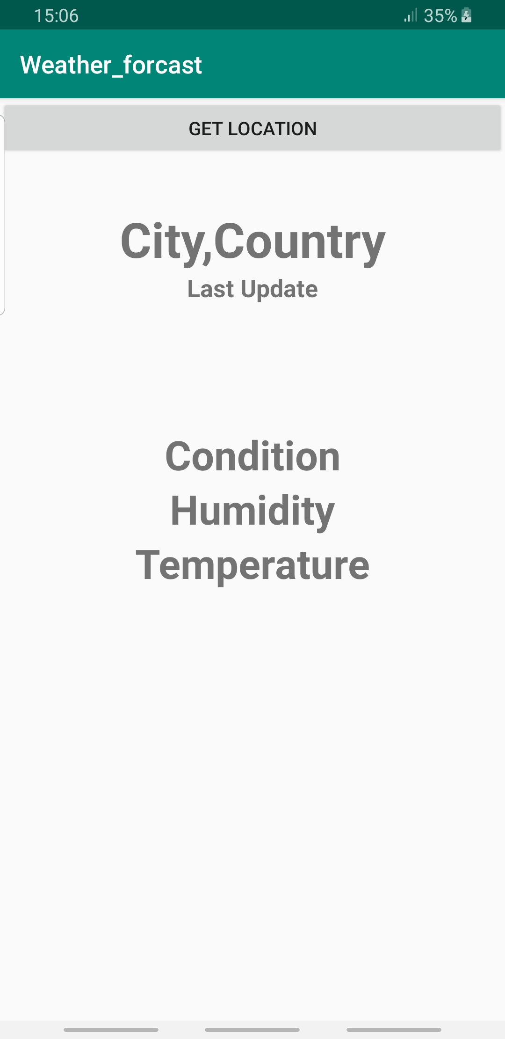
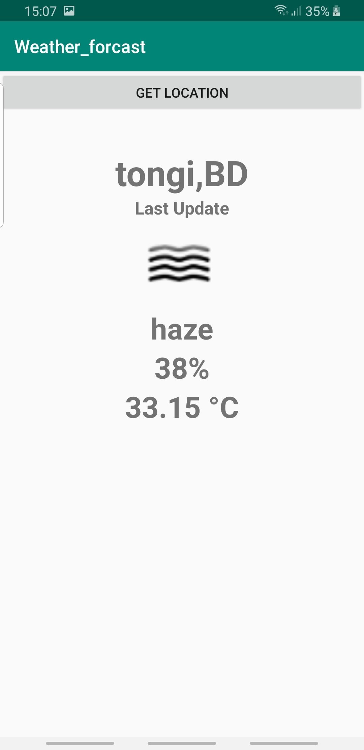
Weather Update

Slide 6
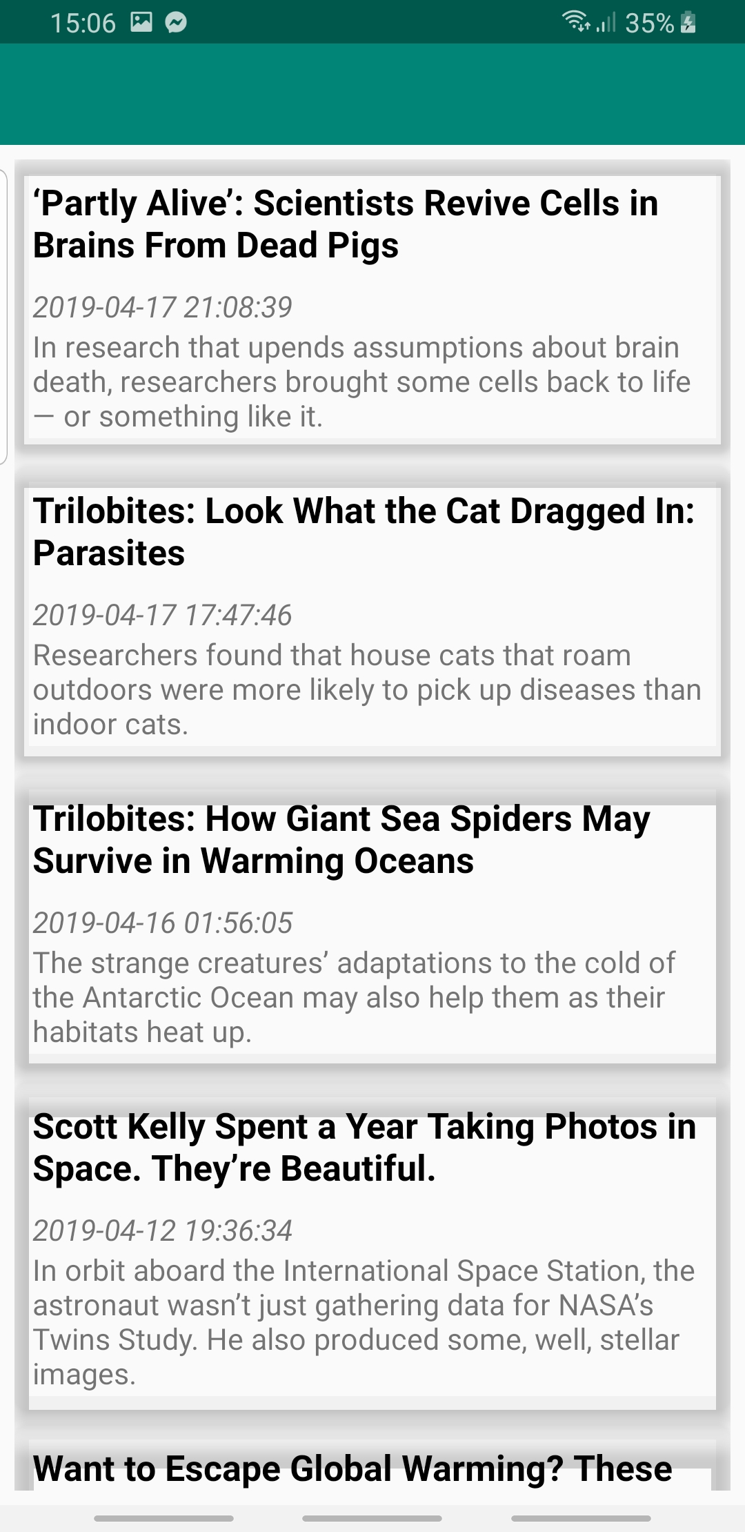
RSS Feeder

Slide 7
Remaining Works
Completing UI
Forming To-Do List

Slide 8
Thank You

