Slide 1

PATHOK PRANTOR: A Bangla Book Recommendation System
CSE 3200: System Development Project
09 August 2025
Supervised By
Md Mehrab Hossain Opi
Lecturer
Department of Computer Science and Engineering
Khulna University of Engineering & Technology, KUET
Robiul Islam Riyadh
Roll: 2007008
Md. Umar Faruk
Roll: 2007016

Slide 2
Contents
Introduction
Related works
Objectives
System Architecture
Methodology
Conclusions
References

Slide 3
Introduction
Pathok Prantor is an AI-driven social platform where book lovers connect, share reviews.
It combines collaborative filtering and content-based methods to enhance recommendation accuracy.
The system also offers user profile management, social interactions, and an intelligent chatbot for personalized recommendations [5].

Slide 4
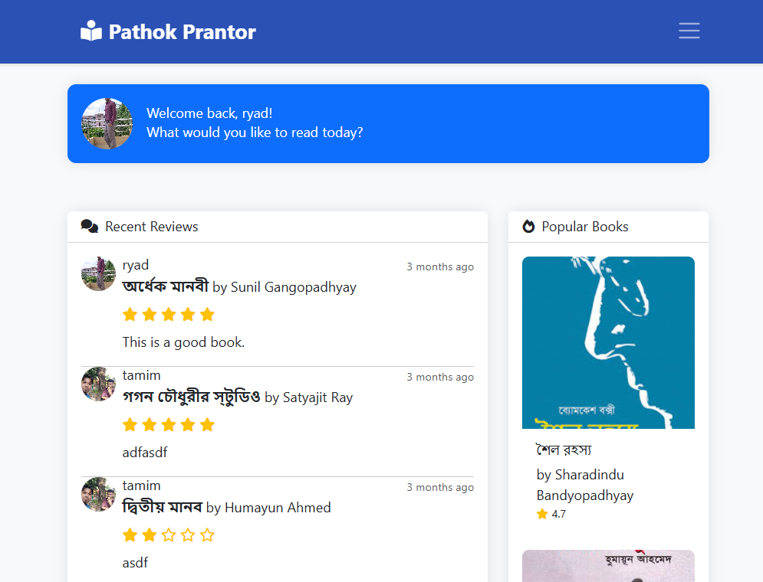
Introduction
Offers trending books, author follows, and reading progress tracking.
Figure 1: Welcome page

Slide 5
Related Works
Goodreads: Social reading platform with basic book recommendations and user reviews.
Difference with the existing solutions:
Bengali Literature Focus
Chatbot Integration

Slide 6
Objectives
Develop a Bengali-Friendly Interactive Web Platform.
Deliver Personalized Book Suggestions
Implement Hybrid Filtering Techniques
Integrate AI-Powered, Explainable Chatbot

Slide 7
System Architecture
Admin Dashboard
Manage Books
Add Books
Edit Books
Delete Books
Manage Authors
Add Authors
Edit Authors Bio
Delete Authors
Manage Users
Ban Users
Unban Users
Data Flow Diagram: (Admin)
Figure 2: Admin flow diagram

Slide 8
System Architecture
Auth user
Data Flow Diagram: (User)
Author Profile
Follow Author
Discover
Book Profile
Rating & Review
Chatbot
Auth user
Registered
yes
Home
Login
Auth user
User Personal Profile
no
Personal Profile
Guest user
Registration
User Reading Status
Update Status
Figure 3: User flow diagram

Slide 9
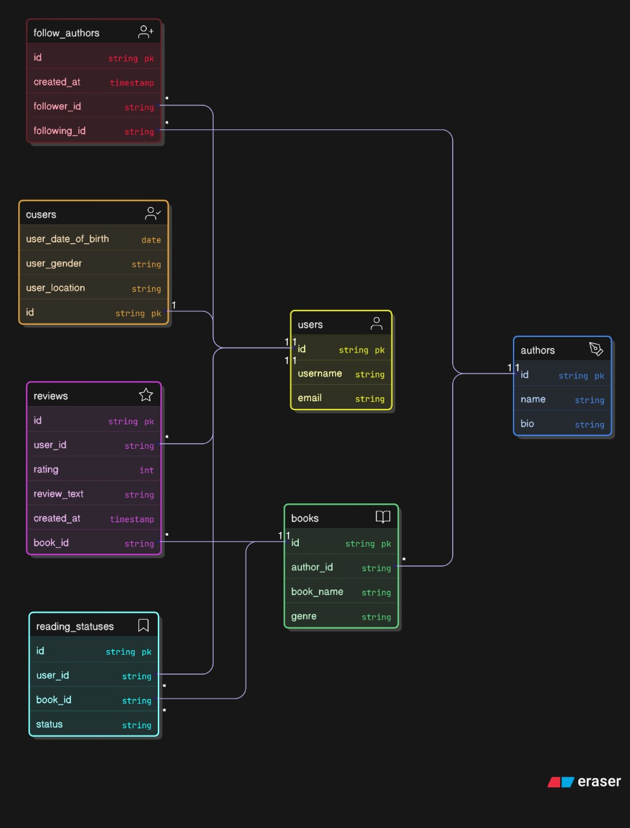
System Architecture
ER Diagram
Figure 4: ER diagram of the system

Slide 10
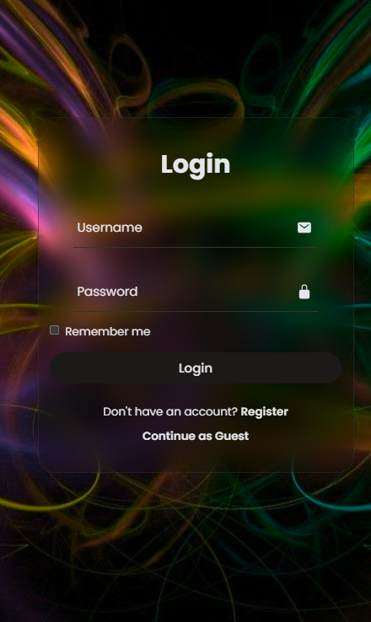
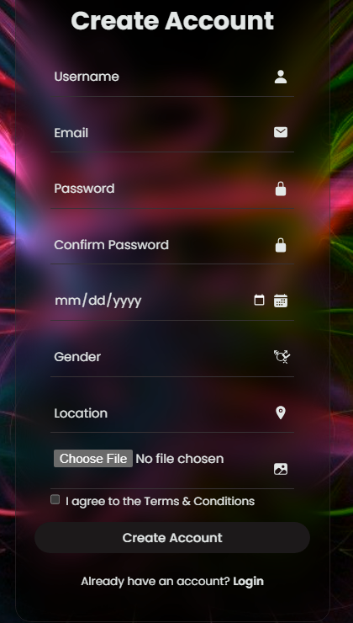
UI Design
Form-based Login & Sign Up
Can Navigate as guest user
Figure 5: Login & Sign Up page

Slide 11
UI Design Contd.
Most recent reviews of followed authors
Most popular books
Newly released books
Figure 6: Home page of Pathok Prantor

Slide 12
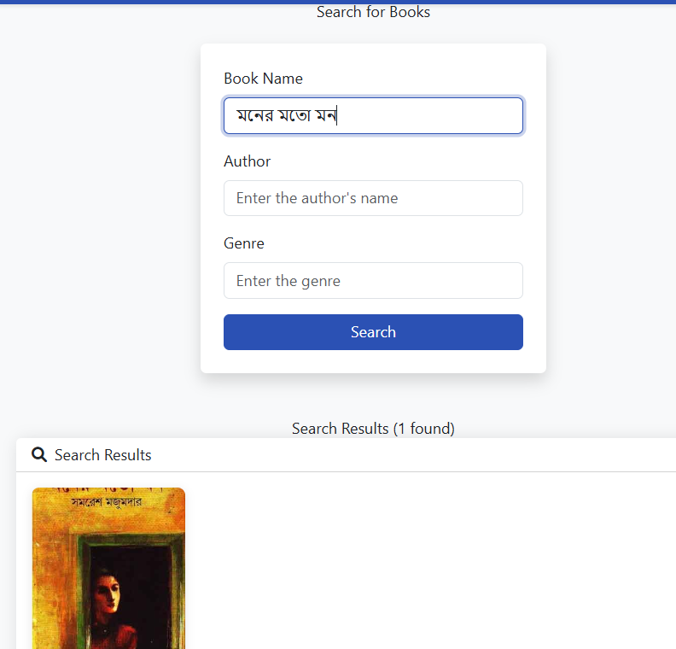
UI Design Contd.
Trending searches
Search by book, author, genres
Shows Top Searches books
Figure 7: Discover page

Slide 13
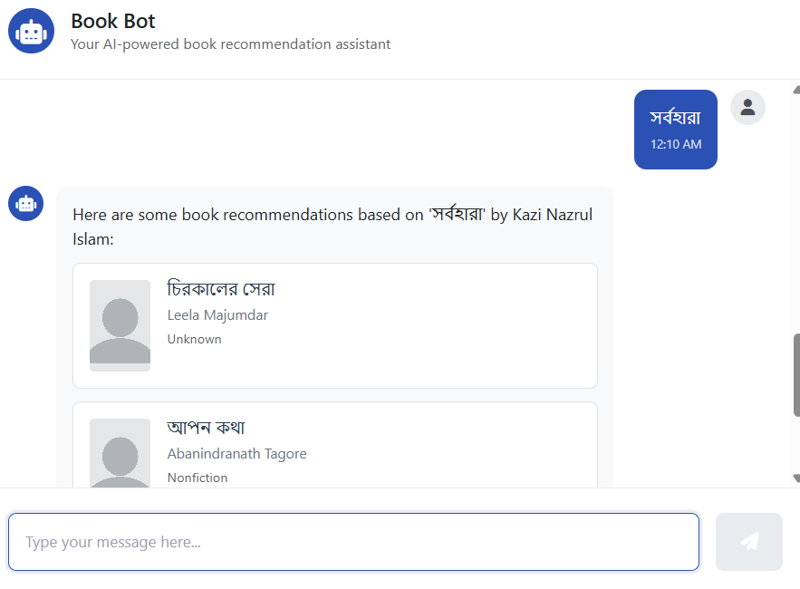
UI Design Contd.
Recommended books by author
Recommended books by books
Recommended books by genres
Figure 8: Book Bot page

Slide 14
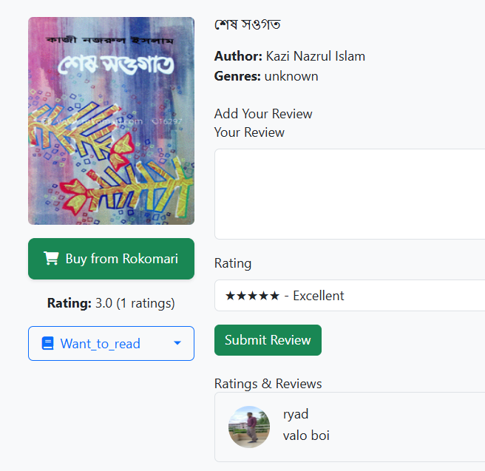
UI Design Contd.
Can submit as well as edit review and ratings
Can buy books from rokomari
Can get book meta data
Can update current reading status
Figure 9: Book Profile page

Slide 15
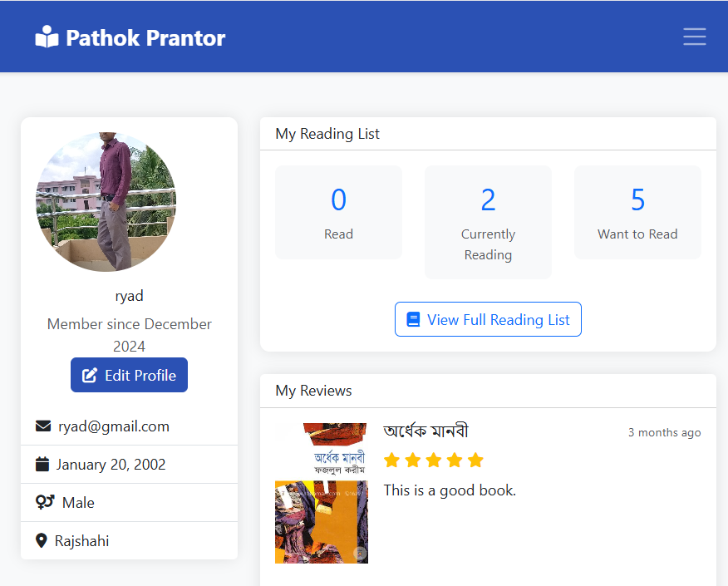
UI Design Contd.
Can update profile
Can view his own reviews
Can view his reading status
Figure 10: User Profile page

Slide 16
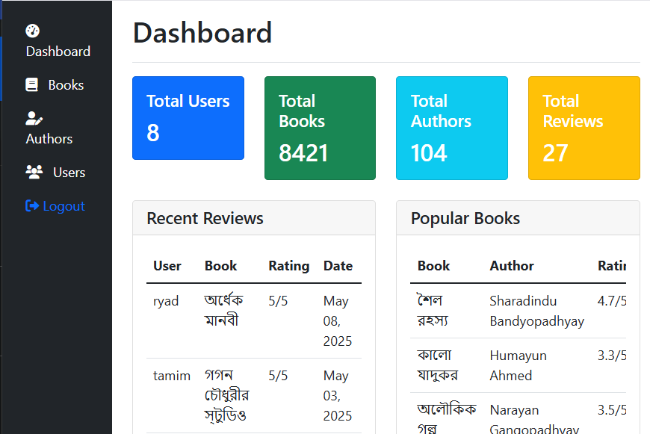
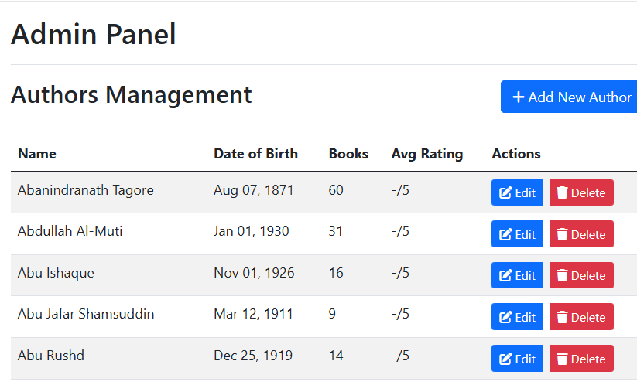
UI Design Contd.
Can perform CRUD operations
Can ban users
Figure 11: Admin panel

Slide 17
Tools Used
Python
Django
Jupyter Notebook
VS Code
SQLite
HTML, CSS, JS

Slide 18
Methodology
Dataset Collection
Model Implementation
Web Implementation

Slide 19
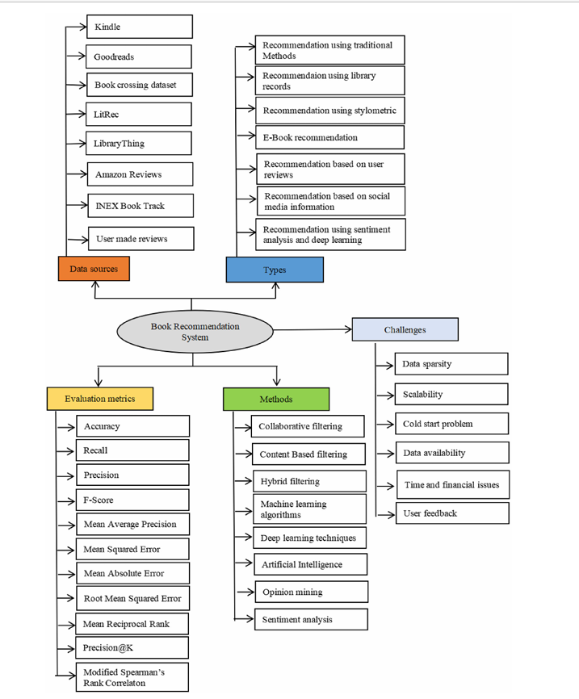
Dataset Collections
Collect Bangla writers from Wikipedia.
Scrapping Users and Book meta data from Goodreads.
Process Raw data & handle outliers.
Figure 12: Taxonomy of book recommendation system

Slide 20
Model Implementation
Content-Based Filtering
Using Book meta data
Collaborative Filtering
Using analysis of user behavior
Hybrid Model
By combining content and collaborative filtering
Chatbot Integration
Hybrid model is integrated on chatbot

Slide 21
Web Implementation
Backend
Django MVT design pattern
Database
SQLite
Frontend
HTML, CSS & JS

Slide 22
Web Implementation
Web Architecture:
Data
Model
Django Framework
URL
View
User
Template
Figure 13: MVT Architecture

Slide 23
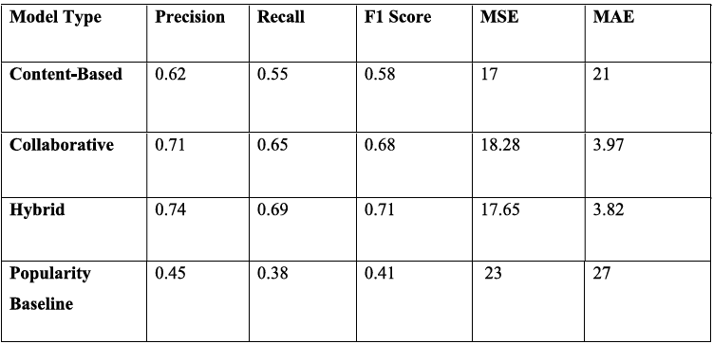
Results
Content-Based: Lower accuracy, higher error.
Collaborative: Strong precision-recall balance.
Hybrid: Best overall performance.
Baseline: Weakest, lacks personalization.
Table 1: Model evaluations

Slide 24
Conclusion
AI-powered Bengali book recommendations for personalized reading.
Social features like reading status, reviews, and chatbot.
Robust admin tools for smooth management and community safety

Slide 25
Future Study
Boost recommendation accuracy using deep learning and richer datasets.
Add multilingual support for broader audience engagement.
Integrate sentiment analysis to enhance personalization.
Launch mobile app for wider accessibility.

Slide 26
References
[1] G. Behera, S. K. Panda, and M.-Y. Hsieh, “Optimizing Recommendation Systems by Fusion of K-NN, Singular Value Decomposition, and XGBoost for Enhanced Performance,” Computer Standards & Interfaces, vol. 89, 2024.
[2] K. V. Rodpysh, S. J. Mirabedini, and T. Banirostam, “Employing singular value decomposition and similarity criteria for alleviating cold start and sparse data in context-aware recommender systems,” Electronic Commerce Research, 2021.
[3] “Tourist Places Recommender System Using Cosine Similarity and Singular Value Decomposition Methods,” Knowledge-Based Systems, 2021. 30
[4] E. Frolov and I. Oseledets, “HybridSVD: When Collaborative Information is Not Enough,” arXiv preprint, 2018.
[5] Mohsin Mushtaq, “Scraping Book Data from Goodreads Using Python,” Medium, Mar. 2024.

Slide 27
Thank You

