Slide 1

FragPTQ: Fragility-Guided Post-Training Quantization for Vision Transformers
CSE 4000 : Project/Thesis
KHULNA UNIVERSITY OF ENGINEERING & TECHNOLOGY
Department of Computer Science and Engineering
Md. Robiul Islam Ryad
Roll: 2007008
&
Md. Umar Faruk
Roll: 2007016
Dr. Sk. Imran Hossain
Professor
Dept of CSE, KUET
Supervised by-

Slide 2
Outline
Introduction
Background & Motivation
Literature Review
Problem Statement
Proposed Methodology
Experimental Setup
Result & Discussion
Conclusion
Future Work
References

Slide 3
Introduction
What is ViT?
Vision Transformers process images as a sequence of patches using self-attention to learn global context.
How ViT Works
Patch Embedding
Positional Encoding
Transformer Encoder
Classification Head

Slide 4
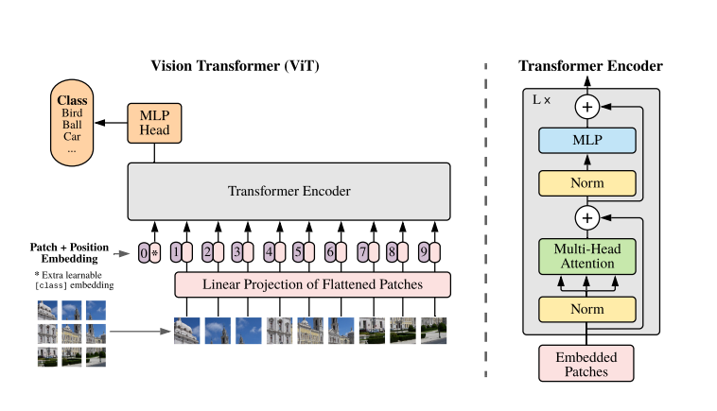
Vision Transformers (ViTs)
Image divided into fixed-size patches
Linear embedding + positional encoding
Transformer encoder blocks
Self-attention enables global context modeling
Achieve state-of-the image classification performance
Fig 1: Architecture of Vision Transformer [4]

Slide 5
Computational Challenges of ViT
Quadratic complexity of self-attention
Large parameter count
High memory footprint
High inference latency
High power consumption
Challenging deployment on edge devices

Slide 6
What is Quantization?
Quantization
Converts high-precision values to low-precision formats with minimal accuracy loss.
Key Points
Goal: Faster, smaller, energy-efficient models
Mechanism: Quantizes weights & activations
Benefits: Lower memory, faster inference, edge deployment
Techniques
PTQ: Quantize after training
QAT: Quantize during training

Slide 7
Literature Review
Table 1: Literature Review- Key Methods, Contributions & Gaps
Method | Core Idea | Main Strength | Key Limitation
AdaLog (ECCV’24) | Adaptive log PTQ | Better low-bit PTQ | Uniform precision
Mix-QViT (CVPR’25) | LRP + sensitivity | Explainable MPQ | Expensive Search
LRP-QViT (DSP'25) | LRP-based MPQ | Layer-aware bits | Ignores quantization sensitivity
LAMPQ (AAAI'26) | Fisher-based MPQ | Layer-wise MPQ | Iterative optimization overhead

Slide 8


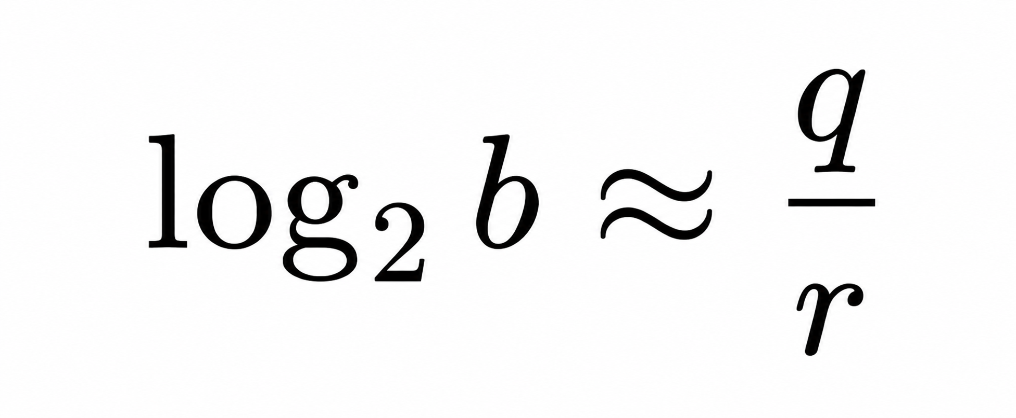
Adaptive Logarithmic Quantizer (Adalog)
AdaLog addresses the power-law distribution of Post-Softmax and Post-GELU activations.
Post-Softmax Quantization:
Quantization
Dequantization
HW-Friendly Approximation

Slide 9
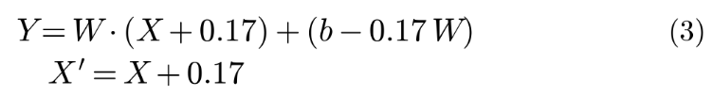



Adalog (contd..)
Shift GELU Activations:
Adalog reformulates the linear layer as
Quantization
Dequantization
Bias Reparameterization

Slide 10
Adalog (contd..)
FPCS : Find the optimal logarithm base and quantization parameters.
Step1: Coarse Search
Search the entire parameter space.
Select the best candidate regions
Step2: Prograssive Search
Search only within the selected regions
Use smaller intervals for better accuracy
Step3: Fine Search
Refine the best candidate
Select the optimal parameters

Slide 11
Problem Statement
Uniform bit-width across all transformer layers.
Not all transformer blocks are equally sensitive.
Uniform precision ignores layer-wise quantization sensitivity.
Suboptimal bit allocation and avoidable accuracy loss.
An adaptive, sensitivity-aware mixed-precision strategy is needed.

Slide 12
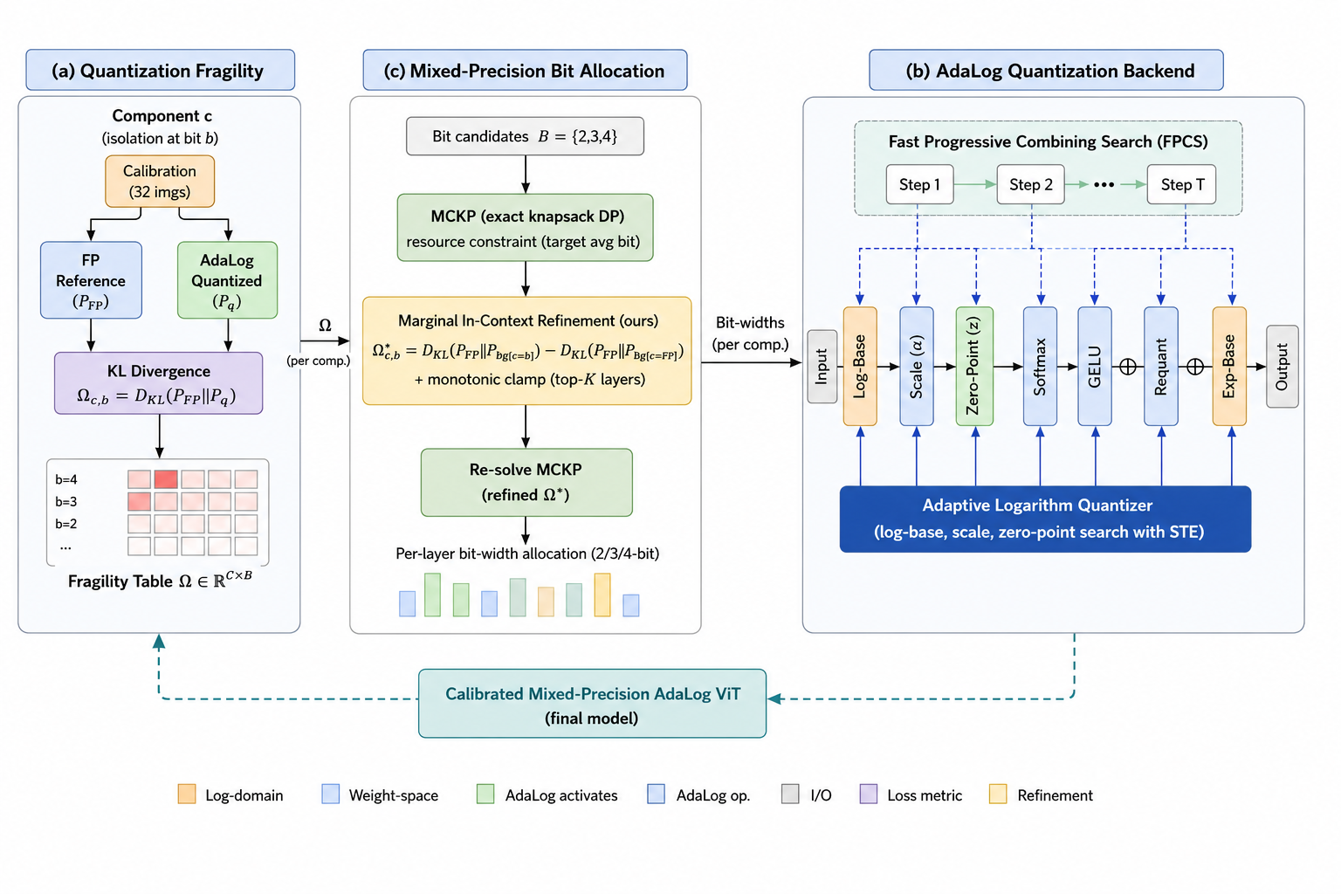
Proposed Method (FragPTQ)
Fig 2: Proposed Architecture

Slide 13


Fragility Measurement
Measure each layer’s quantization sensitivity.
Fragility Metric:
Interpretation:
High Fragility -> Higher Bit-width
Low Fragility -> Lower Bit-width

Slide 14


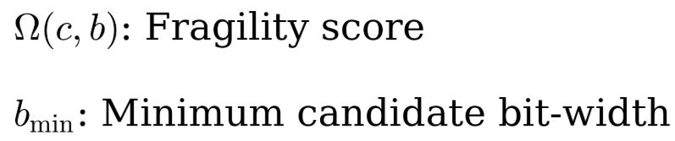
Mixed-Precision Bit Allocation(MCKP)
Cost Evaluation:
Pc: Number of parameters in component c
b: Candidate bit-width
Value Evaluation:
where,

Slide 15
Mixed-Precision Bit Allocation(MCKP) (contd..)
DP State:
where,
i : First i quantizable components processed
w : Memory Budget used
DP Transition:
DP[i][w]
DP[i][w] = max(DP[i-1][w-cost(i,b)] + value(i,b), DP[i][w])

Slide 16
Second-Pass Refinement
Select Top-K
Choose the K most fragile component
Build Background
Quantize all other components using the 1st-pass allocation
Recompute Fragility
Re-evaluate the Top-K components in the quantized background
Re-run MCKP
Update the refine scores and compute the final bit allocation

Slide 17

Old Second-Pass Formulation
Old Refinement:
Issue
Background KL dominates the measurement
The component’s true contribution is hidden
Result
Noisy fragility scores
Incorrect bit allocation

Slide 18
Marginal Refinement
Marginal Formulation:
Key Idea:
Remove shared background error
Measure only the component’s contribution
Clamp residual noise
Benefits:
Consistent Omega values
Reliable bit allocation
Fair component comparison

Slide 19
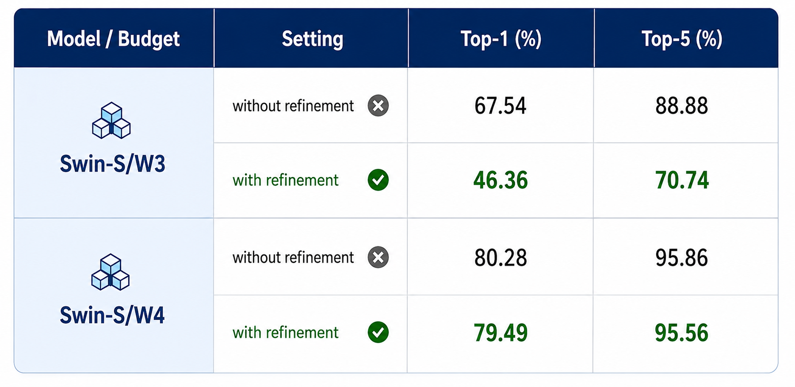
Refinement Ablation Study
Table 2: Refinement ablation at W3/W4

Slide 20
Root Cause Analysis Of Refinement Failure
Floored-Zero Noise
small marginal KL values become 0, making component appear safe for lower bit-widths.
False Bit Equivalence
Monotonic clamping makes 2-bit and 3-bit appear equally effective.
Incorrect Budget Allocation
Noisy scores cause MCKP to over-allocate 2-bit components
Ex: Swin-S/W3: 11 -> 29 components assigned to 2-bit
That’s why we prefer off Refine for extreme low bits

Slide 21
Experimental Setup
Hardware & Software
GPU: NVIDIA GeForce RTX 4070 (12 GB VRAM)
Framework: PyTorch, CUDA 12.x, AdaLog backend
Models
DeiT-Tiny / DeiT-Small / DeiT-Base
ViT-Small / ViT-Base
Swin-Small / Swin-Base
Dataset & Calibration
Evaluation: ImageNet-1K Validation (50,000 images)
Calibration: 32 unlabeled images (Batch size = 32)

Slide 22
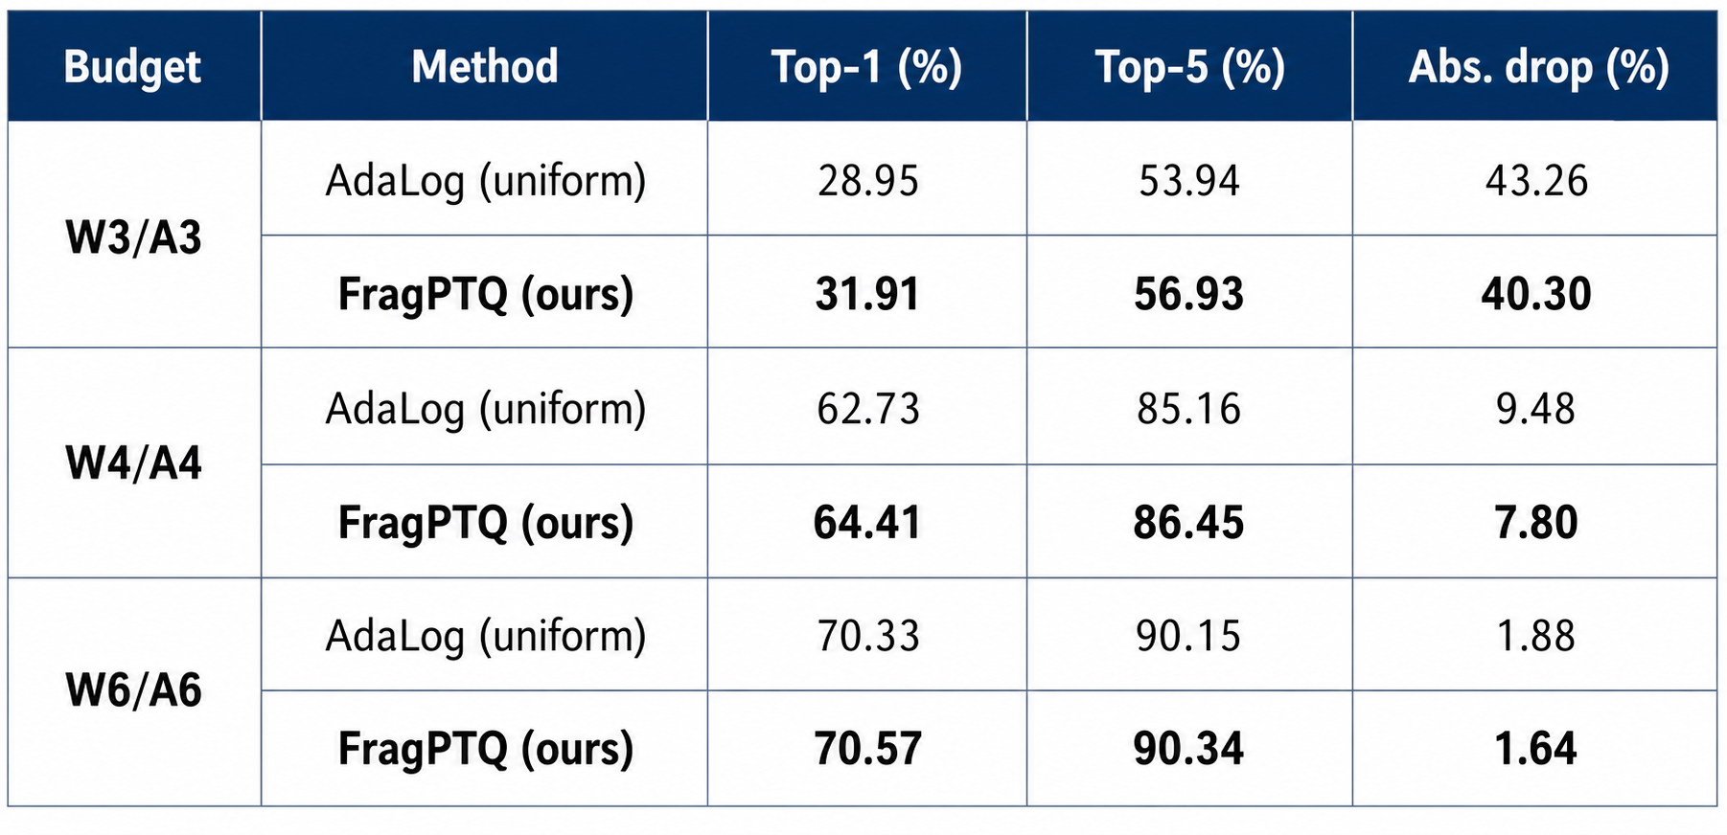
Primary Accuracy Comparison
Table 4: FragPTQ vs. AdaLog on DeiT-Tiny (FP32 = 72.21/91.10)

Slide 23
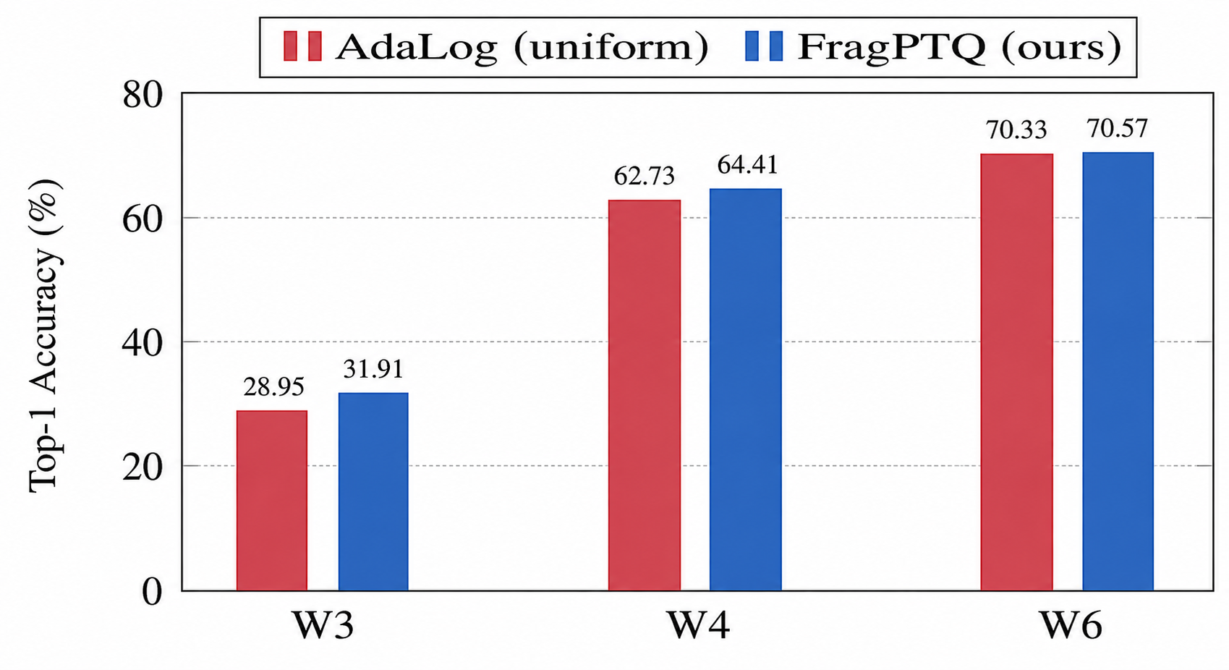
Overall Performance Comparison (DeiT-T)
Fig 3: FragPTQ outperforms uniform AdaLog.

Slide 24
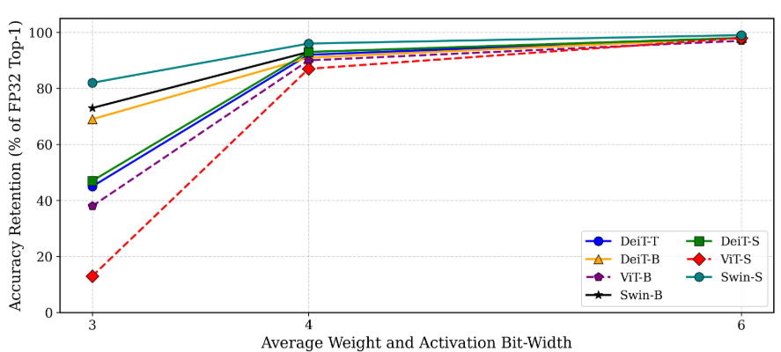
Accuracy Retention Across Models
Fig. 4: Accuracy retention (%) at W3/A3, W4/A4 and W6/A6 budgets.

Slide 25
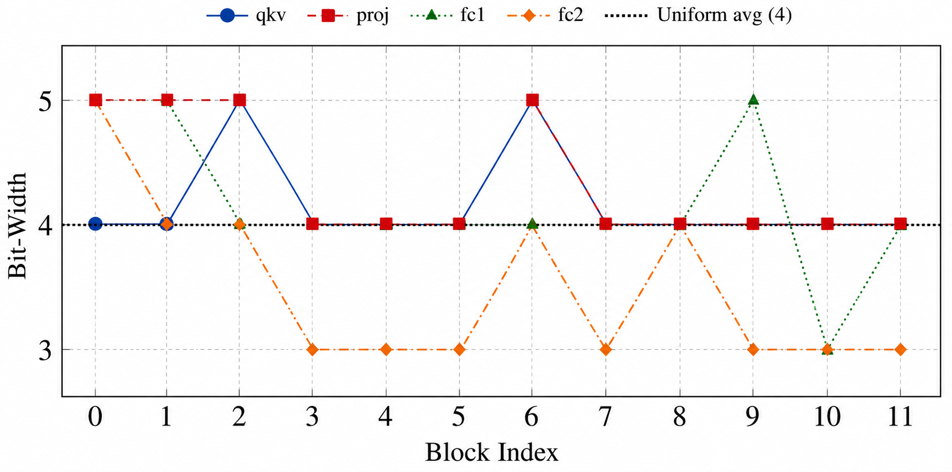
Mixed-Precision Bit Distribution
Fig 5: Block Component-wise bit allocation at W4.

Slide 26
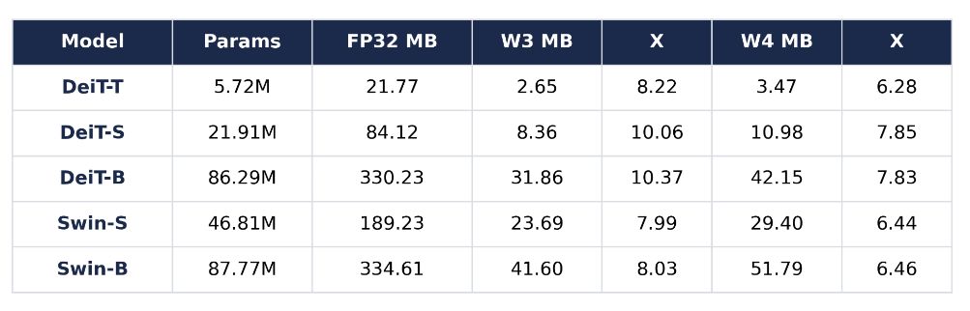
Memory Compression Results
Table 3: Memory Reduction under Different Bit Budgets

Slide 27
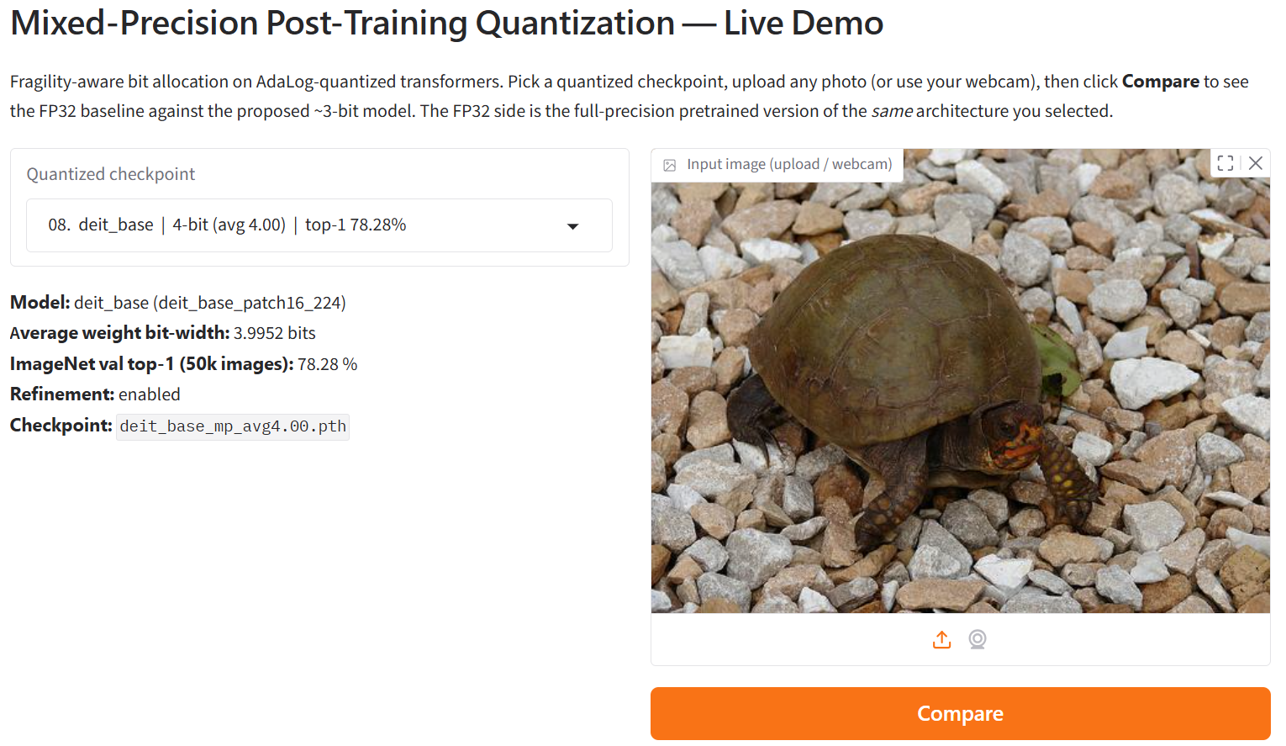
FP32 vs. Proposed Quantized Model Inference
Fig 6: Gradio-based interface for FP32 and Proposed Quantized model evaluation.

Slide 28
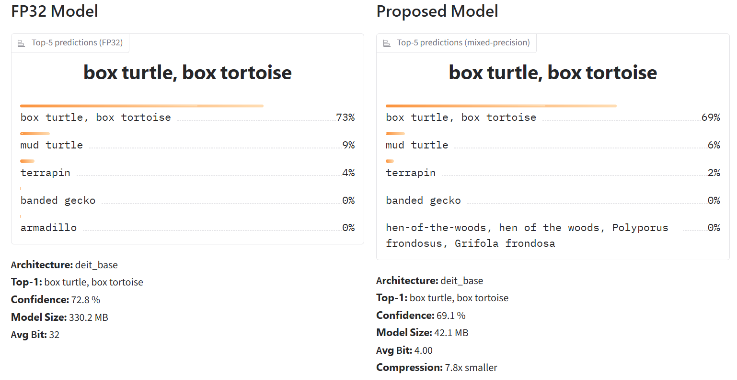
Inference Result Comparison
Fig 7: FP32 vs. Proposed model predictions.

Slide 29
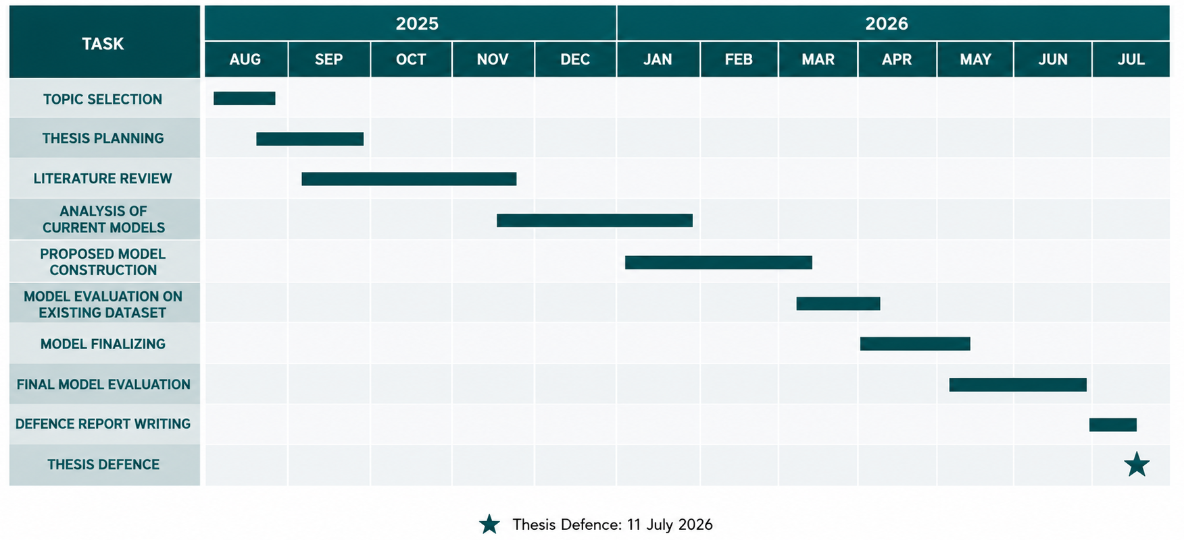
Gantt Chart

Slide 30
Conclusion
Proposed FragPTQ, a fragility-guided mixed-precision PTQ framework.
Introduced KL-divergence for component-wise fragility estimation.
Optimized bit allocation using the MCKP algorithm.
Improved Top-1 accuracy over uniform AdaLog at the same memory budget.
Enabled efficient low-bit ViT deployment without retraining.

Slide 31
Future Work
Dynamic and adaptive compression
Deployment on diverse hardware (TPU, FPGA, IoT)
Extension to object detection and segmentation tasks
Broader models and tasks
Automated pipelines

Slide 32
References
[1] Z. Wu, Y. Zhang, J. Wang, et al., "AdaLog: Post-Training Quantization for Vision Transformers with Adaptive Logarithm Quantizer," European Conference on Computer Vision (ECCV), 2024.
[2] Z. Yuan, C. Xue, Y. Chen, et al., "PTQ4ViT: Post-Training Quantization for Vision Transformers with Twin Uniform Quantization," European Conference on Computer Vision (ECCV), 2022.
[3] Z. Li, X. Liu, J. Wang, et al., "RepQ-ViT: Scale Reparameterization for Post-Training Quantization of Vision Transformers," IEEE/CVF International Conference on Computer Vision (ICCV), 2023.
[4] A. Dosovitskiy, L. Beyer, A. Kolesnikov, et al., "An Image Is Worth 16×16 Words: Transformers for Image Recognition at Scale," International Conference on Learning Representations (ICLR), 2021.
[5] Z. Dong, Z. Yao, A. Gholami, M. Mahoney, and K. Keutzer, "HAWQ: Hessian Aware Quantization of Neural Networks with Mixed-Precision," IEEE/CVF International Conference on Computer Vision (ICCV), 2019.

Slide 33
Thank You

