Slide 1
CUSTOMER CHURN PREDICTION SYSTEM
An End-to-End Deep Learning Pipeline for Telecom Customer Retention
ANN · Regularization · Keras Tuner · Deployment
Deep Learning Unit — Final Project

Slide 2
Business Problem & Objective
Retention is cheaper than acquisition.
Acquiring a new telecom customer costs 5–25x more than retaining an existing one. Predicting churn before it happens lets retention teams intervene early — with offers, upgrades, or improved support.
5–25x
Cost of new vs.
retained customer
~27%
Customers in this
dataset who churned
Objective
Build a production-ready ANN system that predicts whether a customer will churn (Yes / No), covering the full pipeline: preprocessing → model design → tuning → evaluation → deployment.
84%
ROC-AUC of the
final ANN model

Slide 3
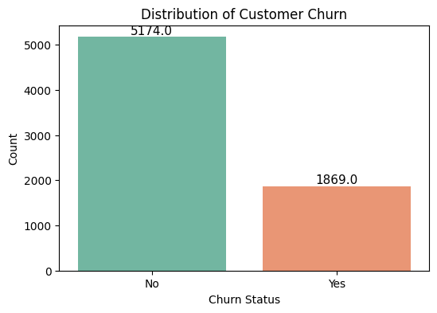
Dataset Overview
IBM Telco Customer Churn Dataset (Kaggle)
7,043
21
3
Customers
Raw Features
Feature Groups:
Demographics · Account · Services
Target Variable — Churn (imbalanced)
Feature Highlights
Demographics: gender, senior citizen, partner, dependents
Account: tenure, contract type, payment method, paperless billing
Services: internet, phone, security, backup, streaming
Billing: monthly charges, total charges

Slide 4
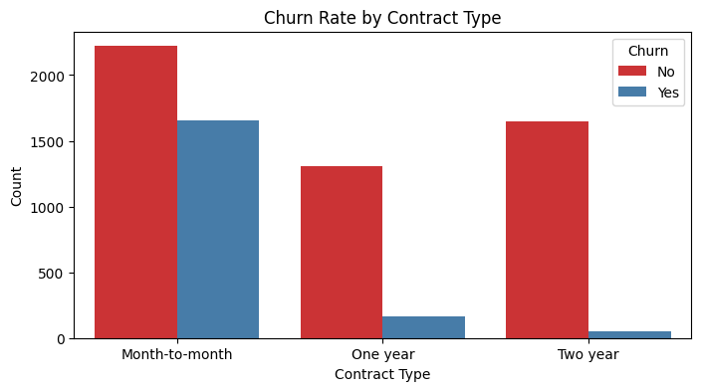
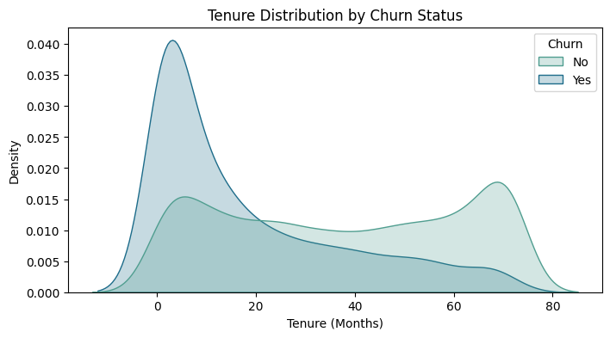
EDA — Key Insights
Contract type drives churn.
Month-to-month customers churn far more than 1- or 2-year contract holders — the single strongest retention lever.
New customers are highest-risk.
Churn is concentrated in the first 6–12 months of tenure, then drops sharply — onboarding is critical.

Slide 5
Preprocessing Pipeline
Split before scaling/encoding — no data leakage from validation or test sets
1
Clean
X_train_raw, X_temp_raw, y_train, y_temp = train_test_split(
X, y, test_size=0.30, random_state=42, stratify=y
)
X_val_raw, X_test_raw, y_val, y_test = train_test_split(
X_temp_raw, y_temp, test_size=0.50,
random_state=42, stratify=y_temp
)
preprocessor = ColumnTransformer([
('num', StandardScaler(), numerical_cols),
('cat', OneHotEncoder(drop='first'), categorical_cols)
])
# Fit ONLY on training data
X_train = preprocessor.fit_transform(X_train_raw)
X_val = preprocessor.transform(X_val_raw)
X_test = preprocessor.transform(X_test_raw)
Drop customerID, coerce TotalCharges, impute median
2
Split first
70 / 15 / 15 stratified split on raw features
3
Fit on train only
StandardScaler + OneHotEncoder fitted once
4
Transform val/test
Same fitted preprocessor — zero leakage

Slide 6
ANN Architecture & Regularization
model = Sequential([
Dense(64, activation='relu',
input_shape=(input_dim,),
kernel_regularizer=l2(0.01)),
Dropout(0.3),
Dense(32, activation='relu',
kernel_regularizer=l2(0.01)),
Dropout(0.3),
Dense(1, activation='sigmoid')
])
model.compile(
optimizer=Adam(learning_rate=0.001),
loss='binary_crossentropy',
metrics=['accuracy', AUC(), Recall()]
)
early_stop = EarlyStopping(
monitor='val_loss', patience=10,
restore_best_weights=True)
L2 Regularization
Penalizes large weights (λ = 0.01) to reduce overfitting
Dropout (0.3)
Randomly disables 30% of units per layer during training
Early Stopping
Halts training when validation loss stops improving
Class Weighting
Balances the ~73/27 churn imbalance during training

Slide 7
Hyperparameter Tuning
Three complementary strategies used before finalizing the model
1. Learning-Rate Sweep
2. K-Fold Cross-Validation
3. Keras Tuner (Random Search)
Trained across [0.1, 0.01, 0.001, 0.0001] to find a stable convergence rate before deeper tuning.
5-fold CV on the training set to check that performance is stable across different data splits.
Searched units1, units2, dropout_rate, and learning_rate jointly, optimizing validation accuracy.
Best hyperparameters selected
def model_builder(hp):
units1 = hp.Choice('units1', [32, 64, 128])
units2 = hp.Choice('units2', [16, 32, 64])
dropout = hp.Choice('dropout_rate', [0.2, 0.3, 0.4])
lr = hp.Choice('learning_rate', [0.01, 0.001, 0.0005])
return build_tunable_model(..., lr, units1, units2, dropout)
tuner = kt.RandomSearch(model_builder,
objective='val_accuracy', max_trials=8, seed=42)
tuner.search(X_train, y_train, epochs=15,
callbacks=[EarlyStopping(patience=4)])
units1: 64
units2: 16
dropout_rate: 0.2
learning_rate: 0.001

Slide 8
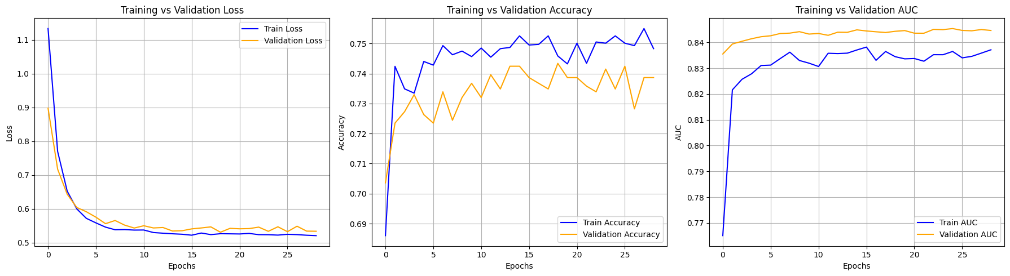
Training Performance
Training vs. validation curves — loss, accuracy, and AUC track closely, indicating regularization is working
No overfitting observed: training and validation curves stay tightly aligned across all 3 metrics — loss stabilizes around 0.52–0.54, accuracy near 74–75%, and AUC between 0.84–0.845.

Slide 9
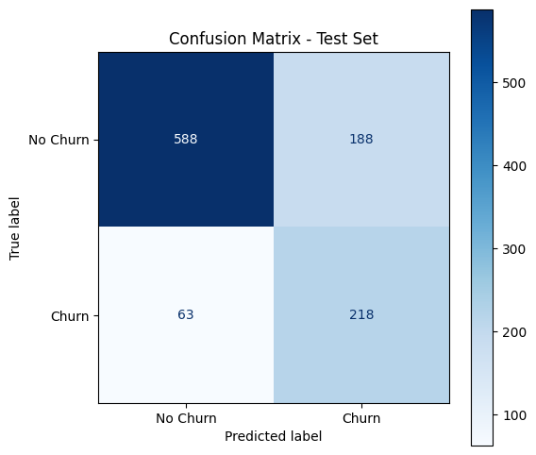
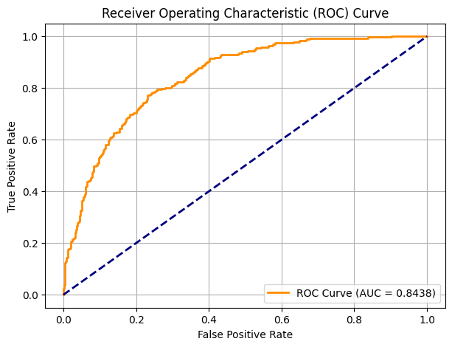
Evaluation Results (Test Set)
76%
78%
54%
0.84
Accuracy
Churn Recall
Churn Precision
ROC-AUC

Slide 10
Baseline Comparison
Random Forest was trained on the same features as a sanity-check baseline against the ANN
Model | Test AUC | Notes
ANN (this project) | ~0.844 | Tuned, regularized, class-weighted
Random Forest | ~0.818 | Untuned baseline, n_estimators=100
Random Forest
remains a useful,
low-maintenance
sanity check —
fast to train and
robust to outliers.
Why keep the ANN?
Slightly higher discriminative power (AUC) after tuning
Class weighting gives finer control over the recall/precision trade-off
Easier to extend with more data or additional layers as the business scales

Slide 11
Deployment & Inference Pipeline
final_model.save('final_churn_model.h5')
joblib.dump(preprocessor, 'preprocessor.pkl')
def predict_customer_churn(
customer_data,
model_path='final_churn_model.h5',
preprocessor_path='preprocessor.pkl'):
model = tf.keras.models.load_model(model_path)
prep = joblib.load(preprocessor_path)
df = pd.DataFrame([customer_data])
processed = prep.transform(df)
prob = model.predict(processed)[0][0]
pred = int(prob > 0.5)
return prob, pred
1
Save
Model + preprocessor persisted to disk (.h5 / .pkl)
2
Load
Both artifacts reloaded at inference time — no retraining
3
Transform
Raw customer record passed through the same fitted preprocessor
4
Predict
Model outputs churn probability + binary decision at 0.5 threshold

Slide 12
Results Summary & Limitations
What worked
Limitations
ANN reaches ~84% ROC-AUC with no overfitting (train/val curves aligned)
Class weighting lifted churn recall to ~78% — few at-risk customers missed
Fully reproducible pipeline: leak-free preprocessing, saved model + preprocessor, reusable inference function
Churn precision is moderate (~54%) — about half of flagged customers won't actually churn
Single-snapshot dataset — no time-series/behavioral trend features
Trained on one provider's data; may need retraining for other markets
Bottom line: the system reliably flags high-risk customers, trading some false alarms for very few missed churners — a sensible trade-off when the cost of losing a customer far exceeds the cost of a retention offer.

