Slide 1
Database Management System
Introduction

Slide 2
Data vs Information
2
Computer Data
▸ Data is a collection of values. Those values can be characters, numbers, or any other data type.
▸ Computer data is a bunch of 1’s and 0’s, known as binary
data.
▸ Computer data is processed by the computer’s CPU and is stored digitally in files and folders on the computer’s hard disk.
Example of Data:
UIU, Email:, Mr. X, x@cse.uiu.ac.bd, Dept. of CSE, Lecturer
Information
▸ When data are processed, interpreted, organized, structured or presented in a given context so as to make them meaningful or useful, they are called information.
▸ Data is raw material(i.e. bits of information) and Information is the product.
Example of Information : Mr. X
Lecturer Dept. of CSE UIU
Email: x@cse.uiu.ac.bd

Slide 3
Data vs Information
3
Computer Data Information
▸ Data is a collection of values. Those values can be ▸ When data are processed, interpreted, characters, numbers, or any other data type. organized, structured or presented in a given
▸ Computer data is a bunch of 1’s and 0’s, known as context so as to make them meaningful or
_{binary data.} useful, they are called information.
▸ Computer data is processed by the computer’s CPU ▸ Data is raw material(i.e. bits of information) and is stored digitally in files and folders on the and Information is the product.
computer’s hard disk.
Example of Data: Example of Information :
UIU, Email:, Mr. X, x@cse.uiu.ac.bd, Mr. X
Dept. of CSE, Lecturer Lecturer
Dept. of CSE
UIU
Email: x@cse.uiu.ac.bd
Data
Data
Data
Processing
Information

Slide 4
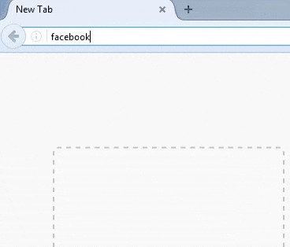
Web-based Information System
4
Web-based Information System, is an information system that uses Internet web technologies to deliver information and services, to users or other information systems/applications.

Slide 5
Web-based Information System
5
Web-based Information System, is an information system that uses Internet web technologies to deliver information and services, to users or other information systems/applications.
What is happening in the background !!!!

Slide 6












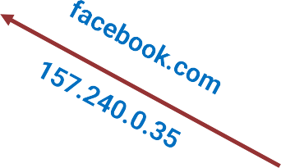

6
Web-based System >> Background Process
157.240.0.35
172.210.0.25
192.168.0.103
HTTP req
SQL
HTTP res
192.168.0.115
Facebook
Database Server Database System
8.8.8.8
192.168.0.110
DNS Recursor (Internal DNS Server)

Slide 7


Web-based System >> Background Process
7
157.240.0.35
172.210.0.25
192.168.0.103
HTTP req
SQL
HTTP res
Data
Information
192.168.0.115
Facebook
Database Server Database System
8.8.8.8
192.168.0.110
DNS Recursor (Internal DNS Server)

Slide 8
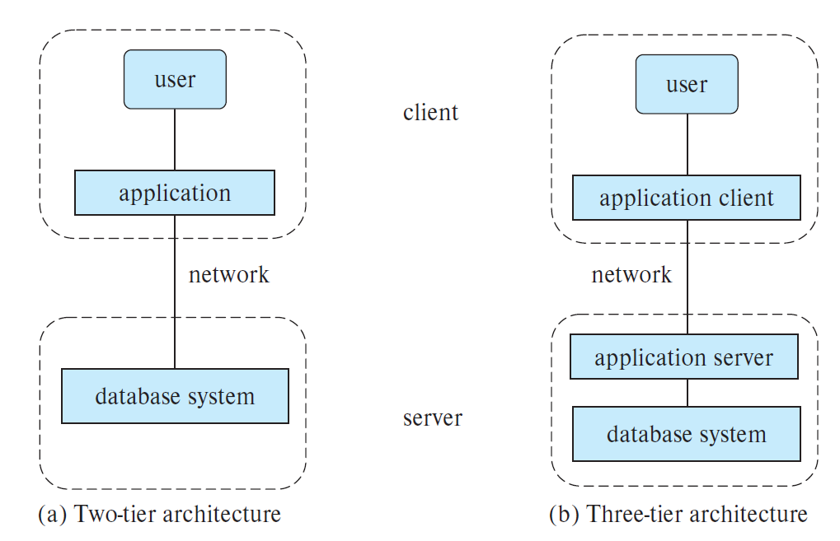
Web-based System >> Two-tier vs Three-tier Architecture
8
Two-tier Architecture
The application resides at the client machine, and invokes database system functionality at the server machine through query language statements.
Three-tier Architecture
The client machine acts as a front end that communicates with an application server. The application server, in turn, communicates with a database system to access data.
The business logic of the application, which says what actions to carry out under what conditions, is embedded in the application server, instead of being distributed across multiple clients.

Slide 9
Database vs Database Management System
9
Database
A database is an organized collection of interrelated data, generally stored and accessed electronically from a computer system.
172.210.0.25
157.240.0.35
192.168.0.103 HTTP req
HTTP res
192.168.0.115
192.168.0.110
SQL
Database Management System
A DBMS is software that interacts with end users, applications, and the database itself to control the storage, organization, and retrieval of data.
Facebook
Database Server
Database System = DBMS + Database
8.8.8.8
DNS Recursor (Internal DNS Server)

Slide 10
Web-based System >> DBMS
10
A DBMS
understands the commands and the queries which define what data is required by the app or website
and
thus use the meaningful method of accessing the database to retrieve the information.
PHP
JSP(Java)
ASP(C#)
Ruby Django(Python) Node.js
172.210.0.25
157.240.0.35
Facebook
192.168.0.103 HTTP req
HTTP res
192.168.0.115
192.168.0.110
SQL
Database Server
Database System = DBMS + Database
8.8.8.8
DNS Recursor (Internal DNS Server)

Slide 11
DBMS >> Key Features
11
Minimizes data redundancy.
Provides data consistency.
Easy to write, update, search, delete data.
Provides atomicity of updates.
Concurrency control for multiple users.
Provides data isolation.
Provides high level of security.
Easy to add/update different integrity constraints.
157.240.0.35
172.210.0.25
192.168.0.103 HTTP req
HTTP res
192.168.0.115
192.168.0.110
SQL
Facebook
Database Server
Database System = DBMS + Database
8.8.8.8
DNS Recursor (Internal DNS Server)

Slide 12

Database System Structure >> Query Processor
12
Program
Query Tool
Query Processor
DDL interpreter: interprets DDL statements and records the definitions in the data dictionary.
Query Processor
DML compiler: translates DML query statements into low-level instructions that the query evaluation engine understands.
Storage Manager
Also performs query optimization i.e. it picks lowest cost evaluation plan from a number of alternative evaluation plans.
Database
Query evaluation engine: executes low-level instructions generated by the DML compiler.

Slide 13
Database System Structure >> Storage Manager
13
Program
Query Tool
Storage Manager
Authorization and integrity manager tests for the satisfaction of integrity constraints and checks the authority of users to access data.
Query Processor
Transaction manager ensures that the database remains in a consistent (correct) state despite system failures, and that concurrent transaction executions proceed without conflicting.
Storage Manager
Database
File manager manages the allocation of space on disk storage and the data structures used to represent information stored on disk.
Buffer manager is responsible for fetching data from disk storage into main memory, and deciding what data to cache in main memory.

Slide 14
Database System Structure >> Database
14
Program
Query Tool
Database
Data files, which store the database itself.
Data dictionary, which stores metadata about the structure of the database, in particular the schema of the database.
Query Processor
Storage Manager
Database
Indices, which provide fast access to data items. A database index provides pointers to those data items that hold a particular value.

Slide 15
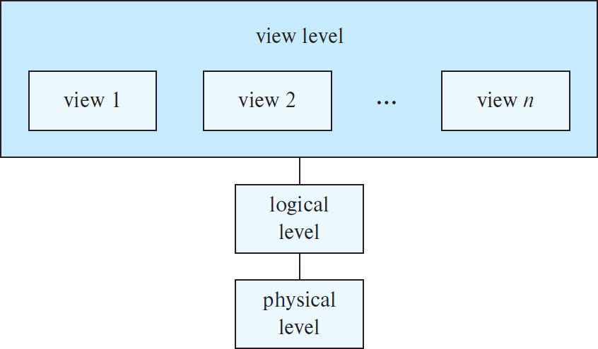
Data Abstraction
15
A database system is a collection of interrelated data(DB) and a set of programs(DBMS) that allow users to access and modify these data.
A major purpose of a database system is to provide users with an abstract view of the data. That is, the system hides certain details of how the data are stored and maintained.
To simplify users’ interactions with the system, developers hide the complexity from users through several levels of data abstraction.

Slide 16
Database Schema
16
▸ Schema describes the overall design of the database at different levels.
▸ Each schema(logical) corresponds to a data model that is a collection of conceptual tools and languages for describing data, data relationships, data semantics, and consistency constraints.
External/View schema
Logical schema
Physical schema

Slide 17
Types of Data Models
17
▸ High-level conceptual data model
▹ E-R Model
▹ Object oriented Model
▸ Record based logical data models
- These models specify logical structure of database with records, fields and attributes.
▹ Relational Model – collections of tables
▹ Hierarchical Model – collections of trees
▹ Network Model – collections of records and links (graphs)
▸ Physical data models (physical level)

Slide 18
SQL vs NoSQL Database
18
SQL | NoSQL
Relational Database | Non-relational Database
SQL databases use structured query language and have a predefined schema. | NoSQL databases have dynamic schemas for unstructured data.
SQL databases are vertically scalable. | NoSQL databases are horizontally scalable.
SQL databases are table based. | NoSQL databases are document, key-value, graph or wide- column stores.
SQLite PostgreSQL Oracle MySQL Microsoft SQL server | MongoDB Cassandra

Slide 19
Relational Database >> MySQL
19
Student
student_id | name | age
1 | ABC | 25
2 | DEF | 20
3 | GHI | 22
4 | JKL | 27
Course
course_id | name | faculty
1 | Java | X
2 | Python | Y
3 | CPP | W
4 | JS | M
Student_Course
student_id | course_Id | marks
1 | 4 | 85
1 | 3 | 90
2 | 3 | 70
4 | 2 | 67

Slide 20
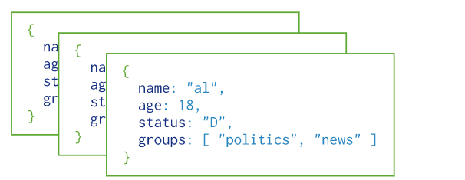
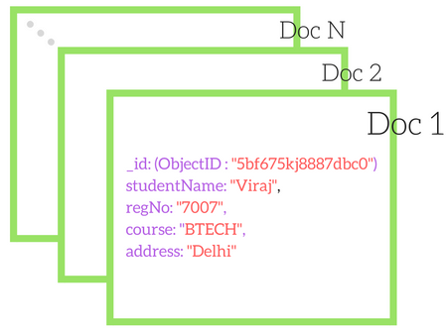
Non-relational Database >> MongoDB
20
Collection 1
Collection 2

