Slide 1
Database Management System
ER Diagram → Relational Schema

Slide 2




Design Phases
2
User Requirements Specification
Conceptual-design Phase
(ER Diagram)
Logical-design Phase (Relational Schema)
Physical-design Phase
(Relational Database)

Slide 3
Database Schema & Data Model
3
Database Schema
Describes the overall design of the database at different levels(physical, logical, view)
Data Model
Describes a way to design database at physical, logical and view level. It is a collection of conceptual tools and
languages for describing data, data relationships, data semantics, and consistency constraints.
High-level conceptual data model → ER Model
Record based logical data model → Relational Model

Slide 4
E-R Diagram vs Relational Schema
4
ER Diagram | Relational Schema
The main components of ER Model are: Entity Set – set of similar entities Relationship Set – set of similar relationships Attributes – including different types of keys | The main components of Relational Model are: Relations (tables) Tuple (row, unordered) Attributes (columns, unordered) Domain (column type) Primary Key Foreign Key
ER Model describes Mapping Cardinality. | Relational Model does not describe Mapping Cardinality.

Slide 5
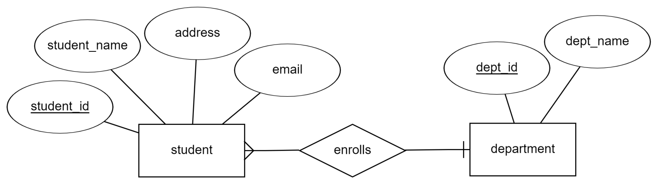
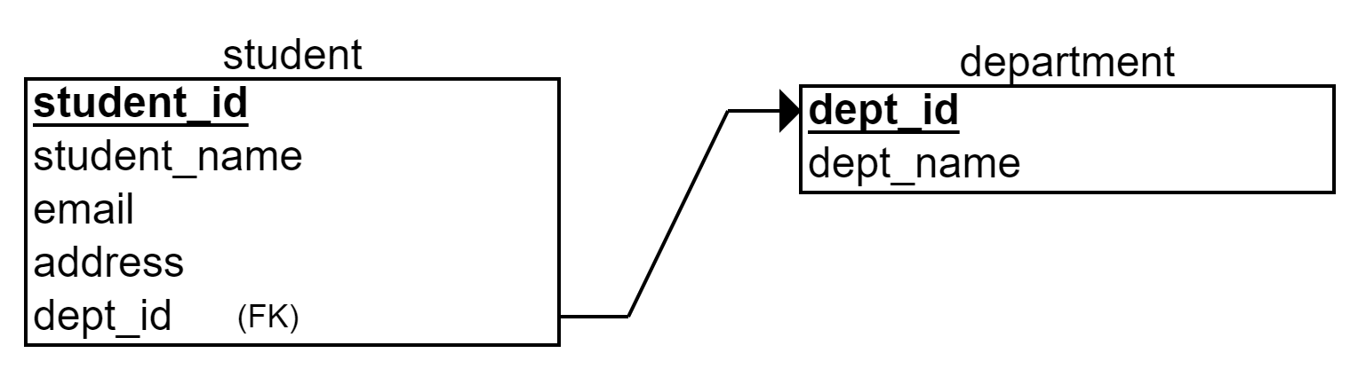
E-R Diagram vs Relational Schema
5
ER Diagram :
Relational Schema :

Slide 6
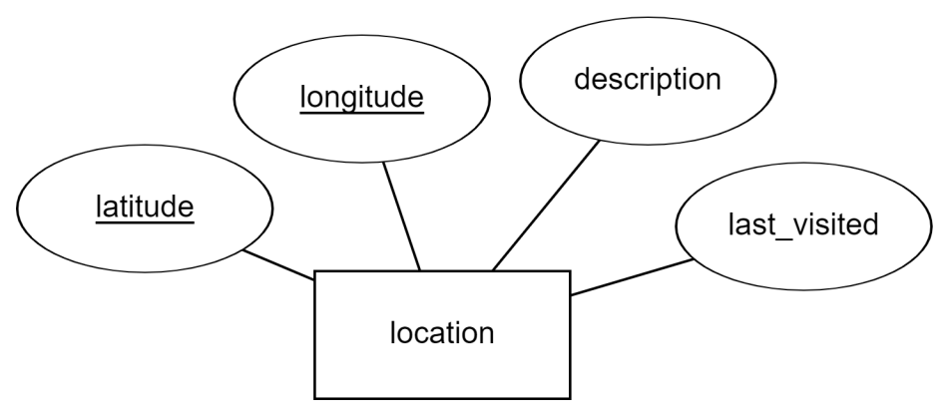
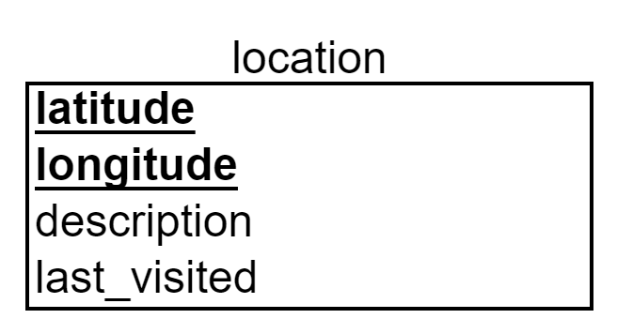
Relational Schema >> Strong Entity Set
6

Slide 7
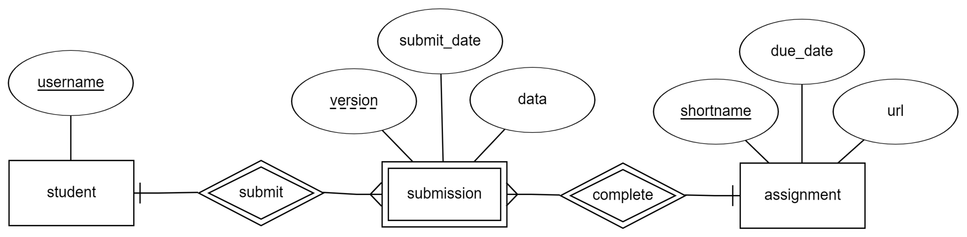
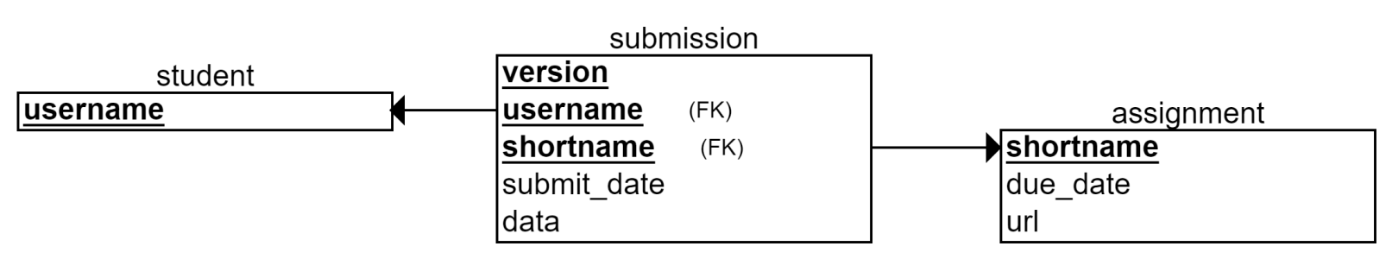
Relational Schema >> Weak Entity Set
7

Slide 8
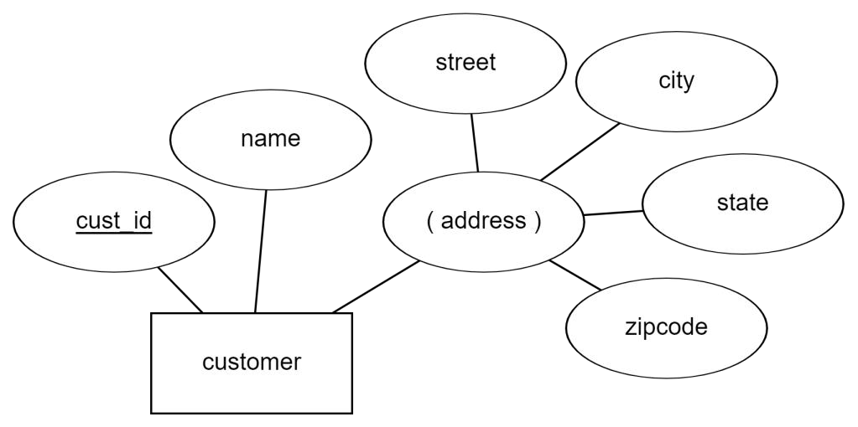
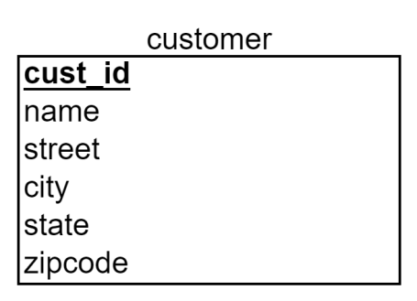
Relational Schema >> Composite Attribute
8

Slide 9
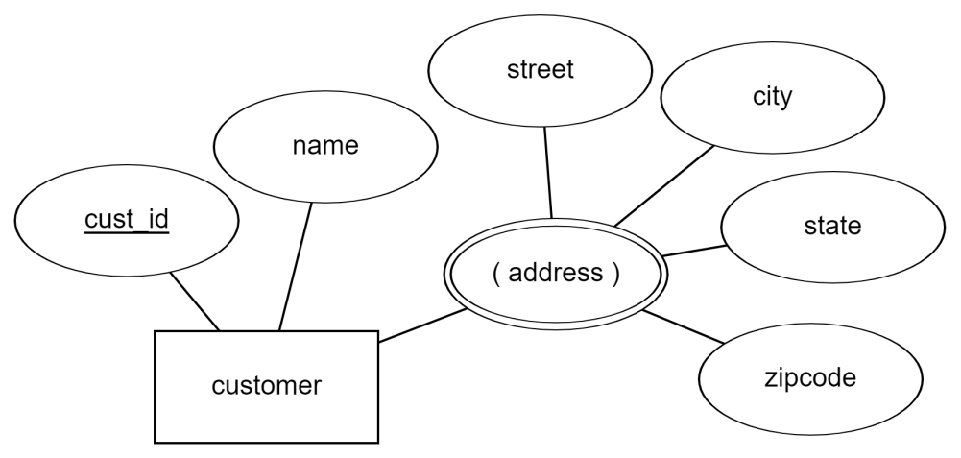
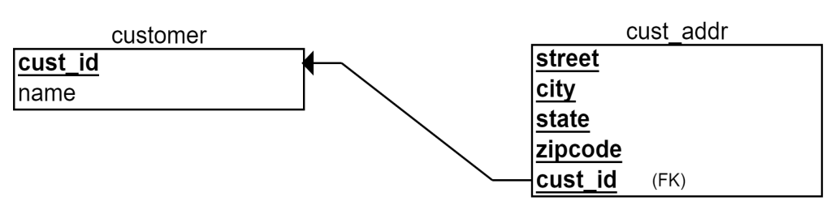
Relational Schema >> Multivalued Attribute
9

Slide 10
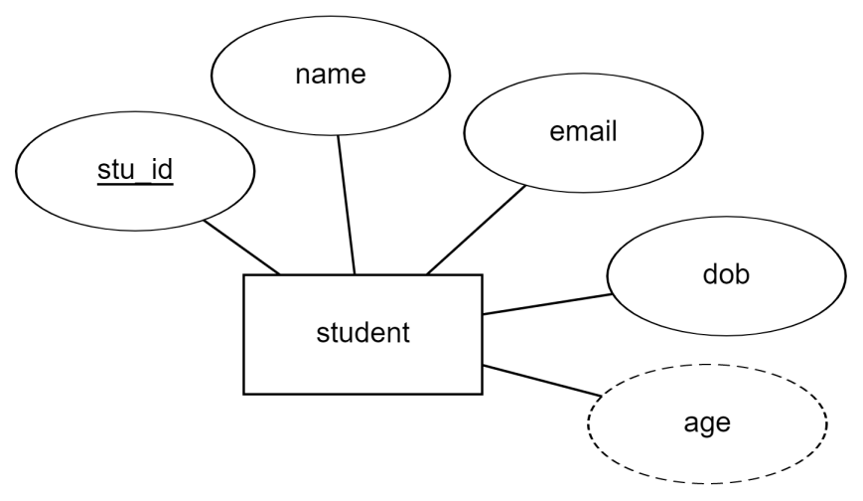

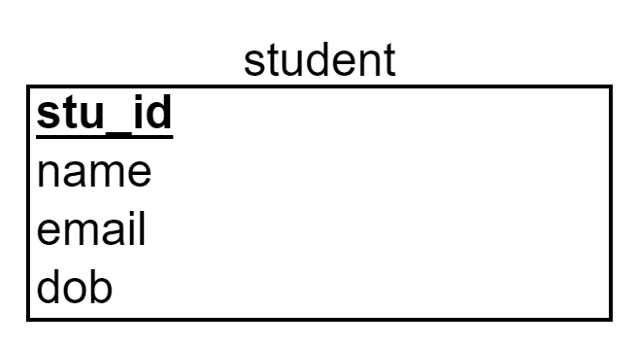
Relational Schema >> Derived Attribute
10

Slide 11
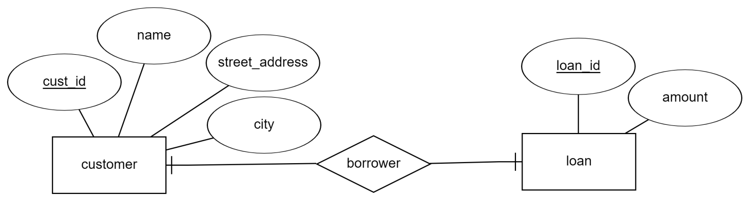
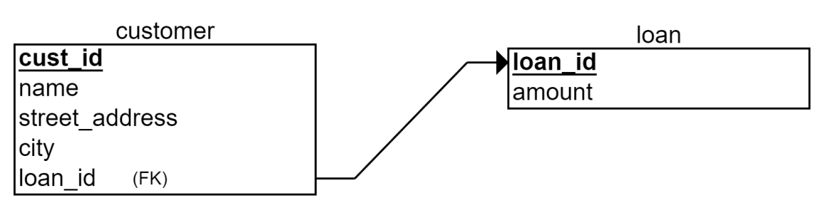
Relational Schema >> One to One Relationship Set
11
Nullable

Slide 12
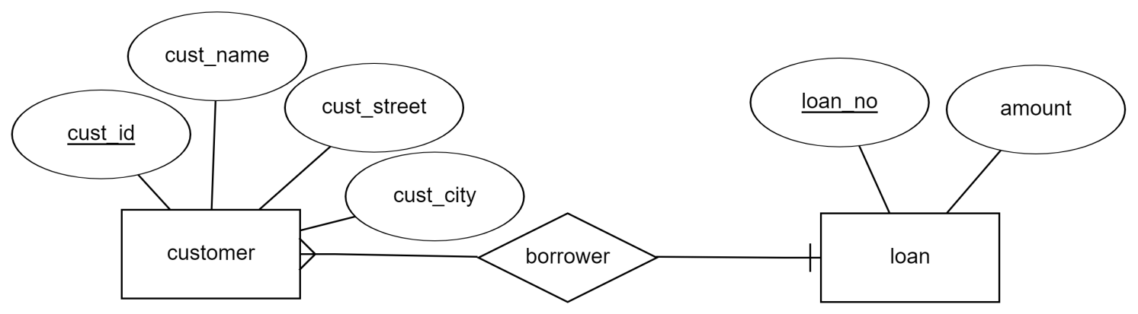
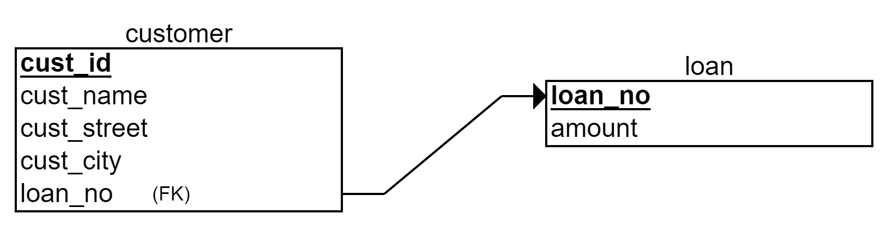
Relational Schema >> One to Many Relationship Set
12
Nullable

Slide 13
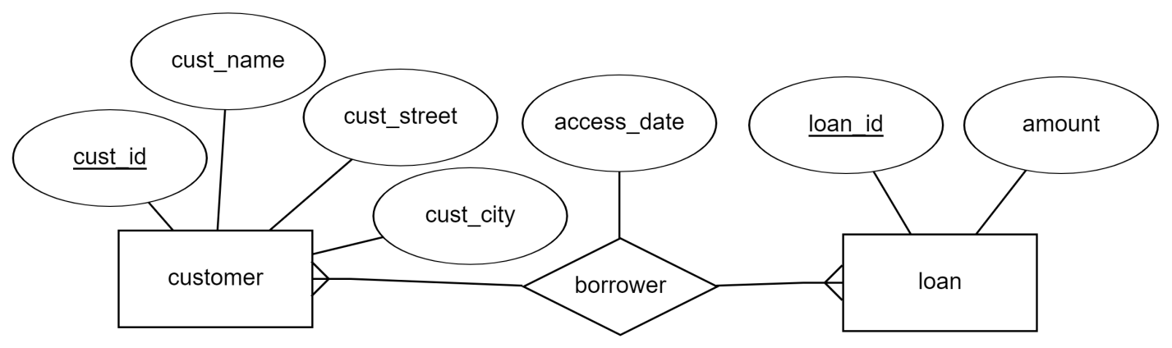
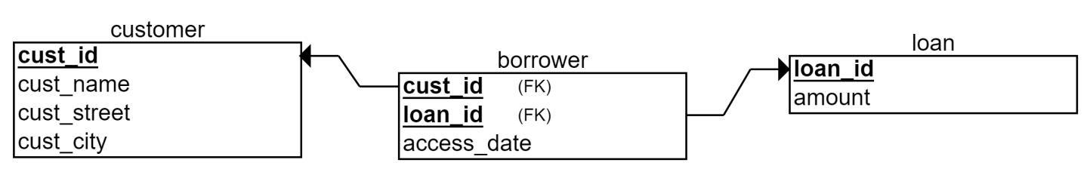
Relational Schema >> Many to Many Relationship Set
13

Slide 14
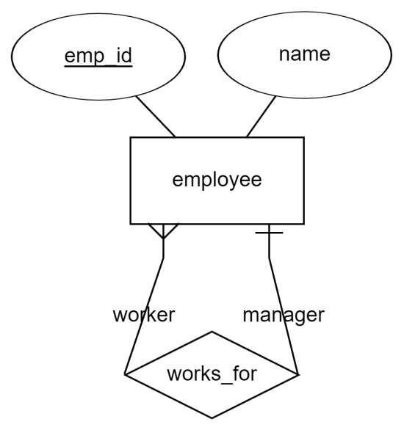
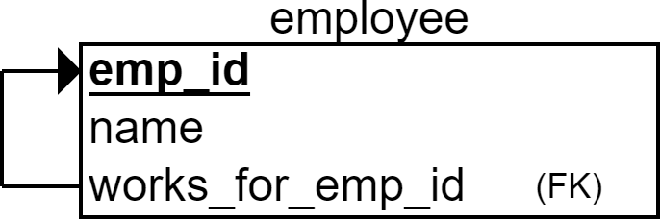
Relational Schema >> Recursive Relationship Set
14

Slide 15
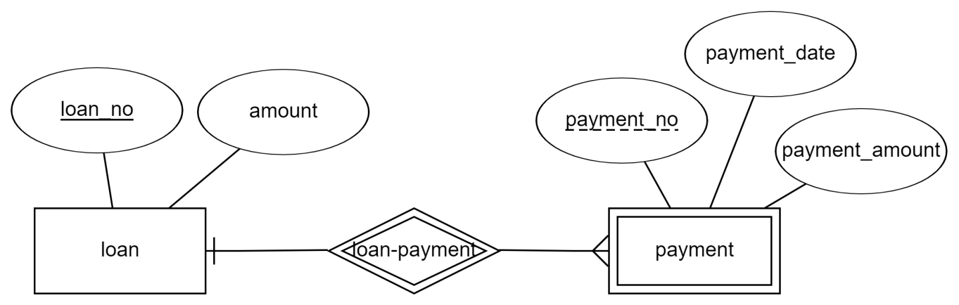
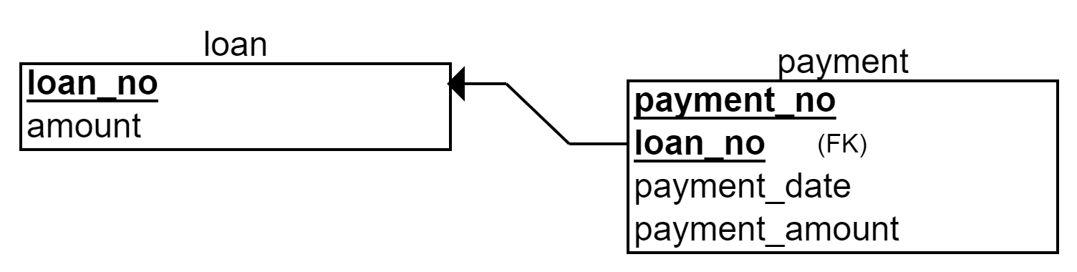
Relational Schema >> Identifying Relationship Set
15

Slide 16
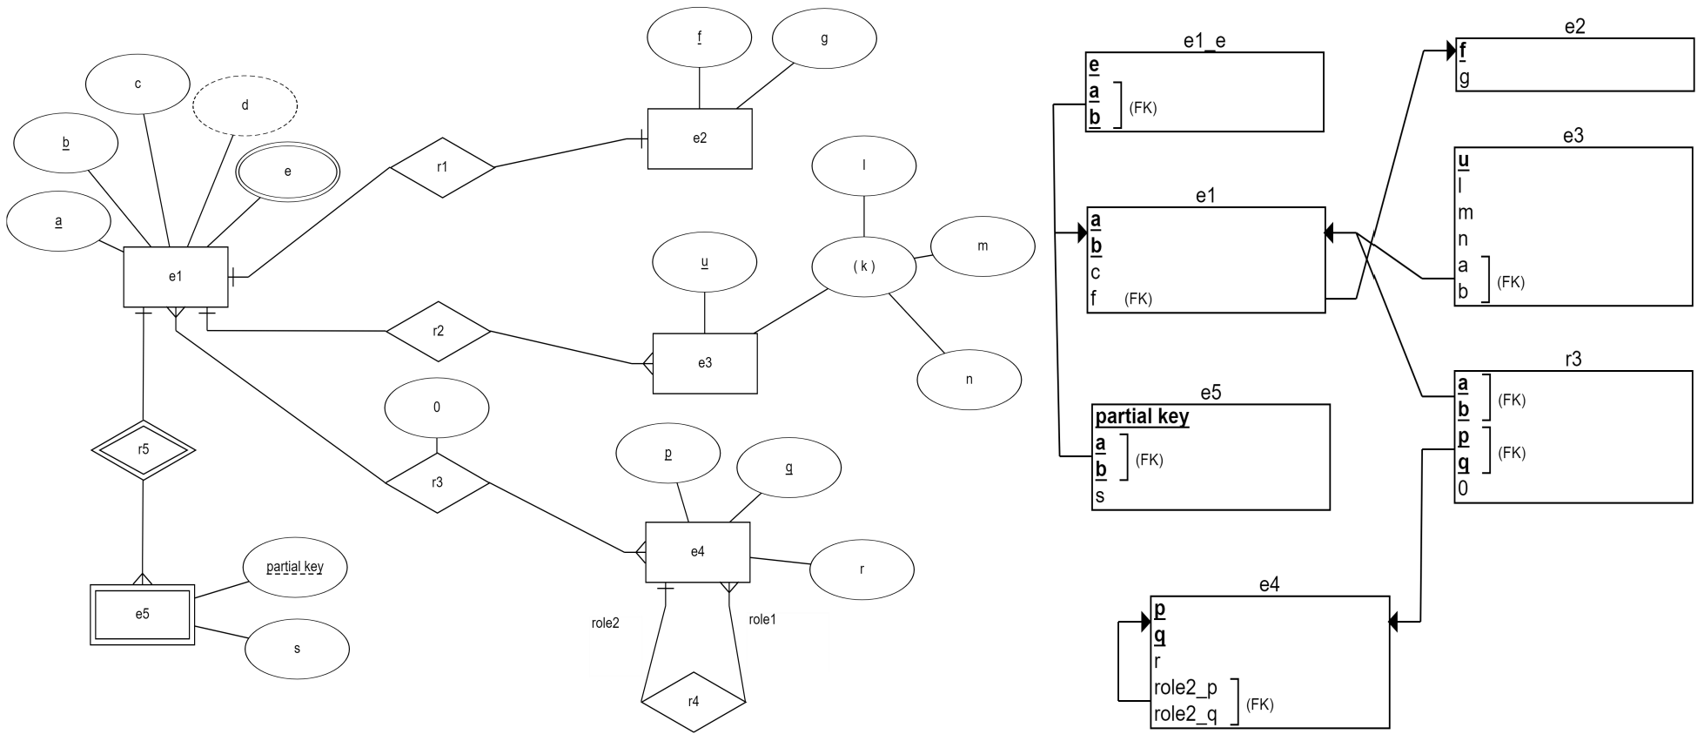
E-R Diagram → Relational Schema
16

