Slide 1

Project :- Feature Extraction and Price Prediction for Mobile Phones
By- Riya Gadia

Slide 2
Intoduction
In this project, we have worked with a dataset that contains detailed information about various mobile phones, including their model, color, memory, RAM, battery capacity, rear camera specifications, front camera specifications, presence of AI lens, mobile height, processor, and, most importantly, the price. Our primary goal is to develop a predictive model for mobile phone prices.
We'll perform a feature extraction analysis to identify the most influential features.

Slide 3
Objective
Our objective is to build a predictive model that can accurately estimate the price of a mobile phone based on its features.
To achieve this, we'll perform a feature extraction analysis to identify the most influential features.
The organization is keen to enhance its pricing strategy by gaining a deeper understanding of the key features that influence the prices of mobile phones in today's highly competitive market.

Slide 4
Dataset Description:
Number of entries: 541
Number of features: 12
Key features: Model, Colour, Memory, RAM, Battery, Cameras, Processor, etc.

Slide 5
Data Preprocessing
Data Cleaning: Conversion of the "Price" column from string to numerical format, ensuring all commas are removed for proper numeric representation.
Handling Missing Values: If any missing values are present, appropriate strategies like imputation or removal are applied.
Feature Encoding: One-hot encoding is applied to categorical features such as Model, Colour, Rear Camera, Front Camera, and Processor to convert them into a format suitable for machine learning algorithms.

Slide 6
Exploratory Data Analysis
Distribution of Features: Analyzing the distribution of numerical features like Memory, RAM, Battery, and Price to understand their range and central tendencies.
Correlation Analysis: Evaluating the correlation between different numerical features and the target variable to identify potential predictors.
Category Frequency: Analyzing the frequency of different categories in categorical features like Model, Colour, and Processor to understand their prevalence in the dataset.

Slide 7
Visualizations

Slide 8
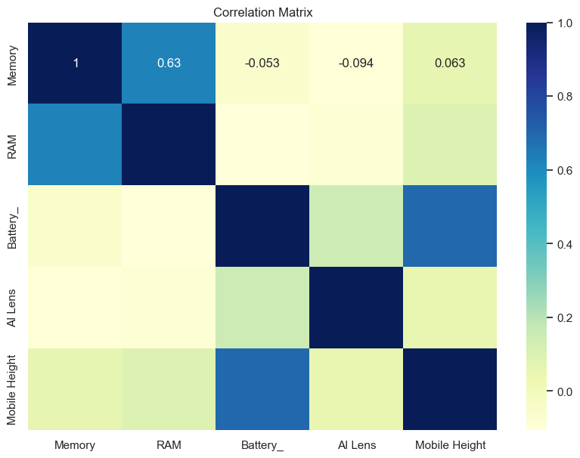
Heat map

Slide 9
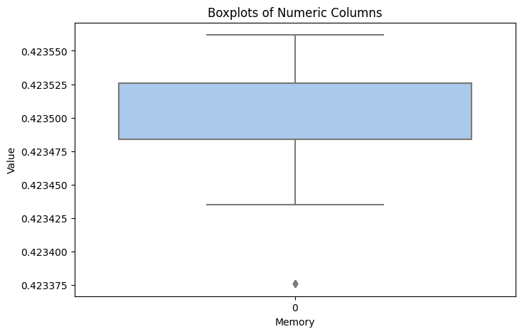
Boxplot

Slide 10
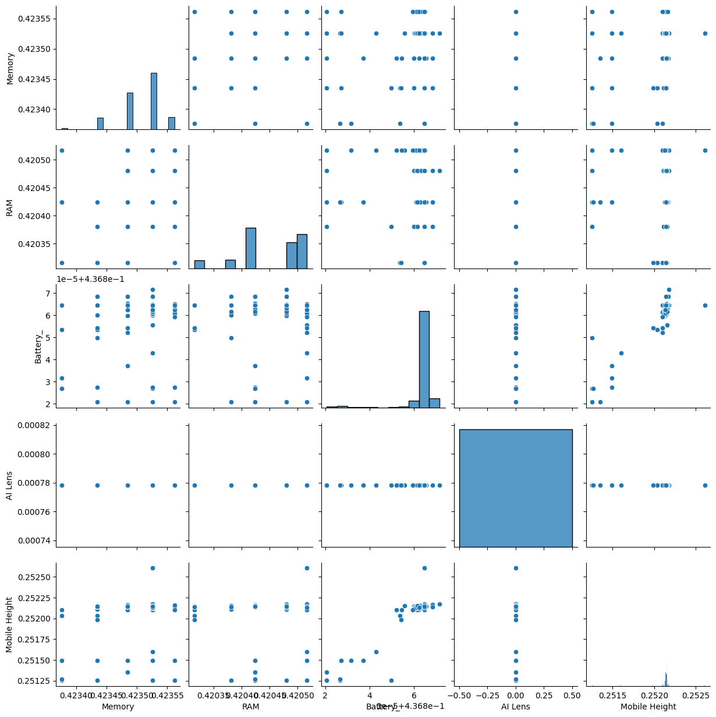
Pairplot

Slide 11
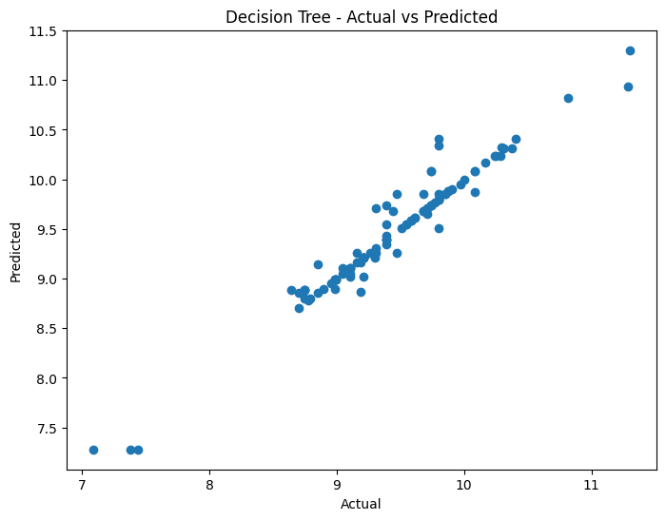
Predicted vs Actual Prices

Slide 12
Conclusion
Best Performers: The Decision Tree Regressor and Random Forest Regressor demonstrated the best performance on both the training and test sets, with R² scores of 0.9418 and 0.9359 respectively. These models are robust and generalize well to unseen data.
Ridge Regression also performed well with an R² score of 0.9114 on the test set, making it a viable option.
XGBRegressor and CatBoosting Regressor also showed strong performance, with R² scores of 0.9209 and 0.9167 respectively, indicating their effectiveness for this task.
Linear Regression and Lasso Regression did not perform well, indicating that they are not suitable for this dataset without significant modifications or improvements.

