Slide 1

User Analytics in the Telecommunication Industry
By- Riya Gadia

Slide 2
Overview
The investor is interested in purchasing TellCo, an existing mobile service provider in the Republic of Pefkakia.
This investor’s due diligence on all purchases includes a detailed analysis of the data that underlies the business, to try to understand the fundamentals of the business and especially to identify opportunities to drive profitability by changing the focus of which products or services are being offered.
To provide a report to analyze opportunities for growth and make a recommendation on whether TellCo is worth buying or selling.

Slide 3
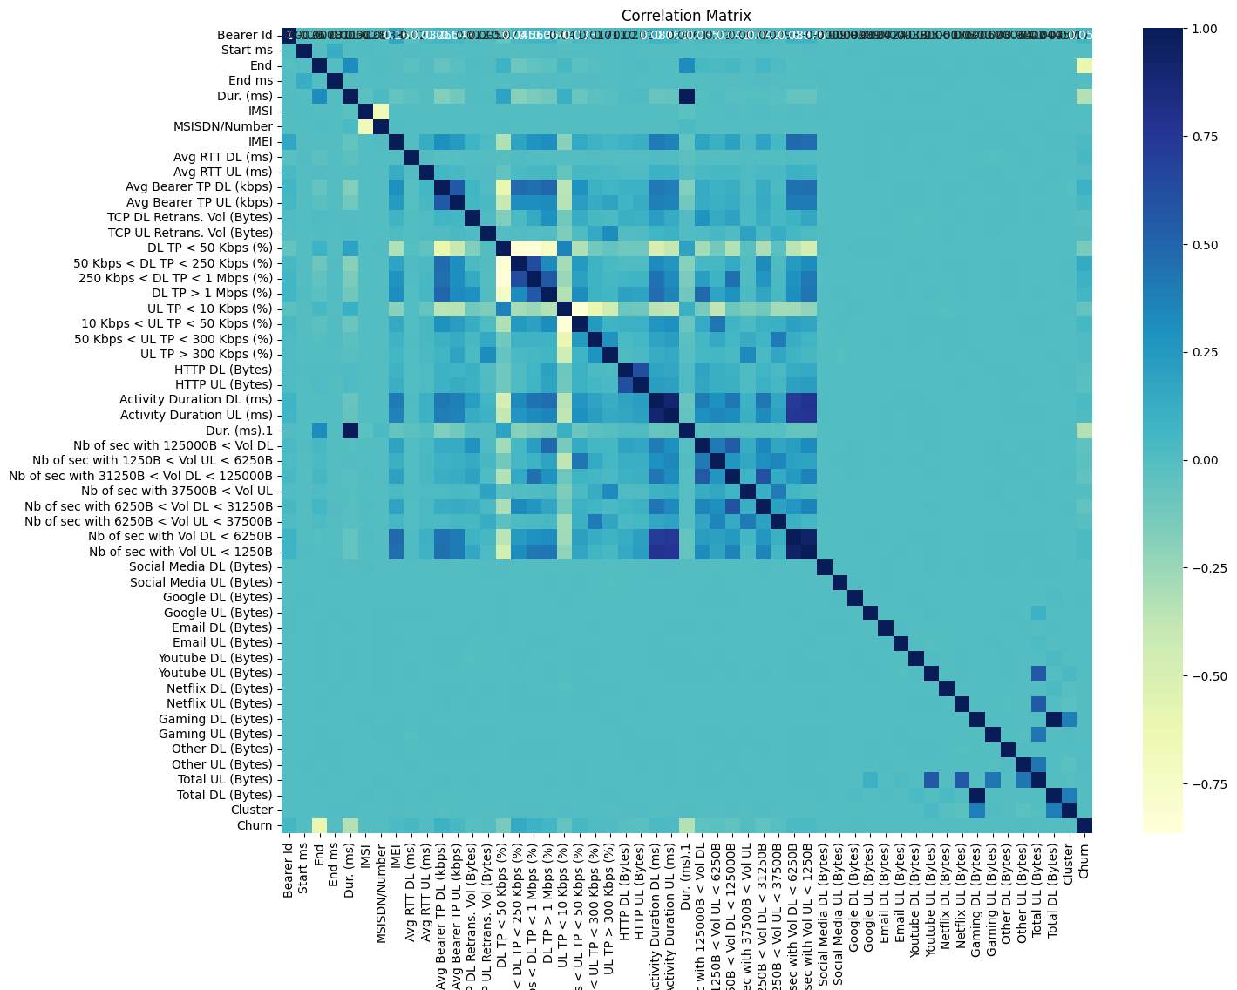
Correlation

Slide 4
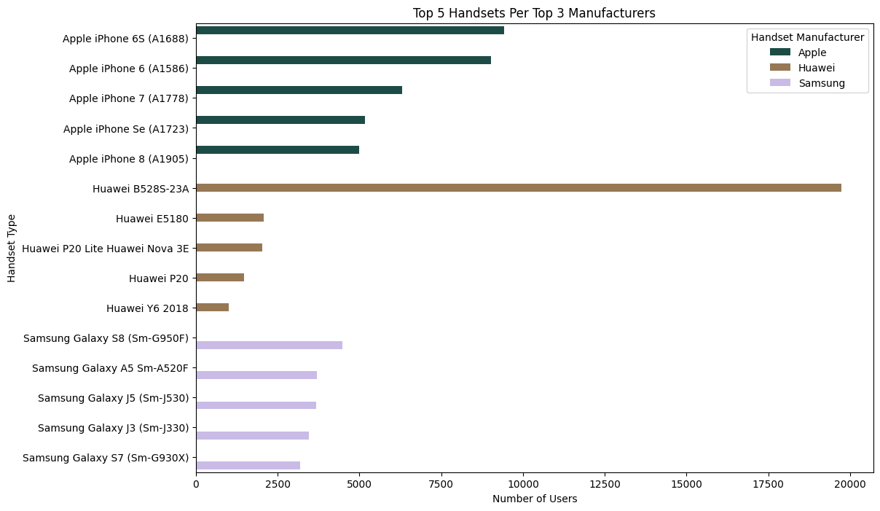
Identify the Top 5 Handsets Per Top 3 Manufacture

Slide 5
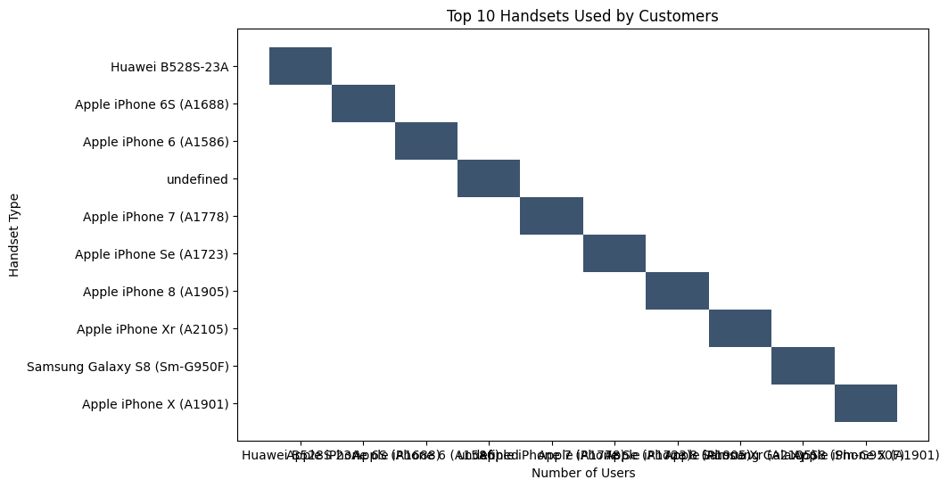
Identify the Top 10 Handsets
Top 10 handsets used by customers: Handset Type Huawei B528S-23A 19724 Apple iPhone 6S (A1688) 9391 Apple iPhone 6 (A1586) 8991 undefined 8892 Apple iPhone 7 (A1778) 6274 Apple iPhone Se (A1723) 5165 Apple iPhone 8 (A1905) 4977 Apple iPhone Xr (A2105) 4555 Samsung Galaxy S8 (Sm-G950F) 4459 Apple iPhone X (A1901) 3805 Name: count, dtype: int64

Slide 6
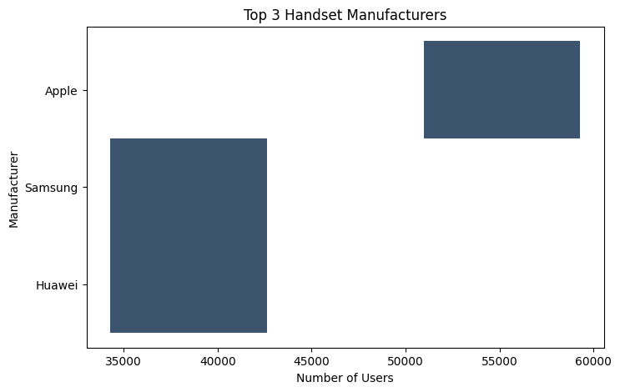
Identify the Top 3 Handset Manufacturers
Top 3 handset manufacturers: Handset Manufacturer Apple 59304 Samsung 40393 Huawei 34269 Name: count, dtype: int64

Slide 7

Key Observations
Apple's dominance: Apple not only leads in terms of the total number of users but also in the variety of models that are still widely used. This reflects strong brand loyalty and customer satisfaction.
Diversity in Samsung devices: While Samsung doesn’t have as many users as Apple, its user base is spread across a variety of models, suggesting a broader range of offerings catering to different segments.
Huawei's niche dominance: The strong showing of the Huawei B528S-23A suggests that Huawei may have a significant presence in specific niches or markets.

Slide 8
Analysis:
Customer Retention: The continued use of older models like the iPhone 6 and 6S could indicate strong customer retention for Apple. It would be interesting to analyze the customer demographics and how they correlate with handset choices.
Impact of undefined handsets: The presence of undefined handsets should be investigated further to understand what this category represents and whether it impacts overall market analysis.
Brand Loyalty: The data suggests that Apple users may have higher brand loyalty, but further analysis on repeat purchases and upgrades could confirm this.

Slide 9
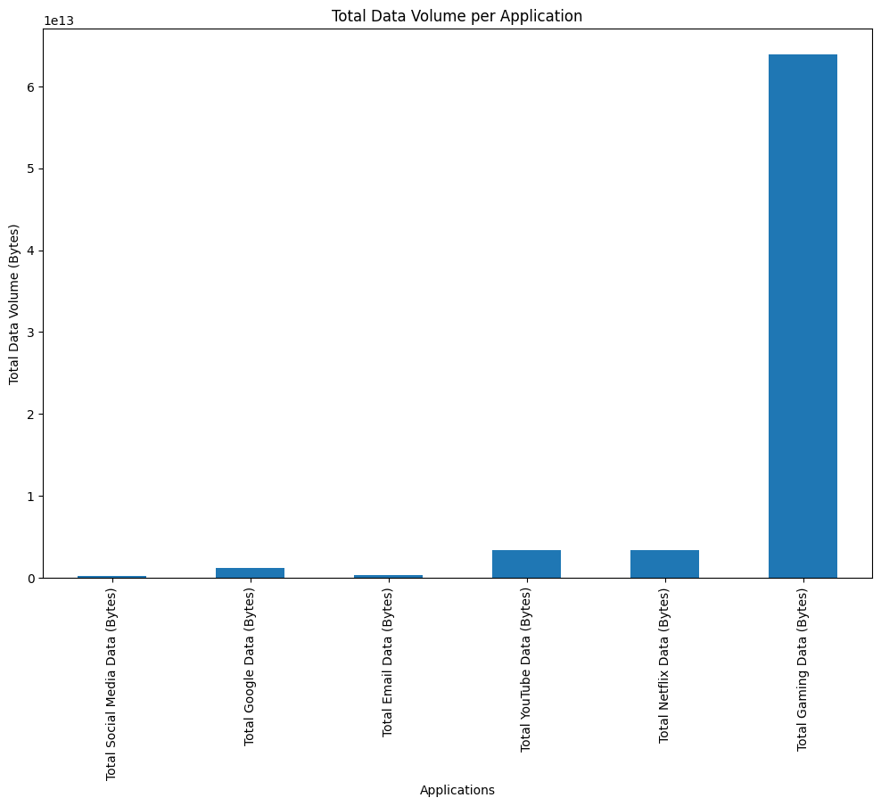
Application usage summary
:Total Gaming Data (Bytes) 6.384655e+13
Total Other Data (Bytes) 6.370400e+13
Total YouTube Data (Bytes) 3.359002e+12
Total Netflix Data (Bytes) 3.356973e+12
Total Google Data (Bytes) 1.158267e+12
Total Email Data (Bytes) 3.351293e+11
Total Social Media Data (Bytes) 2.711855e+11

Slide 10
Key Observations:
Dominance of Gaming and Other Data:
Gaming and Other Data categories consume the most data, each accounting for over 63 TB. These two categories combined represent the bulk of data usage. This could indicate a strong preference for data-intensive applications, particularly in gaming and possibly streaming or other unclassified services.
Significant Video Streaming Usage:
YouTube and Netflix are the next major contributors, each using around 3.36 TB of data. The high data usage in these categories suggests that video streaming is a popular activity among users. It’s interesting that both platforms have nearly identical data usage, indicating a similar level of engagement.

Slide 11
Google Data:​
Google Data stands at 1.16 TB, which is significantly lower than the video streaming and gaming categories. This category could include a mix of search, maps, and other Google services. The relatively lower data usage might reflect less data-intensive activities compared to gaming and video streaming.​
Low Data Usage for Email and Social Media:​
Email and Social Media have the lowest data usage, with Email at 0.34 TB and Social Media at 0.27 TB. This is expected as these activities generally involve smaller data packets compared to gaming or video streaming.​
Despite the ubiquity of social media, the data consumption in this category is low, suggesting that these platforms may not be as heavily used for data-intensive activities (like video streaming or gaming) compared to other categories.​

Slide 12
Output:
Class 0:
Precision: 0.80 (80%): Of all instances predicted as class 0, 80% were correctly predicted.
Recall: 1.00 (100%): The model correctly identified all instances of class 0 (no false negatives).
F1-Score: 0.89 : The high F1-score indicates a good balance between precision and recall for class 0.
Support: 35,571 : The majority class, making up a significant portion of the data.
Class 1:
Precision: 0.00 (0%) : The model failed to correctly predict any instances of class 1.
Recall: 0.00 (0%) : The model failed to identify any true instances of class 1.
F1-Score: 0.00 : The F1-score is zero because both precision and recall are zero.
Support: 8,933 : The minority class, which the model struggled to correctly classify.

Slide 13
Overall Metrics:​
Accuracy: 0.80 (80%)​ : The model correctly classified 80% of the total instances. However, this metric is misleading due to class imbalance.​
Macro Avg:​
Precision: 0.40​
Recall: 0.50​
F1-Score: 0.44​
Interpretation: These averages take the imbalance into account, indicating poor overall performance, particularly in handling the minority class.​
Weighted Avg:​
Precision: 0.64​
Recall: 0.80​
F1-Score: 0.71​
Interpretation: The weighted average is influenced more by the majority class, showing better performance due to its dominance in the dataset.​

