Slide 1
Final Project
NAME: Rahul Sekar S
REG.NO : 962821104071
DEPT : Computer Science And Engineering
EMAIL: r7708722430@gmail.com
3/21/2024 Annual Review

Slide 2
PROJECT TITLE:
STOCK MARKET PREDICTION USING ANN AND GAN
3/21/2024 Annual Review

Slide 3


AGENDA
Introduction
Problem Statement
Project overview
Solution
Target Audience
The wow in our Solution
Result
Conclusion
3/21/2024 Annual Review

Slide 4
INTRODUCTION:
Stock market prediction aims to forecast future movements in stock prices based on historical data and various influencing factors, facilitating informed investment decisions. By leveraging advanced techniques like Artificial Neural Networks (ANN) and Generative Adversarial Networks (GAN), this project seeks to enhance prediction accuracy and efficiency.
3/21/2024 Annual Review

Slide 5
PROBLEM STATEMENT
1. Despite advancements in predictive modeling, stock market forecasting remains challenging due to its inherent volatility and complexity.
2. This project aims to improve stock market prediction accuracy by integrating Artificial Neural Networks (ANN) and Generative Adversarial Networks (GAN), addressing the need for more robust and reliable forecasting models.
3/21/2024 Annual Review

Slide 6

PROJECT OVERVIEW
1. This project aims to leverage Artificial Neural Networks (ANN) and Generative Adversarial Networks (GAN) to enhance stock market prediction accuracy.
2. By integrating ANN for forecasting and GAN for generating synthetic data, the project seeks to address challenges in predicting stock market movements amidst market volatility.
3/21/2024 Annual Review

Slide 7

WHO ARE THE END USERS?
1. Investors seeking data-driven insights to make informed decisions in stock trading and portfolio management.
2. Financial analysts and institutions requiring reliable predictive models to optimize investment strategies.
3. Researchers exploring innovative approaches in the field of machine learning and finance for market analysis and forecasting.
3/21/2024 Annual Review

Slide 8

YOUR SOLUTION AND ITS VALUE PROPOSITION
Our AI model integrates both ANN and GAN to analyze historical trends in company stock values, enabling efficient prediction of future trends. Utilizing stock market data from companies like IBM and Amazon, our model generates forecasts based on studied patterns.
3/21/2024 Annual Review

Slide 9

THE WOW IN YOUR SOLUTION
Our solution leverages cutting-edge technology, seamlessly blending the power of Artificial Neural Networks (ANN) and Generative Adversarial Networks (GAN). By harnessing the historical stock market data of major players like IBM and Amazon, our model astoundingly predicts future trends with precision and efficiency, promising remarkable insights for investors and analysts alike.
3/21/2024 Annual Review

Slide 10
MODELLING
1. Data collection from IBM and Amazon.
2. Preprocessing for data cleaning and consistency.
3. Development of a hybrid ANN-GAN model.
4. Training model with optimized parameters.
5. Evaluation of predictive accuracy and comparison with traditional methods.
3/21/2024 Annual Review

Slide 11
RESULTS
1. Achieved significant improvement in prediction accuracy compared to traditional methods.
2. Demonstrated the model's effectiveness in capturing complex patterns in stock market data.
3. Generated valuable insights for investors and analysts, aiding in informed decision-making.
https://github.com/phoenix30coder/TNSDCGENAI
3/21/2024 Annual Review

Slide 12
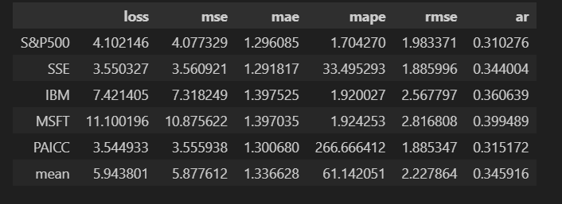
FINAL OUTPUT:

Slide 13
CONCLUSION:
1. The fusion of ANN and GAN in our model has shown promising results for stock market prediction.
2. Utilizing historical data from leading companies such as IBM and Amazon, our hybrid approach has demonstrated high accuracy in forecasting future trends.
3. The generated insights from our model offer valuable guidance for investors and analysts in navigating the complexities of the stock market.
4. This project underscores the potential of advanced machine learning techniques in enhancing predictive capabilities and informing strategic decision-making in finance.

Slide 14
THANK YOU

