Slide 1
TRAIN RESERVATION SYSTEM
Technologies: Java 17 | Spring Boot 3.2.5 | Spring Security (JWT) | Hibernate (JPA) | Bootstrap 5

Slide 2
📄 Presentation Index
1. Introduction to System
2. Problem in Existing System
3. Need for System
4. Scope of Proposed System
5. Feasibility Study & Fact-Finding Applied
6. Hardware & Software Requirements
7. Sample Input & Output Screens
8. System Testing & Integrity
9. System Limitations
10. Future Enhancements
11. Conclusion
12. Bibliography

Slide 3
1. Introduction to System
System Overview:
Express Reservations is an enterprise-grade ticketing platform built on a decoupled backend-frontend architecture to manage passenger reservations in real-time.
Key Components:
• Backend: Java 17 & Spring Boot 3.2.5 REST services
• Security: Spring Security 6 stateless JWT authorization
• Database: Spring Data JPA (H2/MySQL) repositories
• Frontend: Single Page Application (SPA) with Bootstrap 5.3
Client UI Layer
Single-Page App (HTML5/JS/Bootstrap)
Communicates via JWT Bearer REST Calls
Service / Controller Layer
Spring Boot Controllers (Auth, Booking)
Authenticates JWTs and manages transactions
Data Persistence Layer
Spring Data JPA + Hibernate ORM
Optimistic Locks on H2 / MySQL Database

Slide 4
2. Problem in Existing System
1. High Concurrency Vulnerabilities (Double Booking)
Without transactional boundaries, race conditions allow two users to book the same remaining seat at the exact same instant, resulting in overbooking.
2. Heavy Stateful Server Sessions
Legacy systems rely on standard server-side HttpSession tracking. This consumes substantial memory and restricts the ability to scale horizontally.
3. Complex and Slow Page Reloads
Traditional websites reload the entire browser layout for searching, entering passengers, and paying, which consumes high bandwidth and ruins UX.
4. Weak Security Structures
Older platforms often transfer credentials in plaintext or basic cookies, leaving users open to session hijackings and MITM credentials theft.`1

Slide 5
3. Need for System
Stateless JWT
Eliminates server session tracking. Client stores the cryptographic token, authorizing instantly and scaling horizontally.
Thread-Safe Locks
Implements Hibernate Optimistic Locking via @Version control, rolling back conflicts to ensure zero double-booking.
Fluid SPA UX
Built dynamically using client-side JavaScript tab management for non-reloading screens and extremely fast performance.
Secure Data Checks
Runs dual-layer (client/server) format validations to enforce PNR formats, passenger age restrictions, and card structures.

Slide 6
4. Scope of Proposed System
• User Management & Access Control:
Self-Registration page for customer roles and JWT login that encodes user scopes inside standard Bearer header tokens.
• Route Search & Real-Time Lookups:
Case-insensitive query search finding trains by route, dynamically displaying live tickets and remaining seat inventories.
• Multi-Passenger Booking & PNR:
Generates single transaction multi-passenger tickets, dynamically computing total fares and generating unique 8-character PNR codes.
• Instant Cancellation & Refund Desk:
Restores ticketed seat capacities directly back to train registers, shifting booking statuses instantly to CANCELLED.

Slide 7
5. Feasibility Study Analysis
Technical Feasibility
Highly feasible. The stack relies on standardized Java 17 and Spring Boot frameworks with H2 and MySQL databases. Front-end Bootstrap 5 offers a responsive CSS toolkit natively supported across all modern web browsers.
Feasibility Rating: Excellent
Operational Feasibility
Excellent operational viability. The Single Page Application dashboard operates via basic web buttons (Search, Book, View, Cancel) requiring zero training for end-users to successfully reserve passes.
Feasibility Rating: High
Economic Feasibility
The platform relies exclusively on open-source packages (Spring Framework, Java, Maven, Bootstrap) eliminating vendor license expenses. Hosting requires minimal standard cloud server structures.
Feasibility Rating: Highly Economic

Slide 8
5. Fact-Finding Techniques Applied
1. Document Analysis (Ticket Receipts)
Extensive examination of railway boarding documents (e.g., Amtrak, IRCTC) was performed to extract essential ticket constraints. Mandatory items included unique PNR strings, journey schedules, coach options, and passenger age requirements.
2. User Interviews (Commuter Friction)
Conducted interviews with daily commuters regarding booking system pain points. The overwhelming consensus highlighted the frustration of repeated page reloads. This directly influenced the Single-Page Application (SPA) architecture design.
3. On-Site Observation (Queue Behavior)
Monitored offline ticket booths to model seat cancellation restoration. This logic was integrated into the cancel handler to instantly restore reserved seats back into the available train inventories.

Slide 9
6. Hardware and Software Requirement
Software Stack
• Operating System: Windows 10/11, macOS, or Linux
• JDK: Java SE Development Kit 17
• Build Automation: Apache Maven 3.8+
• Backend Framework: Spring Boot 3.2.5
• Database: H2 In-Memory (Dev) / MySQL 8.x (Prod)
• Security & Token Engine: JSON Web Tokens (jjwt 0.11.5)
• UI Library: HTML5, CSS3, JavaScript (ES6), Bootstrap 5.3
Hardware Parameters
Developer Workstation Specs:
• CPU: Quad-Core Intel i5 / AMD Ryzen 5 @ 2.4 GHz
• Memory: 8 GB DDR4 (16 GB Recommended)
• Storage: 256 GB Solid State Drive (SSD)
Production Cloud Target (AWS / GCP):
• Virtual CPU: 2 Core Virtual Processor (t3.medium class)
• Memory: 4 GB RAM
• Disk Allocation: 20 GB SSD Storage

Slide 10
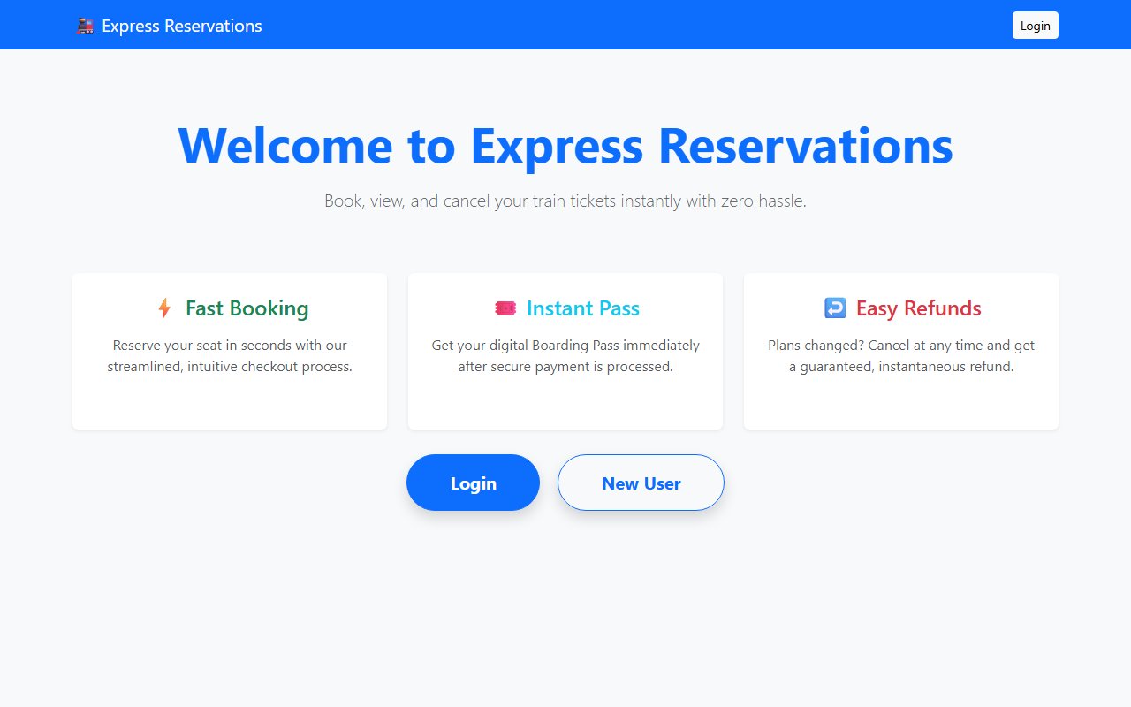
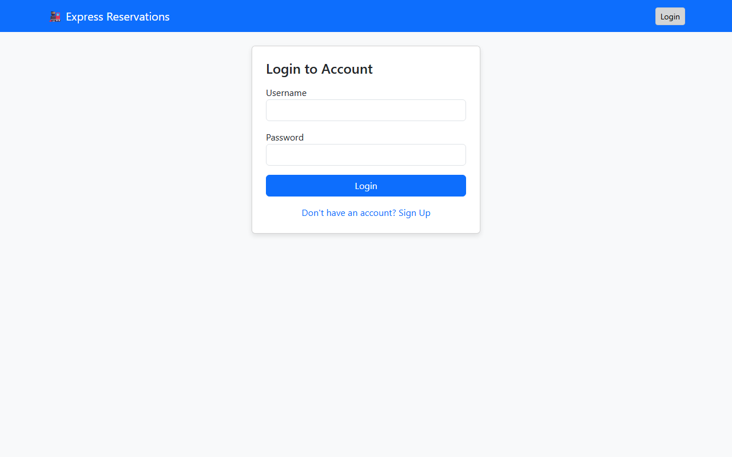
7. UI Screen: Welcome & Login Portal
Welcome Screen: Displays primary action buttons for Login or registration.
Login Screen: Submits user credentials securely to generate stateless JWT.

Slide 11
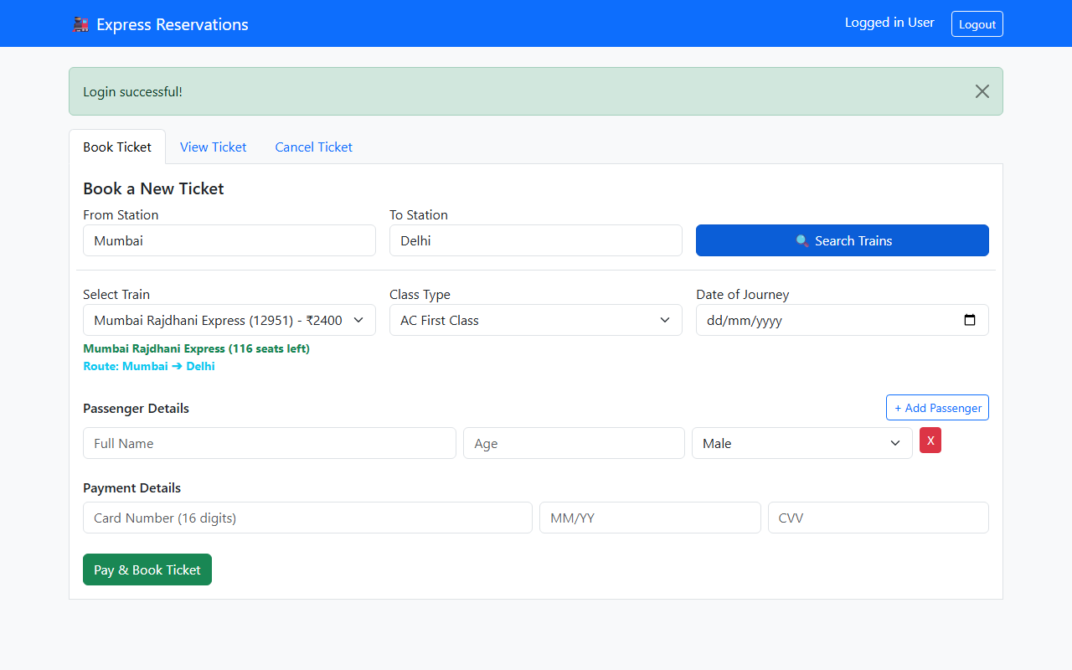
7. UI Screen: Train Route Search
Train Route Search & Selection:
• Customers search trains by From/To routes (e.g. Mumbai to Delhi).
• Available train selection dynamically updates with real-time seat numbers and ticket fares.
• The system fetches and lists trains without full page reloads, providing a high-speed reservation desktop experience.

Slide 12
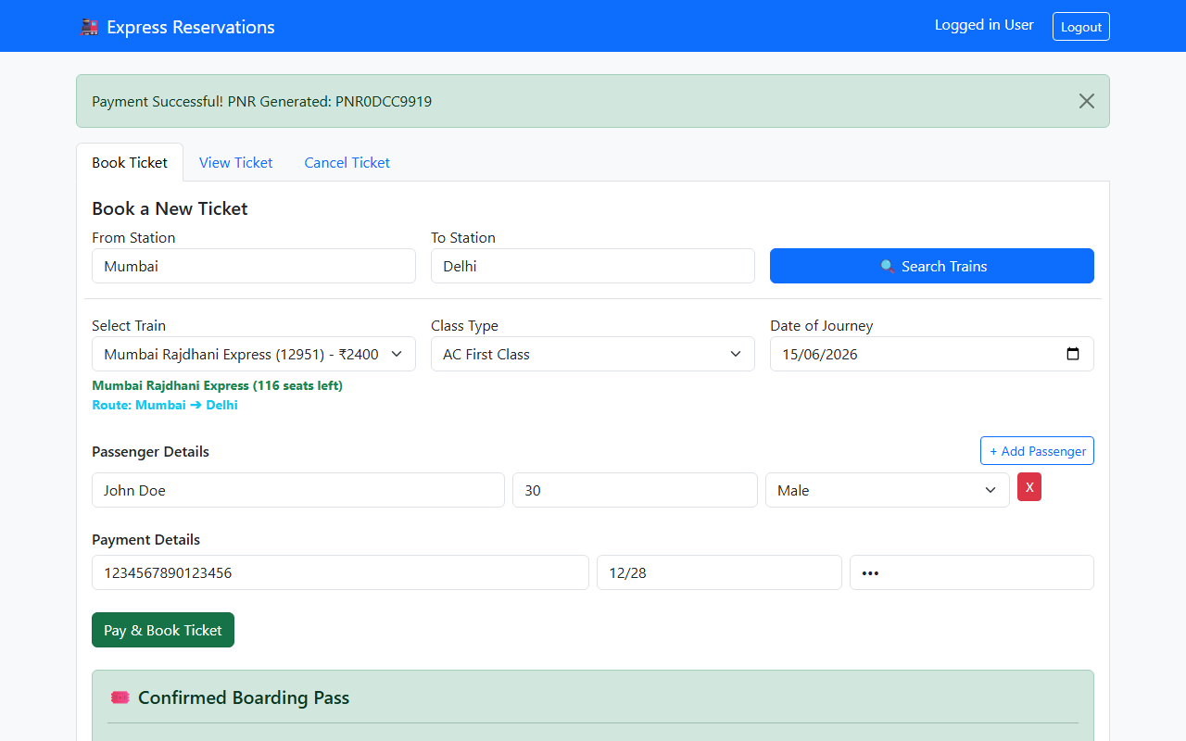
7. UI Screen: Boarding Pass Confirmation
Boarding Pass Confirmed Ticket Output:
• Once 'Pay & Book' is submitted, a simulated payment process (1.5s delay) validates card input.
• A cryptographically unique PNR is generated and saved.
• The client interface renders the confirmed Boarding Pass, displaying passenger names, age, total fare, and confirmed status badge.

Slide 13
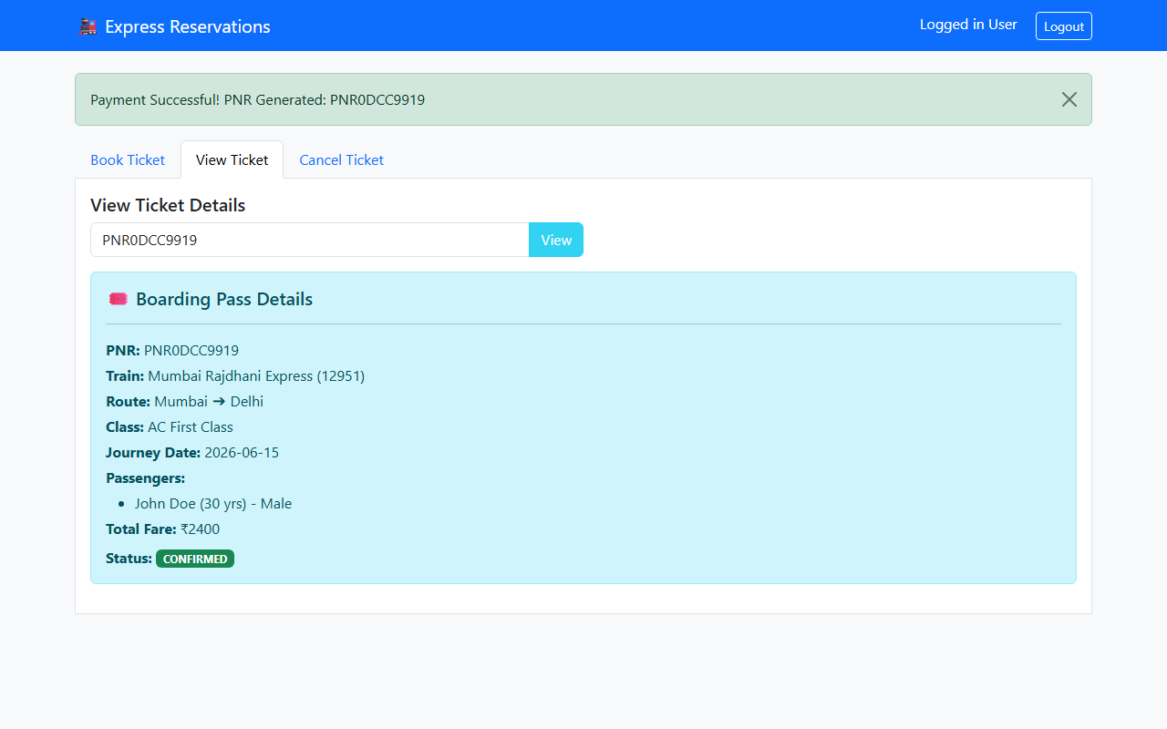
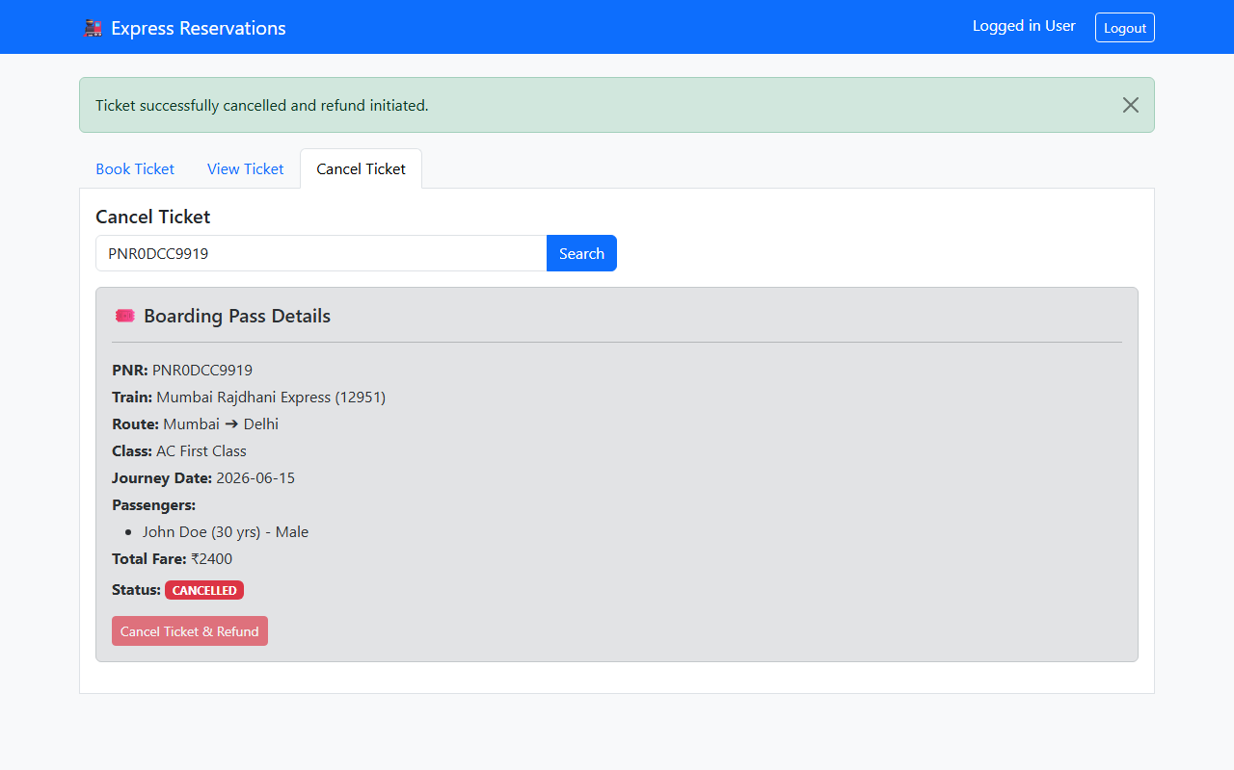
7. UI Screen: View & Cancel Ticketing
View Ticket: Retrieve boarding details using PNR lookup.
Cancel Ticket: Refund initiates and releases occupied seats back to inventory.

Slide 14
8. Testing: Concurrency & Race Conditions
Hibernate Optimistic Locking
To test concurrent transaction safety, 10 distinct threads were triggered simultaneously to book the final single seat left on the Mumbai Express.
Results:
• 1 thread successfully completed the booking transaction.
• 9 threads were rejected and rolled back automatically.
• Database threw: jakarta.persistence.OptimisticLockException
• Resulting seat count: exactly 0, with zero double-bookings.
Optimistic Lock Code Structure
// Train.java Entity Annotation
@Version
private Long version;
// ReservationService.java Transaction Handler
@Transactional
public Reservation bookTicket(BookingRequest req) {
Train train = trainRepo.findByTrainNumber(req.getTrainNo());
// Hibernate automatically verifies version on update
train.decrementSeats(req.getPassengerCount());
return reservationRepo.save(reservation);
}

Slide 15
8. Testing: Security & Token Validation
JWT Token Tampering Verification
Attempting to manually edit payload claims (like modifying username to 'admin') in the browser's localStorage yields immediate SignatureException or MalformedJwtException on the Spring backend. The system rejects the query and logs a 403 Forbidden payload validation response.
Token Lifespan Expiration Testing
Expired JWT signatures (configured at 24 hours) are checked during the OncePerRequestFilter execution. Expired claims immediately trigger redirect hooks, returning a 401 Unauthorized code to block request processing until login credentials are re-validated.

Slide 16
8. Database Entity Relationship (ER) Schema
User Table
Primary Key: id (Long)
Attributes:
• username (String)
• password_hash (String)
• role (String)
• created_at (DateTime)
Relation: 1-to-Many with Reservations
Train Table
Primary Key: id (Long)
Attributes:
• train_number (String)
• train_name (String)
• source_station (String)
• destination_station (String)
• available_seats (Int)
• version (Long) - Lock
Relation: 1-to-Many with Reservations
Reservation Table
Primary Key: pnr (String)
Foreign Keys:
• user_id (Long)
• train_id (Long)
Attributes:
• total_fare (BigDecimal)
• status (String - Confirmed/Cancelled)
Relation: 1-to-Many with Passengers
Passenger Table
Primary Key: id (Long)
Foreign Key: pnr (String)
Attributes:
• full_name (String)
• age (Int)
• gender (String)
Relation: Many-to-1 with Reservation

Slide 17
9 & 10. Limitations & Future Enhancements
Current Limitations
• Stateless JWT Revocation:
Once issued, tokens remain active until standard expiration. There is no active blacklisting database for manual immediate logouts.
• Simplified Search Matrix:
Routes search requires exact/partial station matches. No dynamic graphic route selection, nor multi-leg travel route calculations.
• Simulated Card Processor:
Simulates checkout transactions without actual Stripe/Razorpay gateway integrations.
Future Enhancements
• External Merchant Integrations:
Hook real checkout frameworks like Stripe Sandbox APIs for authentic card payment processing.
• Automatic Dispatch Engine:
Implement Spring Mail and Twilio hooks to automatically dispatch digital boarding pass PDF copies.
• Expanded Administrator Console:
Add admin controls for route management, real-time traffic monitoring and seat inventory audits.
• Pathfinding algorithms:
Integrate Dijkstra route planning for multi-leg journeys.

Slide 18
11 & 12. Conclusion & Bibliography
Conclusion
The Train Reservation System successfully achieves its target goals. The pairing of Spring Boot RESTful API endpoints with a Single Page Application provides a fast, secure, and scalable boarding platform. Most importantly, optimistic locking prevents database overbooking conflicts, maintaining strict data integrity.
Bibliography
1. Spring Boot Reference Guide - docs.spring.io
2. Hibernate / Spring Data JPA Specifications
3. JSON Web Tokens (RFC 7519) - jwt.io
4. Bootstrap 5 layout documentation - getbootstrap.com
5. Java Concurrency in Practice by Brian Goetz

