Slide 1
CUSTOMER CHURN ANALYSIS
Uncovering the drivers of customer attrition using Python and SQL
Python
Pandas
Seaborn
SQL
Data Cleaning • Exploratory Data Analysis • SQL Business Insights
Riya Mawar

Slide 2
Project Objective
This project analyzes the Telco Customer Churn dataset to understand why customers leave and what factors most strongly predict attrition. Using Python for data cleaning and exploratory analysis, and SQL for deeper business-focused querying, the goal is to turn raw customer data into clear, actionable retention strategies.
Clean & Prepare Data
Exploratory Analysis
SQL Business Queries
Retention Insights
"You can’t fix what you don’t understand — churn analysis turns lost customers into lessons."
Customer Churn Analysis | Python & SQL
2

Slide 3
Dataset Overview
The dataset used is the Telco Customer Churn dataset, containing demographic, account, and service-usage details for each customer. It includes the customer's contract type, billing information, subscribed services, and whether they churned — making it well suited for churn prediction and retention analysis.
Dataset Type
Telco Customer Churn Dataset (subscription & billing records)
Sample Columns
customerID
tenure
Contract
MonthlyCharges
TotalCharges
PaymentMethod
InternetService
Churn
Key columns include: tenure, Contract, MonthlyCharges, TotalCharges, PaymentMethod, InternetService, and Churn.
7,043
21
0
Raw Customer
Records
Total Columns
Duplicate
Records
Customer Churn Analysis | Python & SQL
3

Slide 4
Data Cleaning Summary
The raw dataset was inspected for missing values, blank entries, incorrect data types, and duplicates before analysis. TotalCharges was stored as text with 11 blank entries for new customers; these were converted to numeric and removed, leaving a clean, analysis-ready dataset.
11
1
0
7,032
Blank TotalCharges
Records Removed
Data Type
Converted
Duplicate
Records Found
Clean Records
Ready for EDA
"High-quality analysis begins with high-quality data — and clean data builds trustworthy insights."
Customer Churn Analysis | Python & SQL
4

Slide 5
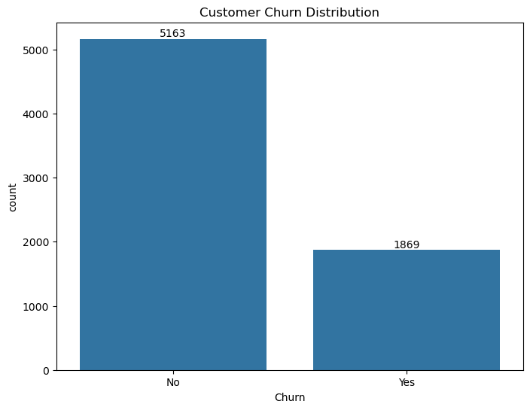
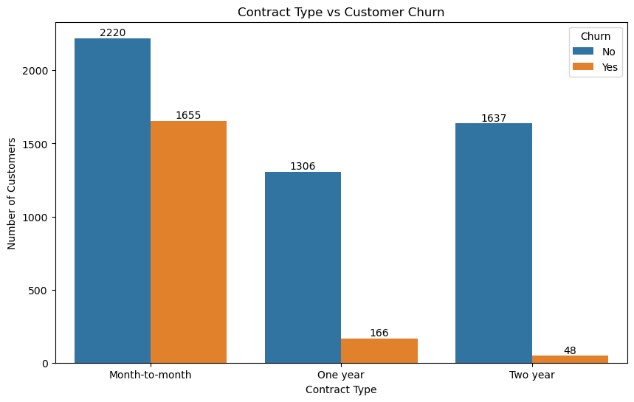
EDA: Overall Churn & Contract Type
Understanding how many customers churn, and how contract length affects retention.
Insight: 26.58% of customers churned (1,869 of 7,032). Nearly 1 in 4 customers left the company.
Insight: Month-to-month customers churn far more (1,655) than one-year (166) or two-year (48) contract holders.
Customer Churn Analysis | Python & SQL
5

Slide 6
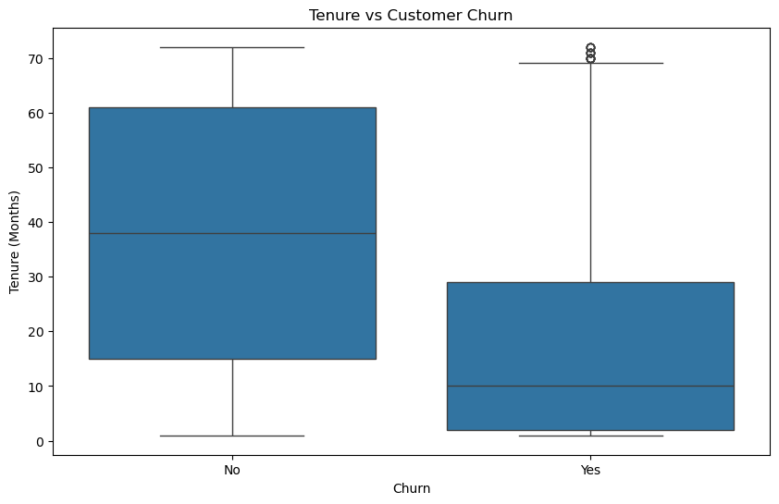
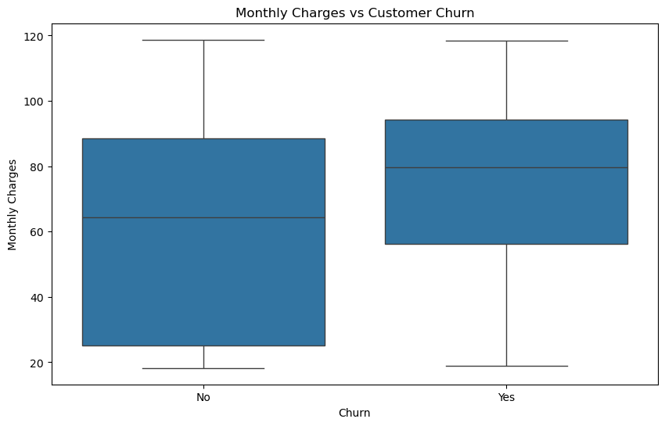
EDA: Tenure & Monthly Charges
Comparing customer loyalty duration and spending between churned and retained customers.
Insight: Churned customers have far shorter tenure (avg 17.98 months) vs. retained customers (avg 37.65 months).
Insight: Churned customers pay higher monthly charges on average ($74.44) than retained customers ($61.31).
Customer Churn Analysis | Python & SQL
6

Slide 7
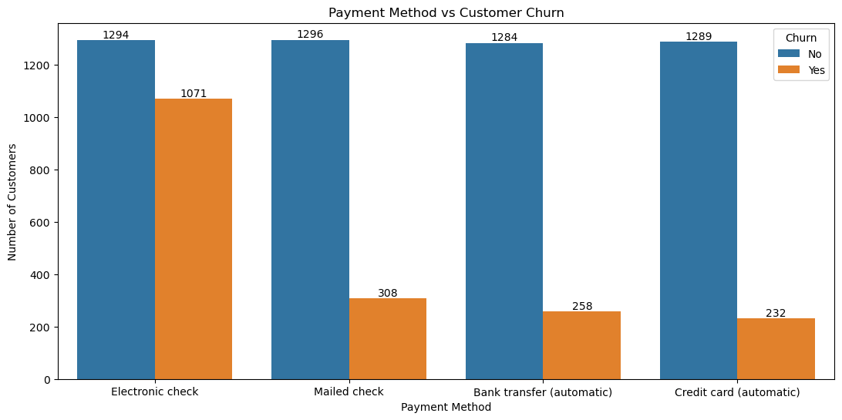
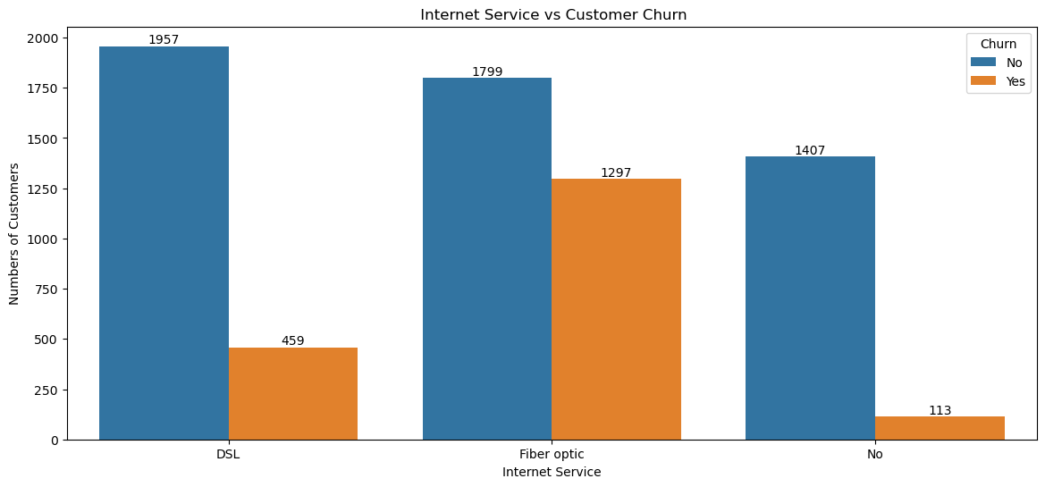
EDA: Payment Method & Internet Service
Examining how billing method and service type relate to churn.
Insight: Electronic check users churn the most (1,071) — far above automatic payment methods.
Insight: Fiber optic customers churn most (1,297), suggesting pricing or service-quality concerns.
Customer Churn Analysis | Python & SQL
7

Slide 8
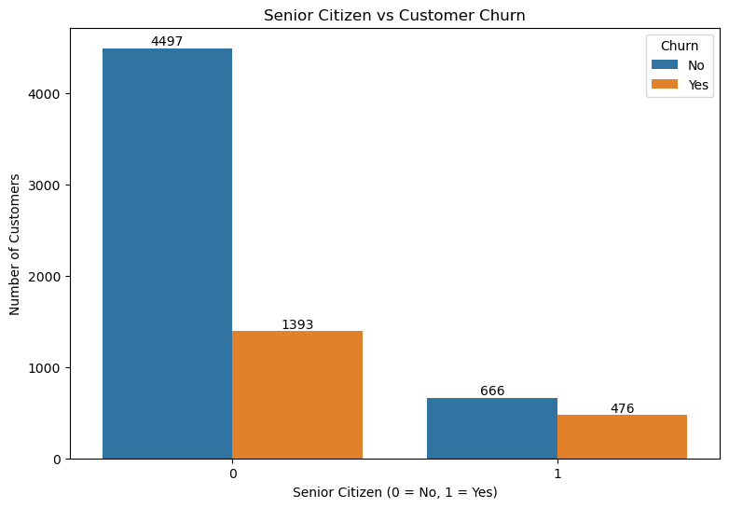
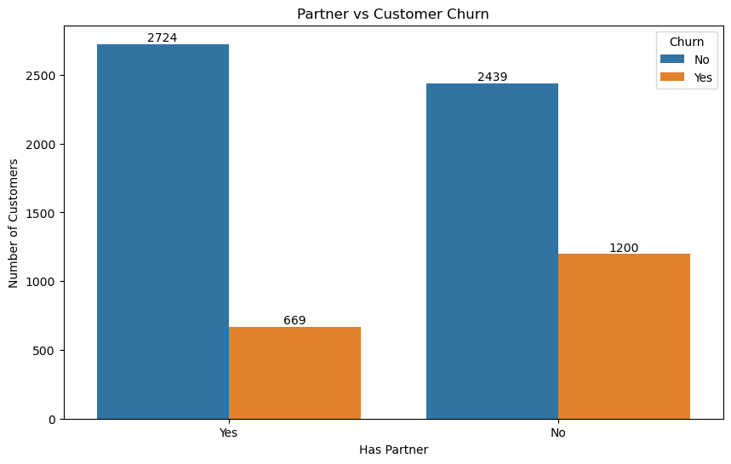
EDA: Customer Profile
Exploring how demographic and household factors influence churn behavior.
Insight: Senior citizens churn at a higher relative rate than non-senior customers.
Insight: Customers without a partner churn more (1,200) than those with a partner (669).
Customer Churn Analysis | Python & SQL
8

Slide 9
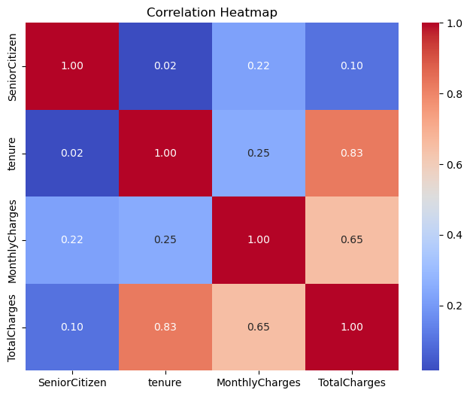
Correlation Analysis
Relationships between key numerical features in the dataset.
Tenure ↔ TotalCharges:
Strong positive correlation (0.83) — customers who stay longer accumulate higher total charges, as expected.
MonthlyCharges ↔ TotalCharges:
Moderate positive relationship, driven largely by tenure.
SeniorCitizen:
Shows no strong correlation with the other numerical features.
Customer Churn Analysis | Python & SQL
9

Slide 10
SQL Business Insights
Key metrics extracted through SQL queries on the cleaned dataset.
7,032
26.58%
$64.80
$76.26
Total Customers
Analyzed
Overall Churn
Rate
Avg Monthly
Charges
Highest Avg Charge:
Electronic Check
Contract Type Drives Churn
Top Customers Ranked by Value
Month-to-month customers accounted for 1,655 churned accounts — dramatically higher than one-year (166) and two-year (48) contracts. Longer commitments strongly correlate with retention.
Using SQL window functions (RANK), top customers by total charges were identified overall and within each contract type — e.g. customer 2889-FPWRM leads with $8,684.80 — enabling targeted loyalty efforts for high-value accounts.
Customer Churn Analysis | Python & SQL
10

Slide 11
SQL Insights: Tenure & Spending Patterns
Deeper SQL queries comparing customer loyalty duration, contract pricing, and payment behavior.
37.65 mo
17.98 mo
$66.40
$43.96
Avg Tenure —
Retained Customers
Avg Tenure —
Churned Customers
Highest Avg Charge:
Month-to-Month
Lowest Avg Charge:
Mailed Check
Loyalty Grows Over Time
Payment Method Signals Risk
Customers who stayed had more than double the average tenure of those who churned (37.65 vs. 17.98 months). This confirms that the first year of the customer relationship is the highest-risk period for attrition.
Electronic check users pay the highest average monthly charge ($76.26) and also showed the highest churn earlier in this analysis. Mailed check users pay the least ($43.96) and churn far less — pricing and payment friction likely both play a role.
Customer Churn Analysis | Python & SQL
11

Slide 12
SQL Insights: High-Value Customers
Using ORDER BY and the RANK() window function to identify and prioritize top customers.
Top 10 Customers by Total Charges
Customer ID | Contract | Total Charges
2889-FPWRM | One year | $8,684.80
7569-NMZYQ | Two year | $8,672.45
9739-JLPQJ | Two year | $8,670.10
9788-HNGUT | Two year | $8,594.40
8879-XUAHX | Two year | $8,564.75
9924-JPRMC | Two year | $8,547.15
0675-NCDYU | Two year | $8,543.25
6650-BWFRT | Two year | $8,529.50
0164-APGRB | Two year | $8,496.70
1488-PBLJN | Two year | $8,477.70
RANK() Over Total Charges
Customer 2889-FPWRM leads with $8,684.80 in total charges, followed by 7569-NMZYQ at $8,672.45. Nine of the top 10 spenders hold Two-year contracts — the company's most loyal segment.
Ranking Within Contract Type
Partitioning by contract (RANK() OVER PARTITION BY Contract) surfaces the top spender per segment — e.g. 9481-IFBZY leads Month-to-month customers at $8,061.50.
Business Insight: These high-value, long-tenured customers should be prioritized for loyalty rewards — losing them carries outsized revenue impact.
Customer Churn Analysis | Python & SQL
12

Slide 13
Key Findings & Recommendations
1
Month-to-month contracts drive churn
Incentivize longer-term contracts with loyalty pricing.
2
New customers churn early (avg. 18 months)
Strengthen onboarding and early engagement.
3
Electronic check users churn most
Encourage migration to automatic payment methods.
4
Fiber optic customers churn more
Investigate pricing and service quality for fiber users.
"Understanding why customers leave is the first step toward making them stay."
Customer Churn Analysis | Python & SQL
13

Slide 14
Thank You
Customer Churn Analysis using Python & SQL
Riya Mawar
Open to feedback and collaboration — let's connect!

