Slide 1
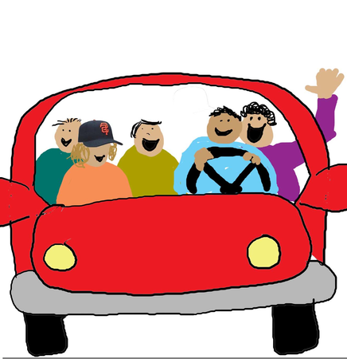
CARPOOL MANAGEMENT
SYSTEM
RIYA.S.MENON

Slide 2
1.INTRODUCTION ABOUT PROJECT
The Carpool Management web application is designed in response to the growing demand for cost-efficient, effective and sustainable solution against day-to-day transportation problem.
Finding alternate forms of transportation for commuting has become necessary in today's urban era due to factors including traffic congestion, environmental concerns, and the increasing travel expenses.
This project aims to create a web-based platform that facilitates carpooling, allowing users to share rides easily, cut down on travel expenses, and contribute to a greener environment.
It connects the drivers with the concerned passengers seeking rides with the number of seats available and hence it optimizes the use of vehicle, which leads to lesser vehicle on roads thus contributing to lesser traffic and hence lesser carbon emissions.

Slide 3

1.1 So, what’s the objective of the project?
.To ease the process of searching and booking for shared rides.
Ultimately, promotes eco-friendly mode of transportation.
Helps the concerned users to achieve a cost-effective ride.
It helps in reducing traffic; since people instead of opting for their private means of transportation look for a share means of commutation; which is especially beneficial in urban areas.
Similarly like in reducing the traffic, it eases out the problem of parking in places which has lesser parking infrastructure since now a lesser number of cars require parking spaces
It provides opportunities for socializing and networking.
It improves the efficiency of transportation resources like fuel; by maximizing the number of passengers per vehicle.
It reduces the travel time and offer a number of commuting facilities.
It offers a safe and reliable means of transportation through verified users(drivers and passengers) and planned routes which enhances safety.

Slide 4

1.2 And who are our target audience?
Daily commuters:
People who travel regularly to school, institutions, workplace and try to opt for cost-effective and convenient mode of transportation.
City dwellers:
People who face heavy traffic and parking challenges everyday.
Students:
School and university students who commute to their educational institutions with the aim of saving money and also meeting new people.
Event attendees:
Individuals attending concert, marriage, conferences or any other sort of large gathering and want to share rides to and from the same venue thus, reducing the tension of parking and travel expenses

Slide 5
Literature Survey
1)Real-time carpooling and ride-sharing: Position paper on design concepts, distribution and cloud computing strategies
Published in: 2013 Federated Conference on Computer Science and Information Systems
Date of Conference: 08-11 September 2013
This paper suggests that many carpooling ideas were generated and implemented before but it couldn’t reach to a global level. This was because it was not developed up to a scalable level. The paper suggests design concepts, distributions and cloud computing strategies that the carpool could follow making it scalable and reach a much larger audience.
2)Using Semantic Features for Enhancing Car Pooling System
This research proposes a unique framework that makes use of trip profiles and place semantics (point of interest)
Users' travels can be categorized as frequent and infrequent travels. On rare occasions, the user is presented with an alternative location that is comparable and falls within the accepted range or route, taking into account the needs of other passengers and drivers. This is done by analyzing the semantics of the destination.
3) Safe Route Carpooling to Avoid Accident Locations and Small-Scale Proof of Concept in Japan
In order to find a safe route for each driver that picks up and drops off coworkers coworkers and travels to and from their office while avoiding high accident-frequency places, the carpooling problem (CPP) is proposed in this article with an emphasis on safety.
The CPP specifies the groups of workers who share each vehicle as well as the routes that drivers should travel in order to maximize and reduce the overall distance traveled.

Slide 6
PROBLEM STATEMENT
The urban environment of today poses serious challenges to city planners as well as regular commuters, such as increased traffic, escalating fuel prices, and degradation of the environment. Putting more cars on the road not only lengthens trips and increases driver stress, but it also increases carbon emissions, which worsen climate change.
A large number of people drive alone, which leads to unnecessary spending and ineffective resource use. Despite the fact that carpooling can reduce traffic, save money, and have a positive environmental impact, there isn't a straightforward, trustworthy, and user-friendly platform to assist commuters in sharing trips.
An inventive way to link drivers with available seats with passengers traveling in the same route is required. In the end, this solution should make it easier for users to identify and schedule shared rides, which will reduce the amount of cars on the road and encourage more environmentally friendly modes of transportation.

Slide 7


EXISTING METHODS AND ITS LIMITATIONS
.
BlaBlaCar: BlaBlaCar a popular carpool ride-sharing website used for long distance travel connects drivee and passengers while traveling city to another village or another Limitations:
made specifically for intercity travel
Not as practical for daily in-town commuting.
restricted in certain geographical areas or countries, that may not
in other areas, which limit its usability.
Prompt charges for each booking a service fee
does not currently offer specific safety features for women
UberPOOL: is a ride-sharing option with the Uber app that allows passengers to share a ride with other people heading to the same destination.
Limitations:
UberPOOL does not exist in all cities, so many people do not have access.
Long travel times—the riders have to expect that there might make detours in the app to pick other riders.
The costs usually surge and fall for UberPOOL, so it is not so predictable, sometimes costing more than expected.
Drivers requesting for money exceeding what was stipulated
does not currently offer specific safety features for women

Slide 8
Proposed Solutions
Introduce "SafeRide" Feature:
The "SafeRide" feature is aimed at giving better safety to the female passengers through a set of tools and options so they have a safe and comfortable carpool.
Key Features of "SafeRide" Model:
Verified Driver Profiles
All the drivers will undergo a detailed verification process, which shall include their background check, identity check, and driving record analysis.
This thus ensures that there are only safe and trustworthy drivers on the platform, hence always putting the minds of passengers at rest.
Driver Rating and Reporting System
Passengers can rate drivers and consequently report issues related to safety.

Slide 9
Gender preference for carpooling
Enable a "Women-Only" carpool option for female passengers so that they will only be matched with a female driver or other female passengers.
Post-Ride Safety Check-In
Once a ride is completed, the platform will ask passengers to confirm if they have safely arrived.

Slide 10
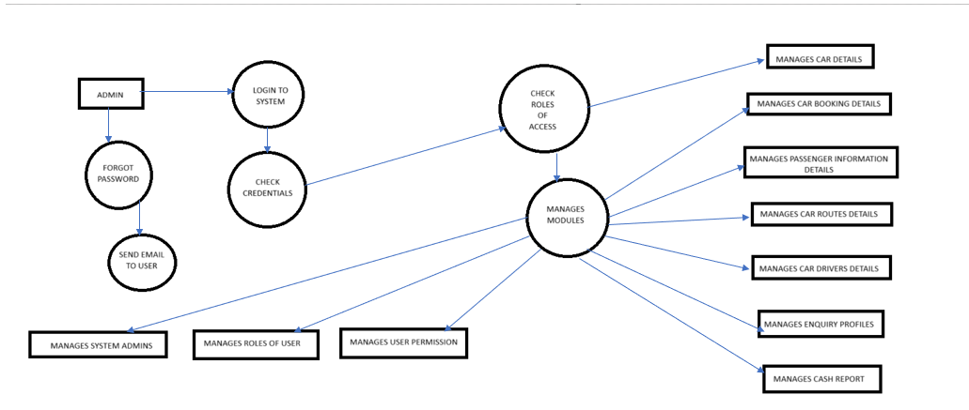
ARCHITECTURAL DIAGRAM

Slide 11
MODULES
User Management Module
Description: Handles user registration, login
Features:
User Sign-up/Log-in by email
User Profile Management - change password
Role-Based Access Control - User, Driver, Admin
Password Recovery and Authentication
Driver Management Module
Description: This handles the registration of drivers, vehicle details of the drivers, and verification of the drivers.
Features:
Driver Application Form and Verification of Drivers with Background Checks, Document Uploading
Vehicle Registration Details, Insurance Details and Service History
Driver Rating and Feedback from Passengers
Passenger Management Module
Description: Handles passenger registration, ride booking and feedback.
Features:
Ride Search and Booking (search for rides, book rides)
Ride History (view past rides)
Passenger Rating and Feedback – for drivers

Slide 12
Payment Management Module
Description: Handles payment processing,
Features:
Payment Processing: Integration with payment gateways
Safety and Security Module
Description: Ensures user safety and data security.
Features:
Driver and Passenger Verification: Identity and background checks

Slide 13
PROJECT MODULE EXPLANATION
User Management Module
The User Management Module facilitates user registration and login via email, allowing users to create and manage their accounts securely. It includes profile management for changing passwords, role-based access control to ensure appropriate permissions for Users, Drivers, and Admins, and a password recovery feature for account security. This module ensures a seamless and secure user experience within the Carpool Management System.
Driver Management Module
The Driver Management Module handles driver registration, including an application form, background checks, and document uploads for verification. It allows for vehicle registration details, insurance information, and service history tracking. Additionally, it features a driver rating and feedback system from passengers, promoting accountability and service quality within the Carpool Management System.
Passenger Management Module
The Passenger Management Module manages passenger registration, enabling users to search for and book rides efficiently. It includes features for viewing ride history, allowing passengers to track their past journeys. Additionally, it incorporates a rating and feedback system for passengers to evaluate drivers, promoting accountability and enhancing service quality within the Carpool Management System.
Payment Management Module
The Payment Management Module facilitates secure payment processing within the Carpool Management System. It integrates with various payment gateways to enable smooth transactions for ride bookings, ensuring that payments are processed efficiently and securely. This module helps maintain financial accuracy and enhances the overall user experience by providing reliable payment options.

Slide 14
PROJECT MODULE EXPLANATION
Safety and Security Module
The Safety and Security Module is designed to ensure user safety and protect data within the Carpool Management System. It includes features for driver and passenger verification, implementing identity and background checks to enhance trust and security. This module helps create a safer environment for all users by confirming the authenticity of drivers and passengers before rides.

Slide 15
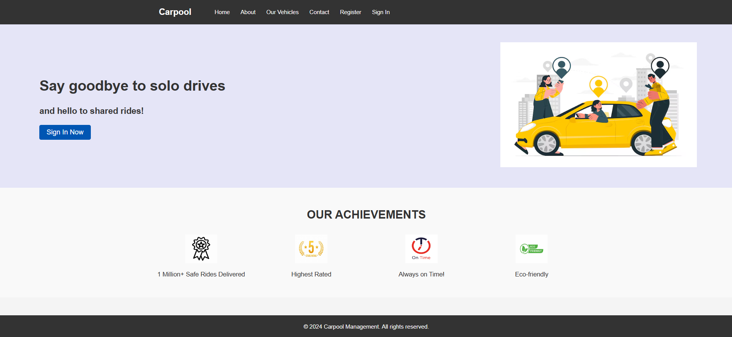
Screenshots
HOME PAGE

Slide 16
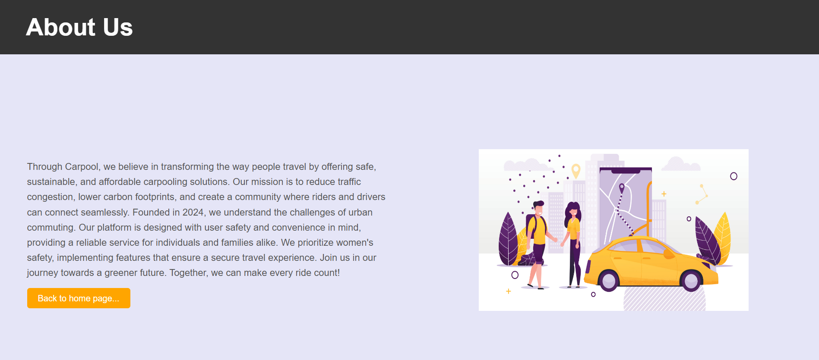
ABOUT US

Slide 17
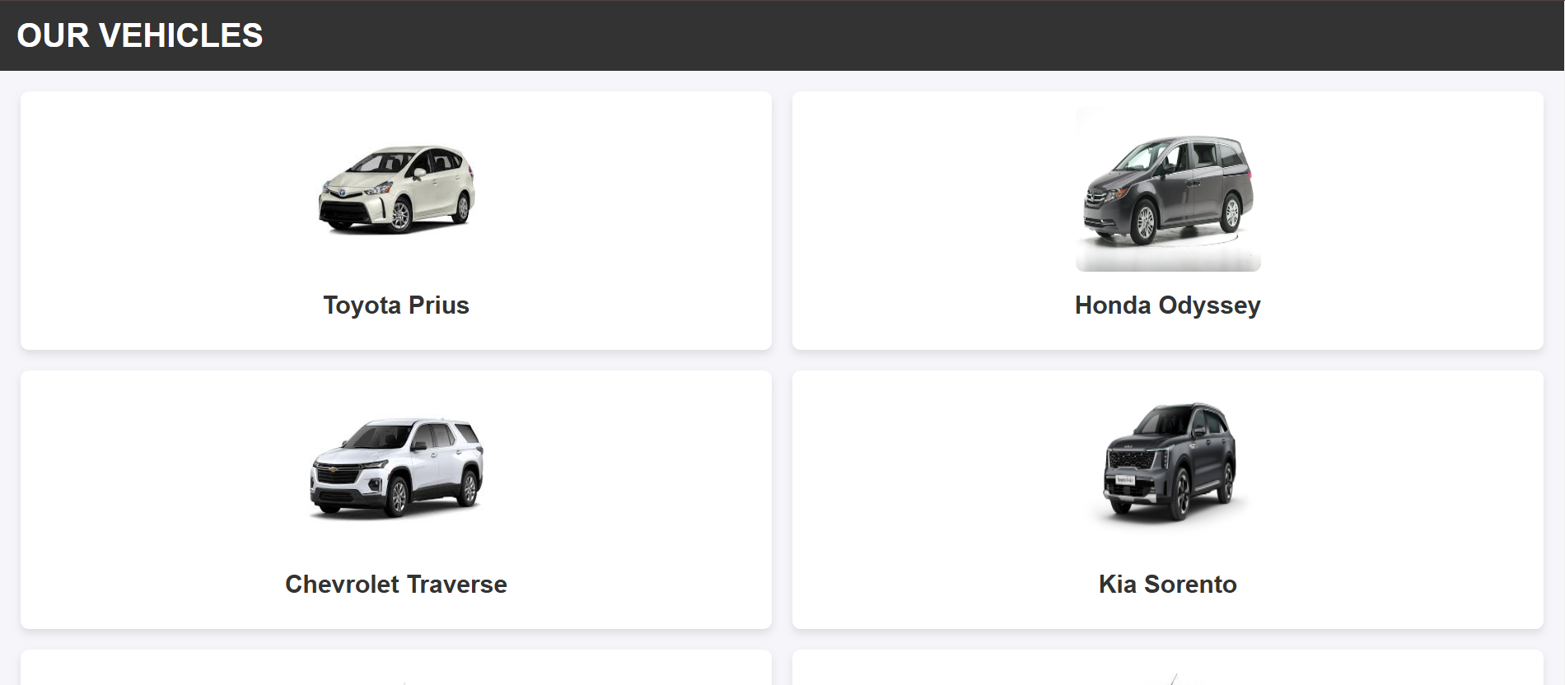
VEHICLES

Slide 18
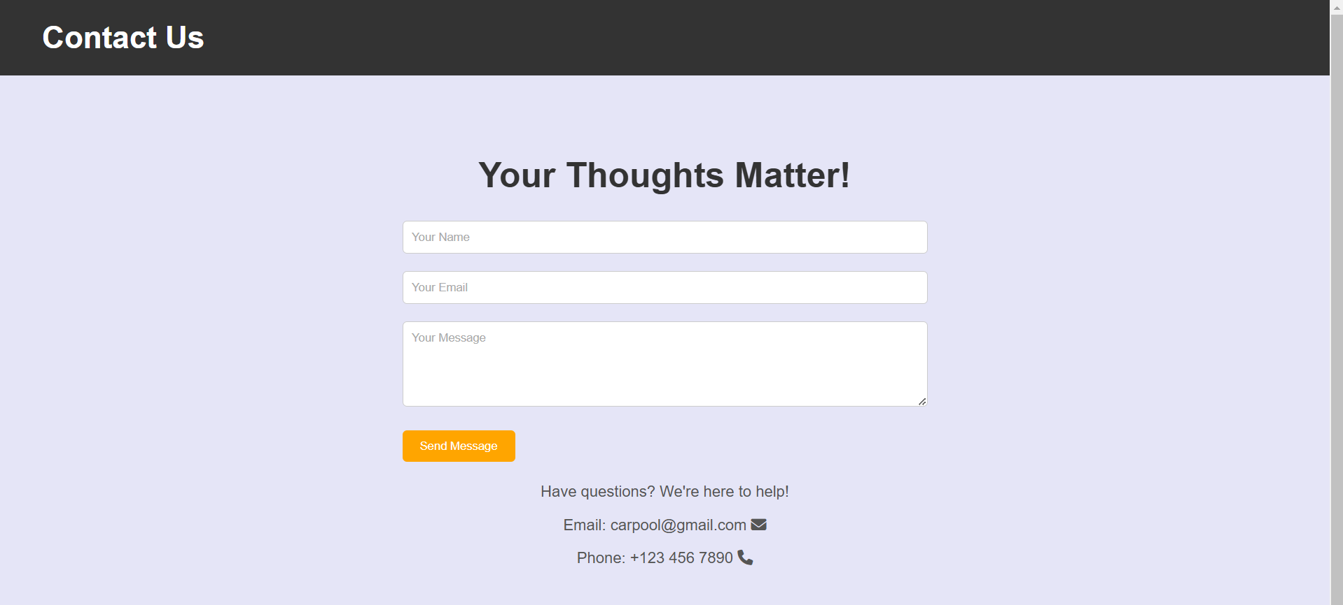
CONTACT

Slide 19
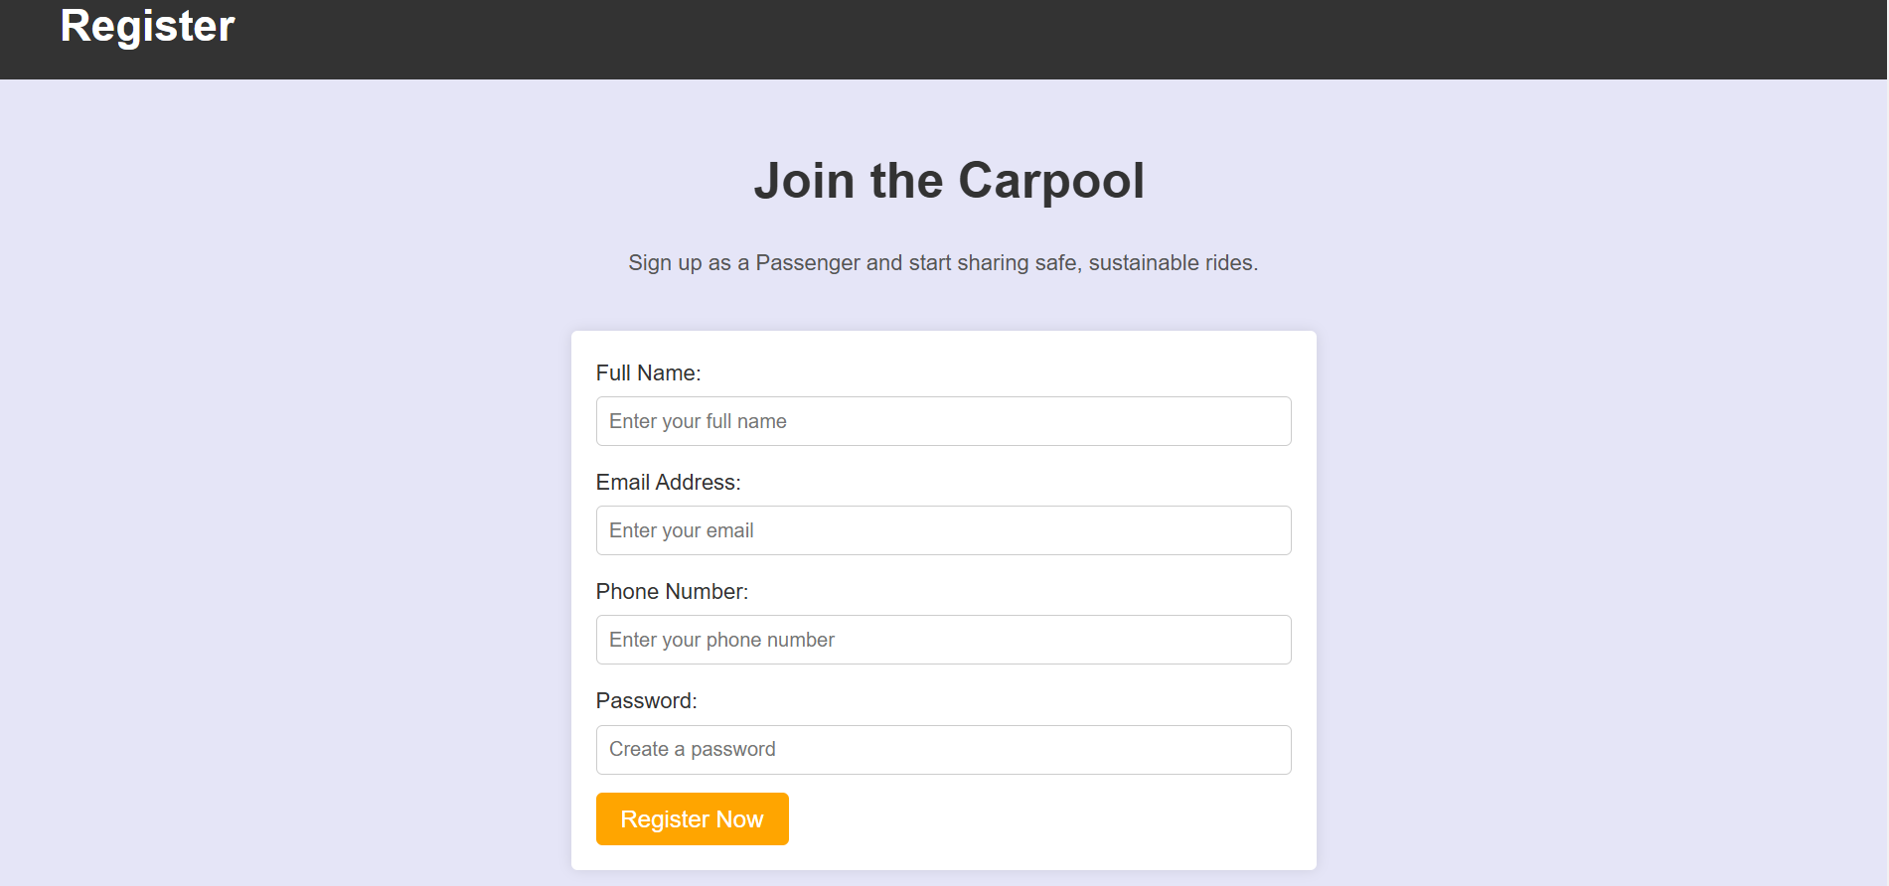
REGISTER

Slide 20
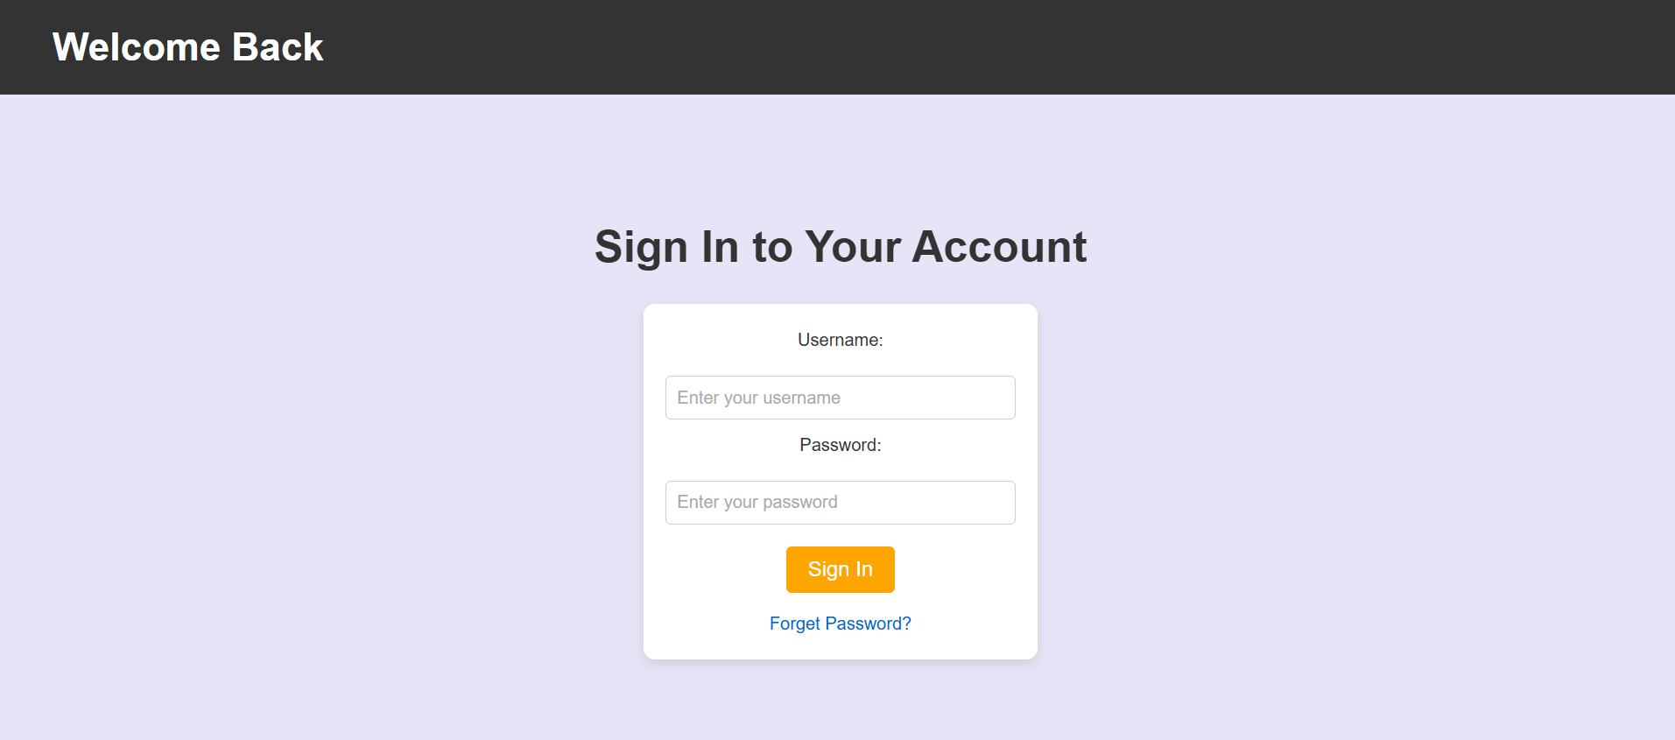
SIGN IN

Slide 21
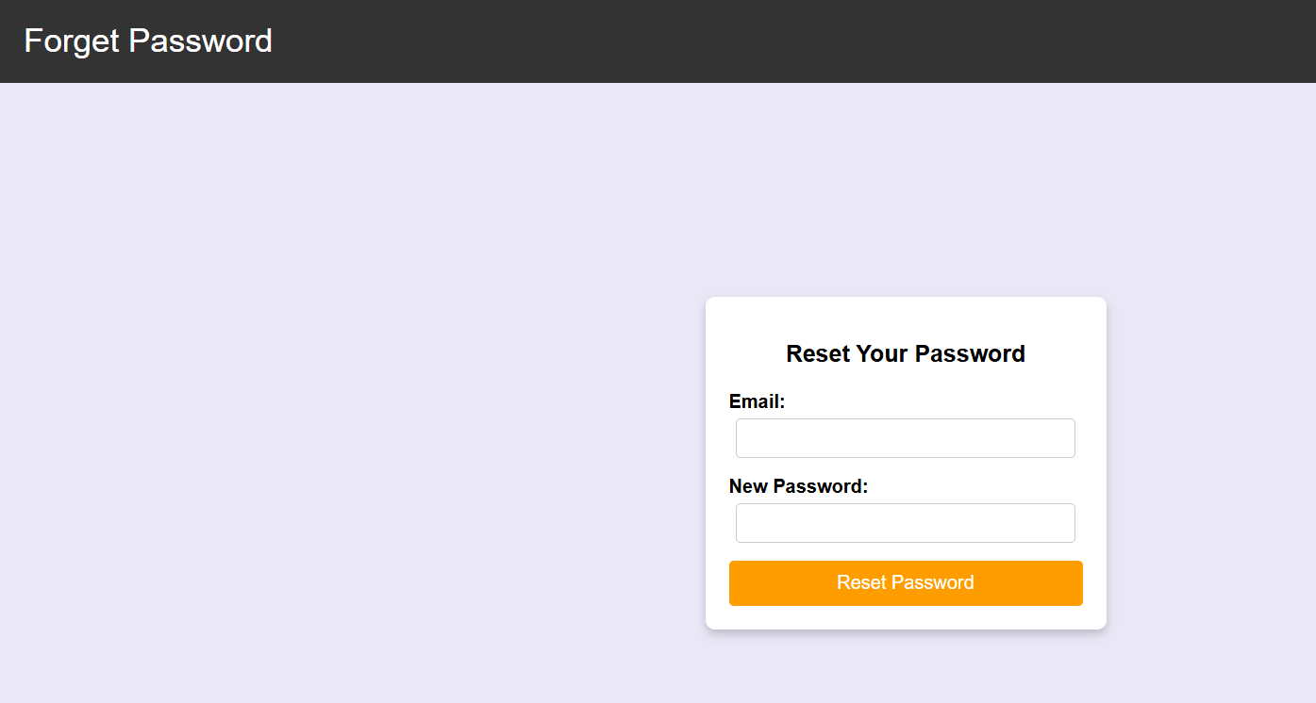
FORGET PASSWORD

Slide 22
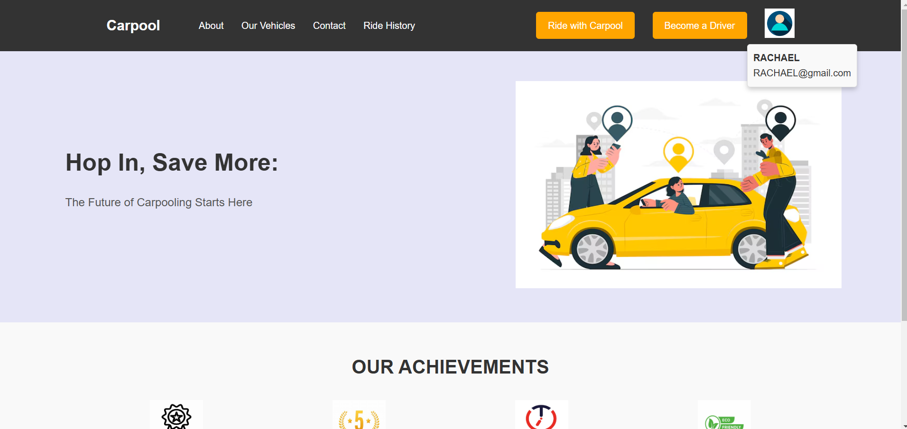
DASHBOARD suppose a user named RACHAEL login to the site

Slide 23
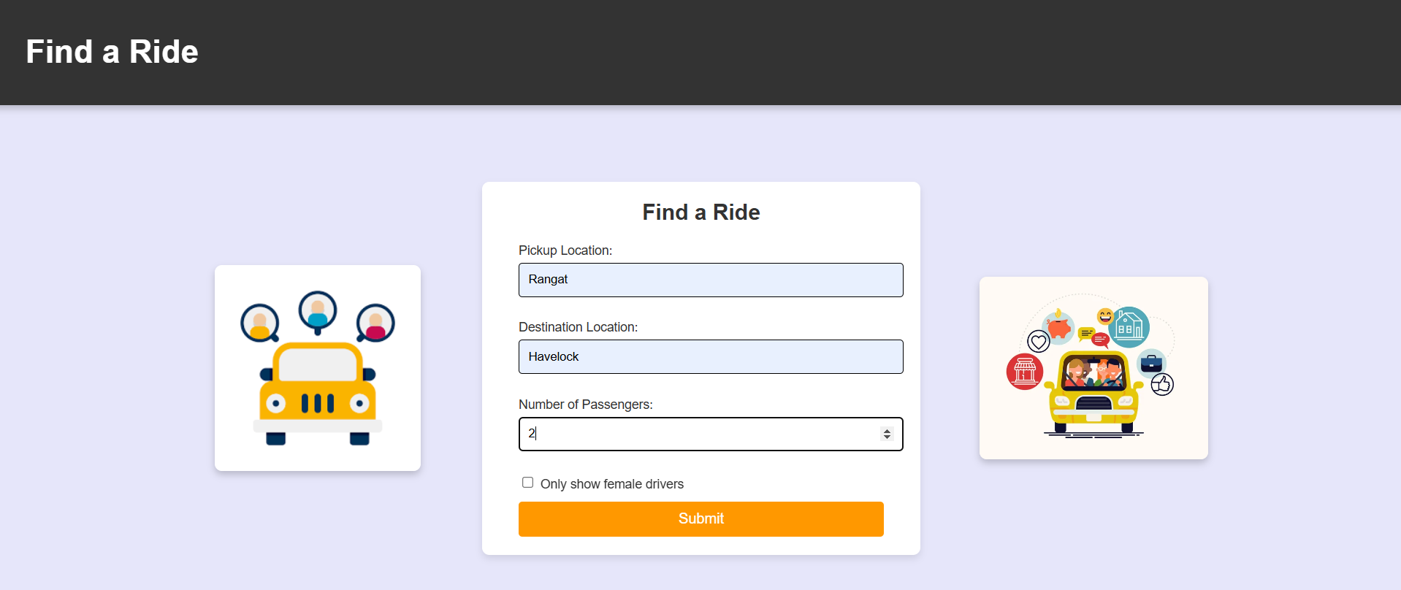
FIND RIDE

Slide 24
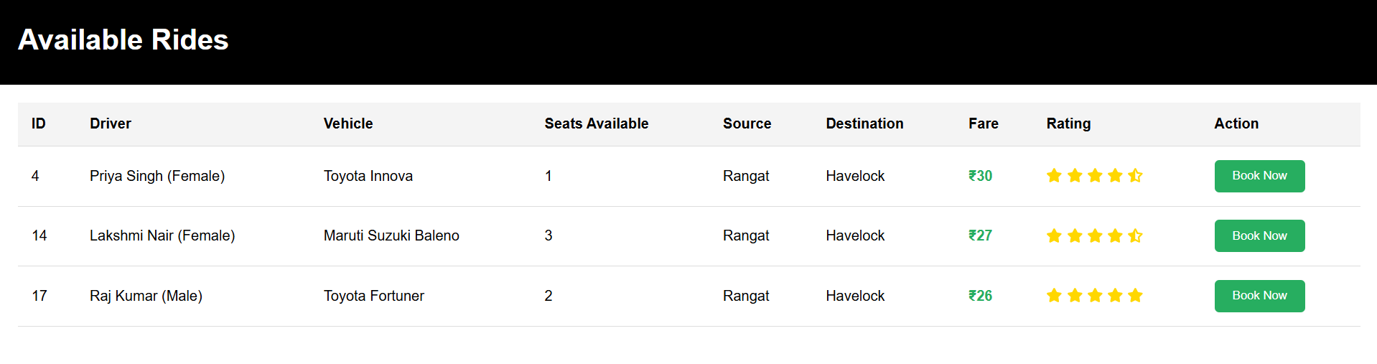
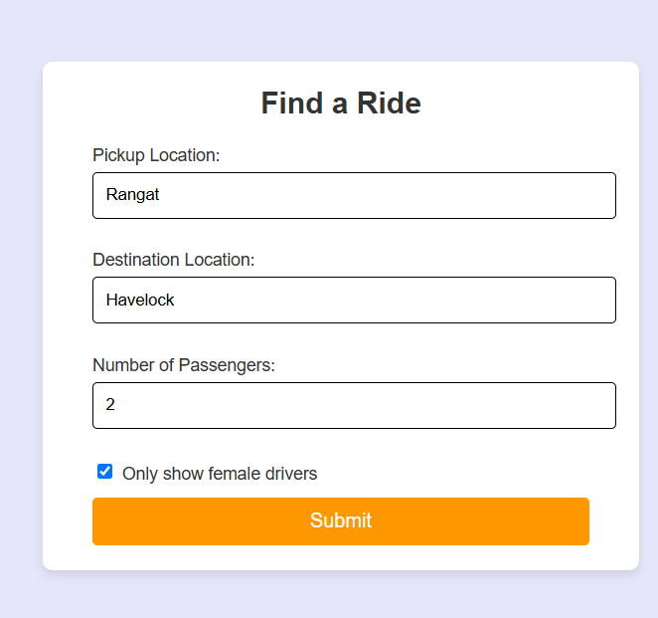
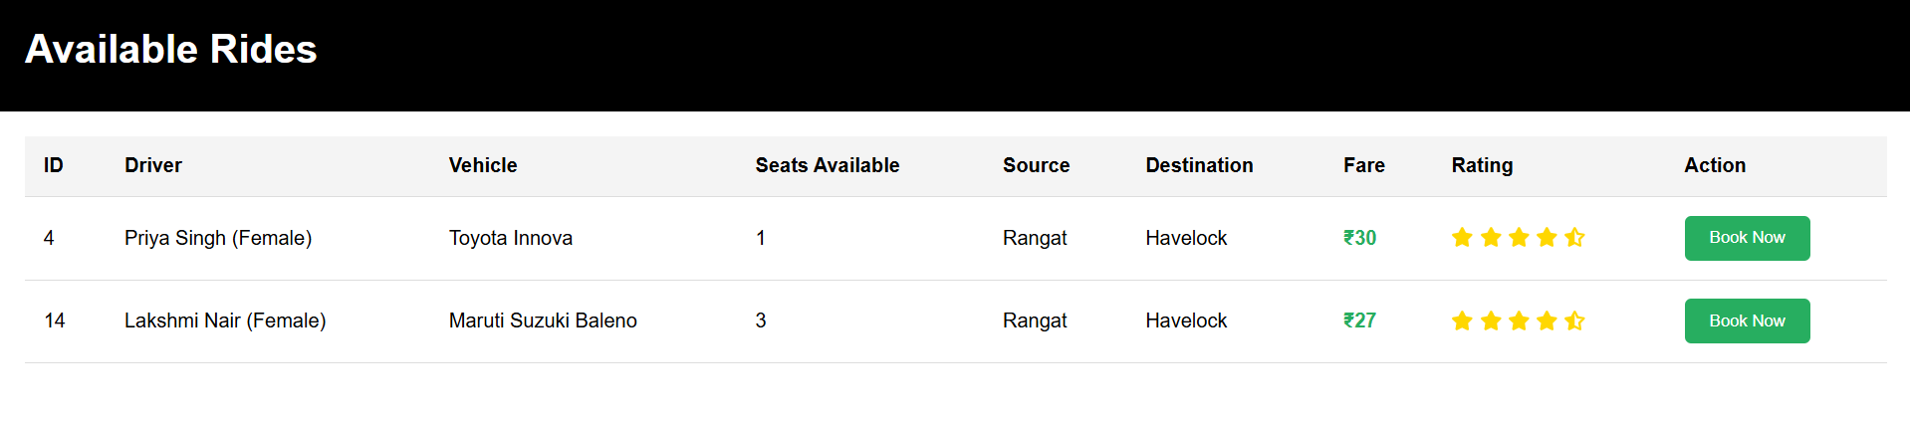
AVAILABLE RIDE

Slide 25
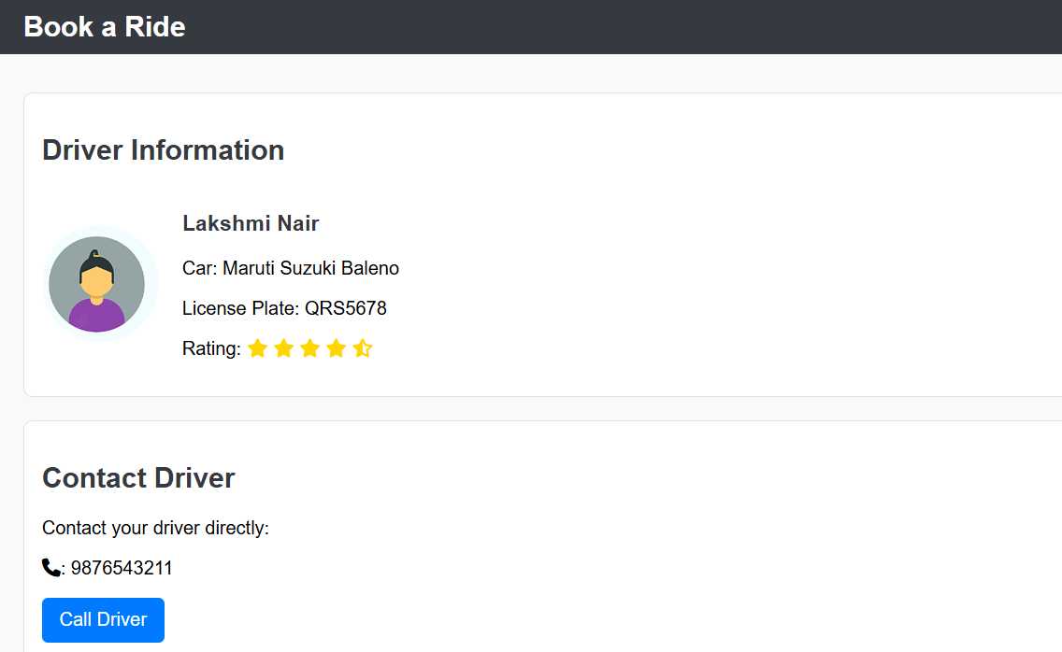
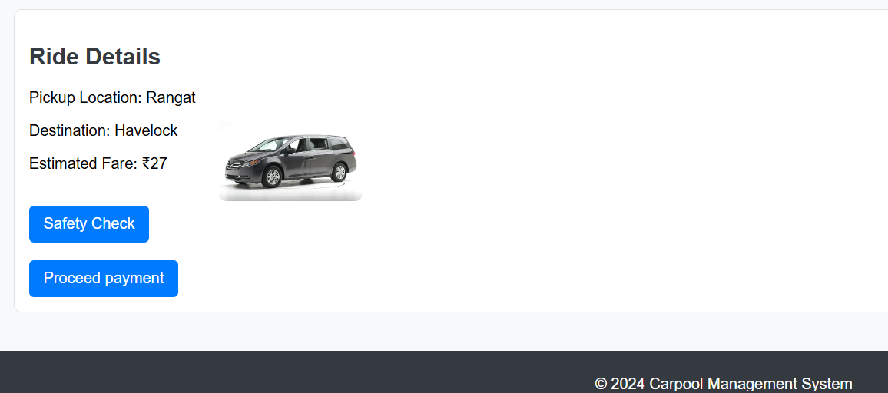
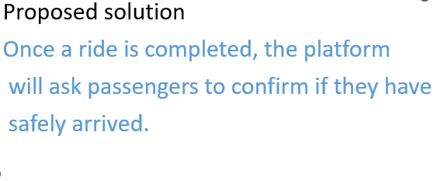
BOOK RIDE

Slide 26
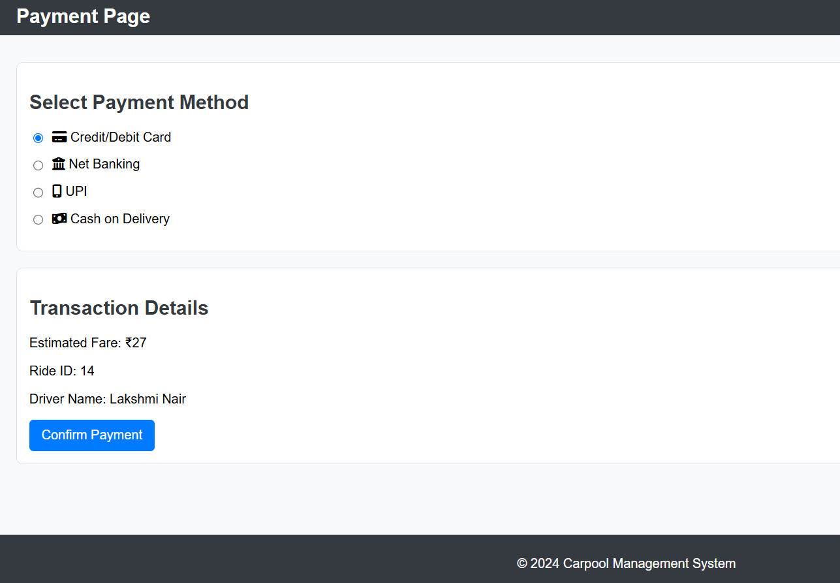
PAYMENT

Slide 27
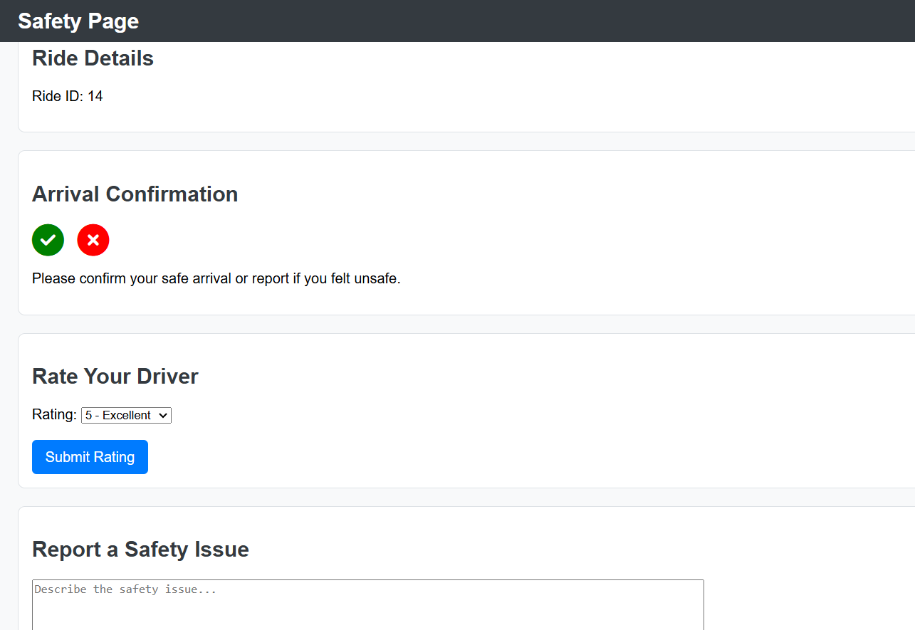
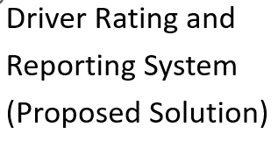
SAFETY CHECK PAGE

Slide 28
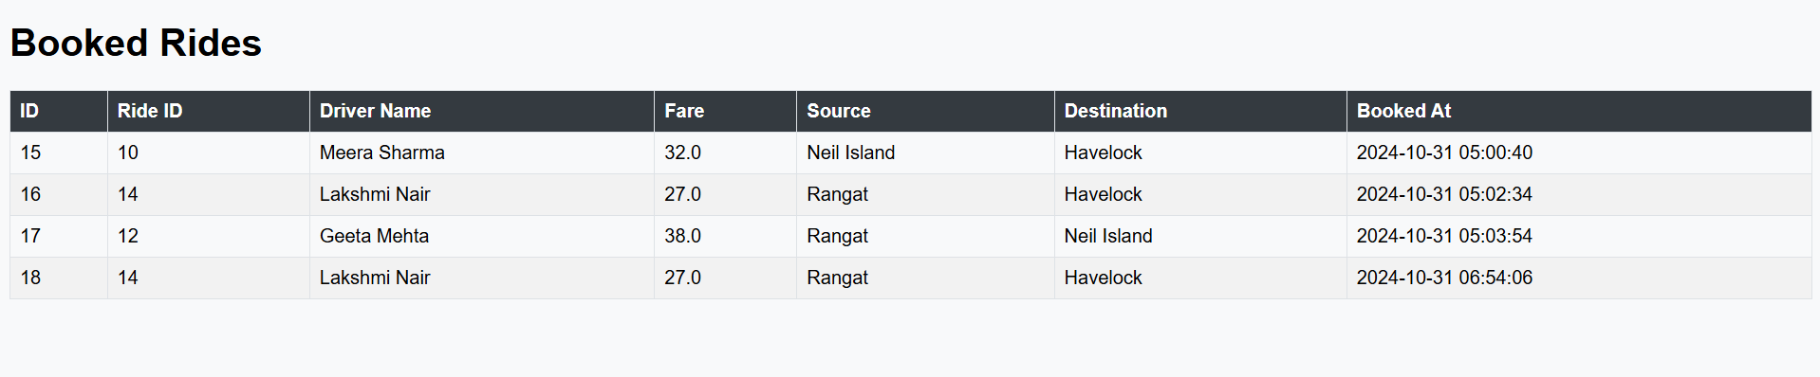
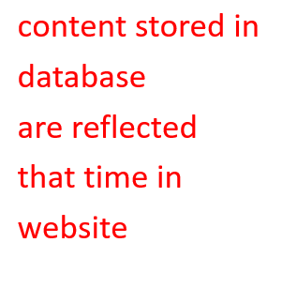
RIDE HISTORY PAGE

Slide 29
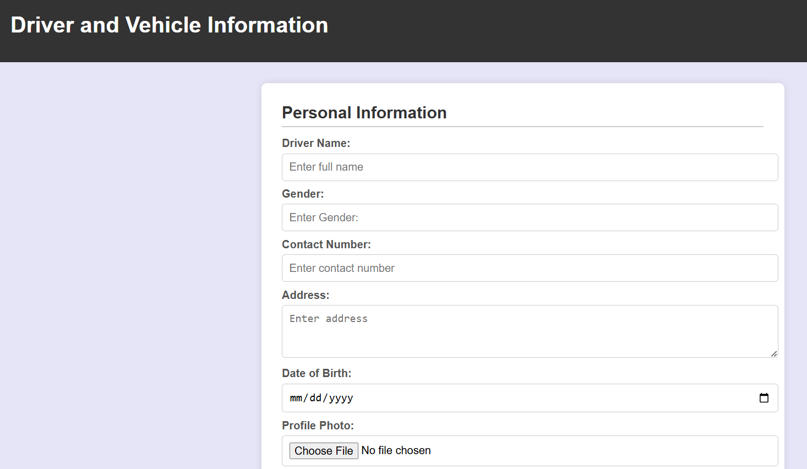
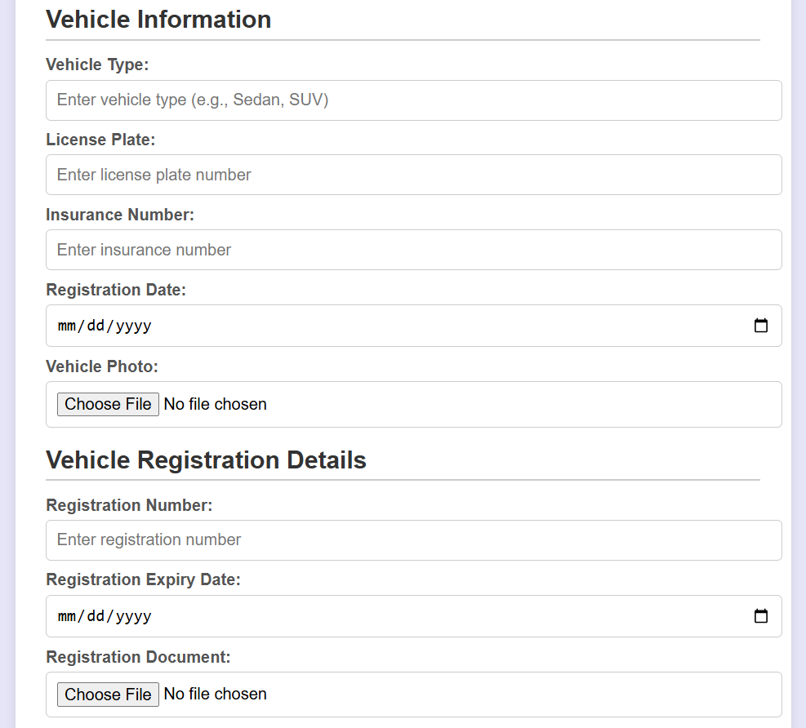
DRIVER REGISTRATION PAGE

Slide 30
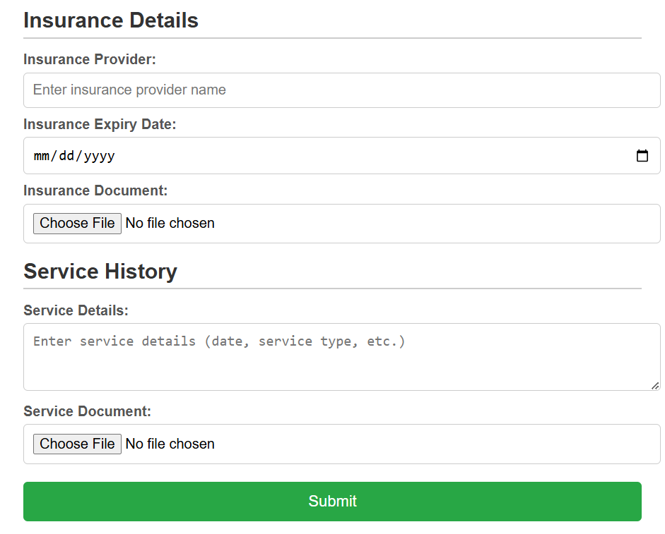
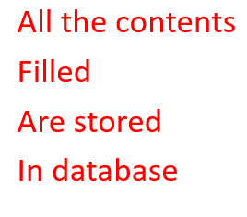
DRIVER REGISTRATION PAGE

Slide 31
CONCLUSION
In conclusion, the Carpool Management website is designed to revolutionize the way people commute, offering a safe, efficient, and cost-effective alternative to traditional transportation methods. By facilitating seamless ride-sharing through comprehensive features such as user management, driver verification, and real-time booking, the platform addresses key challenges in urban mobility. Additionally, the integration of safety measures, user feedback, and robust payment processing enhances user confidence and satisfaction. As a result, the Carpool Management System not only promotes sustainable travel practices but also fosters a sense of community among users, paving the way for a smarter and greener future in transportation

Slide 32
REFERENCES:
IEEE PAPERS:
Car pooling based on Trajectories of drivers and requirements of passengers
Smart peer car pooling system
Using semantic features for enhancing car pooling system
Conference papers:
The future and sustainability of carpooling practices
Smart transportation based on car pooling system
Real time carpooling and ride sharing : position paper on design concepts, distribution and cloud computing strategies

