Slide 1
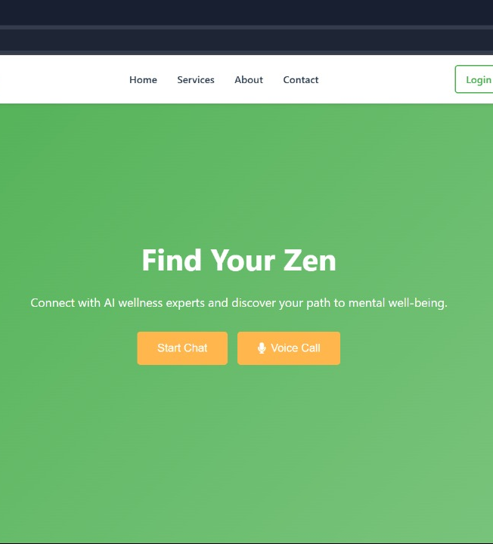
Revolutionizing Healthcare with AI Assistance
Smart Health Support Anytime, Anywhere
Our innovative AI health app provides smart support for users anywhere, anytime, reducing healthcare burdens and expanding access.
by Coding Monkeys

Slide 2
Addressing Key Healthcare Challenges
Lack of Immediate Advice
Overburdened Systems
Limited Expert Access
Reliable Health Tips
Need for trusted precautions and information
Limited access to timely medical guidance
Strained healthcare resources and personnel
Difficult to get specialized consultations
Our AI Health App tackles the challenges by offering instant, expert support.

Slide 3
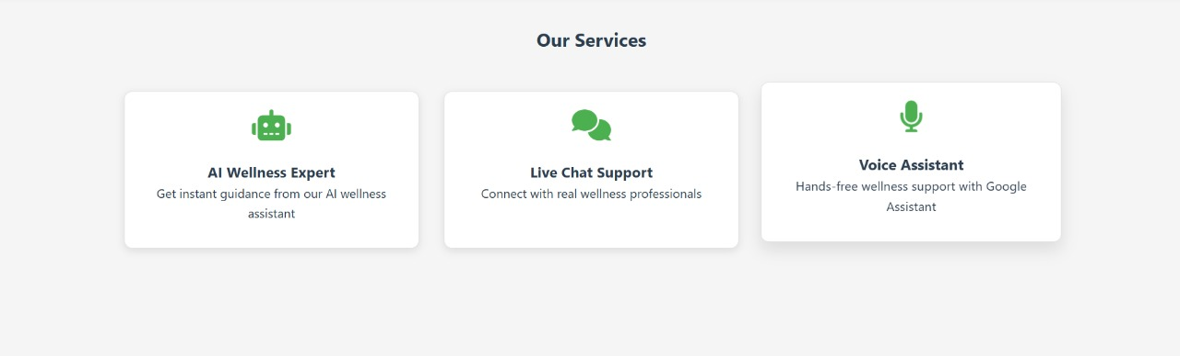




The AI Health App Solution
Virtual Assistant
24/7 Chatbot
Emergency Calling
Personalized Tips
AI-powered health guidance
Round-the-clock medical advice
AI-assisted connection to services
Tailored health precautions
Tackling healthcare challenges through an AI Health App

Slide 4




App Key Features
AI Assistance Calling
Connects users to emergency services
Instant Health Advice
Trained chatbot for quick responses
AI Health Support
Tracks symptoms & suggests measures
Basic Precautions
Wellness and hygiene tips daily
Four main sections of the app, each designed to put the user in touch with appropriate care.

Slide 5




App Workflow
Open App
Choose Option
AI Processes
Receive Help
User launches application
Select chat, call, or support
AI handles request
Get instant response
The user journey is easy and immediate

Slide 6
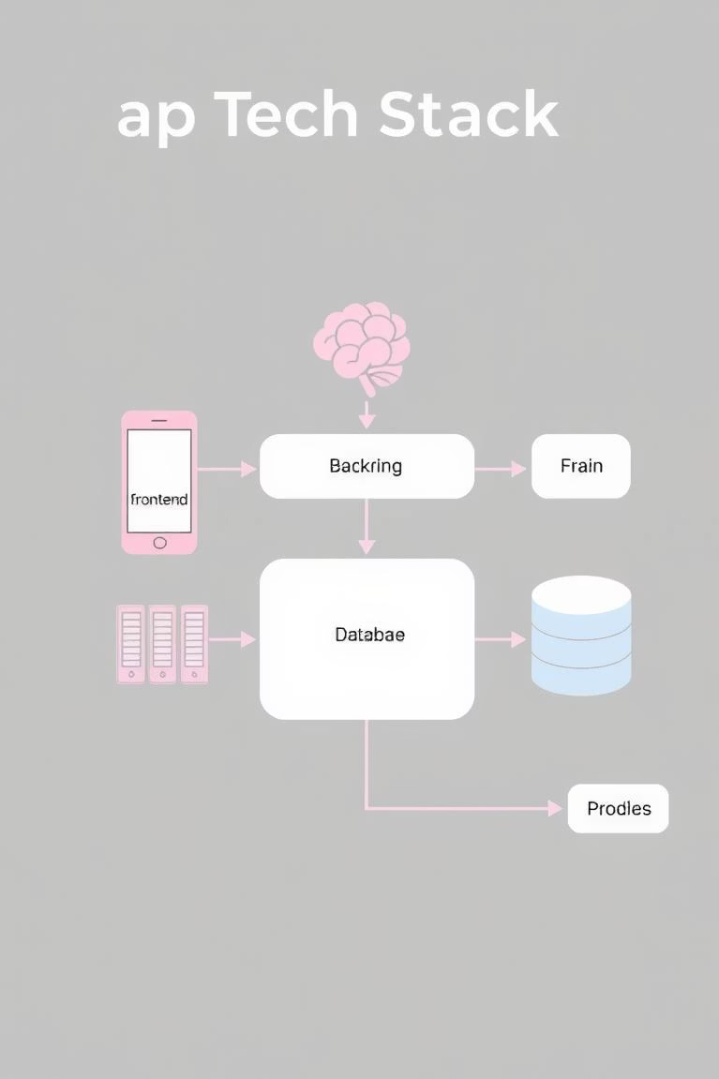
Technology Stack
Frontend
HTML, CSS, JavaScript
Backend
Node.js, Express
AI Models
Gemini, Hugging Face API
Database
Firebase / MongoDB
The technologies work together to make the magic happen

Slide 7
Market Impact & Future Enhancements
Reducing Wait Times
Enhancing Access
Preventive Education
Voice Recognition
Decreasing hospital wait times
Improving telemedicine accessibility
Providing health education
Hands-free AI assistance
Future improvements include integrating with wearables and adding AI diagnostics.

Slide 8
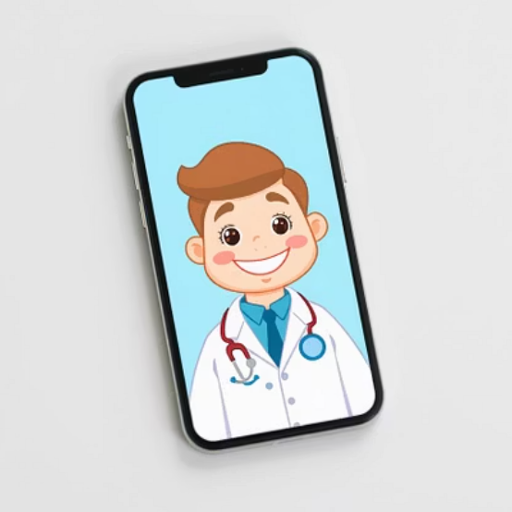
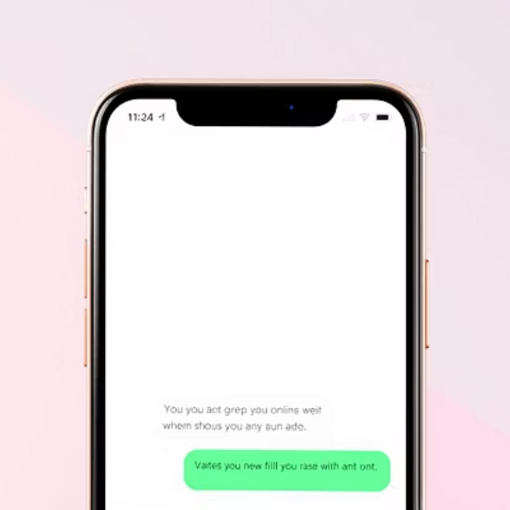
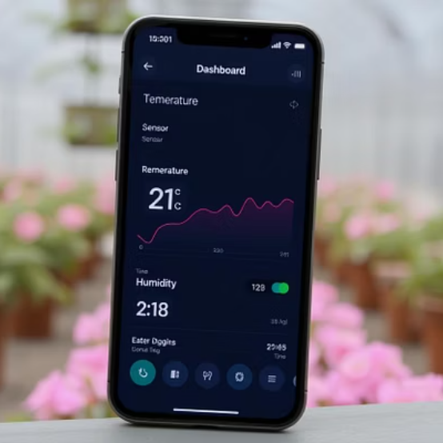
Prototype Showcase
Showing a live demo of the AI assistant in action

Slide 9

Thank You!
Join us in making healthcare smarter!
Making healthcare smarter through AI-driven assistance

