Slide 1
Talking Cars
Idea Presentation by
RASP

Slide 2
The Problem
Comfort and other luxuries have been a hot topic in the development of car technologies. But there is a severe lack of technological development in the field of communication and coordination between cars. Thus, catering to this problem would contribute to car safety, and revolutionize the car industry as well as the experience of the users, leading to safer and more comfortable rides.

Slide 3
Our Solution
Our solution solves this problem by connecting cars using embedded devices along with a simple phone app interface providing a wide range of features like:
Set up multi-car convoys that help improve fuel efficiency, communication and safety.
Share statistics about self & nearby cars such as distances, braking, location and alert other cars about potential threats.
SOS alerts can be transmitted in case of emergency.

Slide 4
Features of our App include:
Forming Convoys
Car to Car talk
Alerts
Convoy Dashboard
SOS
A group for cars travelling together can be formed to share information between them
Drivers can talk with other members of the convoy even when there is no network signal!
Alerts such as sudden braking, cars too close, or convoy car out of range will be shown on car dashboard
Convoy dashboards will allow the user to look at the stats of different cars of the convoy.
An SOS signal comes handy in case the car is stranded.

Slide 5
User Flows
For Convoy Leader
Register on App
Login to App
Setup Convoy
Start Convoy
For Convoy Members
Register on App
Login to App
Accept Convoy

Slide 6




High Level Logic
1. Registration and Login on App will require an internet connection on phone. Users will be stored in a cloud database.
2. The pairing of the phone and the car’s IOT device (Raspberry Pi with nRF24L01 transceiver module) will take place.
3. When a new convoy is set-up by the Convoy Leader, an invitation will be broadcasted to all the nearby cars that are supposed to be in the convoy using the transceiver module on the car .
4. On receiving the invitation, the car’s corresponding phone app will alert the user to accept/reject the invitation.
Gateway
1
DB
2
4
3

Slide 7


High Level Logic Flow
5. After the invitations are accepted, the cars volunteer to share information with each other. The convoy list and the coordinator information is saved in each car device.
6. Once the convoy starts, the convoy leader acts as the coordinator that broadcasts the line-up order of the whole convoy to each car at regular intervals after aggregating the sensor informations from each car.
7. Other than the line-up order, the cars may also talk to each other independently. If a car brakes suddenly or detects some obstacle, it alerts all the cars behind itself directly.
5
R-B-G
R-B-G
6
Leader
Front : Red
Front : Blue
7

Slide 8


Voice Communication
Two or more cars can talk to each other using the
RF24Audio v1.0 - An Open Source Realtime Audio Streaming Library for Arduino.
SOS
A stranded car can broadcast an SOS message that all the cars are configured to be constantly be listening for.

Slide 9

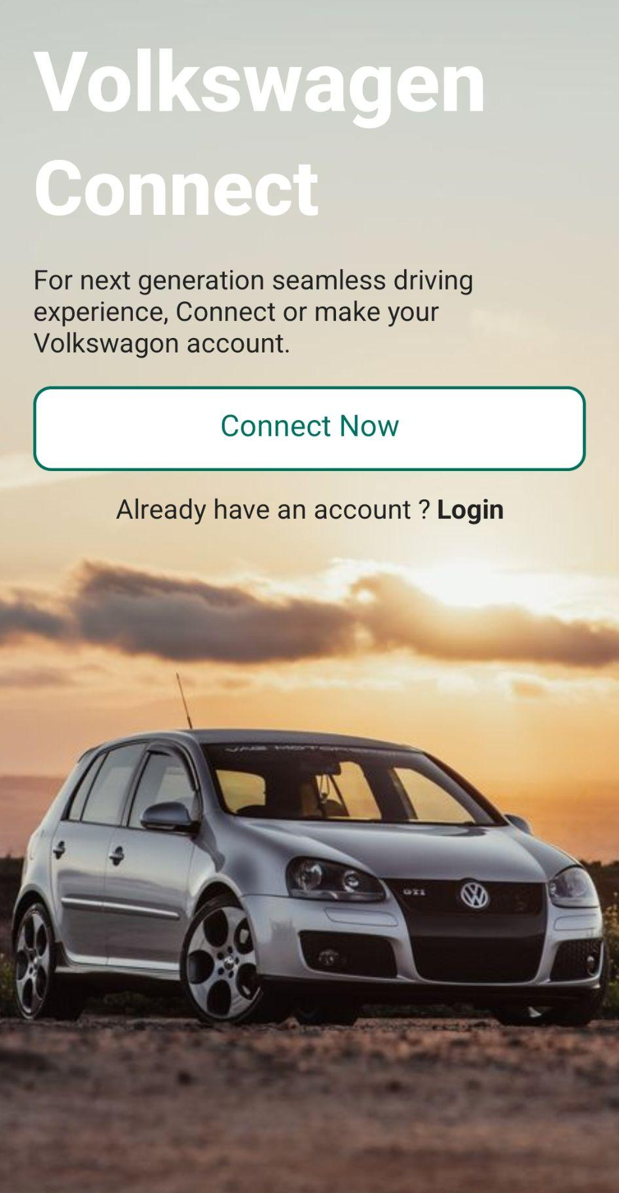
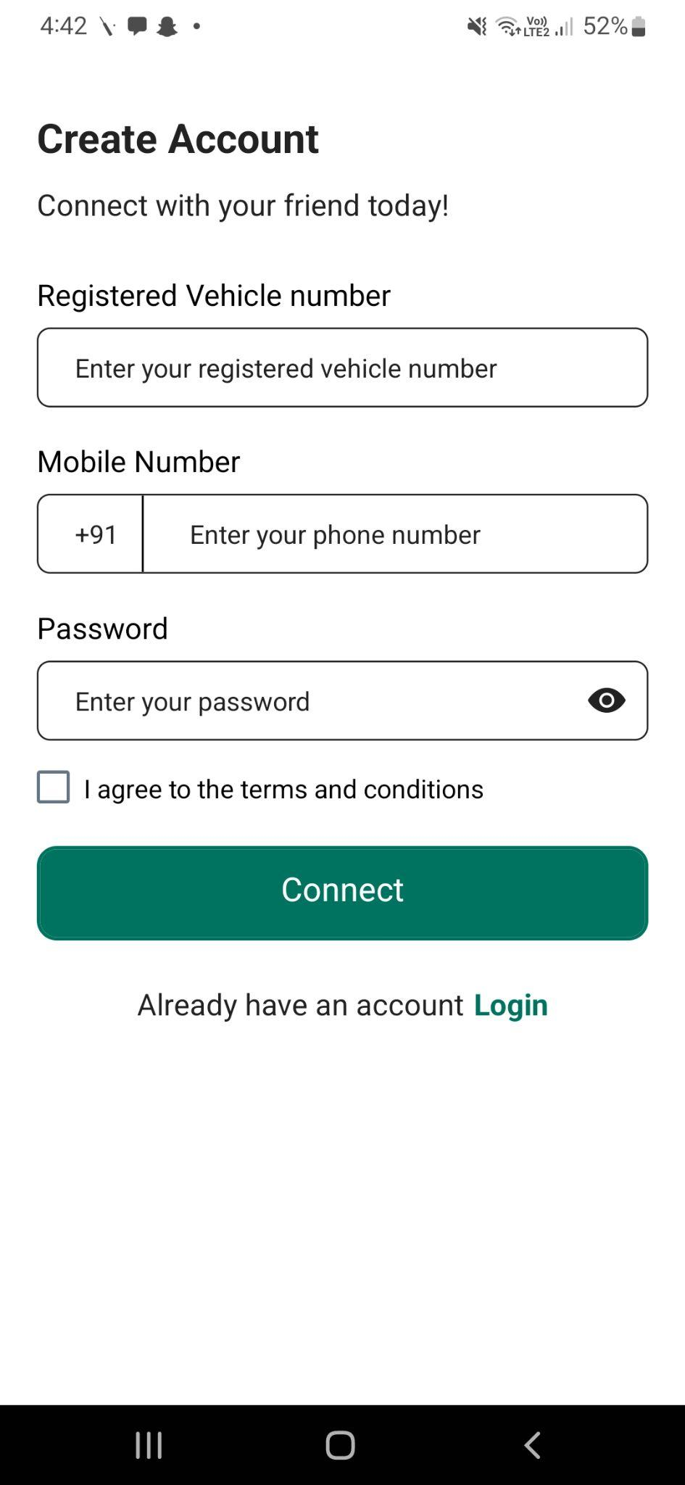
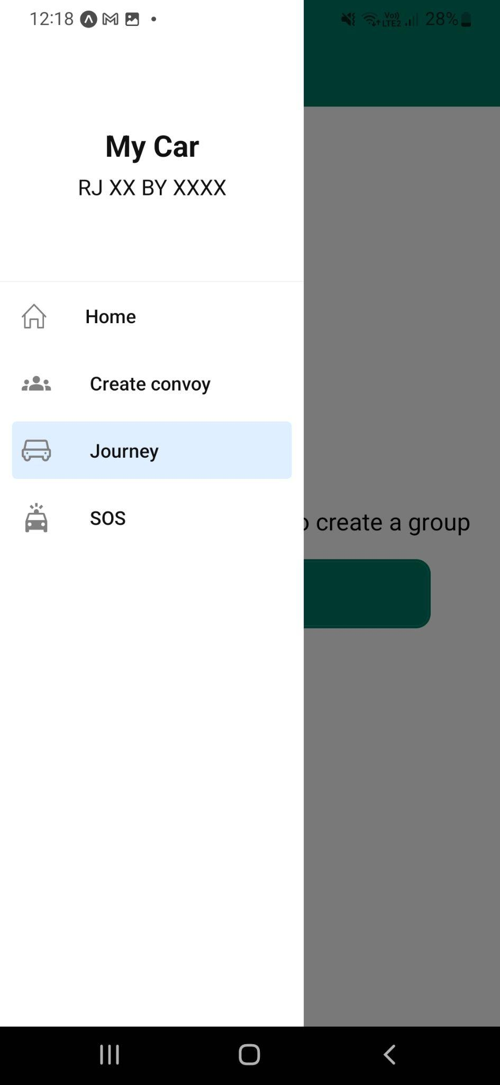
User Interface

Slide 10
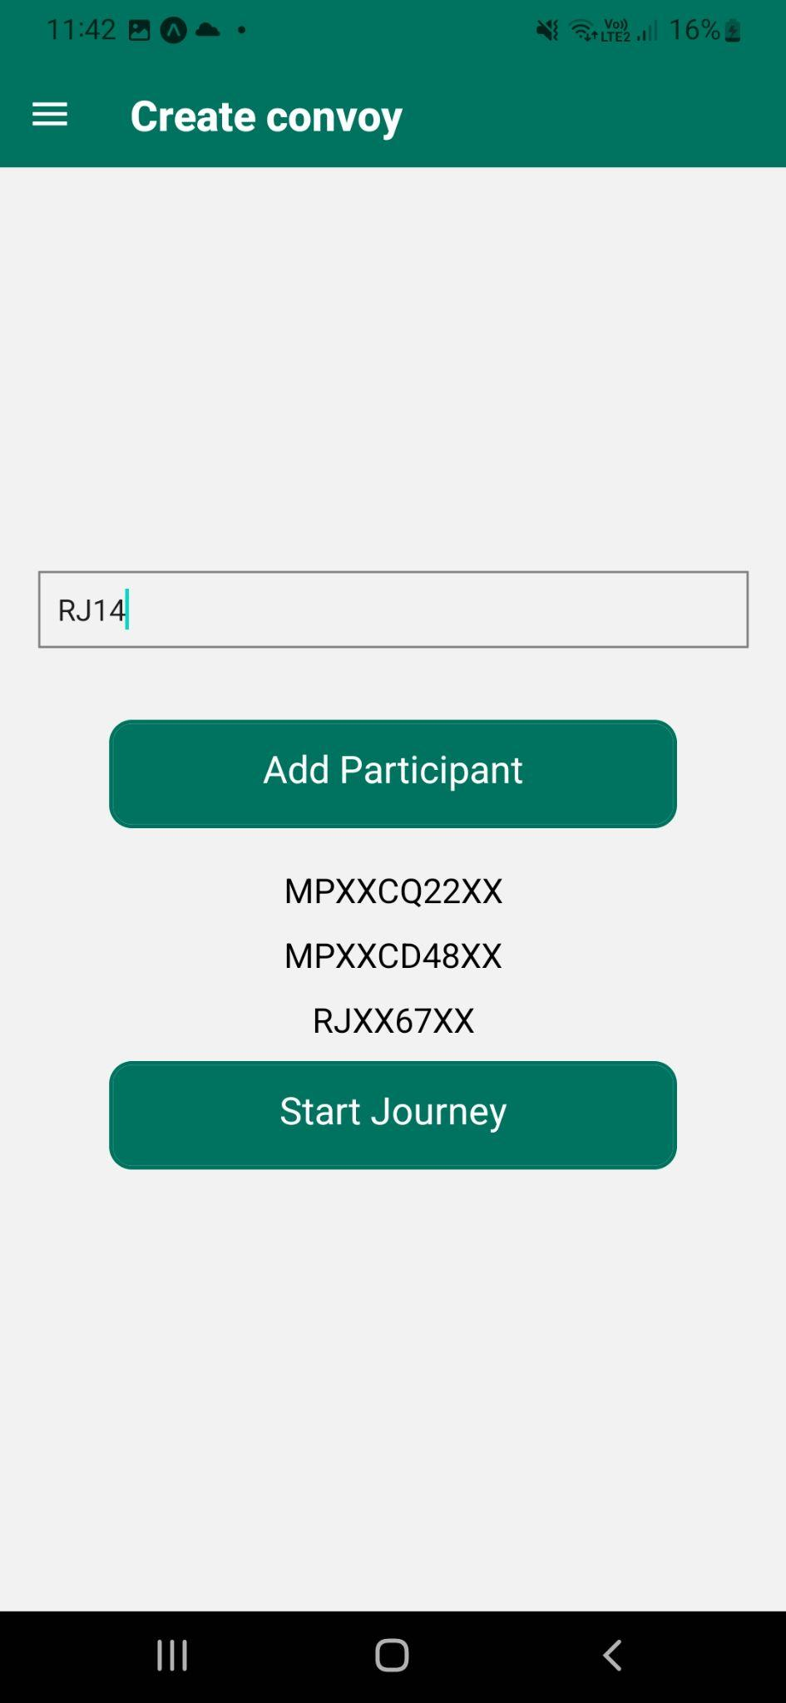
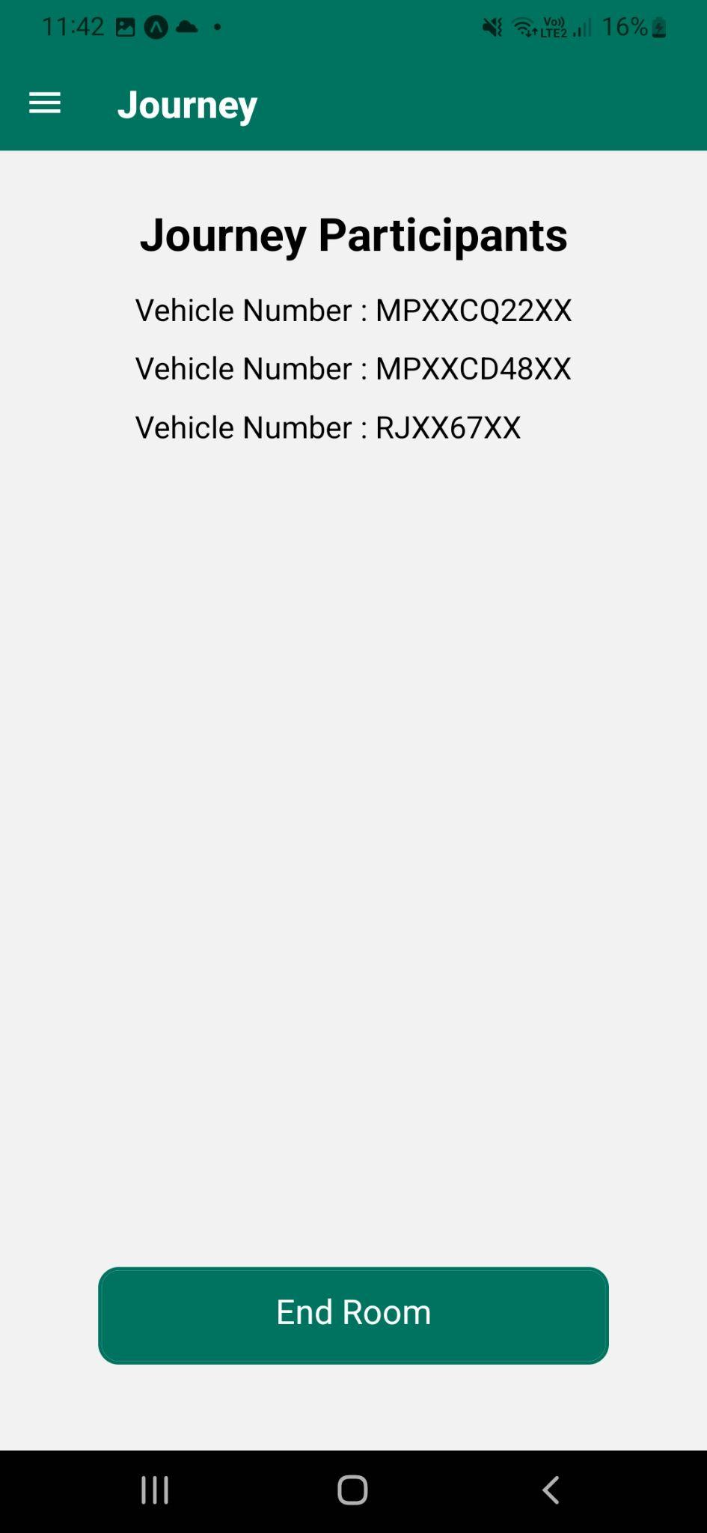
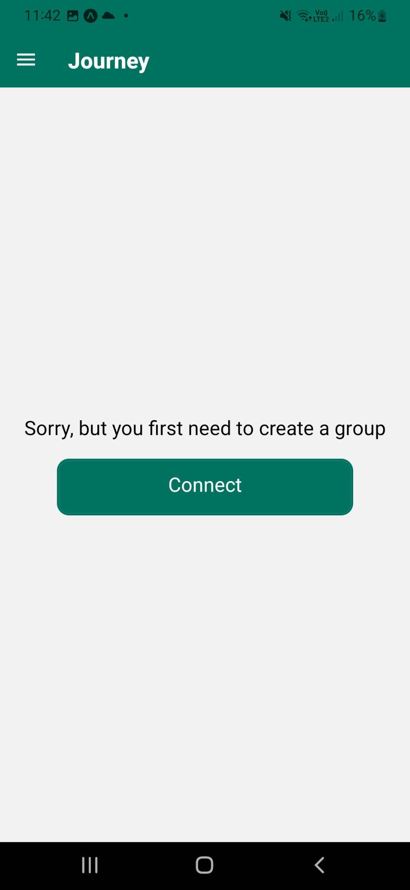
Here, type the vehicle numbers to add members in the group.
On starting the journey, we will get a list of all the convoy members as well as information about them.
If no members have been added, then the ‘Journey’ page will ask to create a convoy.

