Slide 1
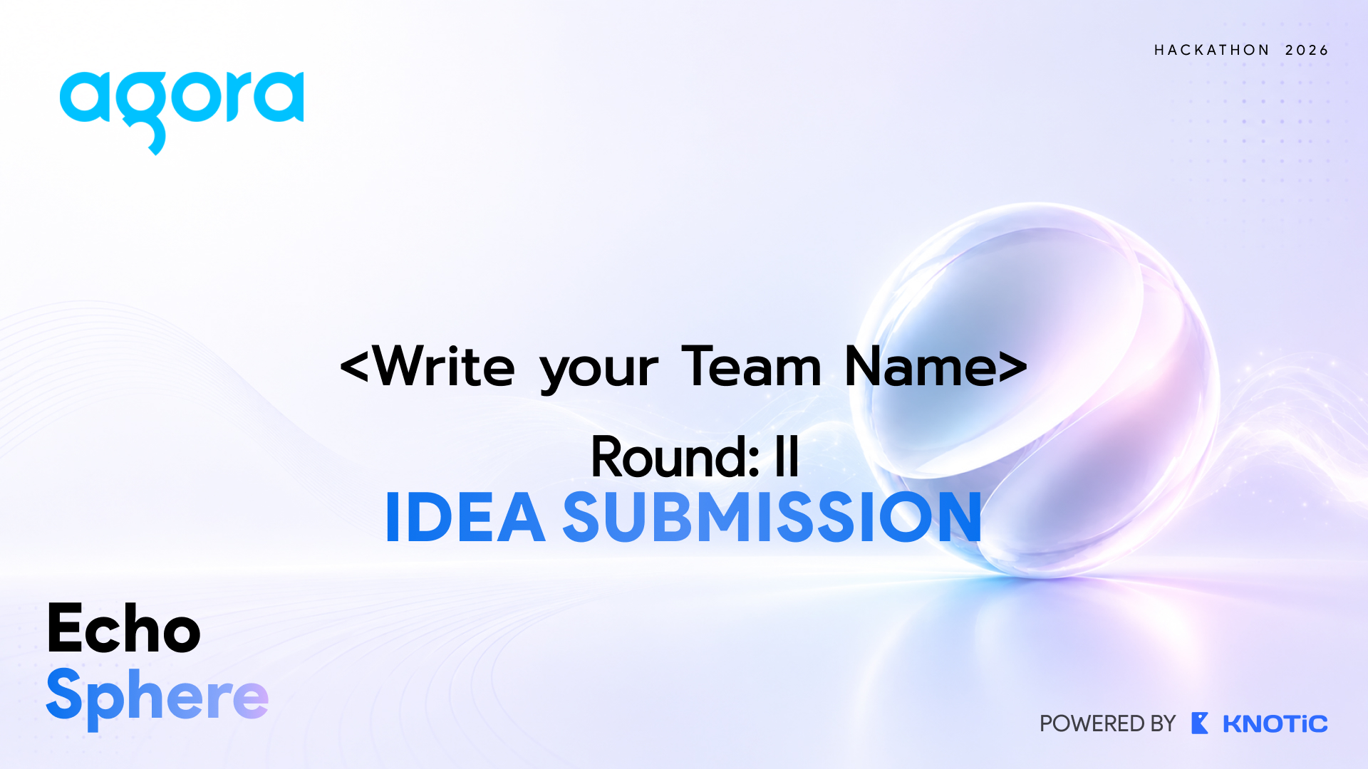

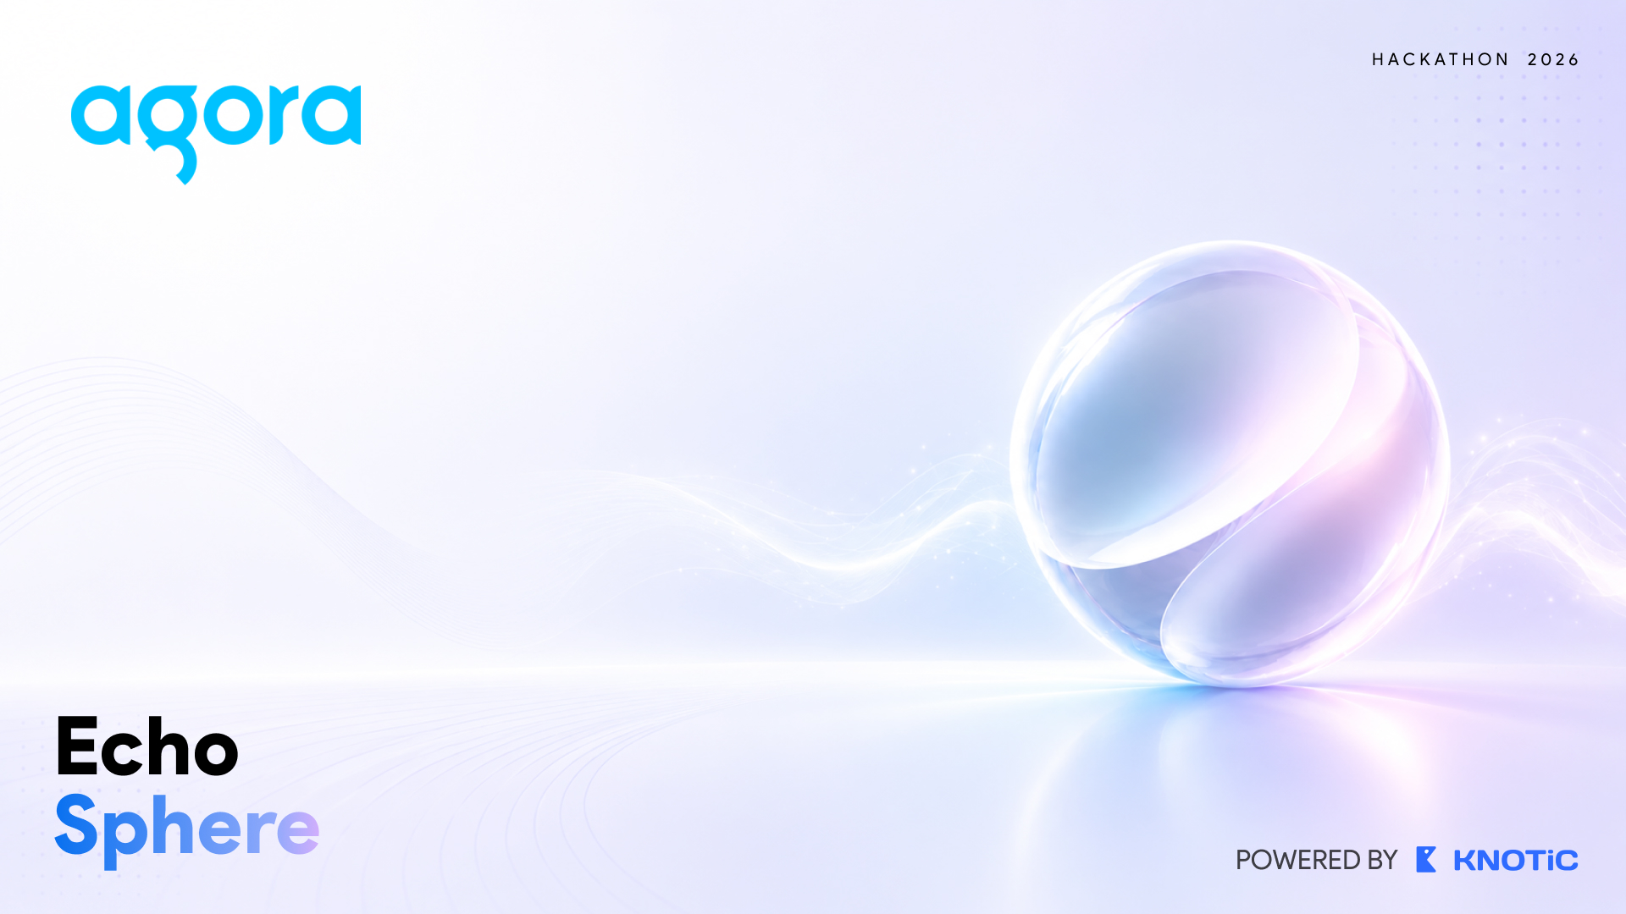
Vocalis AI
SheBuilds
Round: II
IDEA SUBMISSION

Slide 2
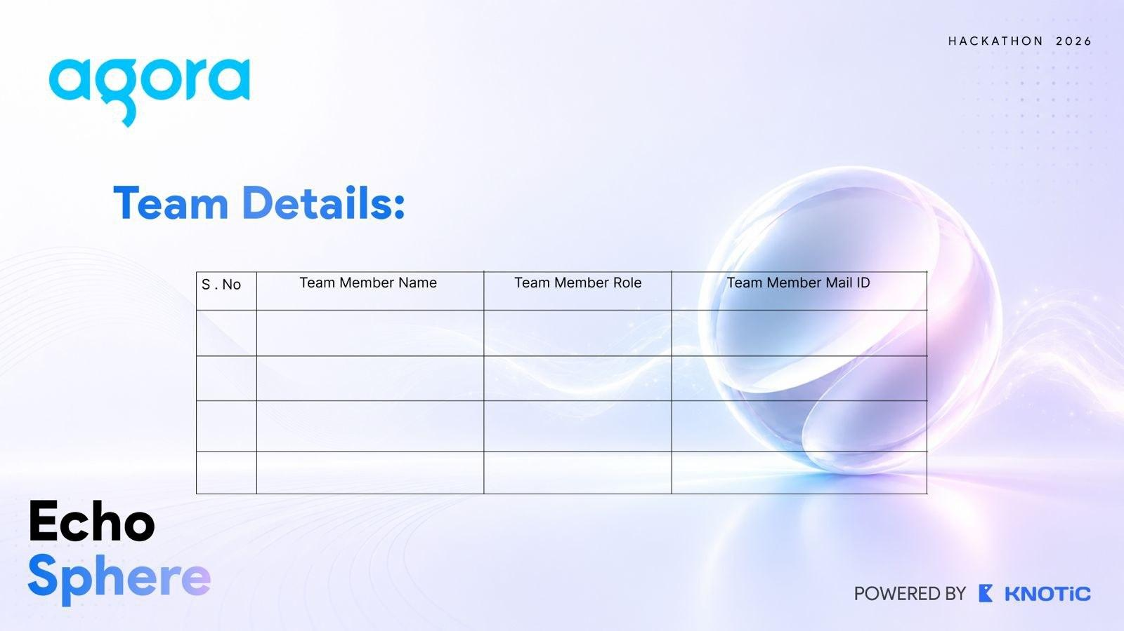
Team Details:
S.No | Team Member Name | Team Member Role | Team Member Mail ID
1 | Riyanshi Verma | Backend and APIs | riyanshi.verma.cseds.2023@miet.ac.in
2 | Kanishka Verma | Frontend | kanishkav7456@gmail.com

Slide 3
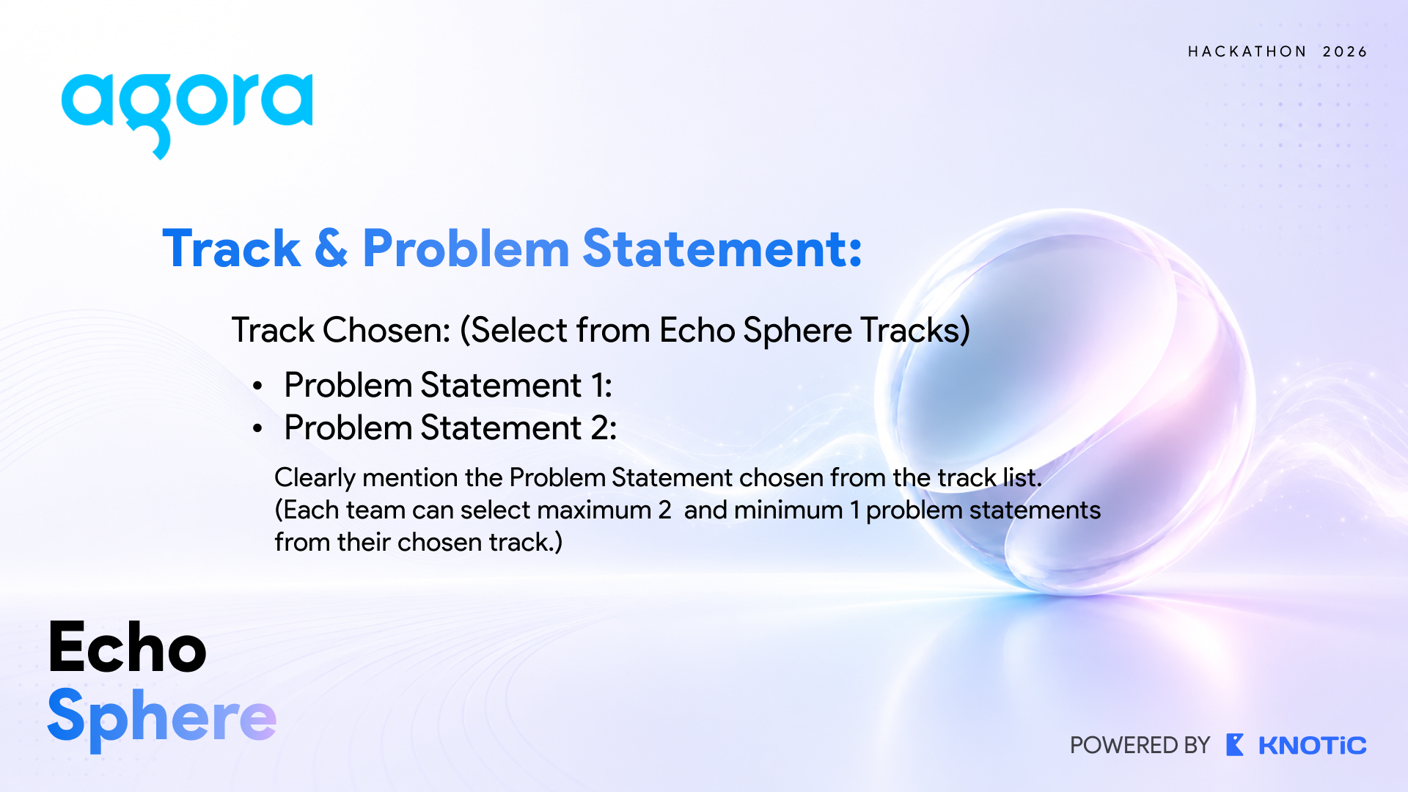
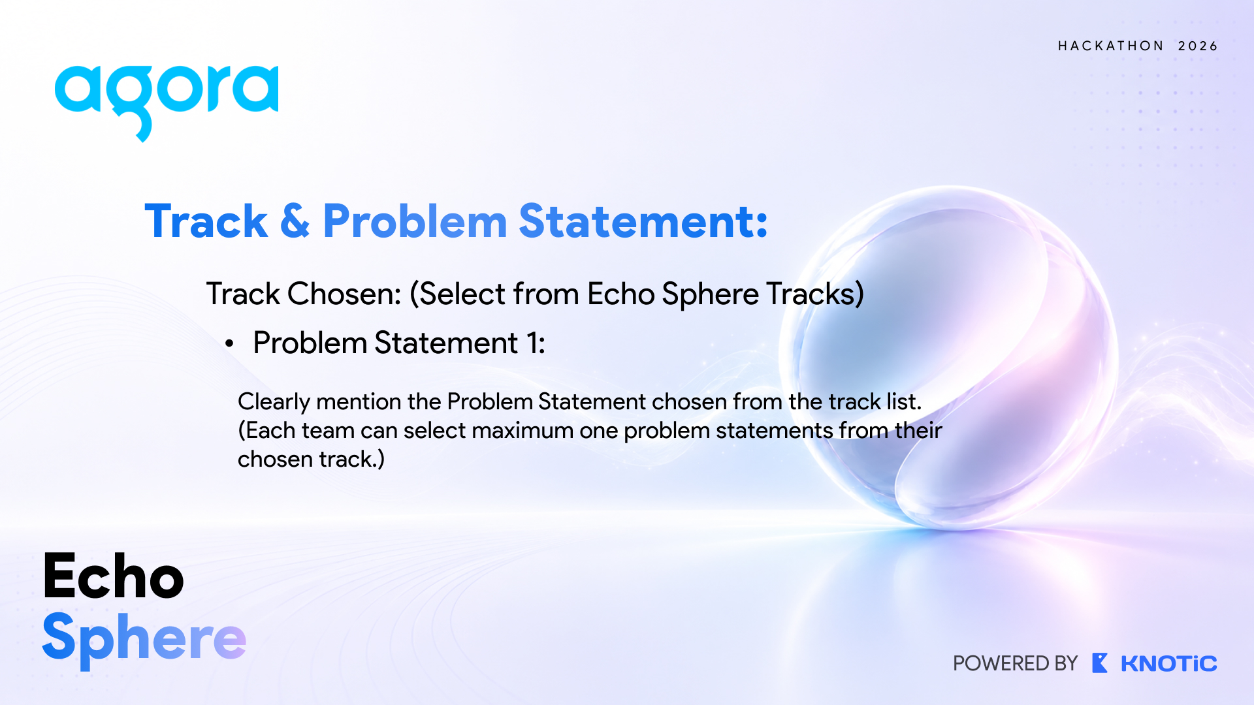
Track - Problem Statement:
Problem Statement: Coordinated AI Interview Panel
Chosen Track: EchoSphere Conversational AI & Real-Time Voice Track
Solution Focus: Reclaiming Senior Engineering Velocity via Low-Latency Multi-Agent Voice Committees

Slide 4
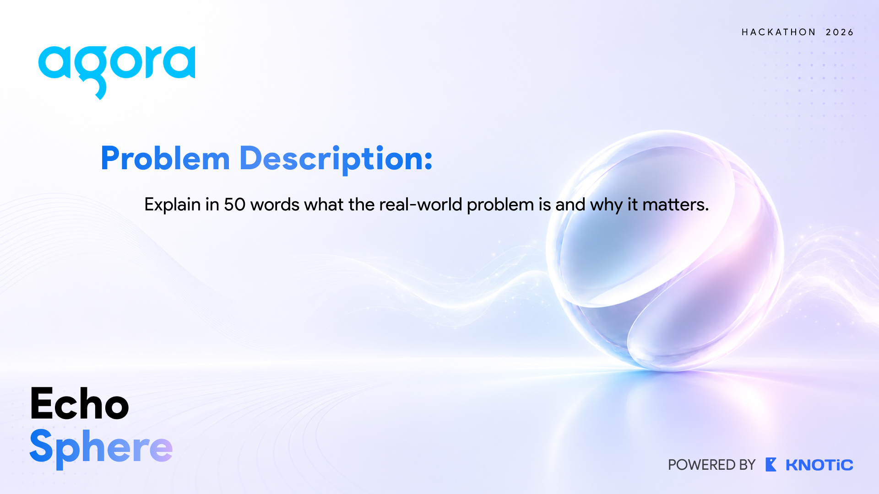
Problem Description:
Senior engineering hiring is a multi-billion dollar enterprise bottleneck. Staff and Principal engineers lose 15–20% of their bandwidth conducting repetitive screens, costing over $1.2M annually per 100 hires in lost velocity. Existing single-prompt AI chatbots are flat, mono-perspective, suffer 1500ms+ latency, lack barge-in interruptibility, and fail to probe technical depth with auditable evidence.

Slide 5
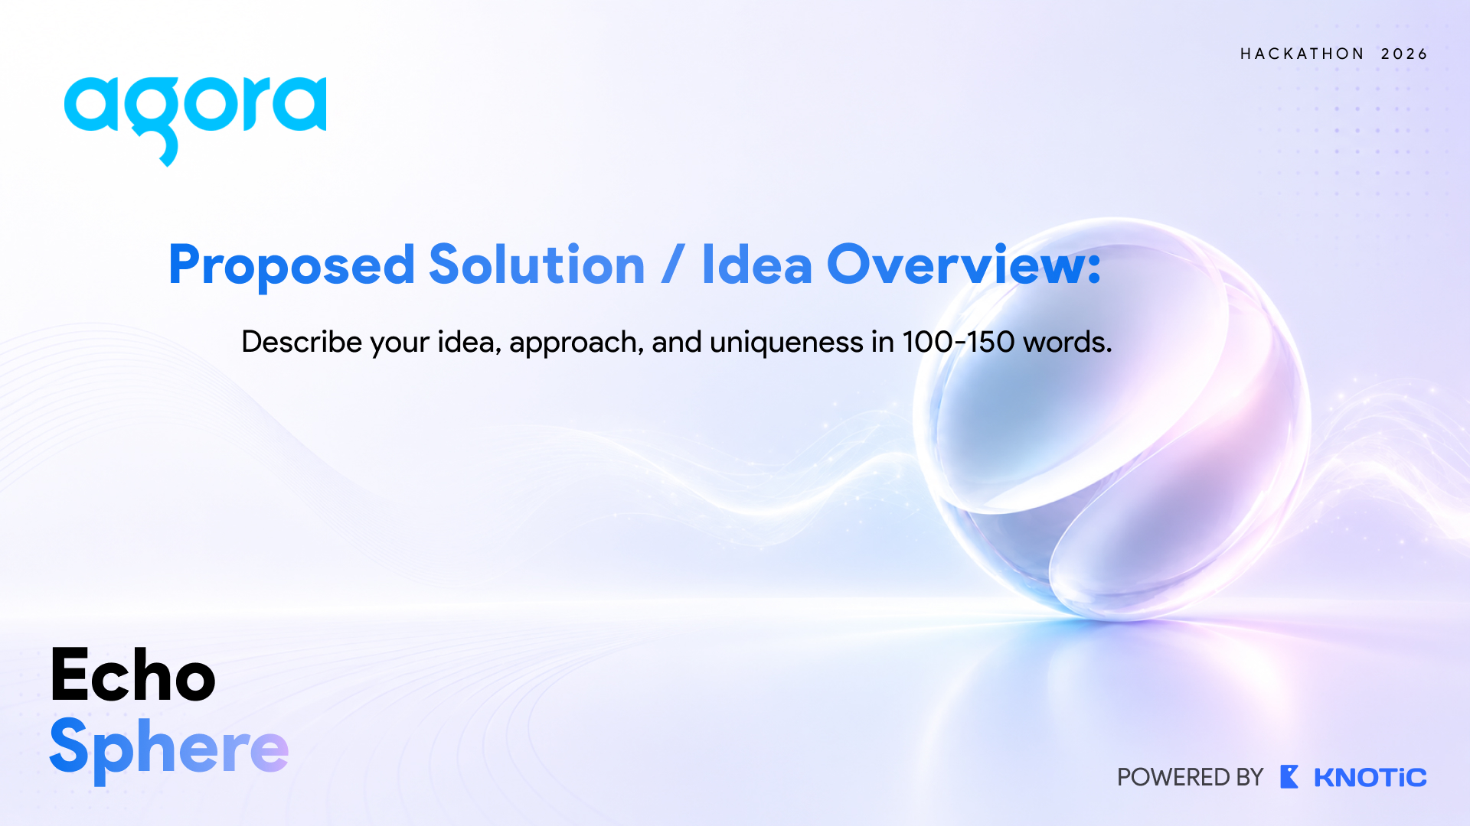
Proposed Solution / Idea Overview:
Vocalis AI is an autonomous, multi-role voice interview committee powered by Agora Real-Time Voice (SD-RTN™) and multi-agent deliberation. Instead of a single chatbot, 4 specialized AI interviewers (Systems Architect, VP of Product, Engineering Director, Security Lead) deliberate backstage, negotiate turn-taking, and share a unified candidate memory bus.
Candidates experience studio-grade 48kHz audio with sub-100ms latency, 3D spatial audio positioning, and instant barge-in interruption detection. Vocalis dynamically calibrates interview depth—escalating to Staff-level edge cases for strong answers while providing structured scaffolding when needed. It delivers 100% evidence-based scorecards with verbatim transcript citations, reducing engineering effort by 80% and hiring costs by $1.2M+ per 100 hires with zero demographic bias.

Slide 6
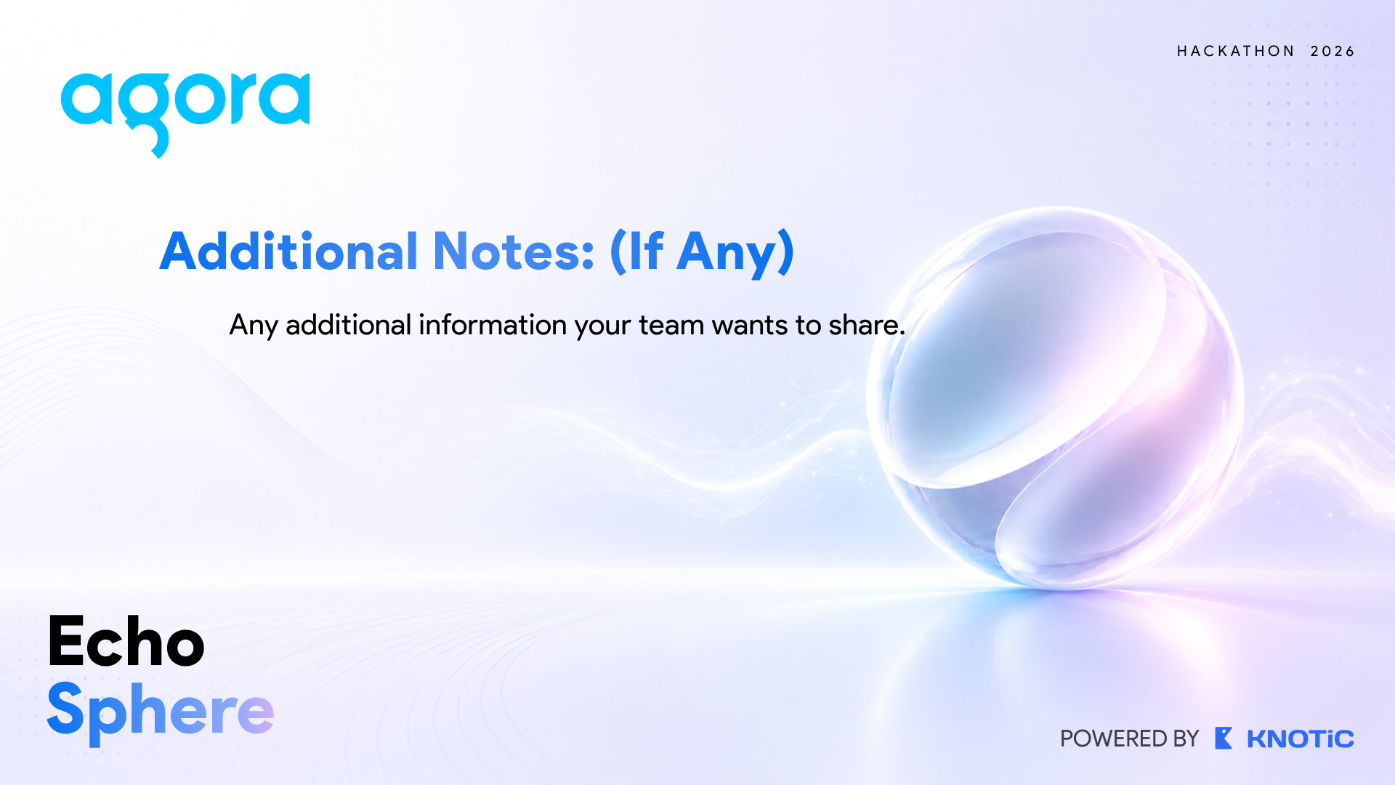
Additional Notes:
Deep Agora Technologies Integration:
Agora Voice SDK & SD-RTN™ Global Edge Mesh (<100ms global latency, 80% packet loss resilience).
Agora Conversational AI: Voice Activity Detection (VAD) & Echo Cancellation (AEC) for instant barge-in.
Agora Spatial Audio Engine: 3D positioning for distinct interviewer acoustics (Left, Center, Right).
Agora AI Noise Suppression (ANS) & Quality Analytics (QoE) telemetry.
Working Prototype & Enterprise ROI:
Built and operational with React, TypeScript, and Bun server architecture.
Proven Business Metrics: 80% engineering hours saved, 3.8x faster time-to-offer, $1.2M+ annual cost savings per 100 hires.

Slide 7
Technical Architecture & Multi-Agent Pipeline:
Candidate Client Ingress Loop (<30ms):
Bidirectional WebRTC audio streaming captures studio-grade 48kHz Opus mic input.
Client-side Voice Activity Detection (VAD) handles real-time speech boundary triggers.
Agora SD-RTN™ & Conversational AI Core (<50ms):
Software-Defined Real-Time Network guarantees <100ms global latency and 80% packet loss resilience.
Acoustic Echo Cancellation (AEC) and Deep AI Noise Suppression (ANS) filter room echo & keyboard clicks.
Instant sub-150ms barge-in interruption detection pauses AI playback naturally when candidate speaks.
Backstage Committee Arbitrator (<60ms):
Multi-agent orchestrator evaluates candidate response depth and picks the optimal interviewer persona
(Marcus Vance - Systems, Elena Rostova - Product, David Chen - Eng Dir, Aria Thorne - Security) to probe.
Shared Candidate Memory Bus & Scorecard Engine:
Centralized context bus tracks resume metrics, prior Q&A claims, technical gaps, and contradiction detection.
Generates 100% evidence-based consensus scorecards with verbatim transcript quote citations.

Slide 8
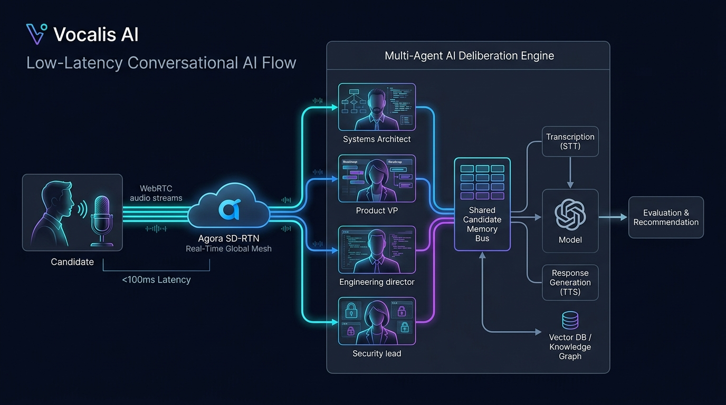

Slide 9
Competitive Advantage & Enterprise Impact ROI:
Differentiation Against Existing Alternatives:
Human Interview Panel: High cost ($150–$250/hr per engineer), severe fatigue, subjective delayed notes.
Generic Single-Prompt AI Bots: 1500–3000ms voice lag, flat persona, no barge-in, easily gamed by buzzwords.
Vocalis AI + Agora Stack: <100ms SD-RTN streaming, 4 specialized deliberative personas, instant sub-150ms barge-in, 3D spatial audio positioning, 100% quote-backed scorecards, and <$2 cost per 45-minute comprehensive round.
Quantifiable Business Impact & Metrics:
80% Engineering Bandwidth Saved: Reclaims hundreds of productive sprint hours for Staff and Principal engineers.
3.8x Faster Time-to-Offer: 24/7 on-demand autonomous interviews eliminate recruiter scheduling bottlenecks.
$1.2M+ Annual Cost Reduction: Calculated on 100 senior technical hires @ $200/hr engineer opportunity cost.
100% Objective Calibration: Standardized, quote-backed evaluation rubrics with zero demographic bias.

Slide 10
