Slide 1



<Write your Team Name>vv
<Write your Team Name>
Round: II
IDEA SUBMISSION

Slide 2

Team Details:
S.No | Team Member Name | Team Member Role | Team Member Mail ID

Slide 3


Track - Problem Statement:
Track Chosen: (Select from Echo Sphere Tracks)
One Problem Statement
Clearly mention the Problem Statement chosen from the track list.
(Each team can select maximum one problem statements from their chosen track.)

Slide 4

Problem Description:
Explain in 50 words what the real-world problem is and why it matters.

Slide 5

Proposed Solution / Idea Overview:
Describe your idea, approach, and uniqueness in 100-150 words.

Slide 6

Additional Notes: (If Any)
Any additional information your team wants to share.

Slide 7
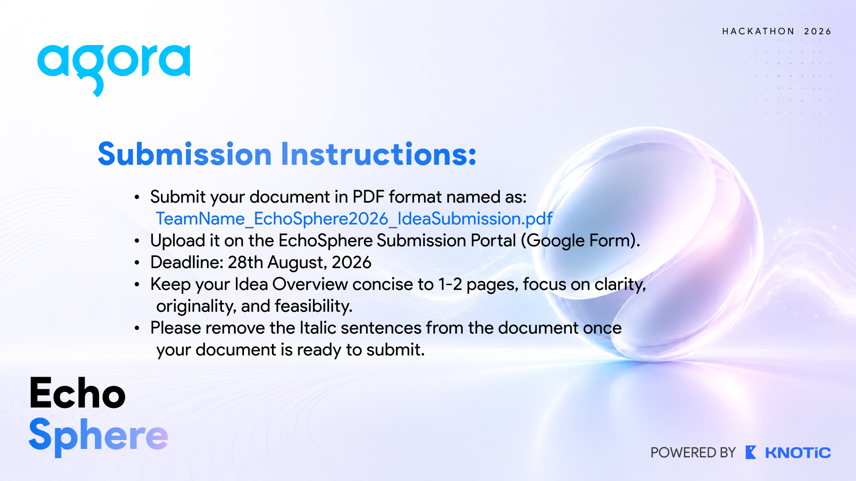
Submission Instructions:
Submit your document in PDF format named as: TeamName_EchoSphere2026_IdeaSubmission.pdf
Upload it on the commudle Submission Portal.
Deadline: 28th August, 2026 23:59
Keep your Idea Overview concise to 10-12 pages, focus on clarity,
originality, and feasibility.
Please remove the Italic sentences from the document once
your document is ready to submit.

