Slide 1

EMPLOYEE DATA ANALYSIS
IN MS-EXCEL
BY
RIYAVARSHINI ARUNPRASAD
POWERED BY

Slide 2


INTRODUCTION
I am excited to present the results of my internship project, Employee Data Analysis, provided by PSYLIQ.
Throughout this journey, I utilized the capabilities of MS-Excel, applying various techniques such as data cleaning, Pivot Tables, dynamic charts, VLOOKUP to derive actionable insights.
My primary goal was to answer key questions posed by PSYLIQ and finally create Dashboard with insights.

Slide 3


DATA INSIGHTS
For each questions, data analysis results and insights are provided respectively

Slide 4
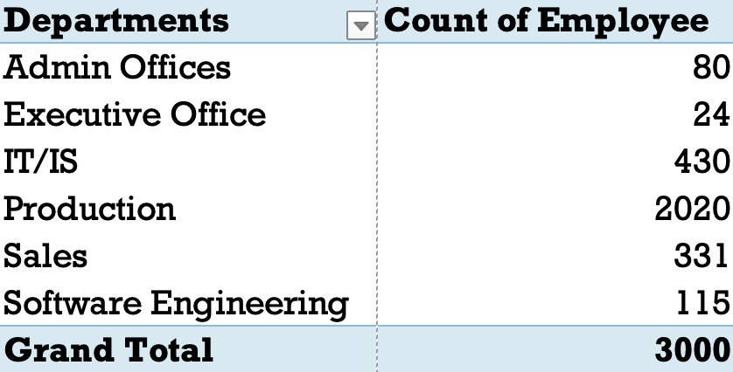
1
create a pivot table to summarize the total number of employees in each department?
The Production department has the highest number of employees, with 2020 individuals.
Admin Offices and Executive Office have relatively smaller employee counts, with 80 and 24 employees, respectively.
Production, IT/IS, and Sales departments appear to be the core operational areas, as they collectively constitute a significant portion of the workforce.

Slide 5
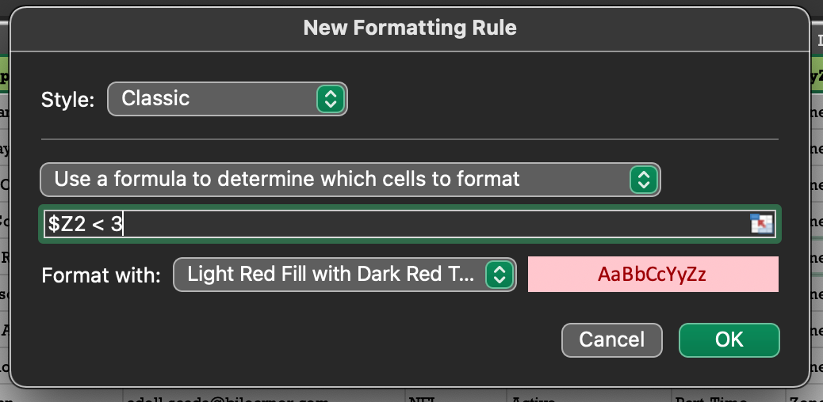
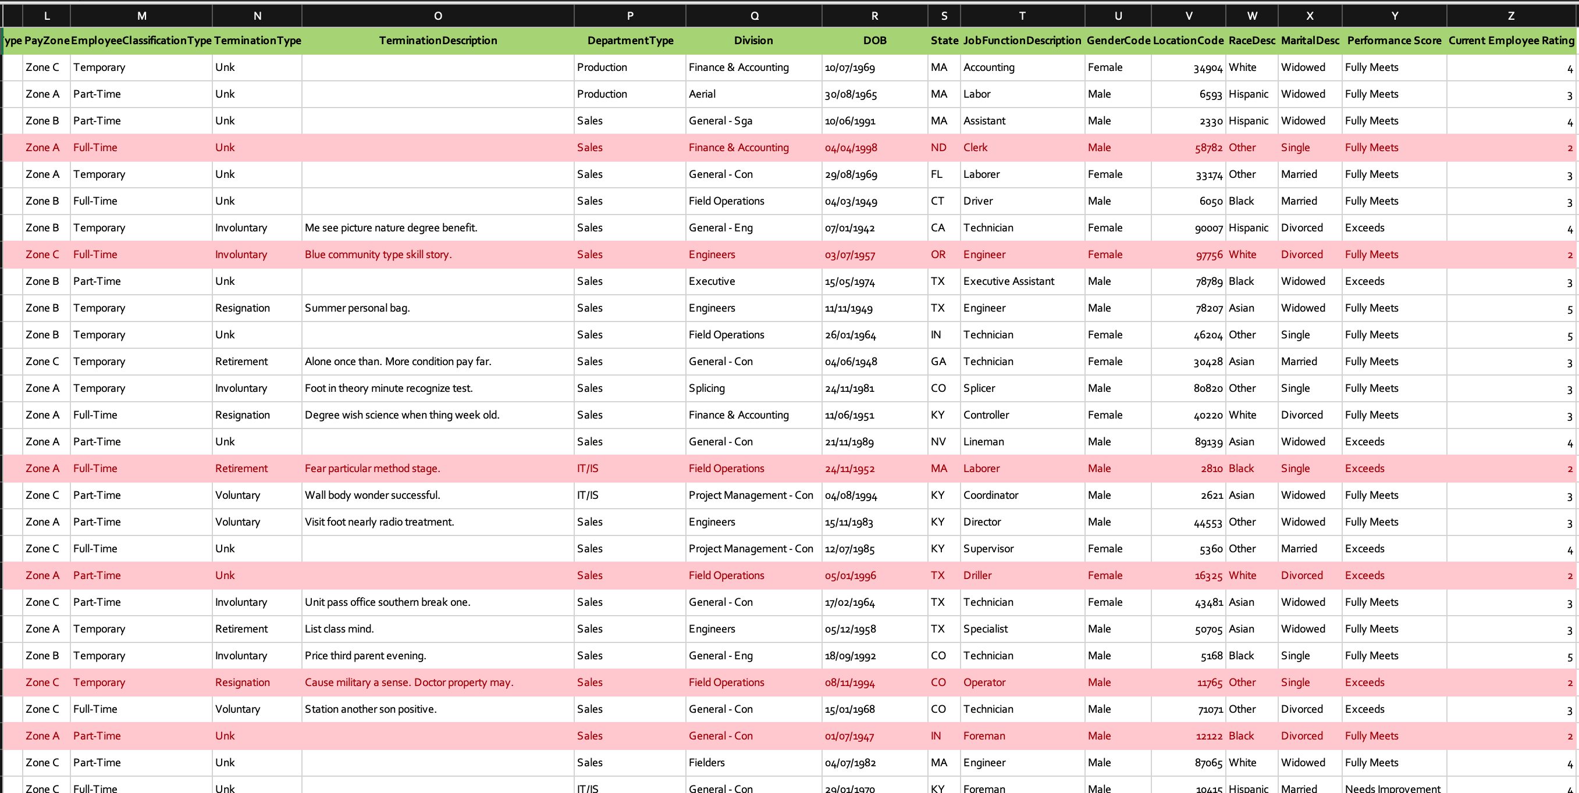
2
Apply conditional formatting to highlight employees with a ”employee rating" below 3 in red .
781 employees found to have employee rating below “3”.
Applied conditional formatting on entire dataset to highlight entire row containing employee rating below 3.
$Z2 < 3 (assuming Z is employee rating column )

Slide 6
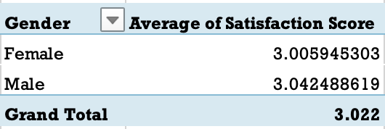
3
Calculate the average "Satisfaction Score" for male and female employees separately using a pivot table.
On average, male employees have a slightly higher satisfaction score compared to female employees.
The overall satisfaction score (grand total) falls in between the average scores of male and female employees, suggesting a relatively balanced satisfaction level across genders.

Slide 7
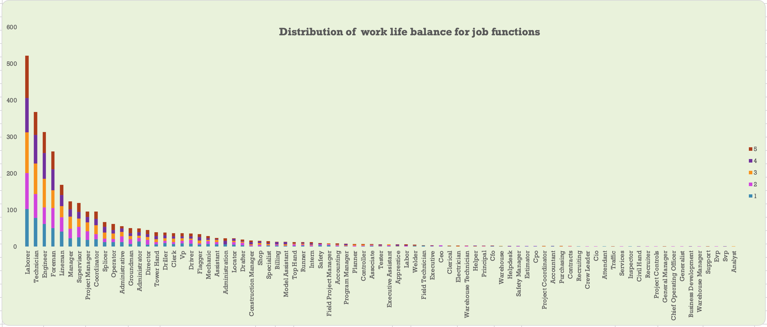
4
Create a chart to visualize the distribution of "Work-Life Balance Score" for different job functions.
Job functions, such as Labourer, Technician, Engineer, and Foreman, have relatively high counts in the higher satisfaction score ranges (4 and 5).

Slide 8
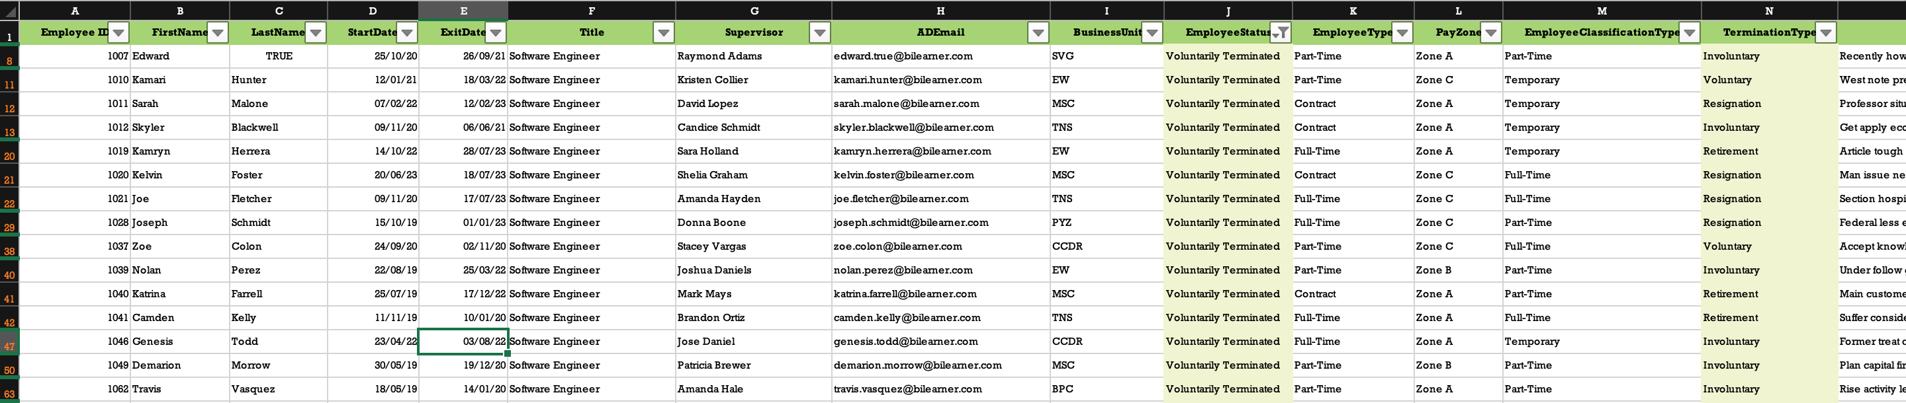
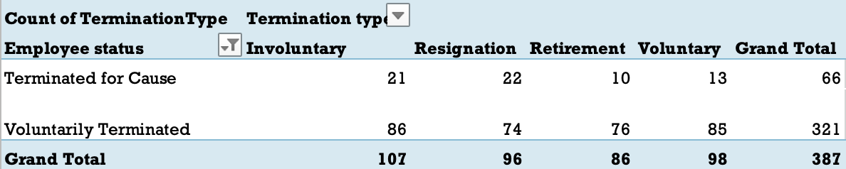
5
Filter the data to display only terminated employees and find out the most common "Termination Type."
Employee who are voluntarily terminated has most common termination type as Involuntary about 86 out of 321.
Employee who are terminated for cause has most common termination type as Resignation about 22 out of 66.

Slide 9
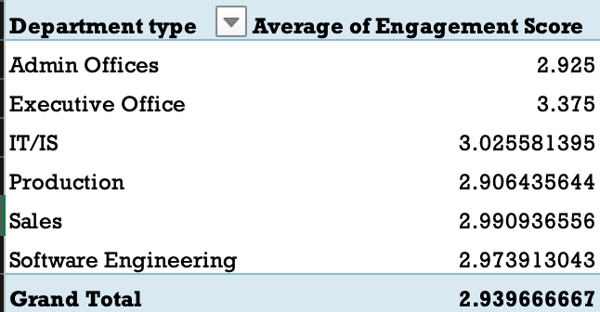
6
Calculate the average "Engagement Score" for each department using a pivot table.
Executive Office has the highest average (3.375), while Production has a slightly lower average (2.906).
Admin Offices, IT/IS, Sales, and Software Engineering fall in between these two extremes.

Slide 10
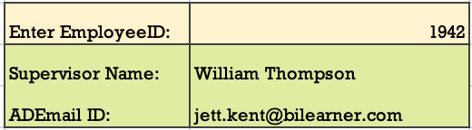
7
Use VLOOKUP to find the supervisor’s name and employee email address for a specific employee.
Create a cell to enter required employeeID [AI5]
Enter formula =VLOOKUP(AI5,A1:AD3001,7) to retrieve supervisor name
Enter formula =VLOOKUP(AI5,A1:AD3001,8) to retrieve email address

Slide 11
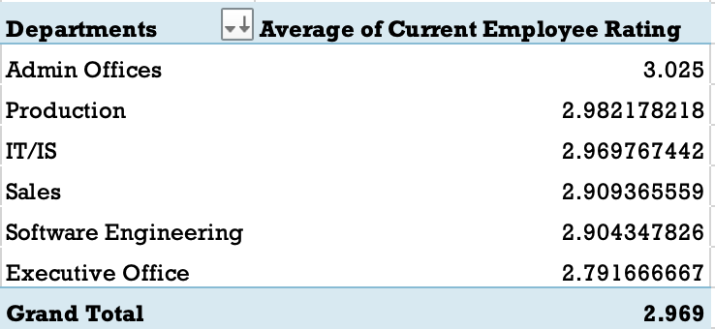
8
Can you identify the department with the highest average "Employee Rating?"
Department Admin Offices found to have highest average Employee Rating.

Slide 12
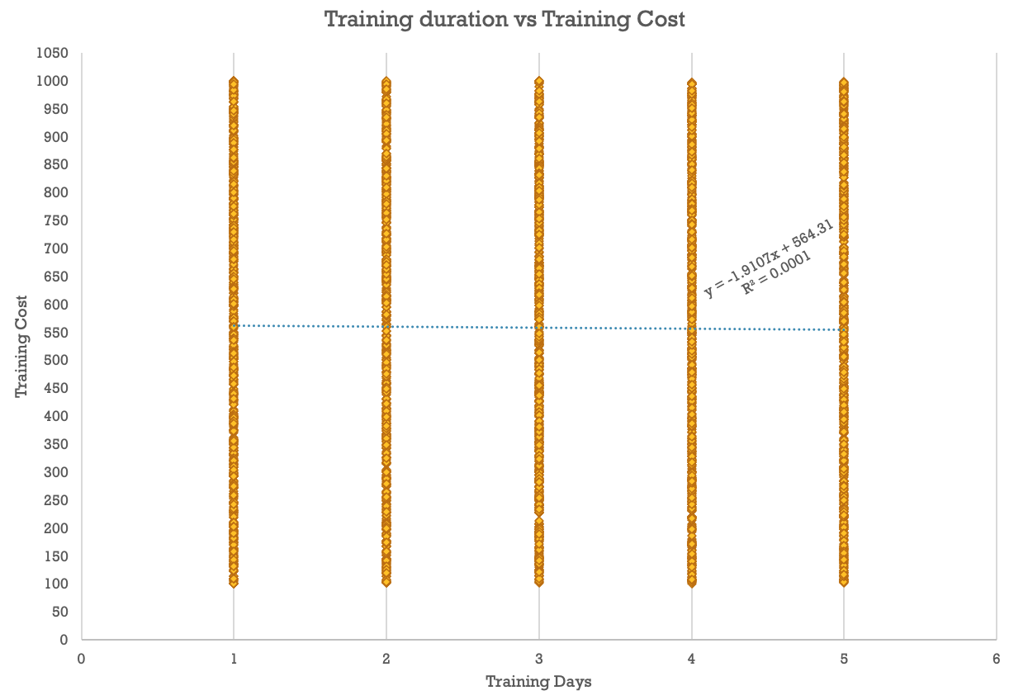
9
Create a scatter plot to explore the relationship between "Training Duration (Days)" and "Training Cost.
From the equation, y = -1.9107x + 564.31 and R² value = 0.0001 , it is evident that the linear relationship between the two variable is very weak.

Slide 13
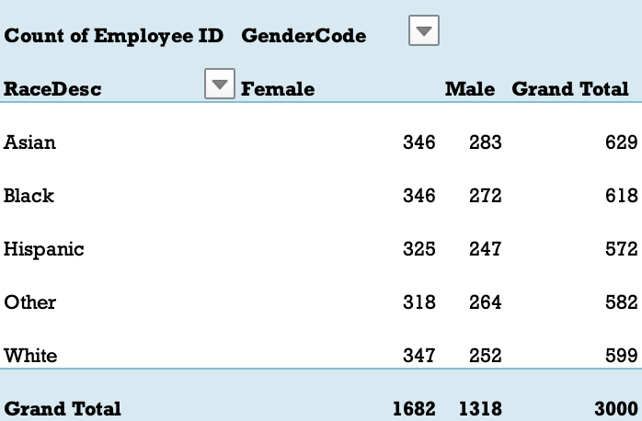
10
Build a pivot table that shows the count of employees by "RaceDesc" and "GenderCode."
Highest number of employee found to be Asian race (629)
Highest number of Female employees belong to White(347), Asian and black (346) race respectively.
Highest number of Male employees belong to Asian (283) race.

Slide 14
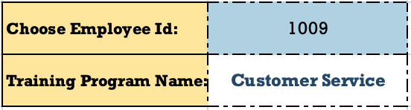
11
Use INDEX and MATCH functions to find the "Training Program Name" for an employee with a specific ID.
Created drop down list to choose employee ID.
Extracted training program name corresponding to the chosen employeeID using the formula = INDEX(A:I,MATCH(L2,A:A),3).

Slide 15
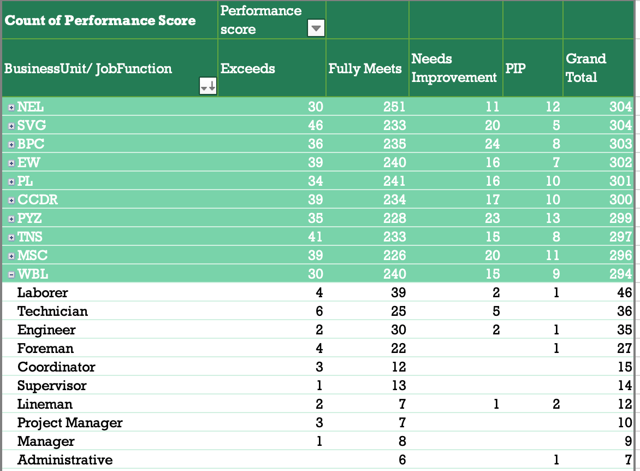
Create a multi-level pivot table to analyze the "Performance Score" by "BusinessUnit" and "JobFunctionDescription."
12
The Fully Meets category dominates in each Business Unit, indicating that a significant portion of employees meets the expected performance standards.

Slide 16
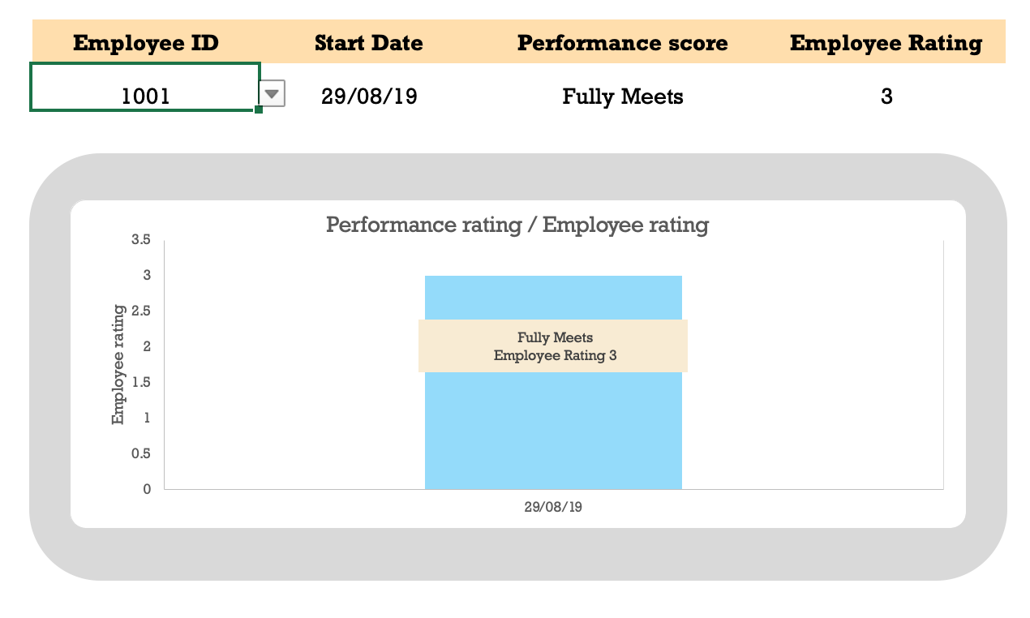
Design a dynamic chart that allows users to select and visualize the performance of any employee over time.
13
Created drop down list to choose EmployeeID.
Used =INDEX(Employee_ID:Current_Employee_Rating, MATCH(R3,Employee_ID,0), {2,3,4} ) to retrieve date , performance score and employee rating of selected employeeID.
Created bar chart which measure employee rating and added label which also show performance rating of employee

Slide 17
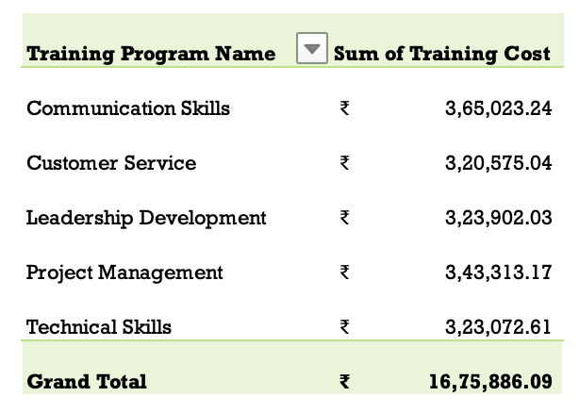
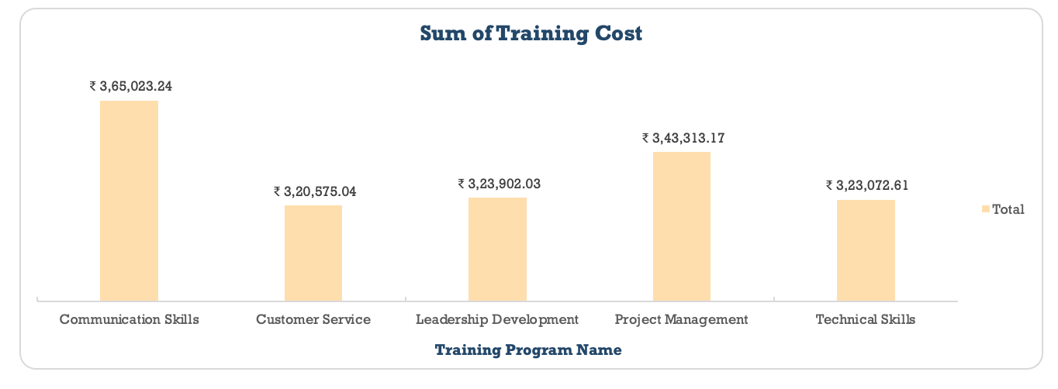
14
Calculate the total training cost for each "Training Program Name" and display it in a bar chart.
Training on Communication skills costs the largest about ₹ 3,65,023.24
Training on customer services costs the smallest about ₹ 3,20,575.04

Slide 18
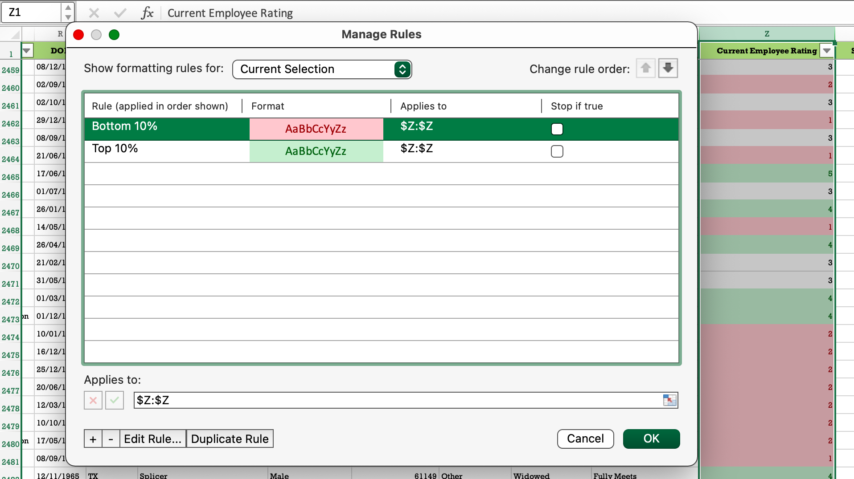
Apply advanced conditional formatting to highlight the top 10% and bottom 10% of employees based on "Current Employee Rating."
15
Found that employees with employee rating 1,2 are bottom 10% about 781 employees.
Employees with employee rating 4,5 are top 10% about 689 employees.

Slide 19
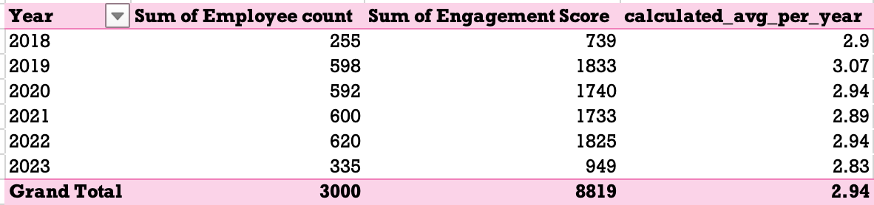
16
Use a calculated field in a pivot table to determine the average "Engagement Score" per year.
There is an increase in Employee count from 2018 to 2019, and then it remains relatively stable in the following years.
The Engagement Score peaks in 2019 approximately 3.07.

Slide 20
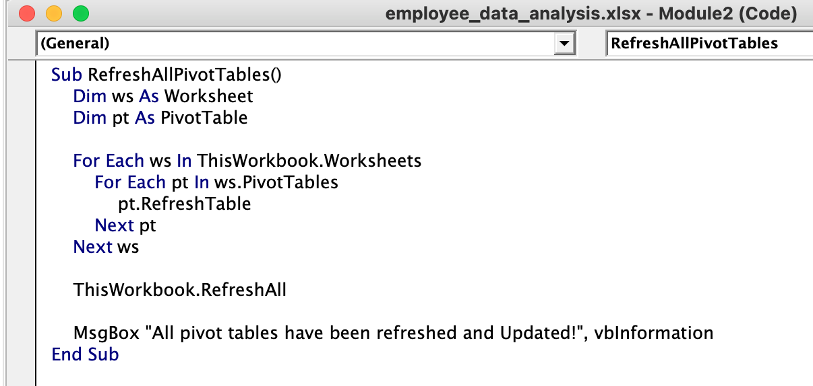
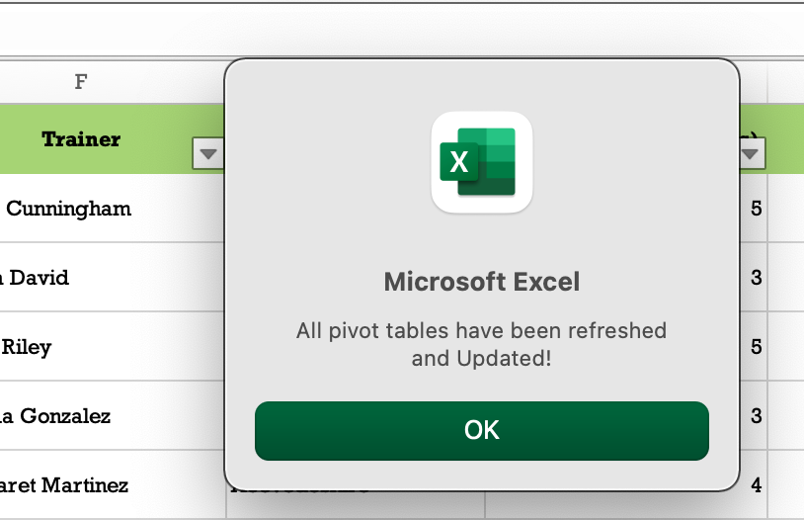
Can you build a macro that automates the process of updating and refreshing all pivot tables in the workbook?
17
Two nested loops to iterate through worksheets and pivot tables.
pt.RefreshTable to refresh each individual pivot table.
ThisWorkbook.RefreshAll for refreshing the entire workbook.

Slide 21
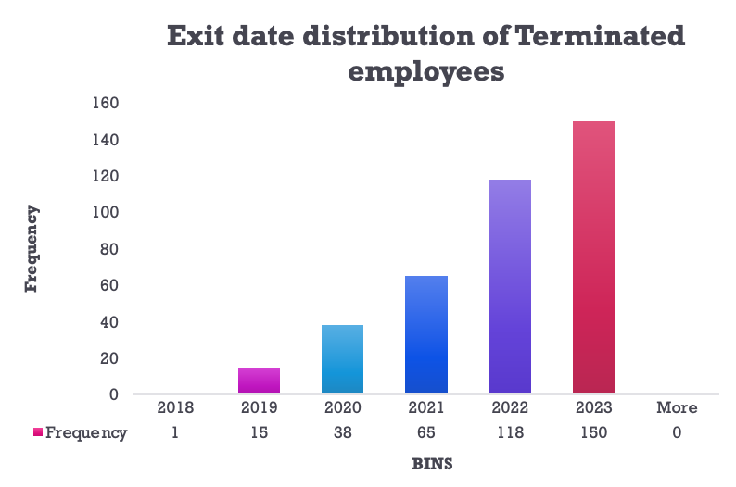
18
Create a histogram to understand the distribution of "ExitDate" for terminated employees.
The number of employees terminated statuses increases significantly in subsequent years.

Slide 22
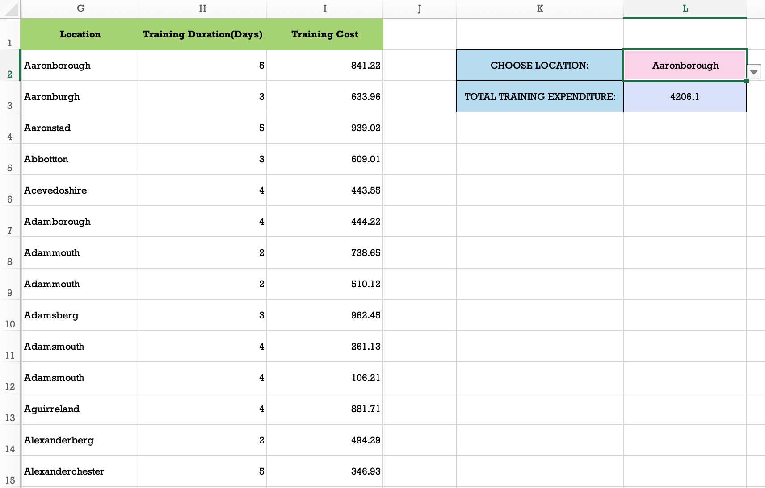
19
Utilize the SUMPRODUCT function to calculate the total training cost for employees in a specific location.
Created drop down list using data validation to choose specific location [L2]
Utilized =SUMPRODUCT((G2:G3001 = L2)*H2:H3001*I2:I3001) to return total training cost for employees

Slide 23

EMPLOYEE ANALYSIS
DASHBOARD

Slide 24
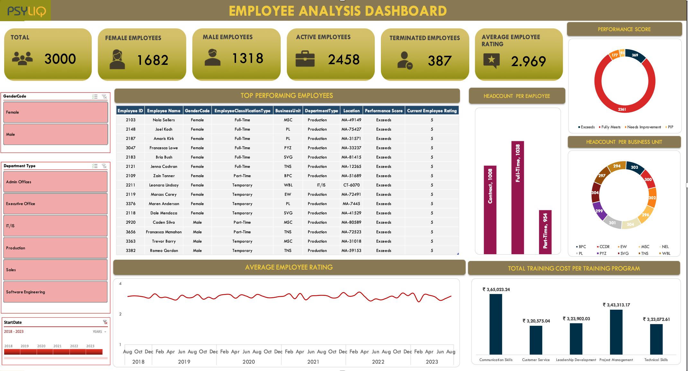

Slide 25
MS – EXCEL FUNCTIONS AND METHODS UTILIZED
Filtering
INDEX Functions
1
7
Sorting
MATCH Function
2
8
Conditional
Formatting
Dynamic charts
3
9
Pivot tables
Pivot Charts
4
10
Multi level
Pivot Tables
Dashboard
5
11
Calculated fields
Slicers
6
12

Slide 26
THANK YOU
Thank you, PSYLIQ, for the invaluable opportunity to not only apply my Excel skills but also for fostering an environment that encourages learning. The chance to delve into creating dynamic pivot tables, incorporating calculated fields, and crafting dashboards in Excel has been both enriching and rewarding.

