Slide 1

TASK - 3
DIABETES PATIENT ANALYSIS
USING SQL
BY RIYAVARSHINI ARUNPRASAD
POWERED BY

Slide 2
INTRODUCTION
Diabetes patient analysis project is a third task provided by PSYLIQ during my internship.
This project aims in demonstrating intern’s SQL skills at all levels.
The primary objective is to analyze a dataset consisting health records of diabetes patients.
The entire project is executed using Oracle SQL Developer, providing a hands-on opportunity to showcase and refine my SQL expertise.

Slide 3
AGENDA
1
DATA OVERVIEW
SCHEMA ENHANCEMENT
4
2
DATA QUERIES
QUERY OPTIMIZATION
5
3
DATA INSIGHTS
CONCLUSION
6

Slide 4
DATA OVERVIEW
This dataset .xlxs format and has 1,00,000 rows and 11 columns making it ideal for analysis.
Attributes and its datatype :
Sl.No | Attribute Name | Data Type | Description
1 | Patient_name | VARCHAR2(50) | Name of the patient
2 | Patient_id | VARCHAR2(20) | Unique identifier of each patient
3 | Gender | VARCHAR2(10) | Gender of Patient
4 | Age | NUMBER(3) | Age of patient
5 | Hypertension | NUMBER(1) | Indicates whether the patient has hypertension (1 for yes, 0 for no)
6 | Heart_disease | NUMBER(1) | Indicates whether the patient has heart diseases (1 for yes, 0 for no)
7 | Smoking_history | VARCHAR2(15) | Smoking history of patient
8 | BMI | NUMBER(5,2) | Body Mass Index of patient
9 | HbA1c_level | NUMBER(3,1) | Haemoglobin A1c level of patient
10 | Blood_glucose_level | NUMBER(4) | Blood_glucose_level of patient
11 | Diabetes | NUMBER(1) | Indicates whether the patient has Diabetes (1 for yes, 0 for no)
Note : While importing data into SQL developer an incorrect column name found and was renamed. Employeename → Patient_name

Slide 5
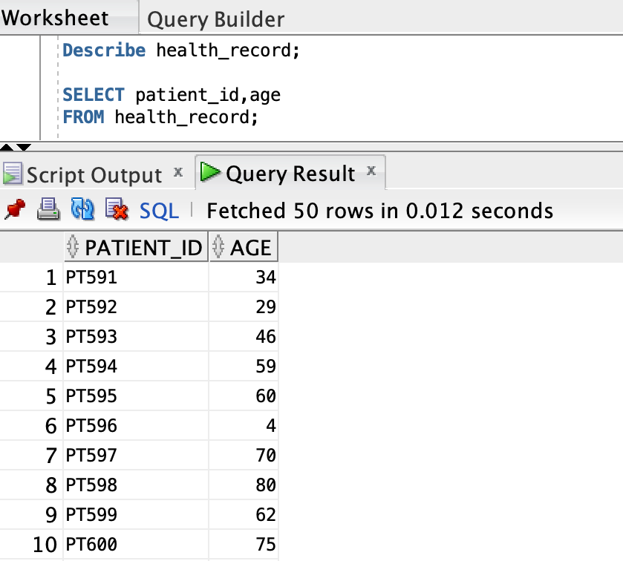
DATA QUERIES
1
Retrieve the patient_id and ages of all patients
SELECT patient_id, age
FROM health_record;
Patient ID and Age of all patients were retrieved.

Slide 6
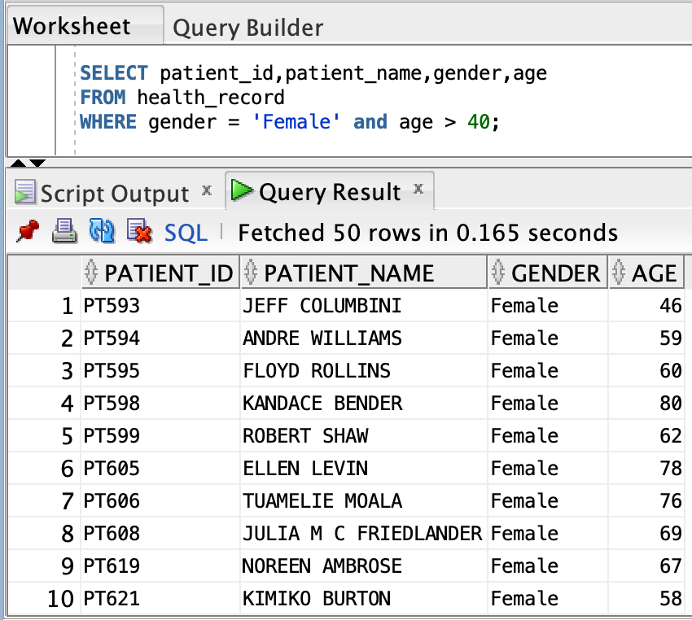
DATA QUERIES
2
Select all female patients who are older than 40.
SELECT patient_id,patient_name,gender,age
FROM health_record
WHERE gender = 'Female’ AND age > 40;
29626 patients found to be female and are above the age of 40

Slide 7
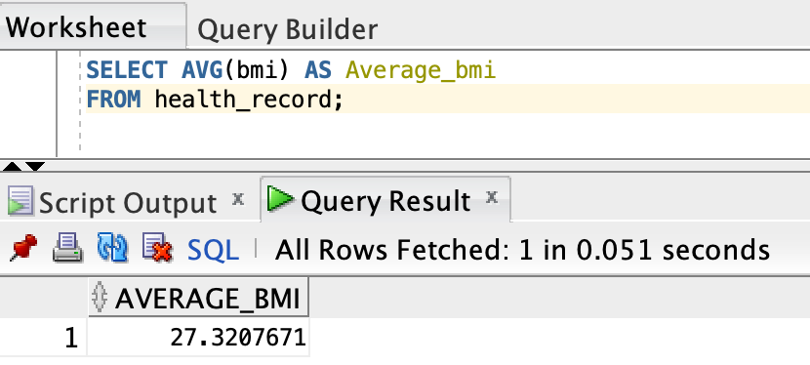
DATA QUERIES
3
Calculate the average BMI of patients
SELECT AVG(bmi) AS Average_bmi
FROM health_record;
The average Body Mass Index of patients found to be approximately 27.3.

Slide 8
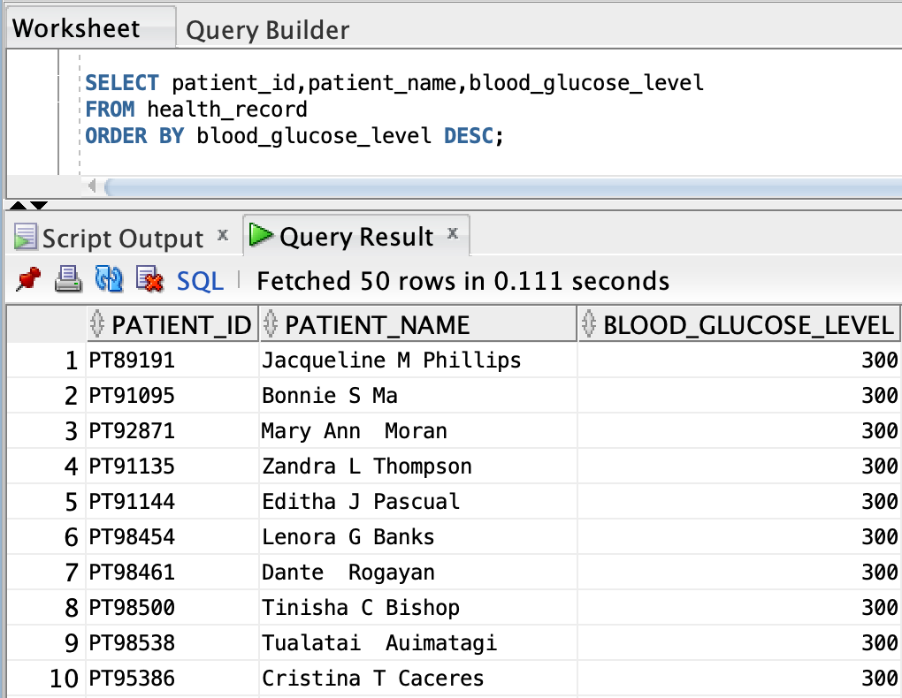
DATA QUERIES
4
List patients in descending order of blood glucose levels
SELECT patient_id,patient_name,blood_glucose_level
FROM health_record
ORDER BY blood_glucose_level DESC;
The patient details have been sorted in descending order of blood glucose level.

Slide 9
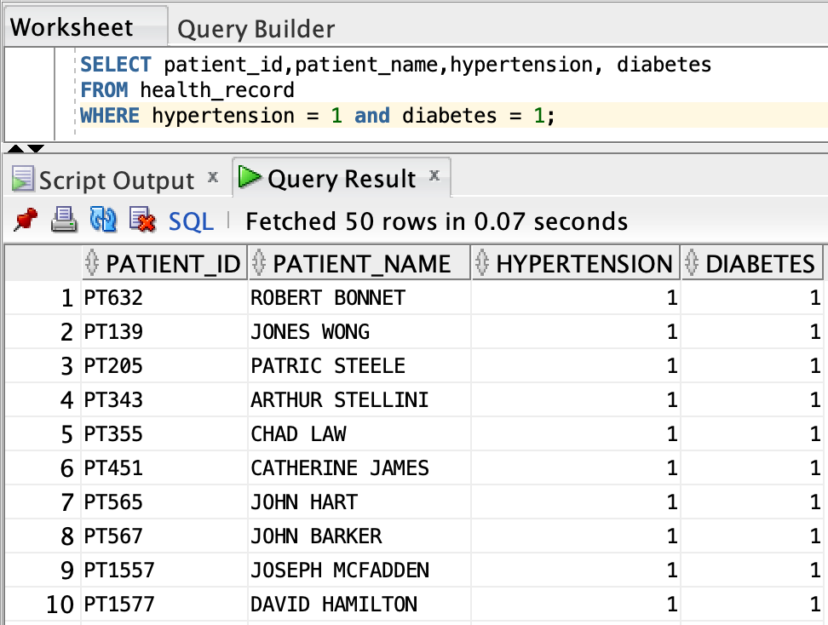
DATA QUERIES
5
Find patients who have hypertension and diabetes
SELECT patient_id, patient_name, hypertension, diabetes
FROM health_record
WHERE hypertension = 1 and diabetes = 1;
1730 patients in dataset found to have hypertension and diabetes.

Slide 10
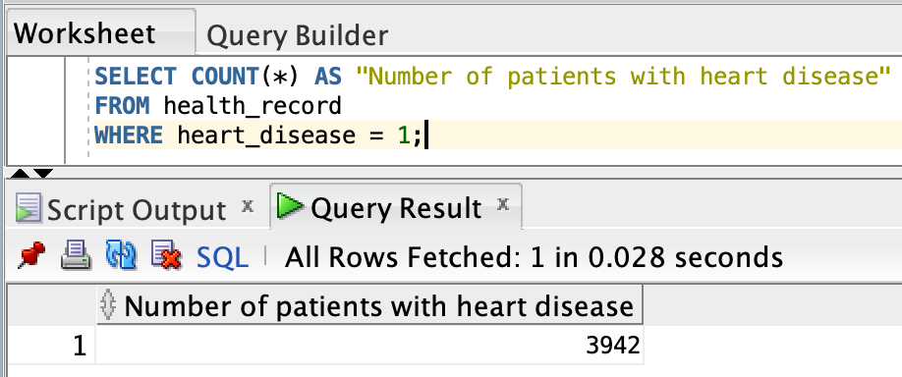
DATA QUERIES
6
Determine the number of patients with heart disease
SELECT COUNT(*) AS "Number of patients with heart disease"
FROM health_record
WHERE heart_disease = 1;
3942 patients in dataset found to have heart disease

Slide 11
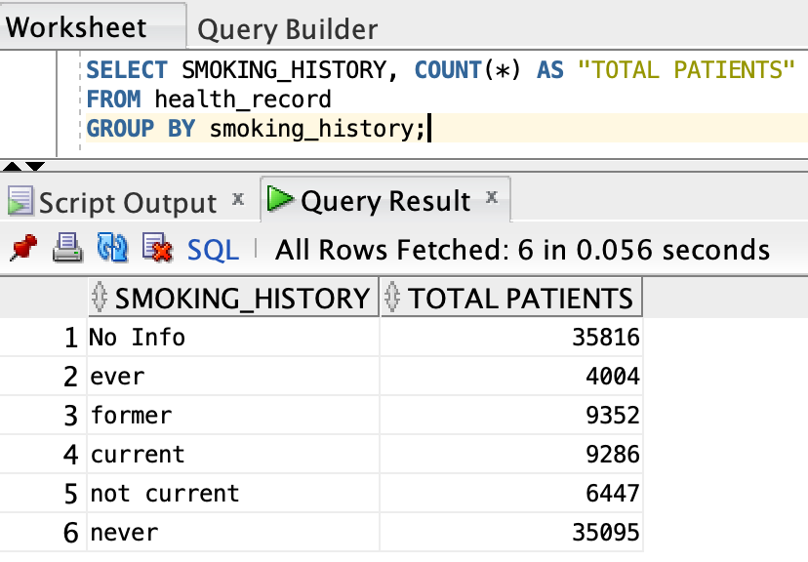
DATA QUERIES
7
Group patients by smoking history and count how many patients are there ?
SELECT SMOKING_HISTORY, COUNT(*) AS "TOTAL PATIENT"
FROM health_record
GROUP BY smoking_history;
There were five distinct entries for denoting patients smoking history and about 35816 entries of No info.
Out of five, Most number of patients about 35095 people never smoked in their life.

Slide 12
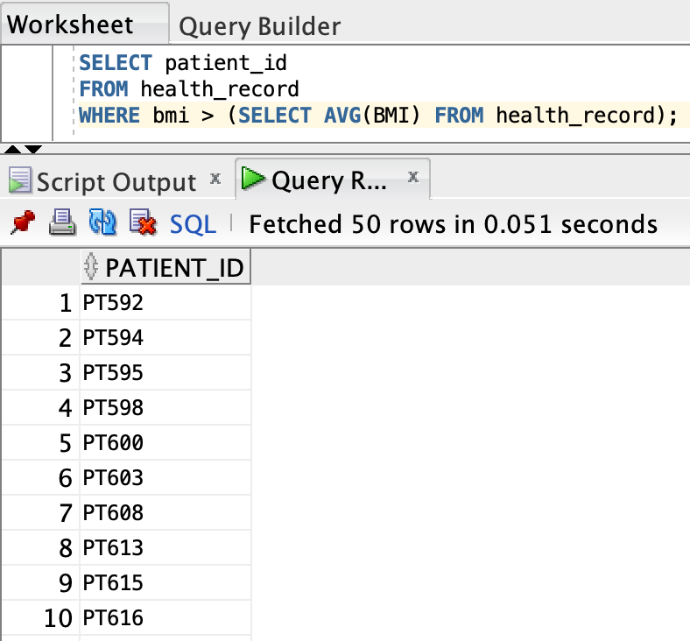
DATA QUERIES
8
Retrieve the Patient_ids of patients who have a BMI greater than the average BMI
SELECT patient_id
FROM health_record
WHERE bmi > (
SELECT AVG(BMI)
FROM health_record );
The Body Mass Index (BMI) of the respective patient greater than the average BMI is calculated from the subquery.
56802 records are retrieved.

Slide 13
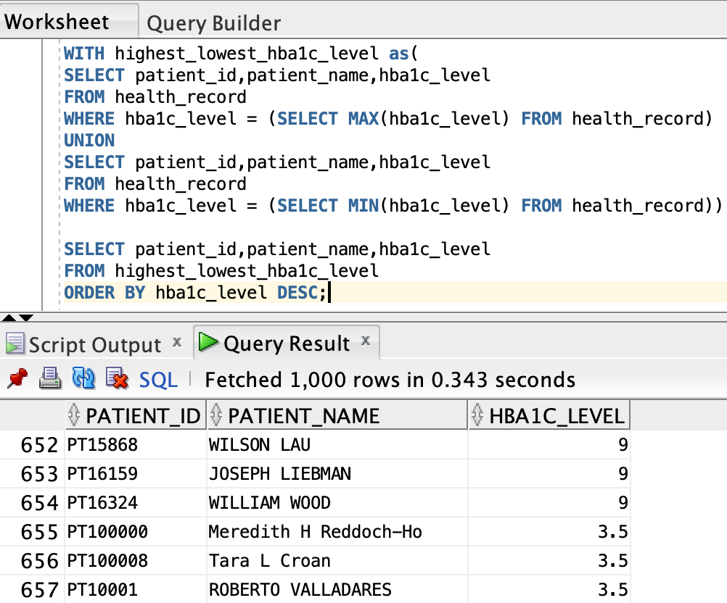
DATA QUERIES
9
Find the patient with the highest HbA1c level and the patient with the lowest HbA1clevel.
The Common Table Expression selects patient details for both the maximum and minimum HbA1c levels using the UNION operator.
The CTE separates the logic for finding the highest and lowest HbA1c levels, providing a cleaner and more organized structure.

Slide 14
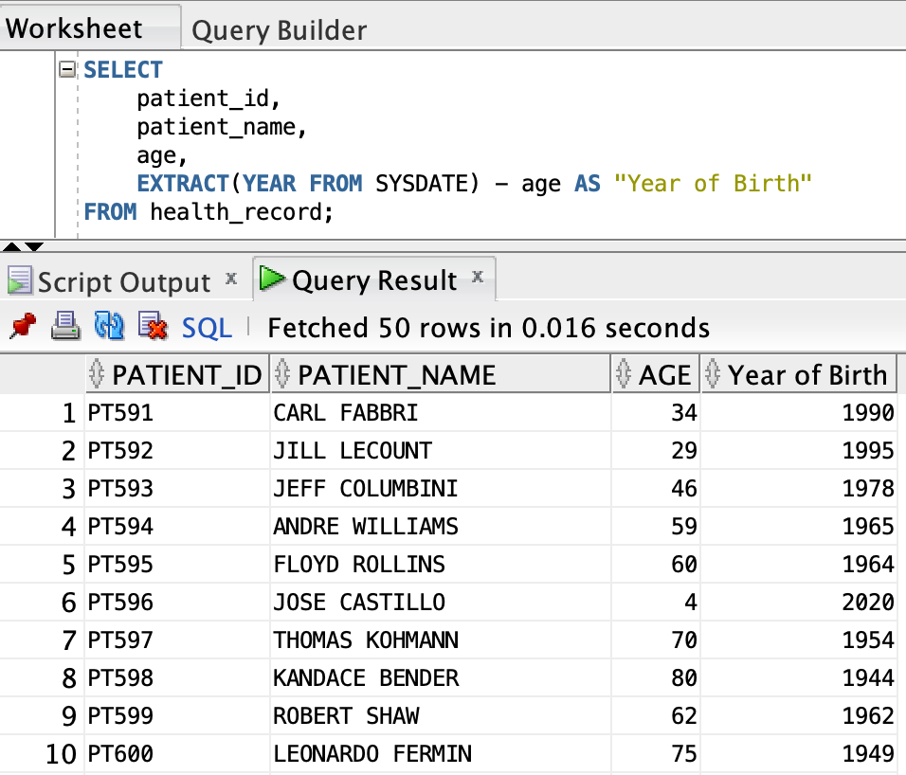
DATA QUERIES
10
Calculate the date of birth of patients in years (assuming the current date as of now).
SELECT
patient_id, patient_name, age,
EXTRACT(YEAR FROM SYSDATE) - age AS "Year of Birth"
FROM health_record;
Subtracting the age of patient from current date provides year of birth of patients.
SYSDATE provides current date in Oracle SQL developer.

Slide 15
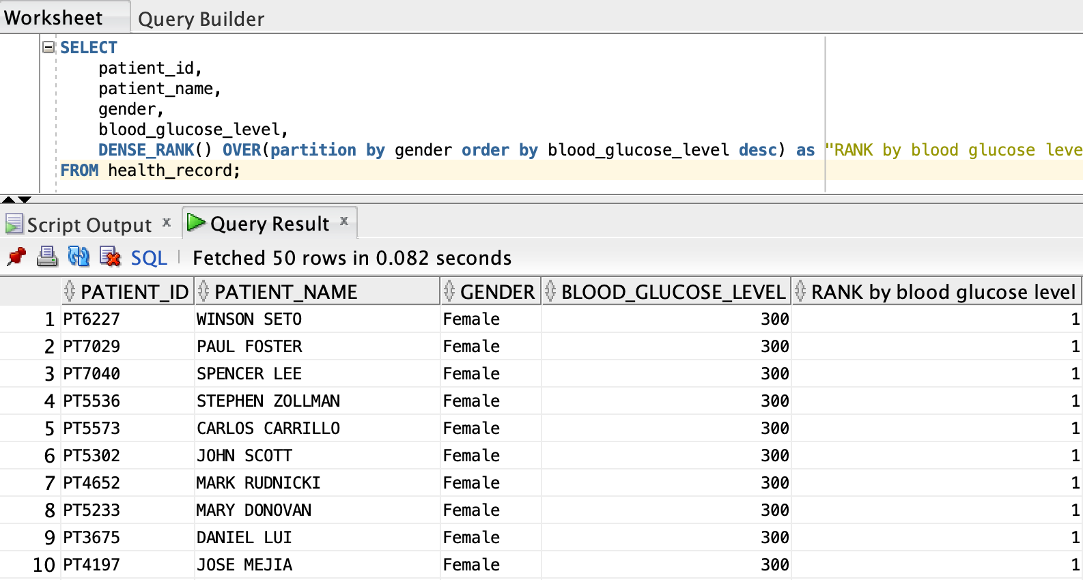
DATA QUERIES
11
Rank patients by blood glucose level within each gender group.
SELECT
patient_id, patient_name, gender, blood_glucose_level,
DENSE_RANK() OVER(partition by gender order by blood_glucose_level desc) as "RANK by blood glucose level"
FROM health_record;
DENSE_RANK() window function to assign a rank to each record in the health_record table based on the descending order of the blood_glucose_level within each gender partition.

Slide 16
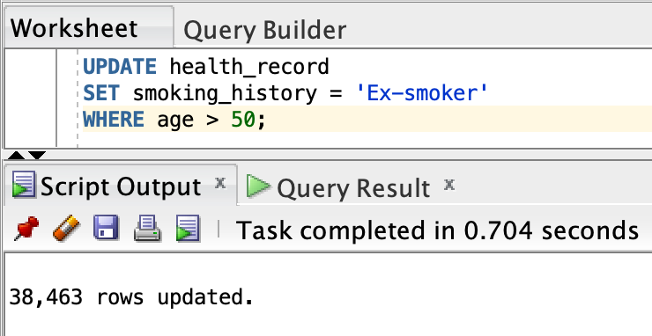
DATA QUERIES
12
Update the smoking history of patients who are older than 50 to "Ex-smoker."
UPDATE health_record
SET smoking_history = 'Ex-smoker'
WHERE age > 50;
Data Manipulation Language (DML) statements are responsible for manipulating data stored in the database.
UPDATE performs updation in table health_record where criteria meet.

Slide 17
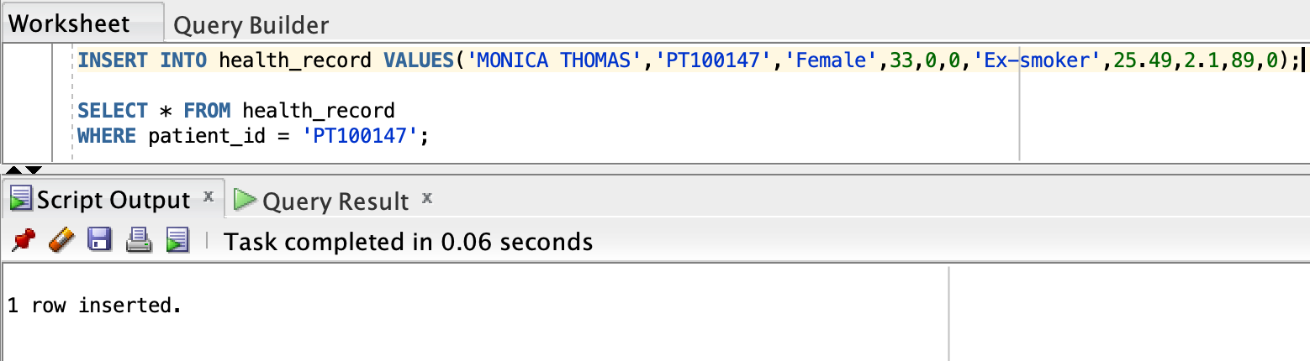
DATA QUERIES
13
Insert a new patient into the database with sample data.
INSERT INTO health_record
VALUES('MONICA THOMAS’, 'PT100147’, 'Female’, 33,0,0,'Ex-smoker',25.49,2.1,89,0);
Data Manipulation Language (DML) statement INSERT is responsible for adding new row of values into table health_record.

Slide 18
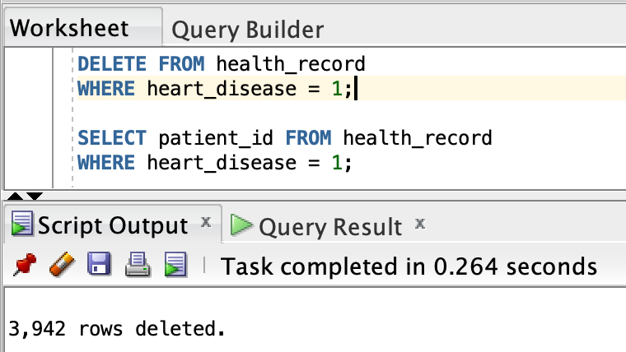
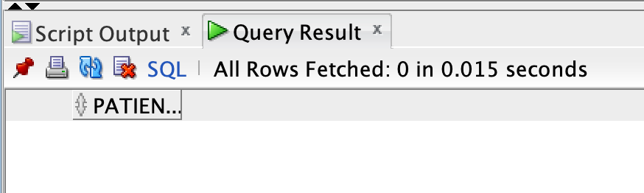
DATA QUERIES
14
Delete all patients with heart disease from the database.
DELETE FROM health_record
WHERE heart_disease = 1;
Data Manipulation Language (DML) statement DELETE removes the rows where criteria meets.
3942 records of patients with heart_diseases were deleted from health_record.

Slide 19
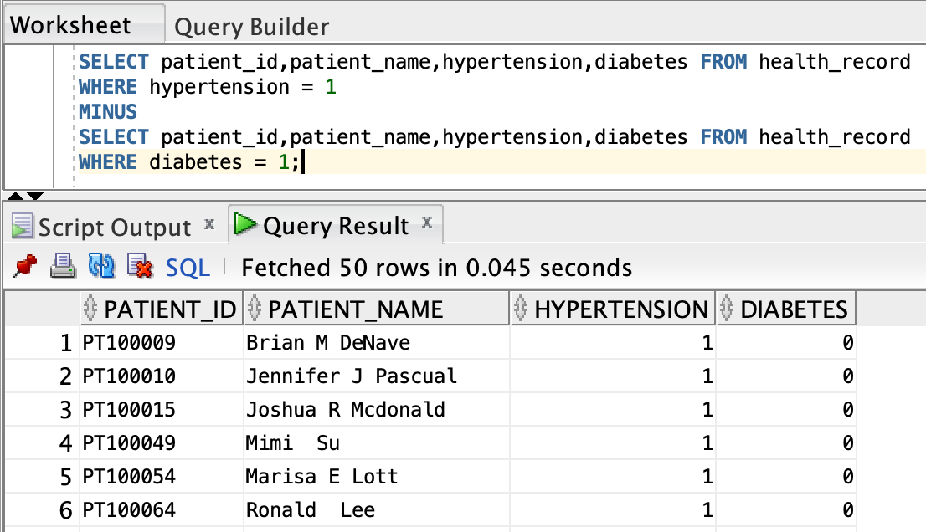
DATA QUERIES
15
Find patients who have hypertension but not diabetes using the EXCEPT operator
Equivalent of EXCEPT in Oracle SQL Developer is MINUS
The MINUS operator is used to subtract the result set of the second query from the result set of the first query.

Slide 20
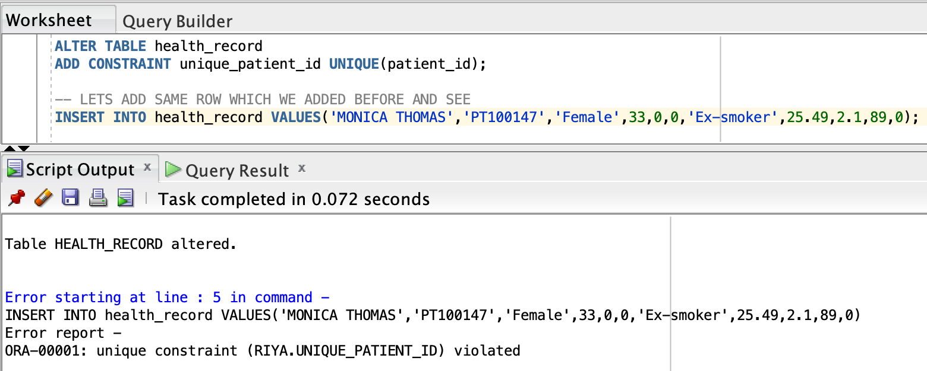
DATA QUERIES
16
Define a unique constraint on the "patient_id" column to ensure its values are unique.
ALTER TABLE health_record
ADD CONSTRAINT unique_patient_id UNIQUE(patient_id);
Data Definition Language statement ALTER TABLE ... ADD CONSTRAINT is used to add or modify the constraints in columns of table.

Slide 21
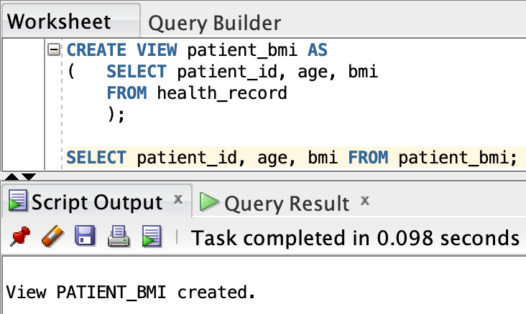
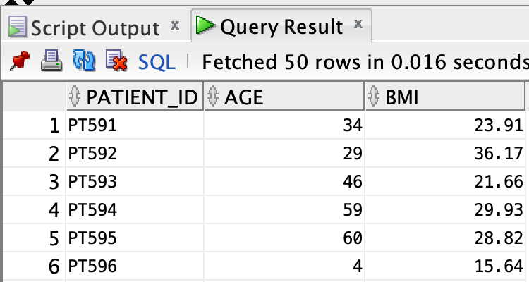
DATA QUERIES
17
Create a view that displays the Patient_ids, ages, and BMI of patients.
CREATE VIEW patient_bmi AS
( SELECT patient_id, age, bmi
FROM health_record
);
SELECT patient_id, age, bmi
FROM patient_bmi;
The view patient_bmi is created to provide a convenient way to query and analyze data from the health_record table, specifically focusing on the patient_id, age, and bmi columns.

Slide 22
SCHEMA ENHANCEMENT
Creating constraints on columns ensure data validation, reduce redundancy, reduce missing values, and in some case, help reduce extreme outliers
Normalizing schema helps to reduce redundancy and enhance data integrity
NORMALIZATION
ADD
CONSTRAINTS
Normalization in given dataset: separating columns into three tables as Patient_details,Health_parameters, Health_history
Make patient_id as primary key in one table and as foreign key in another table. Add check constraint in health_parameter table to avoid extreme outliers.

Slide 23
QUERY OPTIMIZATION
Query optimization is a crucial aspect of database performance tuning.
Some of the optimisation techniques:
REDUCE USING
DISTINCT KEYWORD OFTEN
LIMIT THE RESULTS
AVOID USING SELECT *
INSTEAD
RETRIEVE SELECTIVE COLUMNS
IMPLEMENT INDEXING
ON MOST QUERYING COLUMNS

Slide 24
THANK YOU

