Slide 1
Machine learning project
Aiswarya Y B PES1201701271
Suhail Rahman PES1201701420
Riya Vijay PES1201701814

Slide 2
IMPLEMENTATION
Problem Statement: To classify stellar objects into spectrometric classes based on photometric data , using data set "GALEX_data-extended-feats.csv”. The classes given are 0,1and 2.
We approach the problem using K-NN algorithm to train the model, as the labels are defined [K-NN is supervised learner ]
We load the csv file and split the data into training and testing values on the ratio of 70/30 respectively.
Find the k nearest neighbours for each row of test data with all the trained values.
We computed this by using Euclidean distance measure.

Slide 3
IMPLEMENTATION
We find the Euclidean distance between each row of test data with all train data values. Then, we find the k-nearest neighbours
We sort the distances in increasing fashion and we find the first k values , here the optimal value of k is 23 .
Among those k values we find the majority of those labels we predicted by voting and assign the majority of that to that train value.
We find the accuracy by comparing the predicted value and observed value.
We get an accuracy of 88.263468%

Slide 4
PERFORMANCE
We increased the efficiency by finding the optimal value of k by plotting the all possible values of k versus accuracy of each value of k.
We increased the efficiency by normalizing the data. Normalization was needed here as the features had different ranges of values and it removes the data redundancy.
Computation time for k-nn is prolonged as it computes with every value of test with all values of train data , we decreased the time complexity by using PCA. In our data set there are 24 columns ,there are only 8 independent columns , so we used PCA to reduce dimensions to 8 and it slightly increases the performance by 0.05. It used to take a time of 45 mins before PCA but after PCA it takes a time of 3-5 mins at most.
Conclusion: We get an accuracy of 88.263468% with normalization ,PCA and randomization.

Slide 5
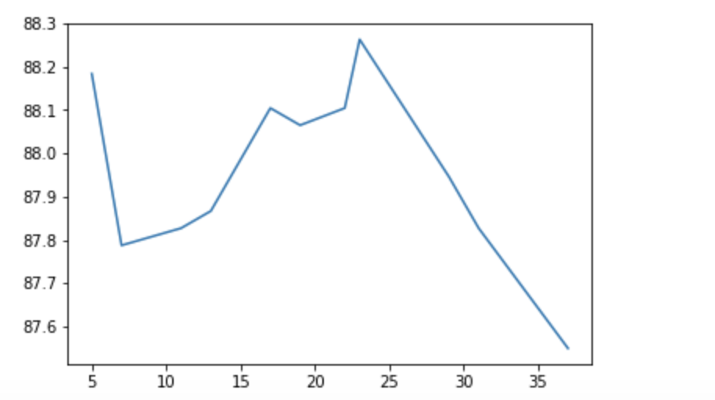
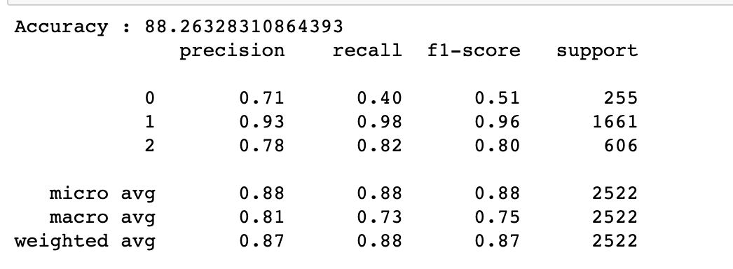
Analysis graphs

Slide 6
THANK YOU

