Slide 1
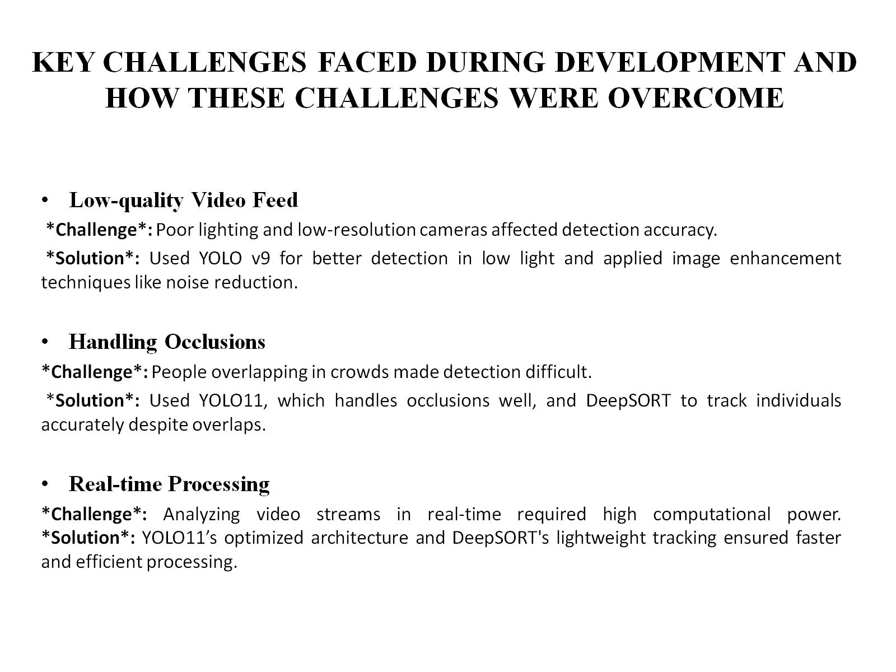
KEY CHALLENGES FACED DURING DEVELOPMENT AND HOW THESE CHALLENGES WERE OVERCOME

Slide 2
