Slide 1
Viruses that have changed the Internet
Belyanskiy Sasha ИС/б-12-2-о

Slide 2
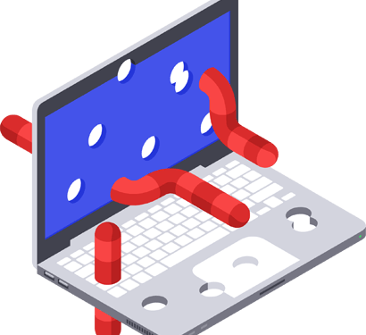
Computer worm
1988, Corwell University graduate student Robert Morris wrote the worm and launched it on the experimental Internet network Arpanet

Slide 3
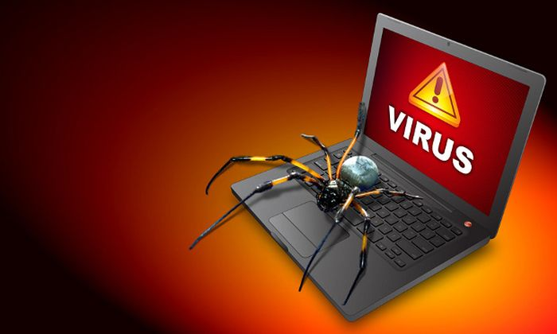
In just a few days, more than 6,000 of the 60,000 computers connected to the network were infected

Slide 4
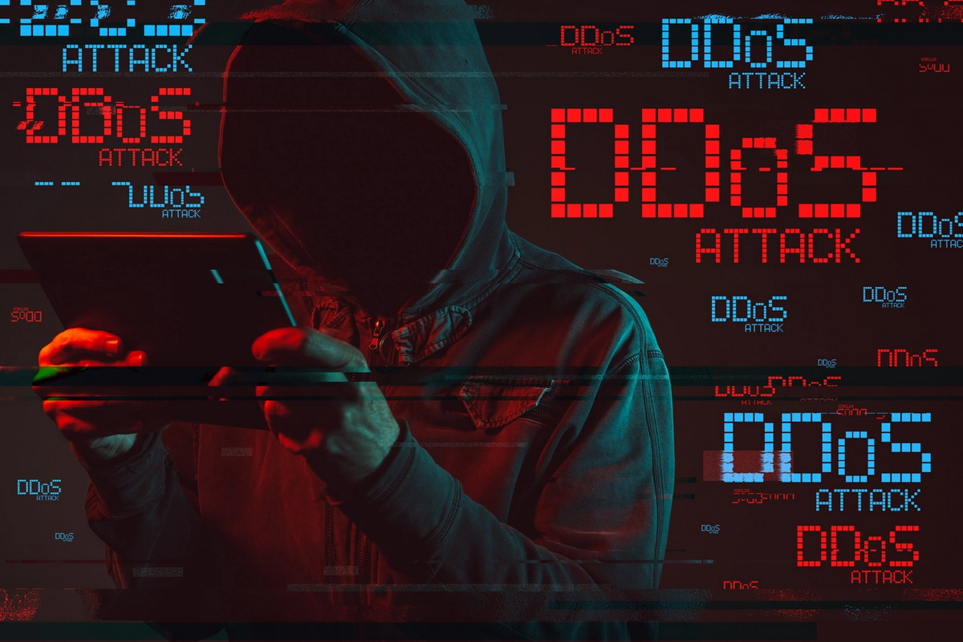
The first dos-attack in the world
2000, guy with the nickname “Mafia boy” broke the servers almost all the portals on the Internet. Experts estimated the damage at more than $1 billion.

Slide 5
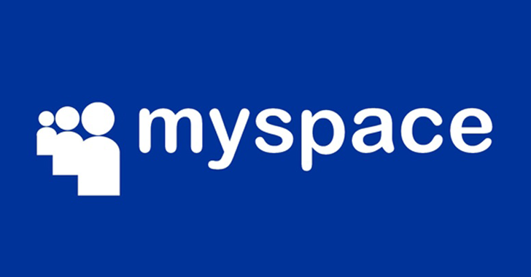
Attack on “my space”
2005, Sam Camcar. The worm he created attacked “My space”

Slide 6
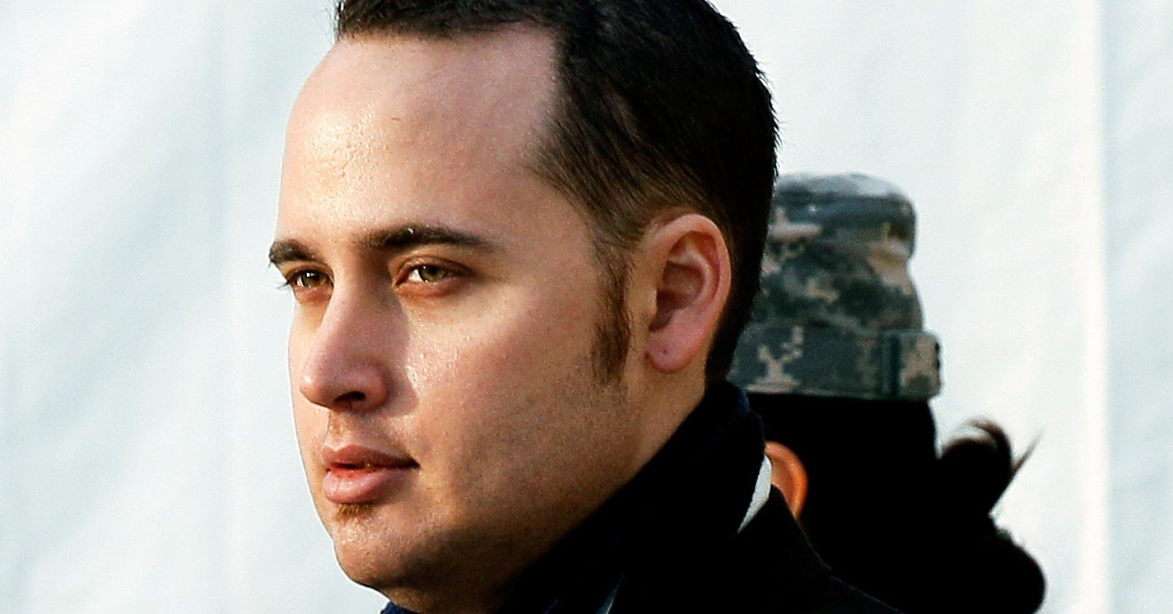
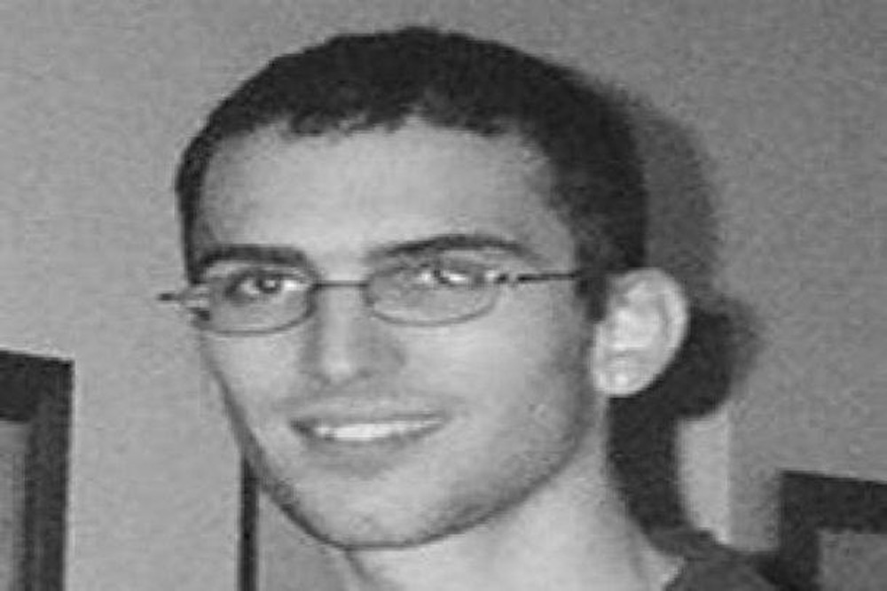
Adrian Lamo
1981 - 2018
Jonathan James
1983 - 2008

Slide 7
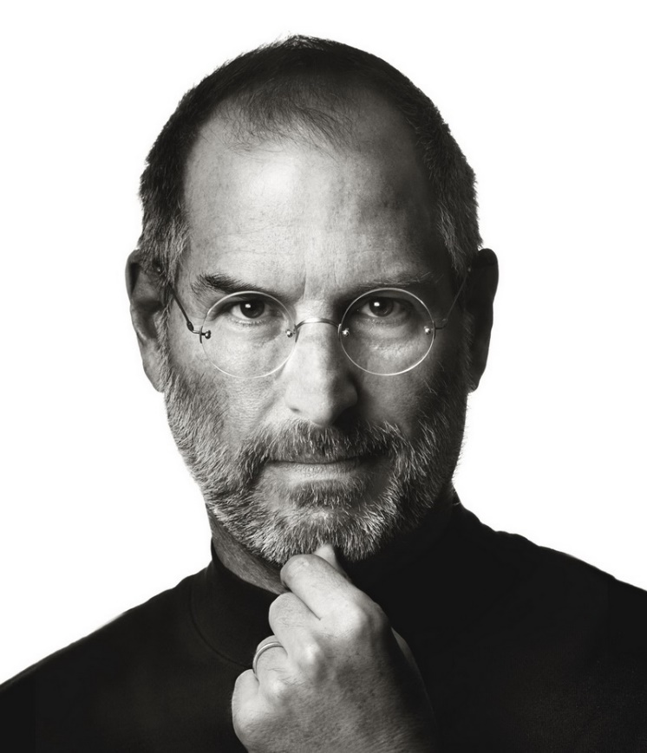
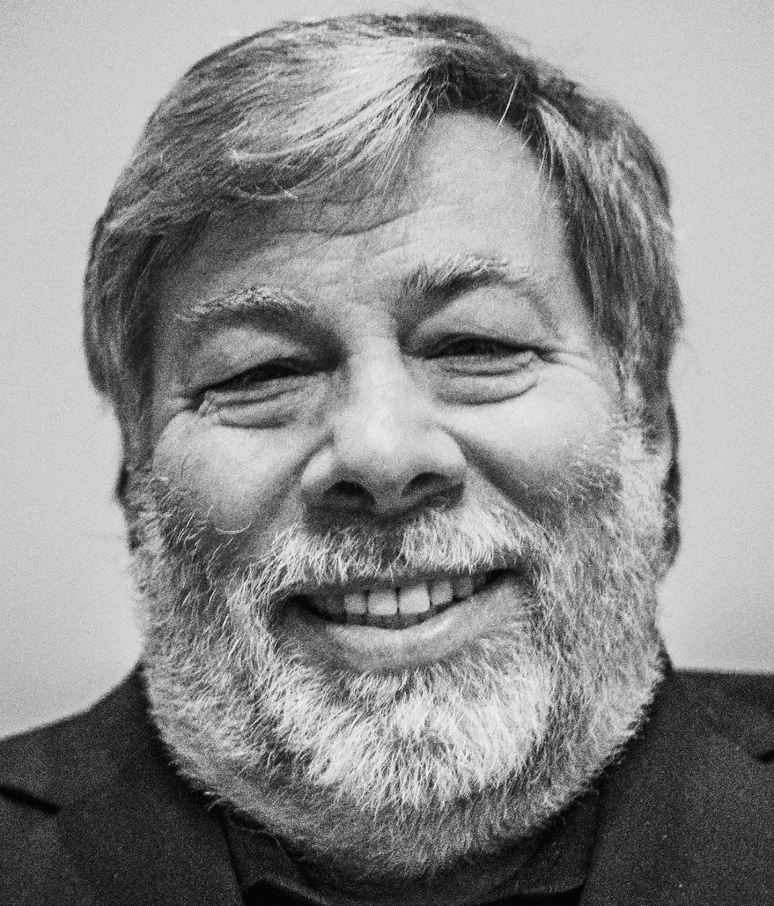
Steve Jobs
1955 - 2011
Stephen Wozniak
1950

Slide 8
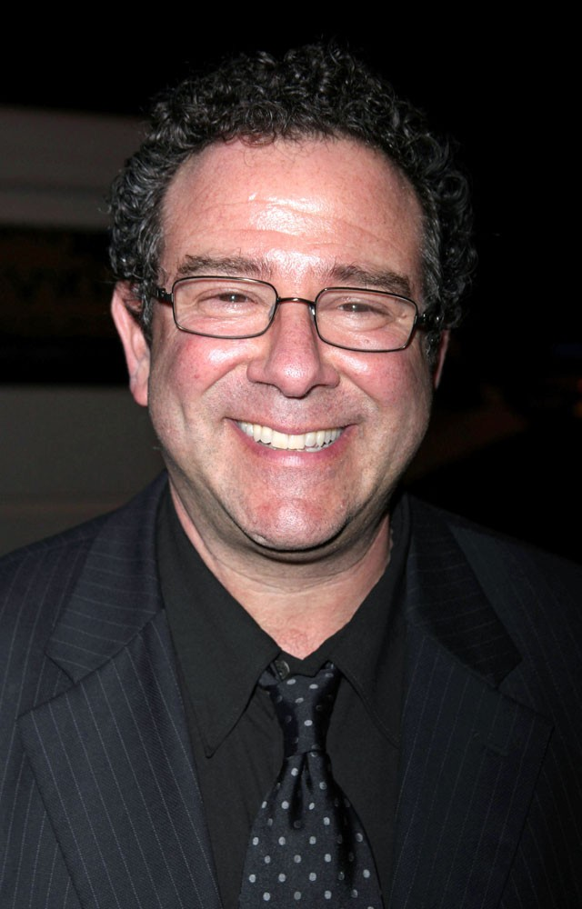
Kevin Mitnick
1963

Slide 9
It’s thanks to such examples that antiviruses, captchas, double authentications and so on appear. As they say, if hackers did not exist, they would be worth coming up with.

Slide 10
Thanks for your attention!

