Slide 1
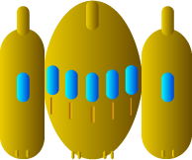
Spaceship image
width = 34 px
height = 28 px

Slide 2



Spaceship correct positioning
0
Y
Y
X
X

