Slide 1
FOOTBALL BUILDER WEB APPLICATION
BY ABDIRIZAK OSMAN

Slide 2

Project brief
Created a landing page for GOALS user experience
Designed for assisting with planning football 5 a side tournaments
Users can submit a form, adding team name and player’s details
User can create, edit, update and delete entries

Slide 3
Concept Project approach
Crud functionality
Project management – Develop Jira Board with 3 sprints
Break down tasks in to epics, user stories and sub tasks
Consider priority of tasks using MOSCOW
Review

Slide 4
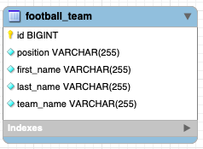
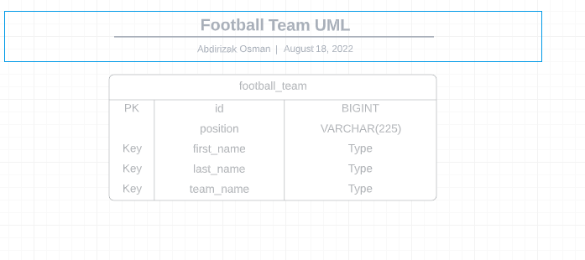
DATA LAYER

Slide 5
Jira Kanban Board Sprint plan
Sprint 2
Focus on MVP tasks
API development
Main crud functionality
Front end development
Date: 16/08/22 09:00 – 14:00, 17/08/22
Sprint 3
Integration and unit testing
Final documentation: diagrams, presentation
Date: 17/08/22 15:00 – 18:00, 18/08/22
Sprint 1
Planning and designing project
Workflow set up
Date: 15/08/22 09:00 – 18:00

Slide 6

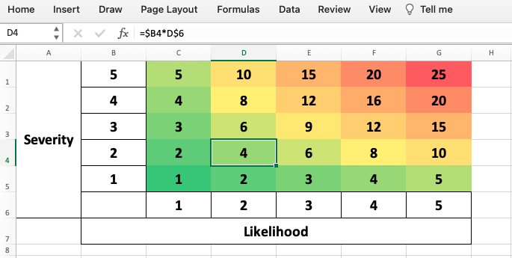
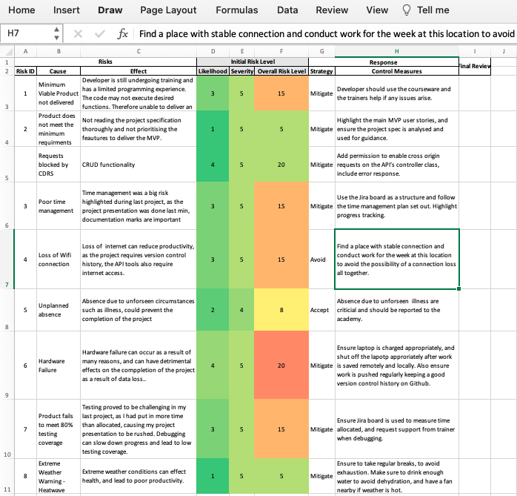
Risk Assessment
Notes:
Created risk assessment to highlight and mitigate possible risks.
Most influential risks: time constraint and failure of software development
Time constraint: First project, little to no experience with Jira and project management
Software development: lack of confidence with testing going in to project week

Slide 7

Continuous Integration
Version Control System:
Initially generated repository from IMS-Starter
Set up remote repository using Feature Branch Model
Regularly pushed commits as data loss precaution
FBM Model – Feature branch model was used to ensure code is ready for deployment when pushed to main
Notes:
FBM model was implemented
Version control was maintained throughout
Changes were committed and pushed regularly

Slide 8
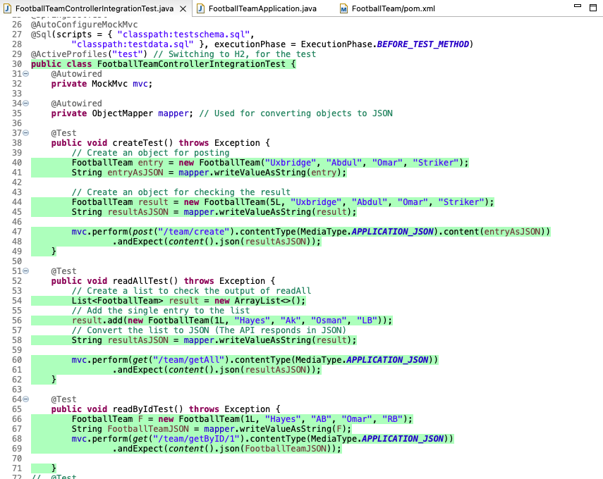
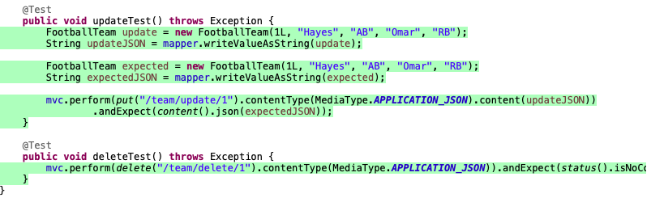
Testing
Integration testing

Slide 9
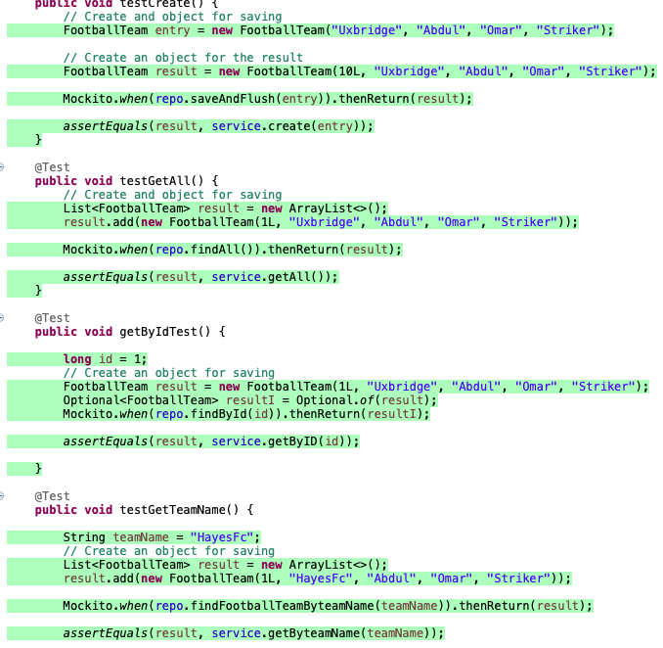
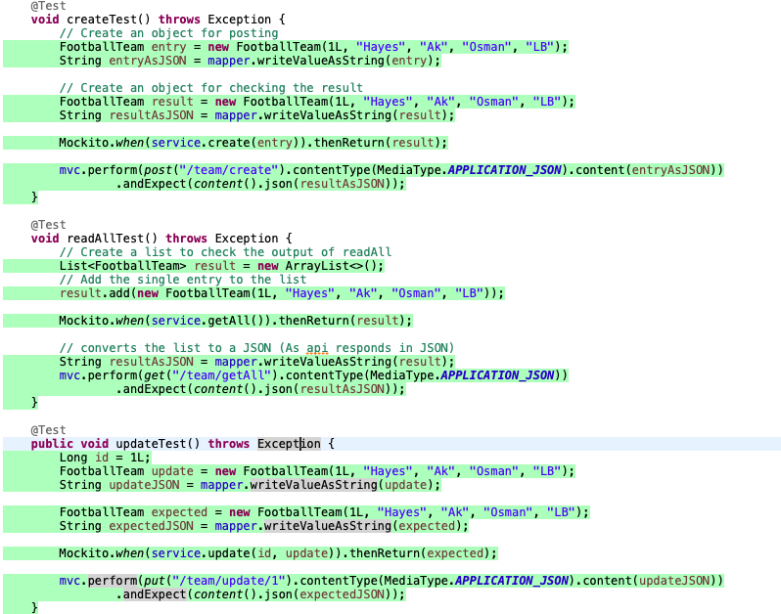
Unit Testing Controller Service

Slide 10
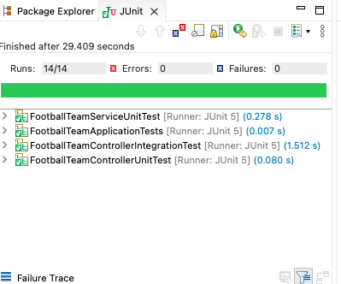
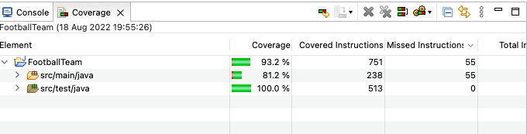
Testing Coverage: ACHIEVED 81%

Slide 11
Demo
CRUD FUNCTIONALITY – PRESENTATION LAYER
TESTING OF API

Slide 12
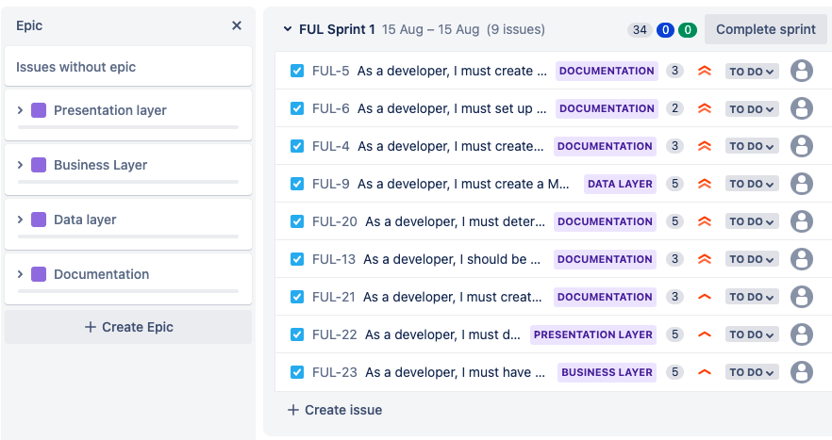
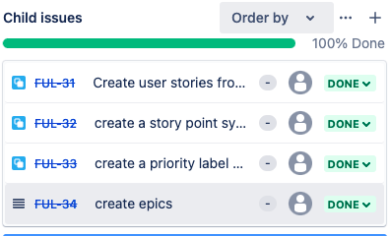
Sprint 1
Notes:
Planning and designing project
Workflow set up

Slide 13
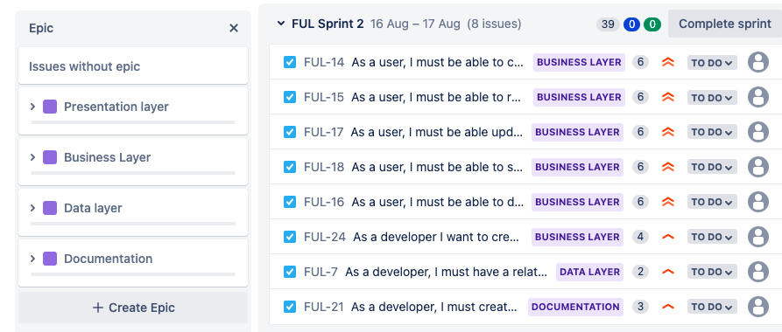
Sprint 2
Notes:
Focus on MVP tasks
API development
Main crud functionality
Front end development

Slide 14
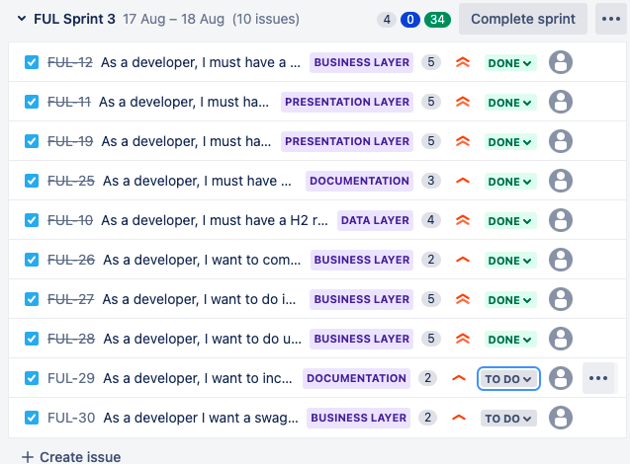
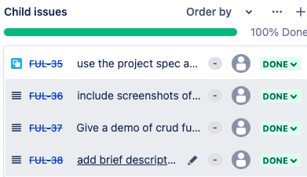
Sprint3
Sprint 3
Notes:
Integration and unit testing
Final documentation: diagrams, presentation
OPEN Jira Kanban board

Slide 15
Conclusion
Project management went well, used Jira board as structure and was able to finish project day before deadline!
Planning and time constraint: I really enjoyed using Jira to structure the project and complete tasks. Finished project day before deadline!
REALLY HAPPY WITH KNOWLEDGE GAINED FROM DEVELOPING ALL three-tier architecture

Slide 16
Happy to take any questions
Special Thank you to my tutors;, Anoush Lowton and Edward , who have been very supportive

