Slide 1
FOOTBALL BUILDER WEB APPLICATION
BY ABDIRIZAK OSMAN

Slide 2

Project brief
Created a landing page for GOALS user experience
Designed for assisting with planning football 5 a side tournaments
Users can submit a form, adding team name and player’s details
User can create, edit, update and delete entries

Slide 3
Concept Project approach
Crud functionality - MVP
Project management – Develop a roadmap using a Jira Kanban Board with 3 sprints
Break down tasks in to epics, user stories and sub tasks
Consider priority of tasks using MOSCOW
Review

Slide 4
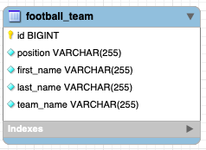
Three-tier Architecture
Presentation Layer – FRONT END
Business layer - API
Data layer - DATABASE
API
FOOTBALL BUILDER
CONTROLLER
SERVICE
REPO

Slide 5
Technology used
Version Control System: Git
Source Code Management: GitHub
Kanban Board: Jira
Database Management System: MySQL Server (Local)
Back-End Programming Language: Java
API Development Platform: Spring Boot
Front-End Web Technologies: HTML, CSS, JavaScript
Build Tool: Maven
Unit Testing: JUnit, Mockito

Slide 6
Jira Kanban Board Sprint plan
Sprint 1
Date: 15/08/22 09:00 – 18:00
Sprint 2
Date: 16/08/22 09:00 – 14:00, 17/08/22
Sprint 3
Date: 16/08/22 09:00 – 14:00, 17/08/22
Planning and designing project
Workflow set up
Focus on MVP tasks
Main crud functionality
API development
Front end development
Integration and unit testing
Final documentation: diagrams, presentation

Slide 7

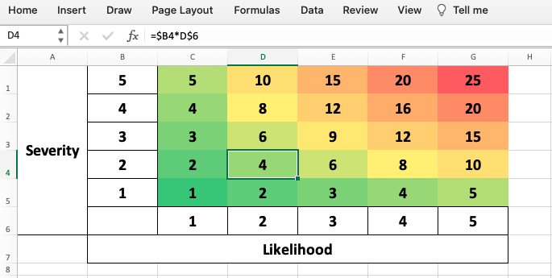
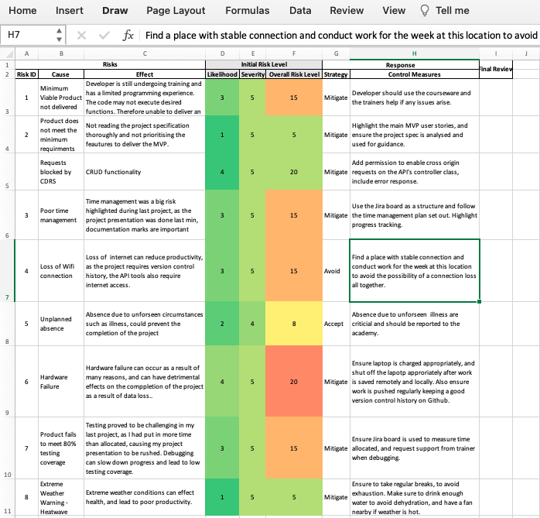
Risk Assessment
Notes:
Created risk assessment to highlight and mitigate possible risks.
Most influential risks: time constraint and failure to meet MVP

Slide 8

Continuous Integration
Version Control System:
Set up remote repository using Feature Branch Model
Regularly pushed commits as data loss precaution
FBM Model – Feature branch model was used to ensure code is ready for deployment when pushed to main
Notes:
FBM model was implemented
Version control was maintained throughout
Changes were committed and pushed regularly

Slide 9
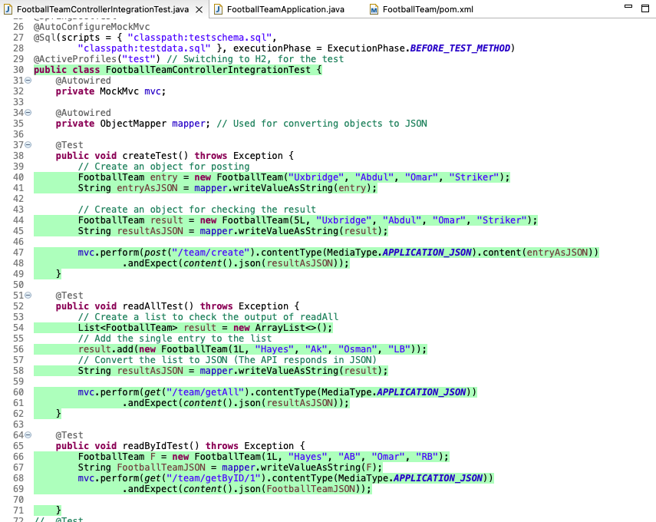
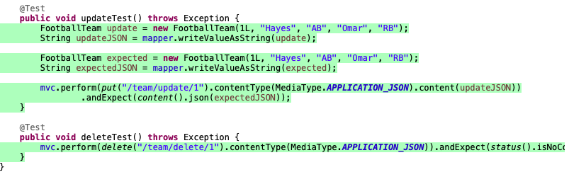
Testing
Integration testing
Notes:
Integration testing is where you test components of an application to see if they logically work together and produce the correct result. These tests are run with JUnit and MockMvc

Slide 10
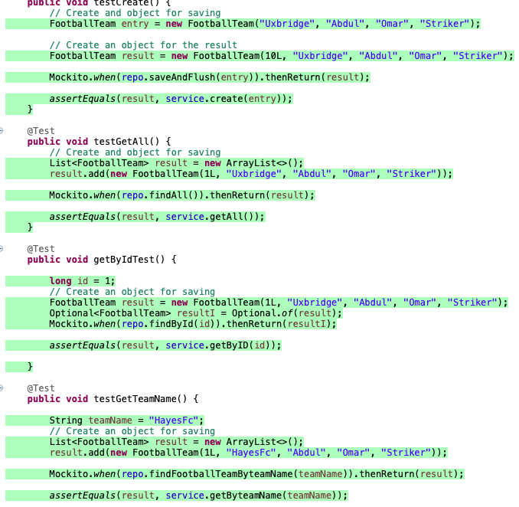
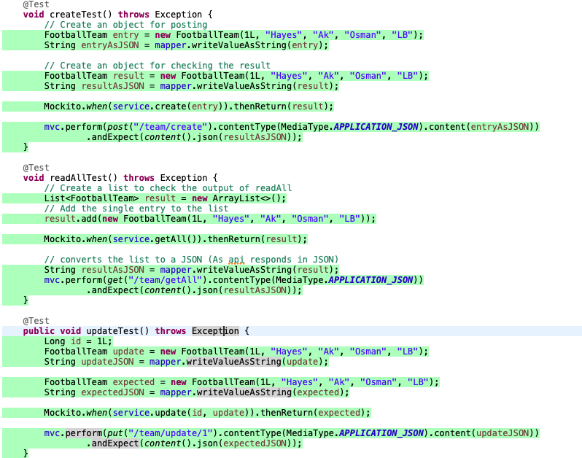
Unit Testing Controller Service
Notes:
Unit testing is essentially testing units of code individually and is done during the development stage. The controller class was unit tested by mocking the the return from the service class. Mockito was used to mimick the return when service method is called. These tests are also run with JUnit, and MockMvc

Slide 11
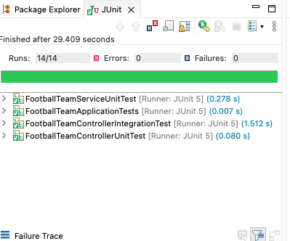
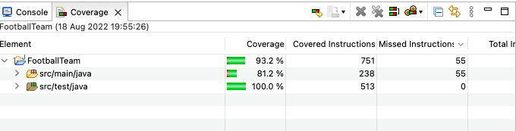
Testing Coverage: ACHIEVED 81%

Slide 12
Demo
CRUD FUNCTIONALITY – PRESENTATION LAYER

Slide 13
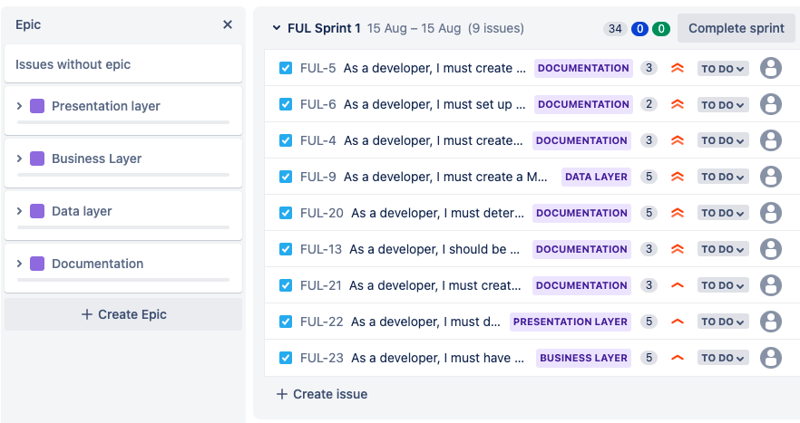
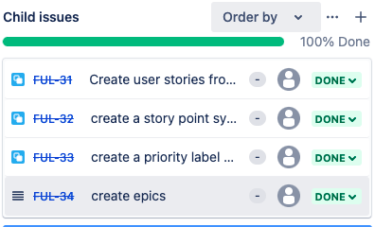
Sprint 1
Notes:
Planning and designing project
Workflow set up: Create backlog, assign user stories to epics, story points, priotity
GIT: Set up remote repo

Slide 14
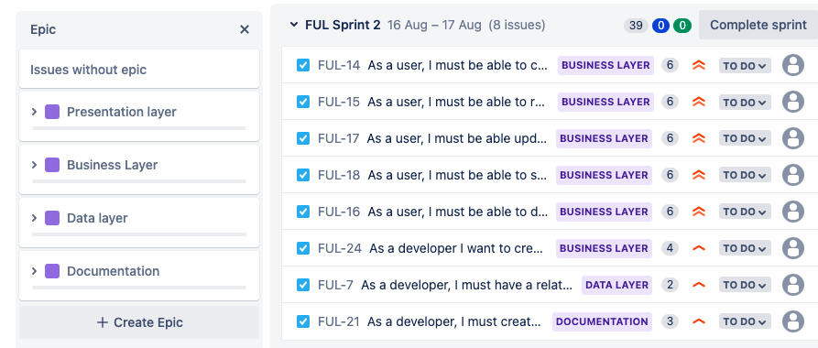
Sprint 2
Notes:
Focus on MVP tasks
API development
Main crud functionality
Front end development

Slide 15
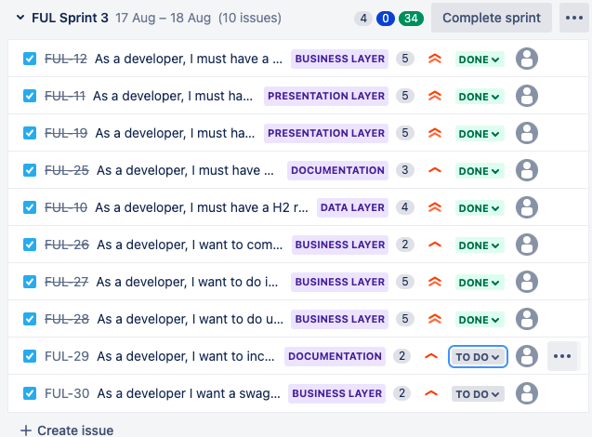
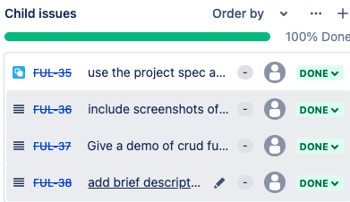
Sprint3
Sprint 3
Notes:
Integration and unit testing
Final documentation: diagrams, presentation

Slide 16
Conclusion
Planning and time constraint: I really enjoyed using Jira to structure the project and complete tasks. Finished project day before deadline!
KNOWLEDGE GAINED FROM WEB DEVELOPMENT: CSS/Bootstrap, JavaScript, SPRING BOOT
FUTURE IMPLEMENTATIONS: DEVELOP THE APPLICATION FRONT END TO MAKE IT MORE USER FRIENDLY, CREATE A LOGIN FOR USERS

Slide 17
Happy to take any questions
Special Thank you to my tutors;, Anoush Lowton and Edward , who have been very supportive

