Slide 1


Fundamental Project: Inventory Management System
By Abdirizak Osman

Slide 2
Introduction
At the time of completing of this project, I have undertaken 4 weeks of effective training as a QA IT Consultant Trainee
I have had hands on practical training with Java, Git, and MySQL, and have proven to learn under fast paced environment
I have really gained great knowledge from this project, mainly from troubleshooting coding errors, and being able to research from websites such as Stack Overflow

Slide 3
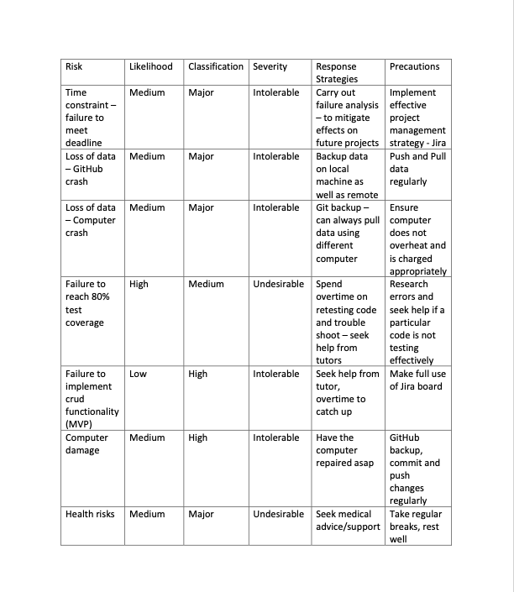
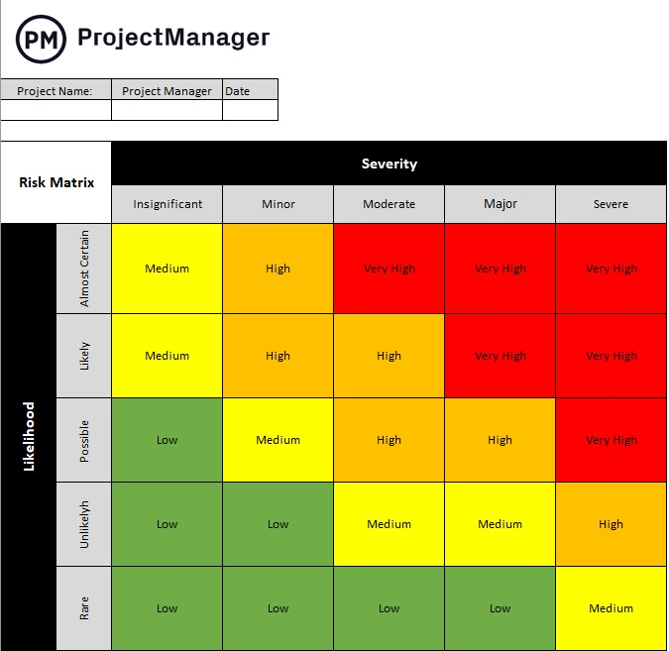
Risk Assessment
Notes:
Created risk assessment to highlight and mitigate possible risks.
Most influential risks: time constraint and failure of software development
Time constraint: First project, little to no experience with Jira and project management
Software development: lack of confidence with testing going in to project week

Slide 4
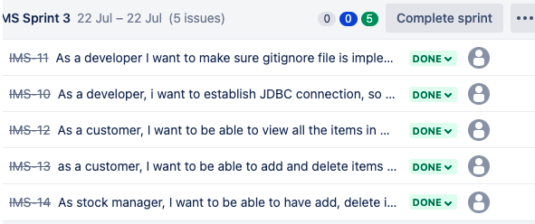
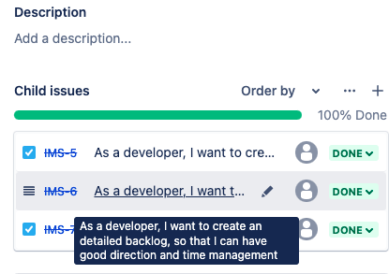
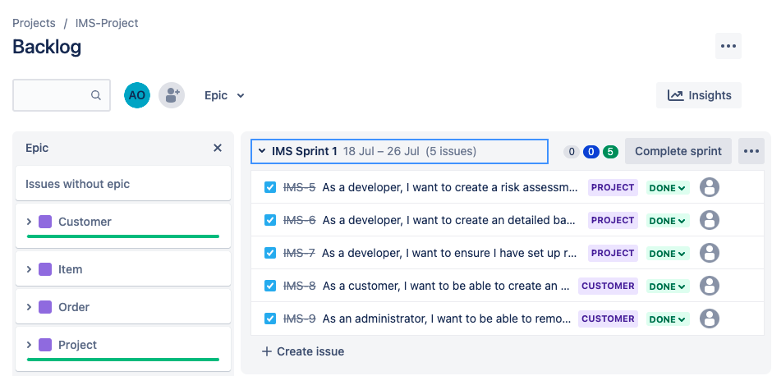
Project Management Jira Kanban board
Notes:
Initially set up the Jira board in the weekend, so had plenty of time to familiarize myself with the functionality of the board.
Sprint Review:
Sprint 1: Went well most stories were non-technical
Sprint2: Most development stories including MVP, really helped me break down the project. Achieved to finish all tasks except some functionality with adding items to orders, which was finished 1 day later
Sprint3 involved:
testing classes, Unit testing and Mockito – went over the allocated time by 5-10hours, due to error chasing and revision on mockito
Ensuring FBM model was achieved
Ensuring read me file completed
Documentation; creating ERD and UML diagrams, presentation
Had to set reminders to update the board, on the first day upon setting up remote repository and forking the template, did not update the board until the next day

Slide 5
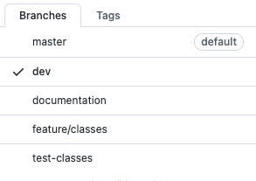
Version Control
Initially generated repository from IMS-Starter
Set up remote repository using Feature Branch Model
Regularly pushed commits as data loss precaution
Notes:
FBM model was implemented
Version control was maintained throughout
Changes were committed and pushed regularly

Slide 6
Development MVP
I spent much overtime over the weekend revising on core design principles, analyzing the project spec – allowed me to start and get some progress by Tuesday
Crud functionality was tested through the CLI in Eclipse, was really impressed as functionality was achieved
Notes:
Full crud functionality, MVP criteria achieved

Slide 7
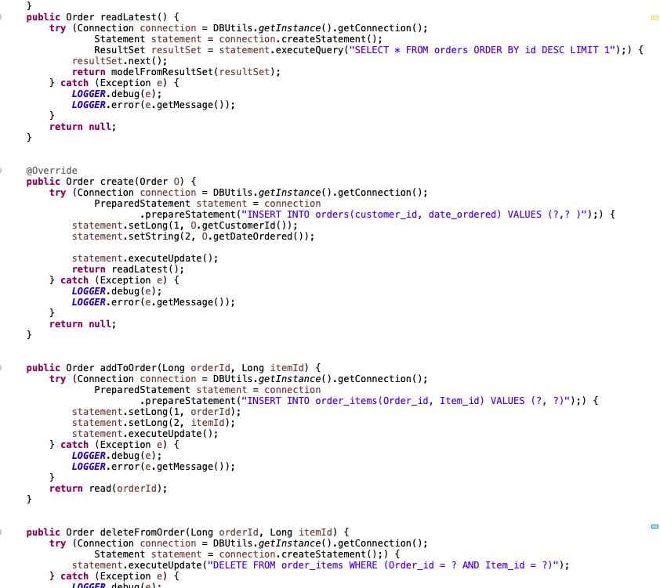
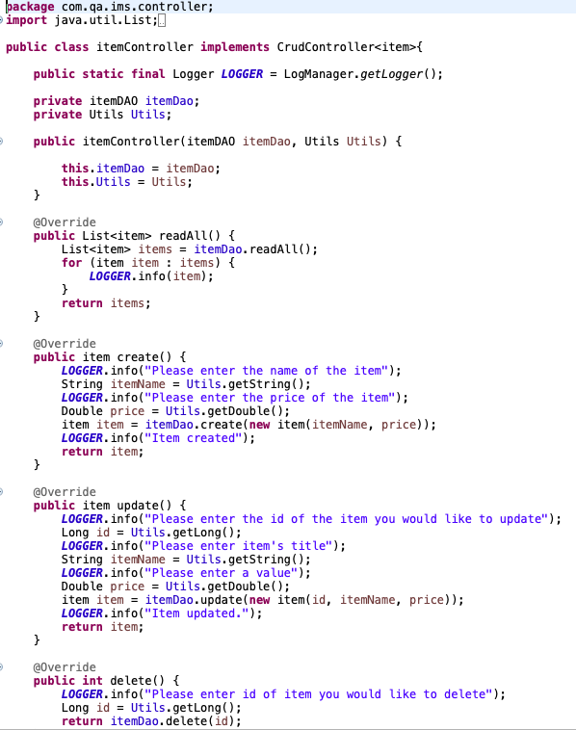
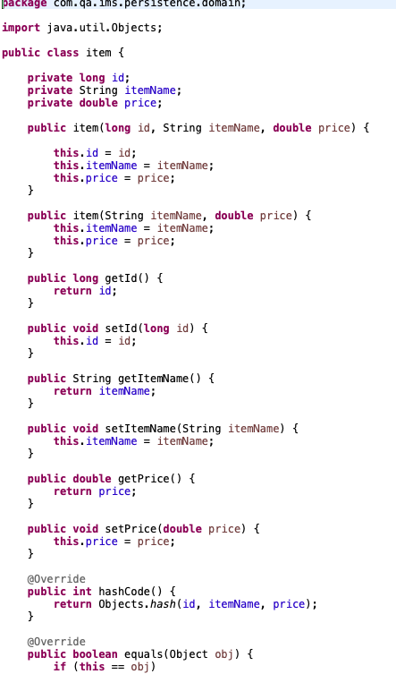
classes
Notes:
Customer classes were already in the IMS template
This implementation played a massive role in the completion of the project against the time constraint, mainly because I was able to really grasp the way the data access object class was community with the database
I spent more time that I would have liked on dao classes, but was mainly because it was my first time working with data access object, thus found myself having to double check my variables against database
I ran in to errors running my crud once done with these classes, as I was not sure how the implementation of switch cases take effect. However after reading through the code in the template, I was able to quickly update it and gain access.

Slide 8
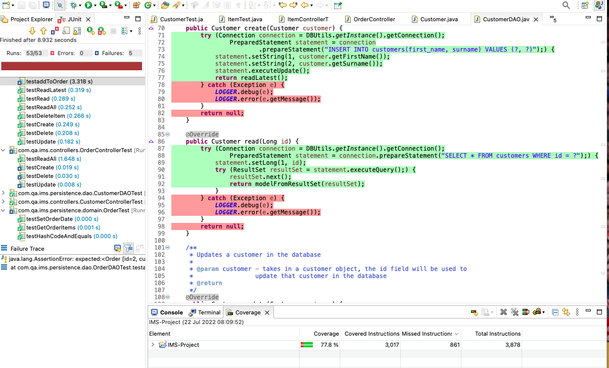
Testing Coverage: 77%
Notes:
What went well: Testing domain classes; constructors, main methods, as well as generated methods such as getters and setters
What could be improved:
Testing catch exceptions in data access object classes
Testing To String methods
Testing enums
3% BELOW 80% - time constraint major factor; had not finished testing order controller class
More practice to be continued with Mockito - Overtime

Slide 9
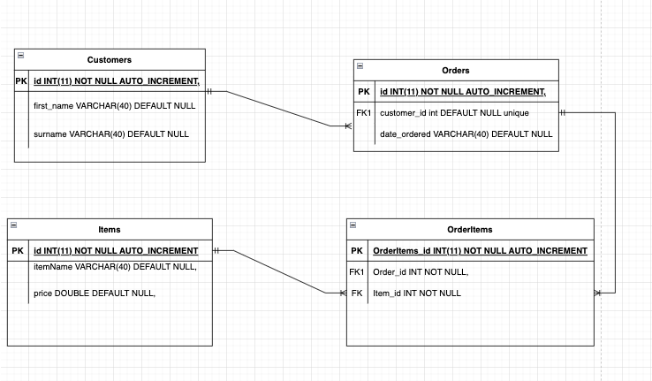
ERD Diagram
Notes:
Relationships:
(Items – Orderitems) is a one and only one to One or many relationship.
customers to orders is a one and only one to One or many relationship
order to customer is a one and only one relationship
Customer to Orderitems, is a one way, One or Many relationship

Slide 10
Conclusion
I really enjoyed coding more than I could have imagined just from this week, the satisfaction of fixing errors through googling error codes was tedious at times but was worth it once I figured out the reason behind it
Planning and time constraint: I really underestimated the time I would have spent on testing, as my Jira board shows – testing my controller classes really slowed me down as I had to revise on Mockito testing
Unfinished: Building and compiling the code still not clear

Slide 11
Happy to take any questions
Special Thank you to my tutors; Jordan, Aswene, Andrew, Piers, and Ed, who have been very supportive during my training period before the project week

