Slide 1
BootCamp Dumbways Minggu 3

Slide 2

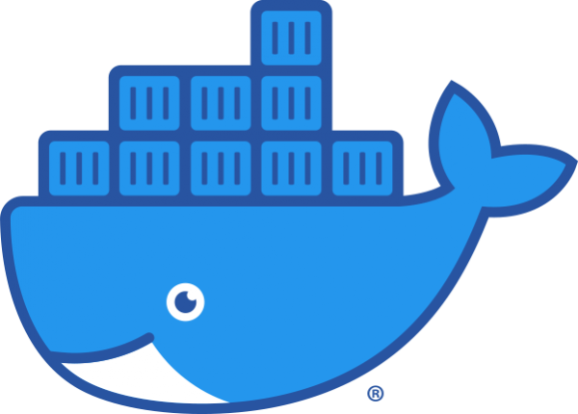
Materi

Slide 3

Materi Tambahan

Slide 4
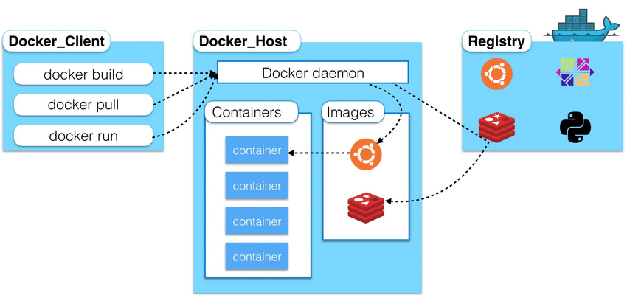

Slide 5
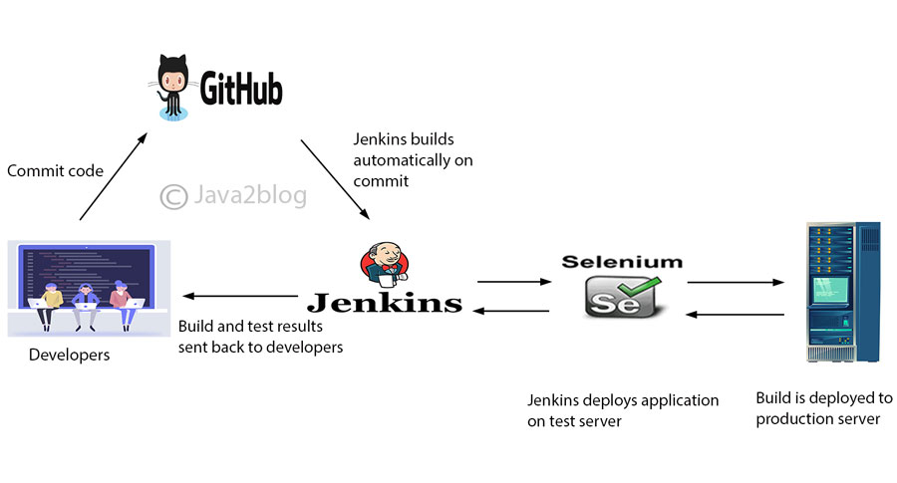

Slide 6
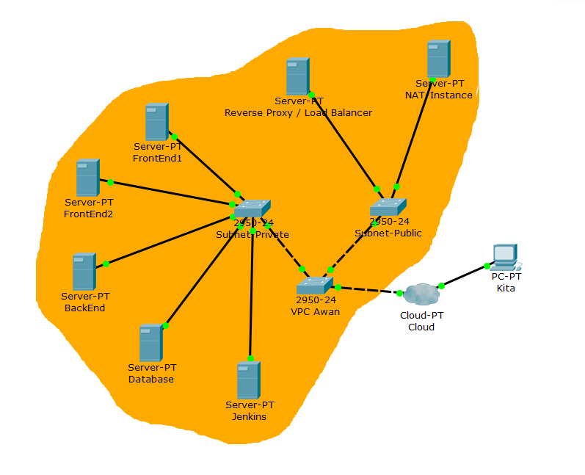

Slide 7
Langkah
Docker
Install Docker
Create Image
Create Container
Jenkins
Install Jenkins
Create Jenkins Job
Bot Notification

Slide 8
1.
Install Docker
Let’s start with the first set of slides

Slide 9
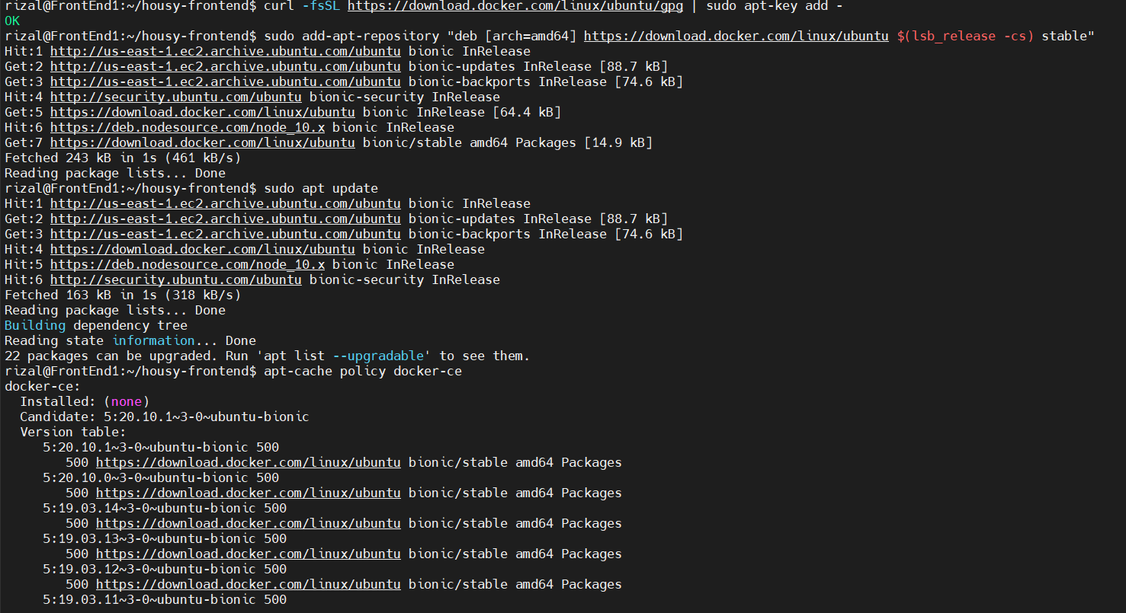

Slide 10
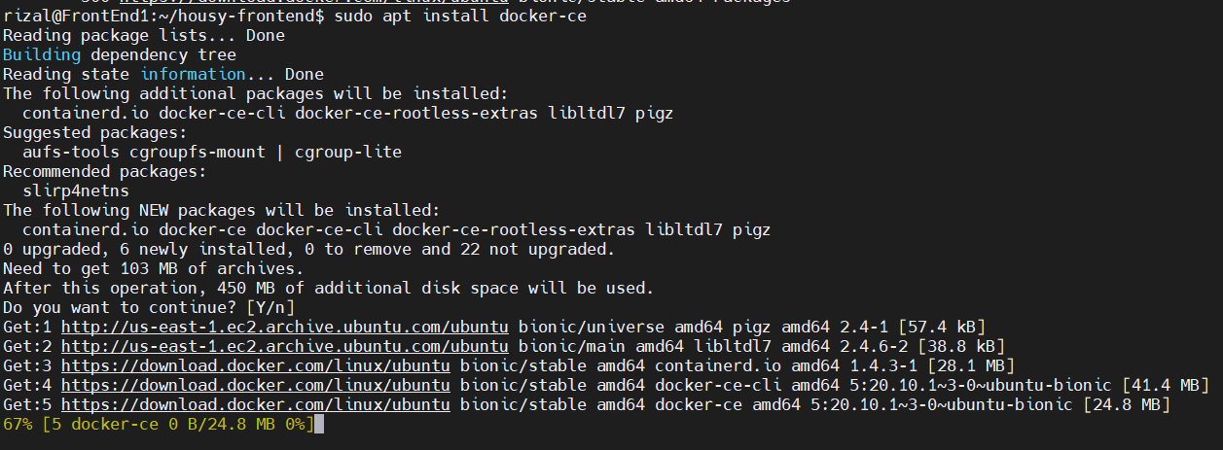

Slide 11
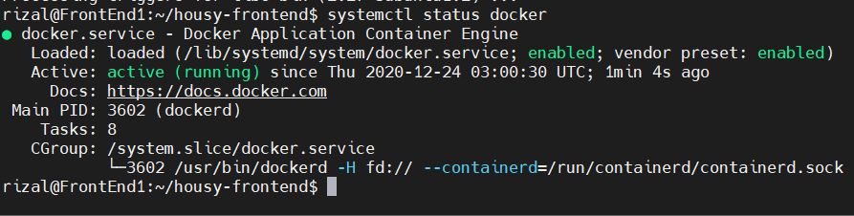

Slide 12
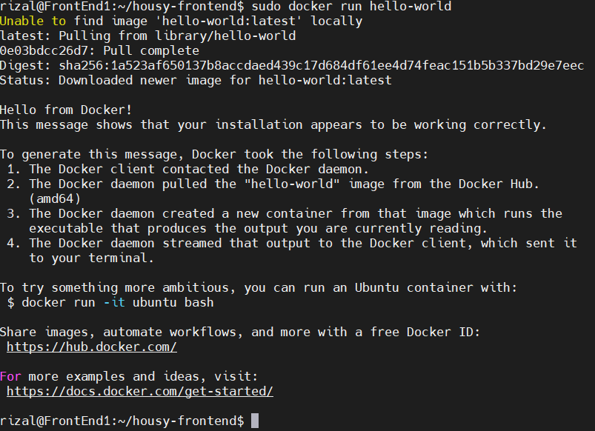

Slide 13
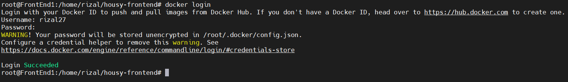

Slide 14
2.Create Image

Slide 15
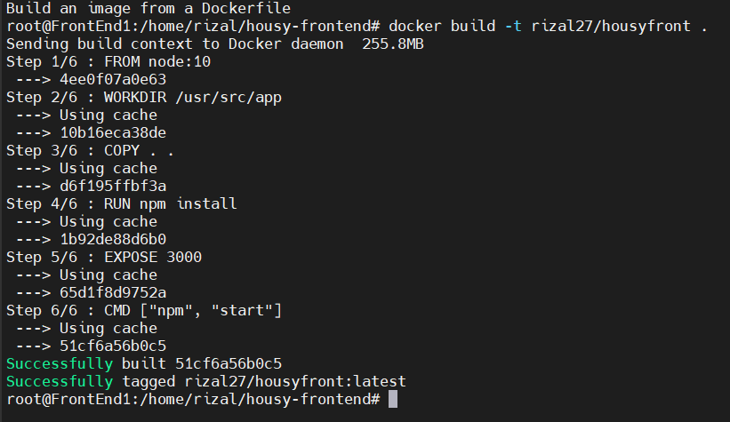
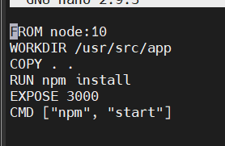

Slide 16
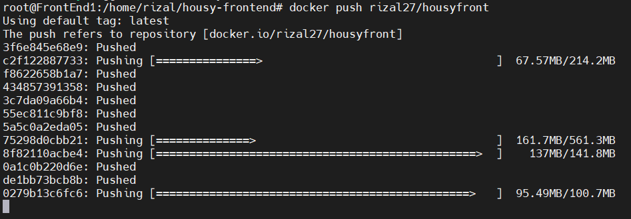

Slide 17
3.Create Container

Slide 18
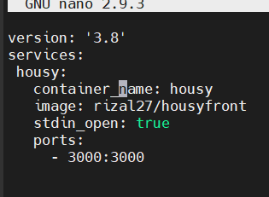
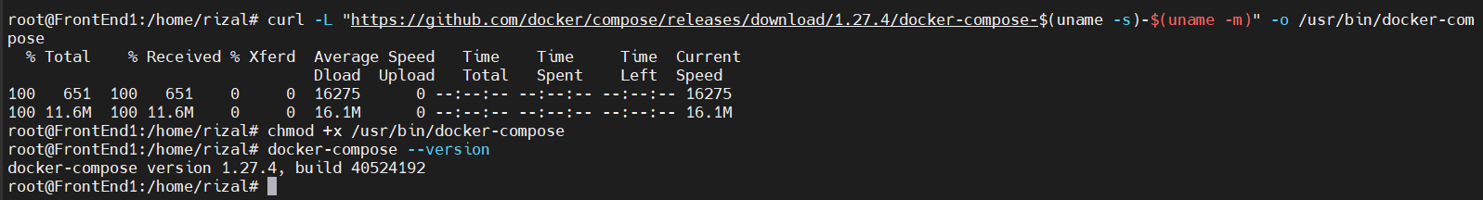

Slide 19
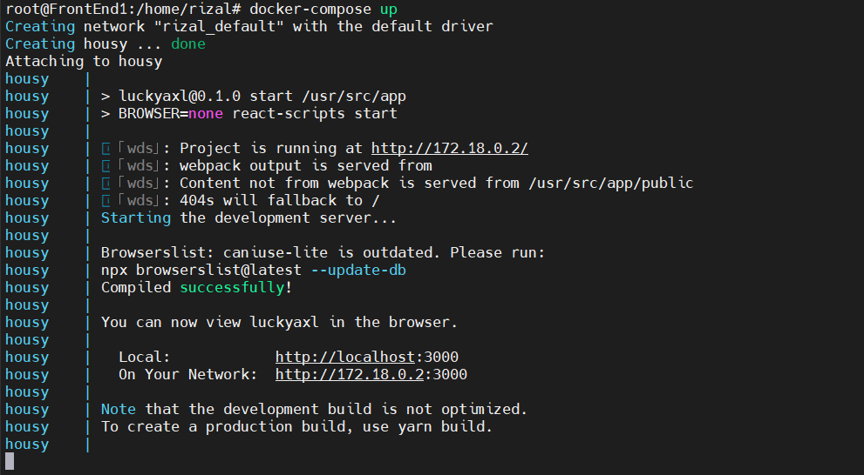

Slide 20
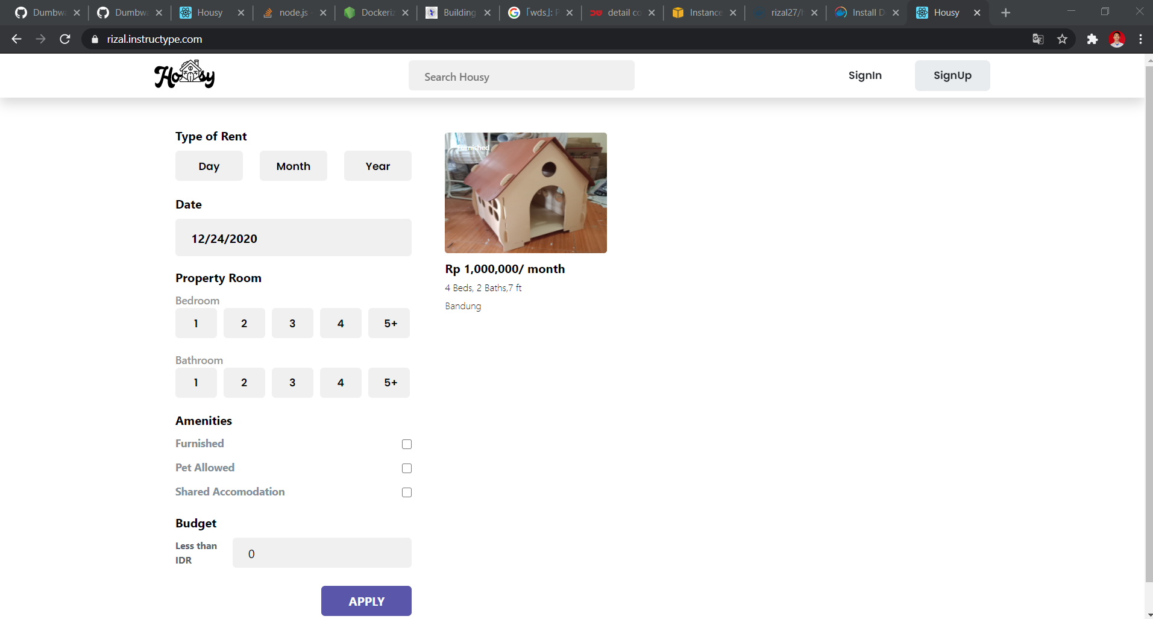

Slide 21
4.Install Jenkins

Slide 22
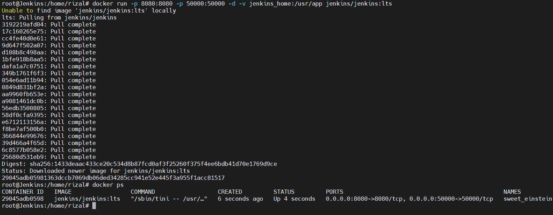

Slide 23
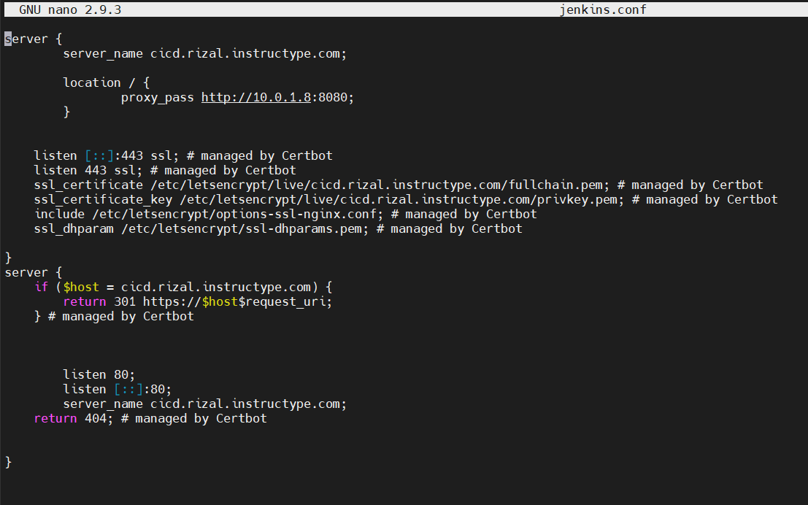

Slide 24
5.Create Jenkins Job

Slide 25
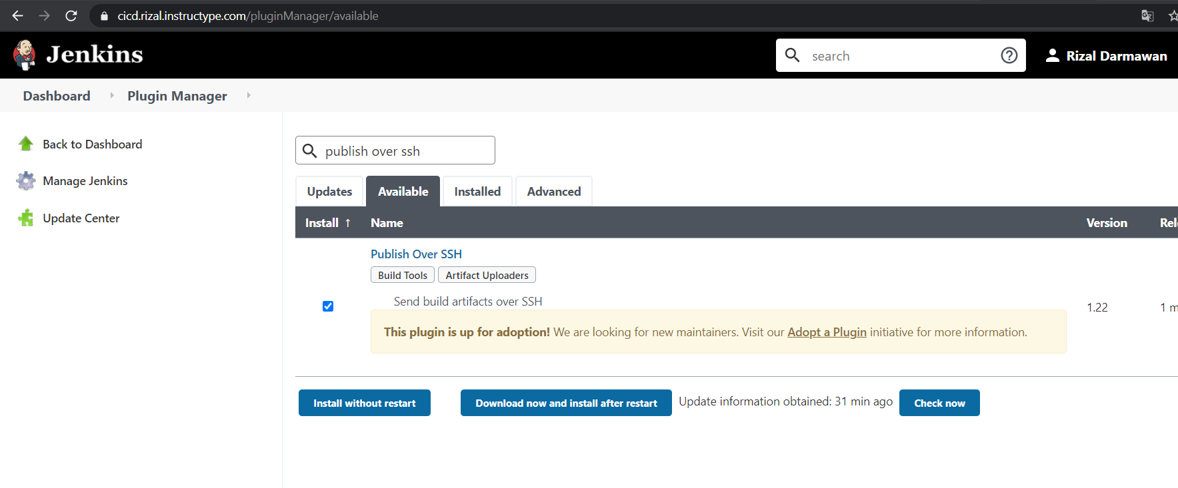
Install Plugin

Slide 26
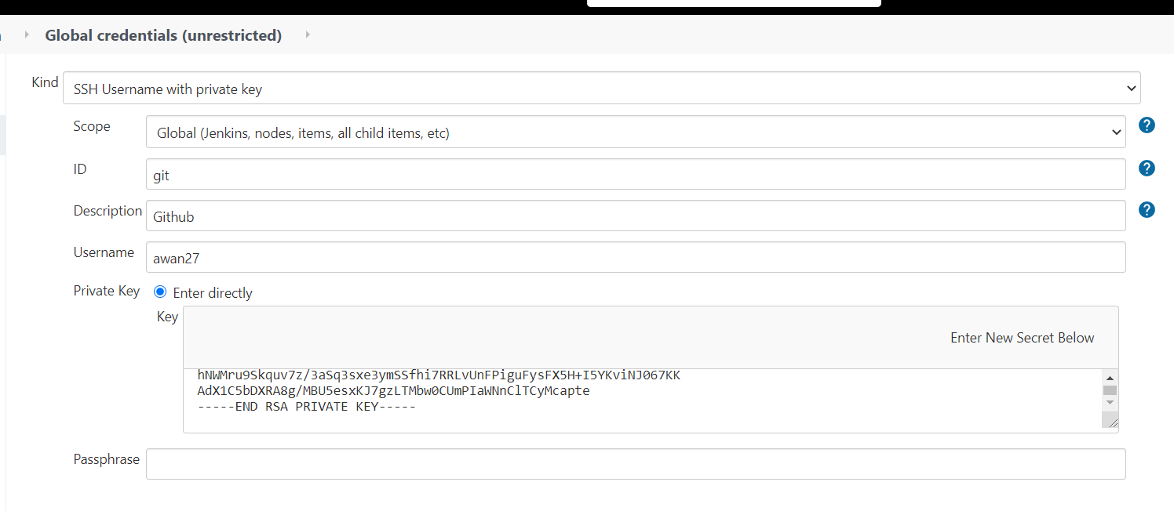
Edit Kredensial

Slide 27
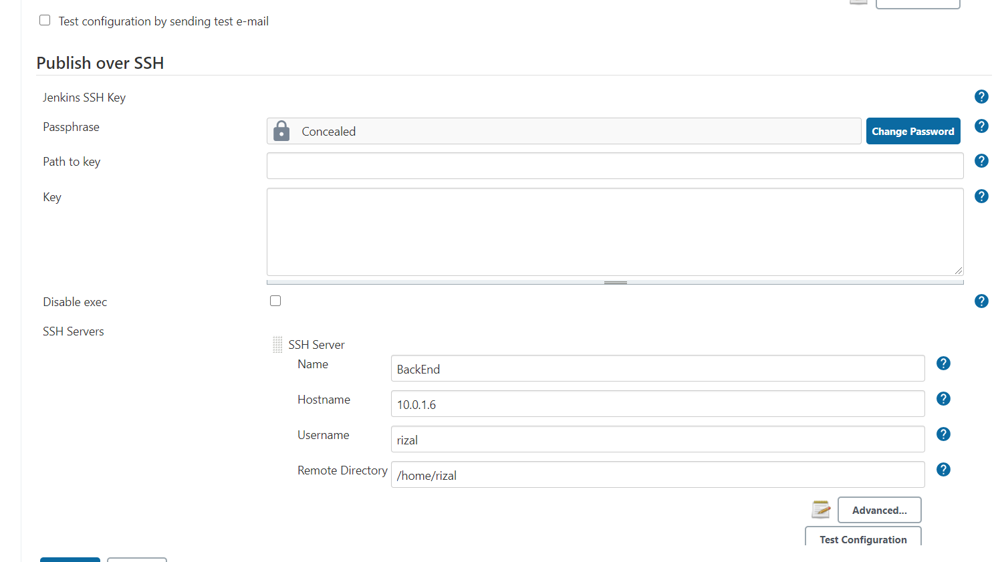
Tambah Server

Slide 28
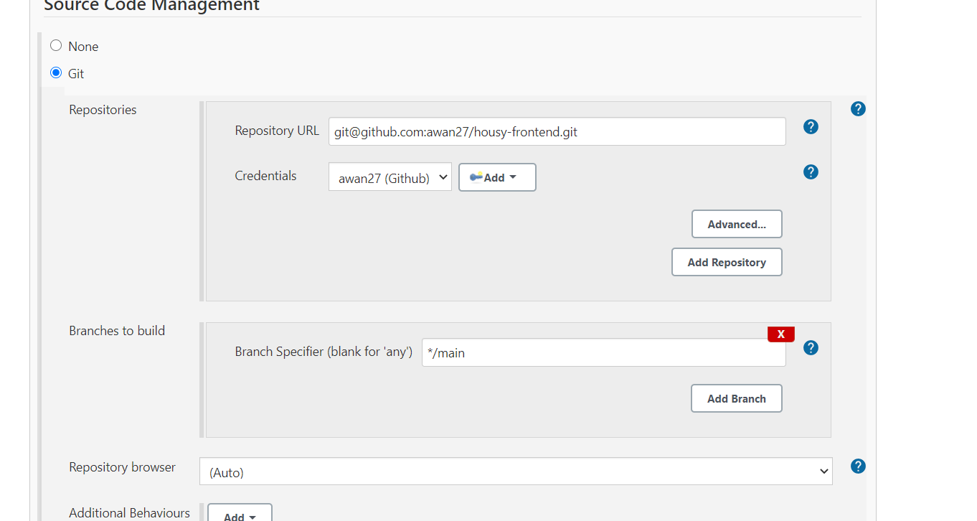
Create Job

Slide 29
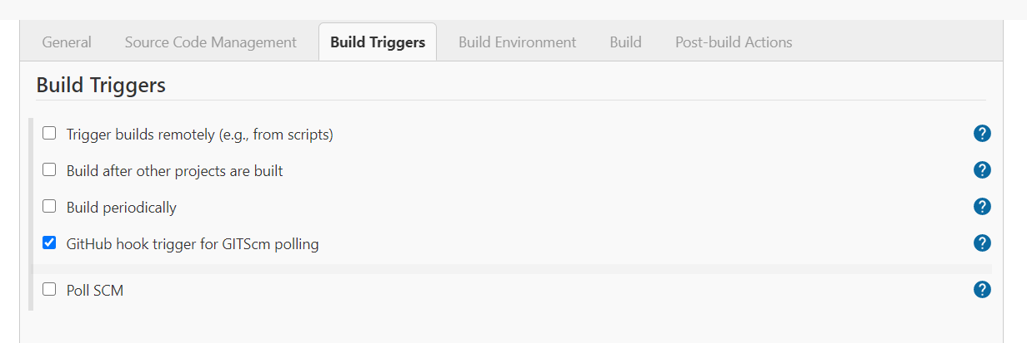
Create Job

Slide 30
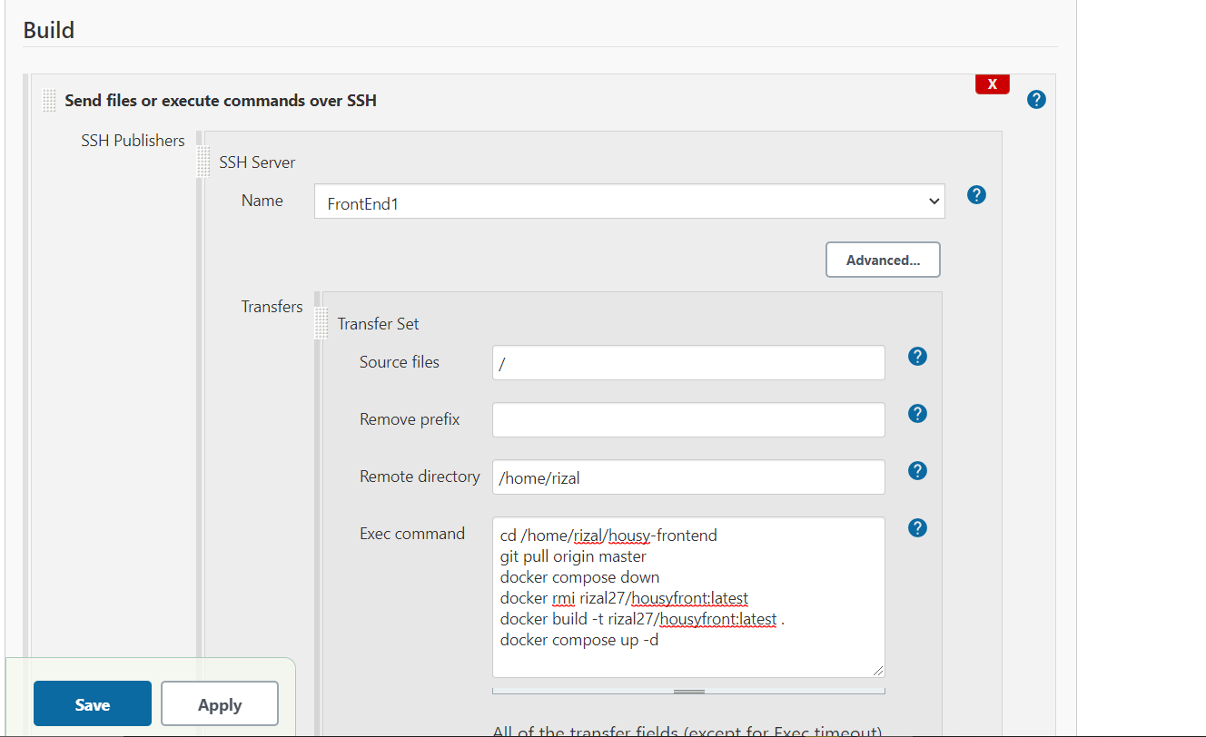
Create Job

Slide 31
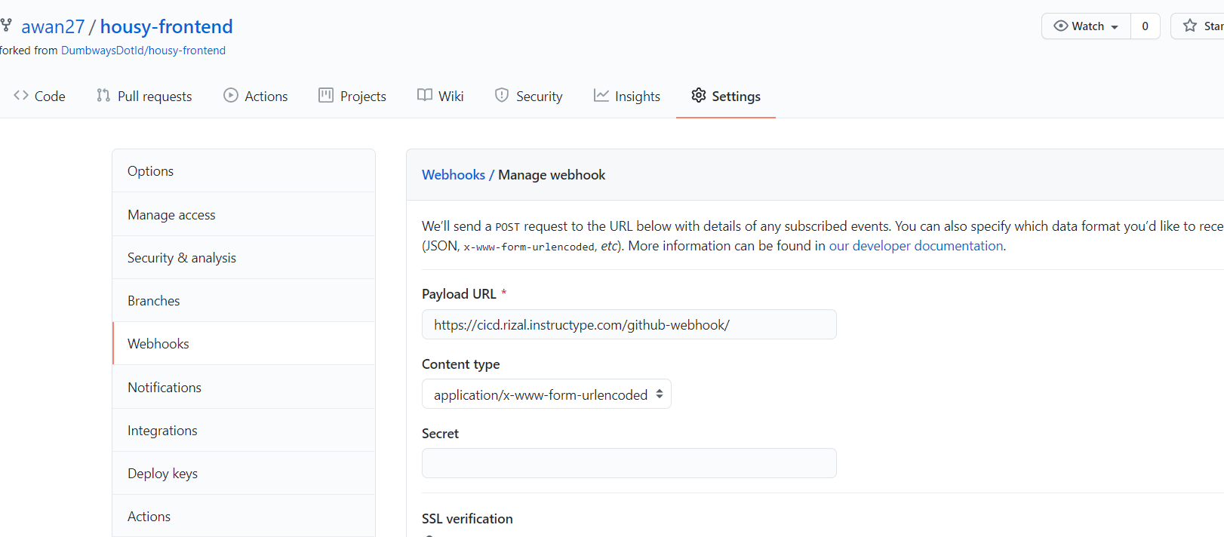
Tambah Webhook

Slide 32
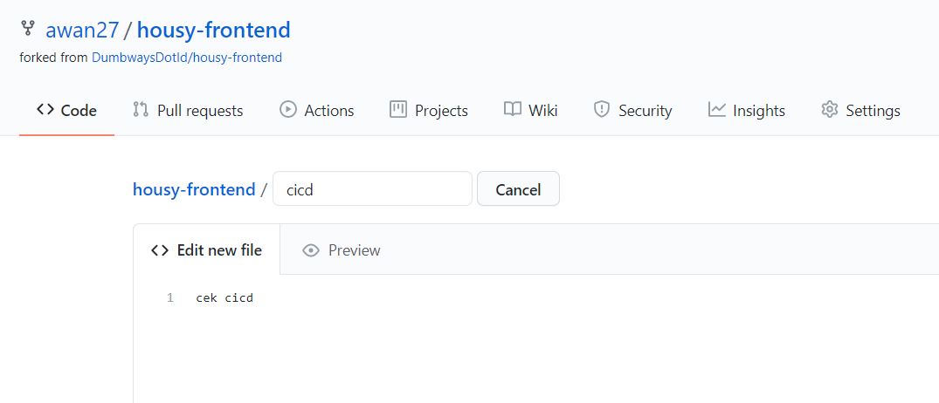
Test Push

Slide 33
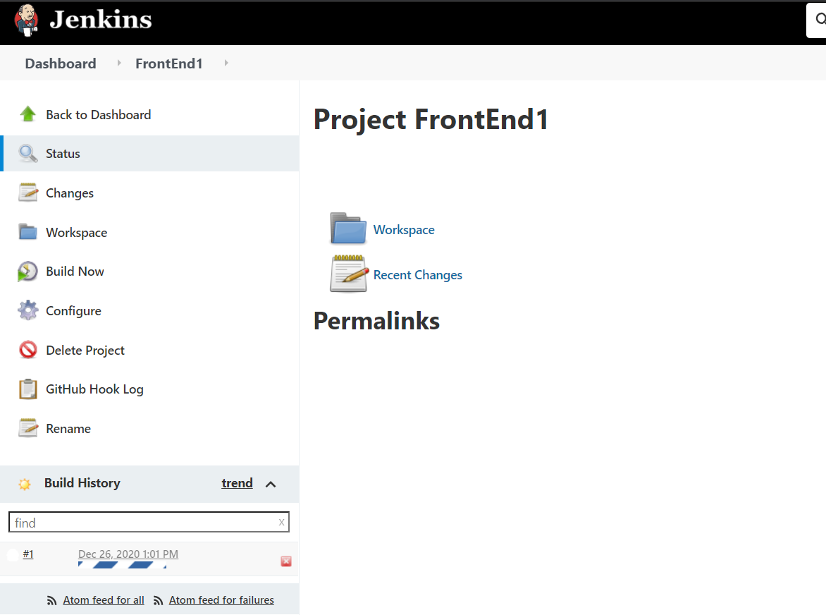
Test Push

Slide 34
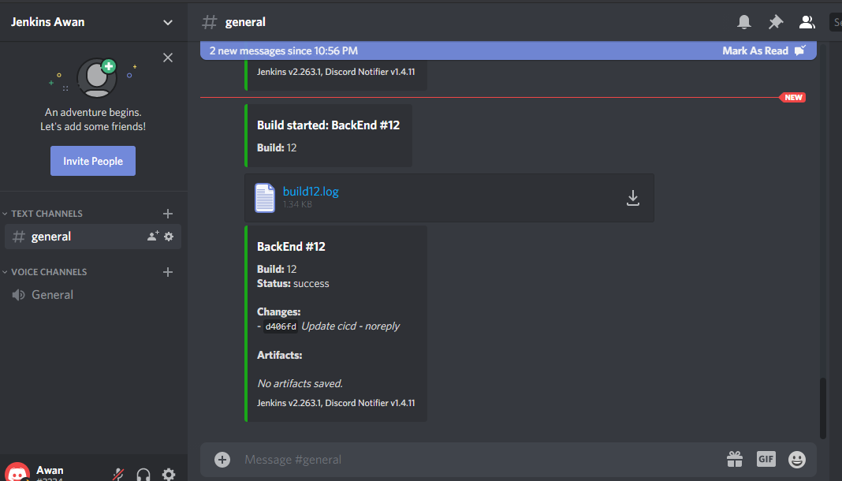
Bot Notif

Slide 35
Database Cluster

Slide 36
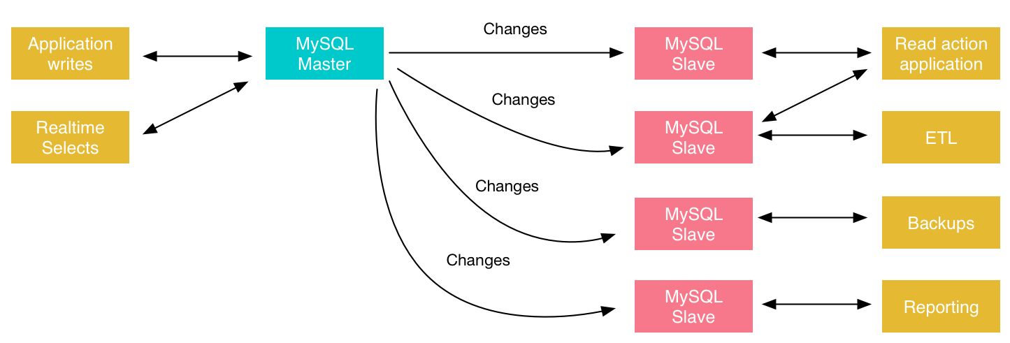

Slide 37
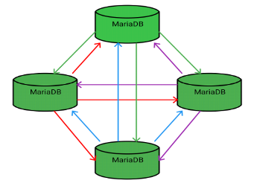

Slide 38
Setting Galera MariaDB

Slide 39
Proses Database Cluster
Install MariaDB
File Config
Galera Cluster
Ketika menginstall MariaDB akan sekaligus install Galera.
File Config Di Setiap Node
Menjalankan Primary Component di satu node

Slide 40
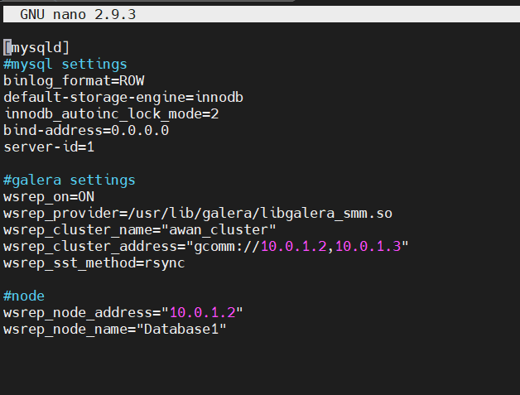
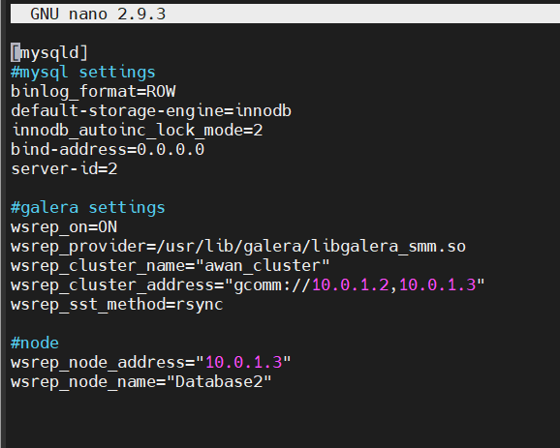

Slide 41
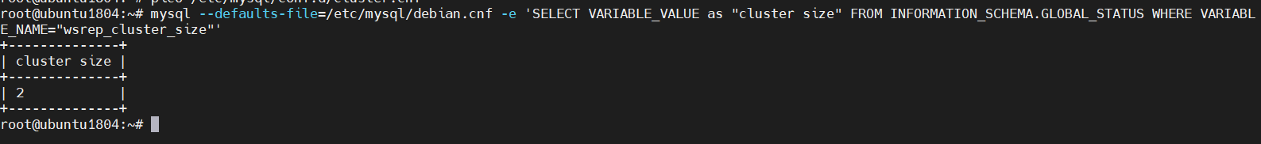

Slide 42
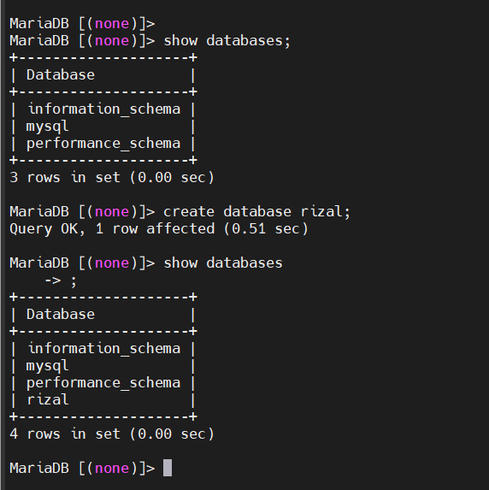
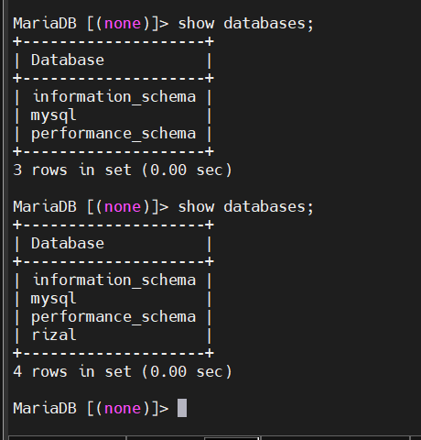

Slide 43
Terimakasih!
Any questions?

