Slide 1
Dumbways Bootcamp Minggu kedua

Slide 2

Hello!
Rizal Darmawan

Slide 3
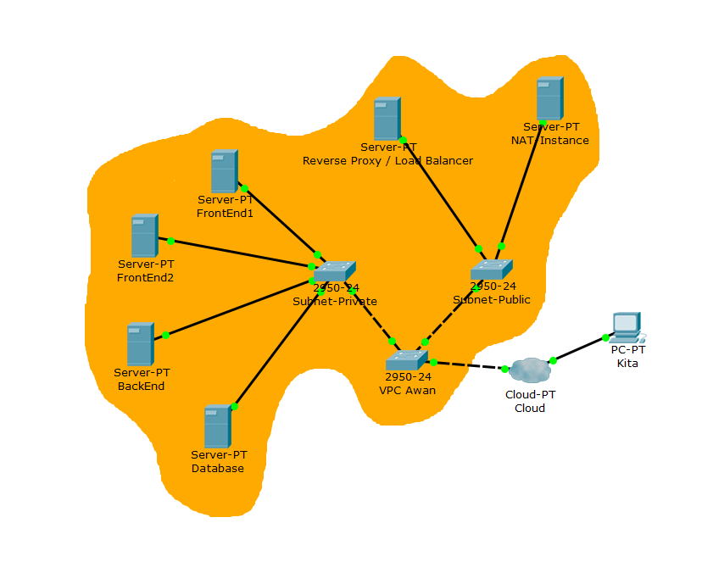

Slide 4







Code and Database
Install Git dan SSH Key
Setup Database
Deploy Backend
Reverse proxy
Custom Domain
Config SSL

Slide 5
1.
Install Git & SSH Key
Let’s start with the first set of slides

Slide 6
Tahapan
Fork Repo
Generate SSH Key
Connect & Clone
Test Push

Slide 7
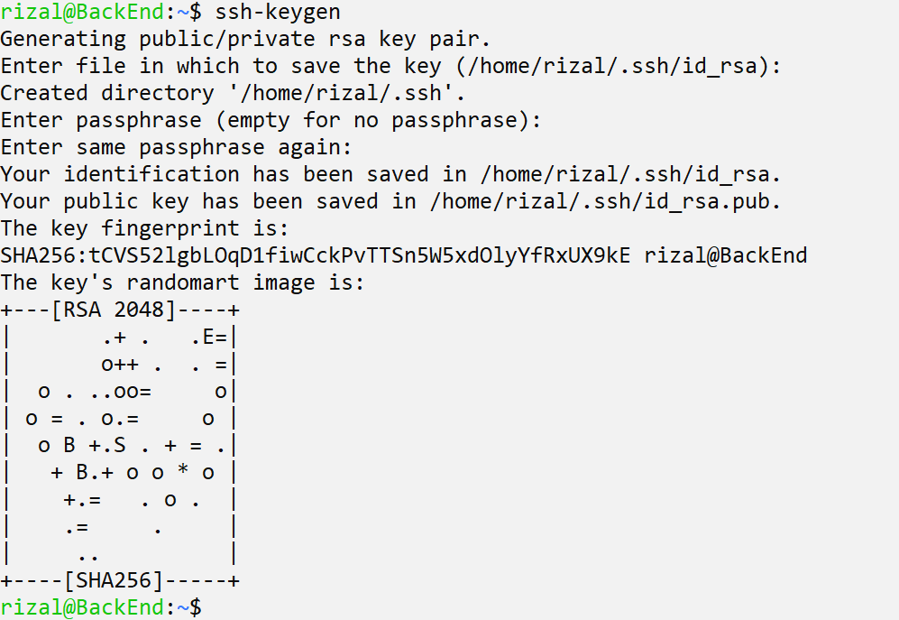
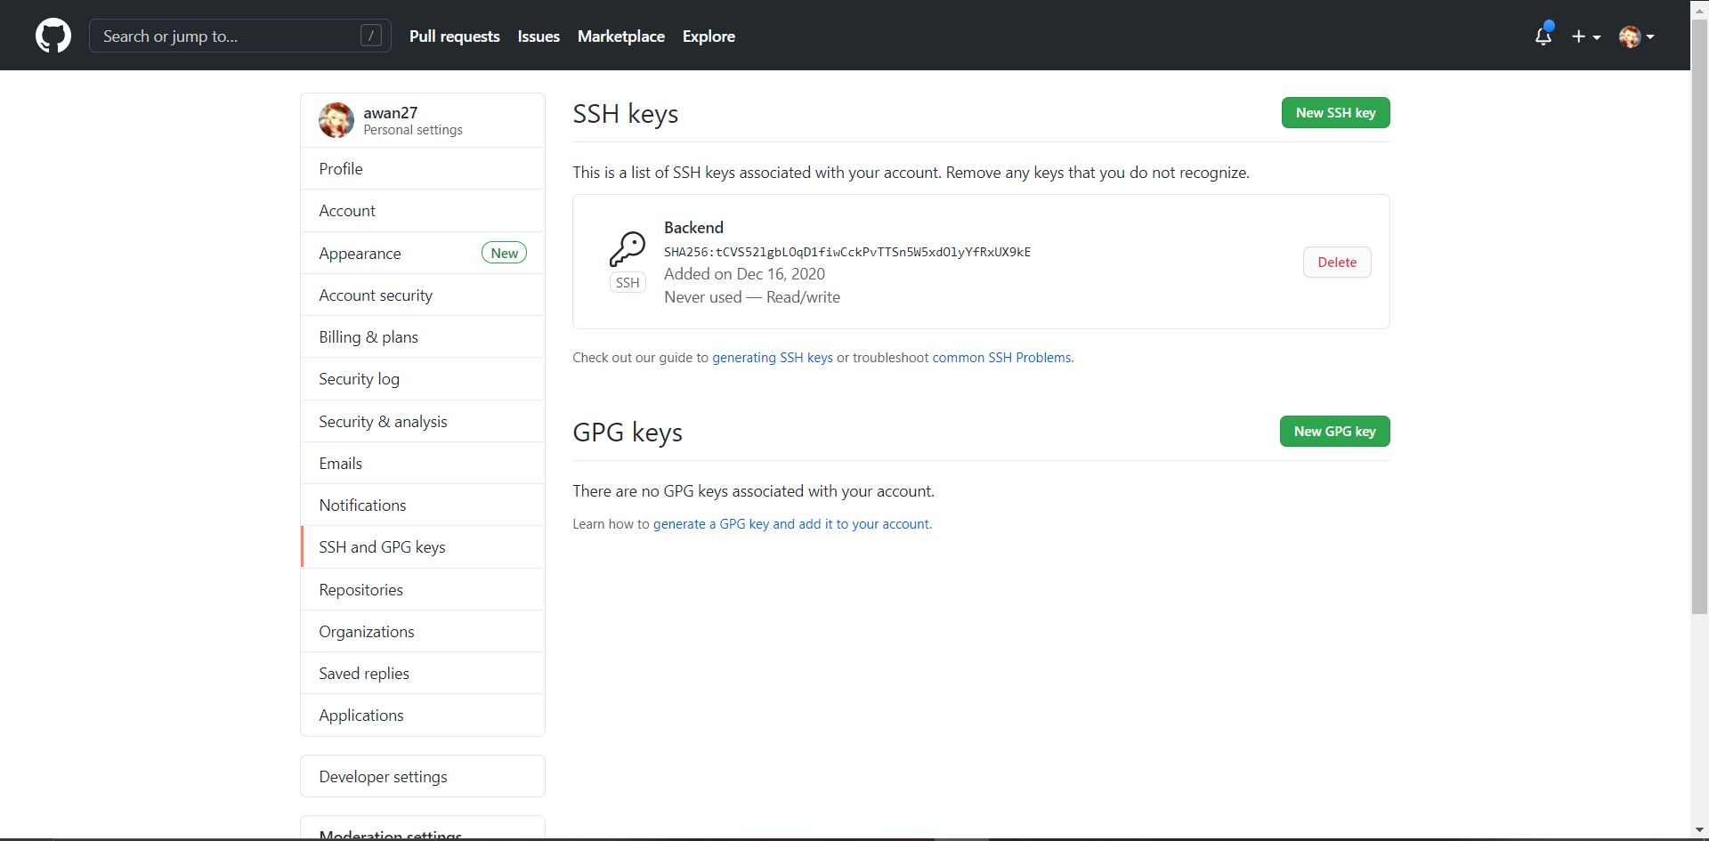
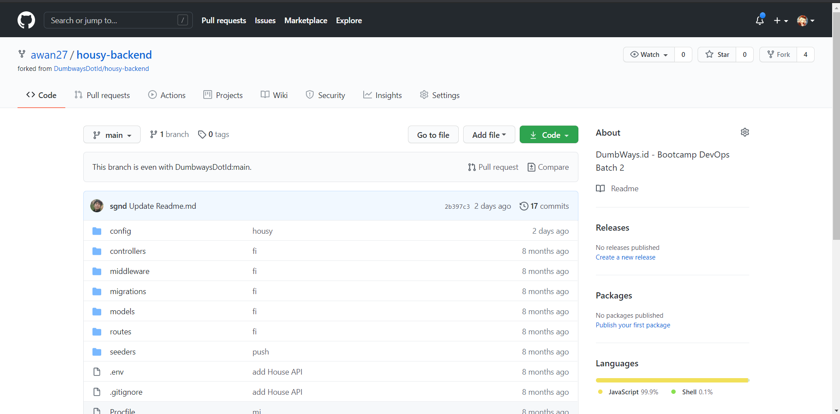
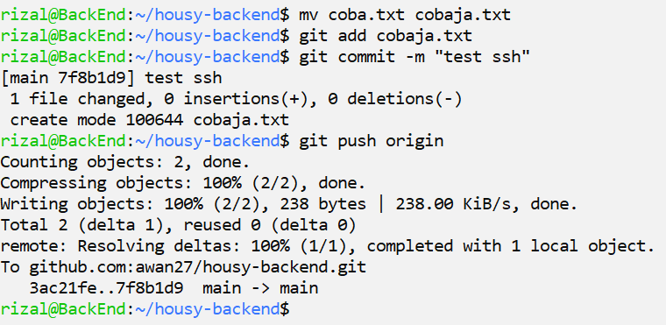
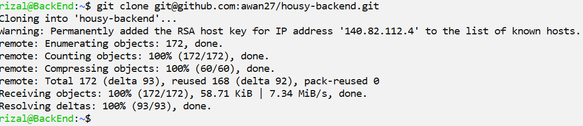
Generate SSH
Fork Repo
Connect & Clone
Test Push

Slide 8
2.
Setup Database

Slide 9
Tahapan
Install MySQL
Tambah dan Edit User
Buat Database
Ubah Bind Address

Slide 10
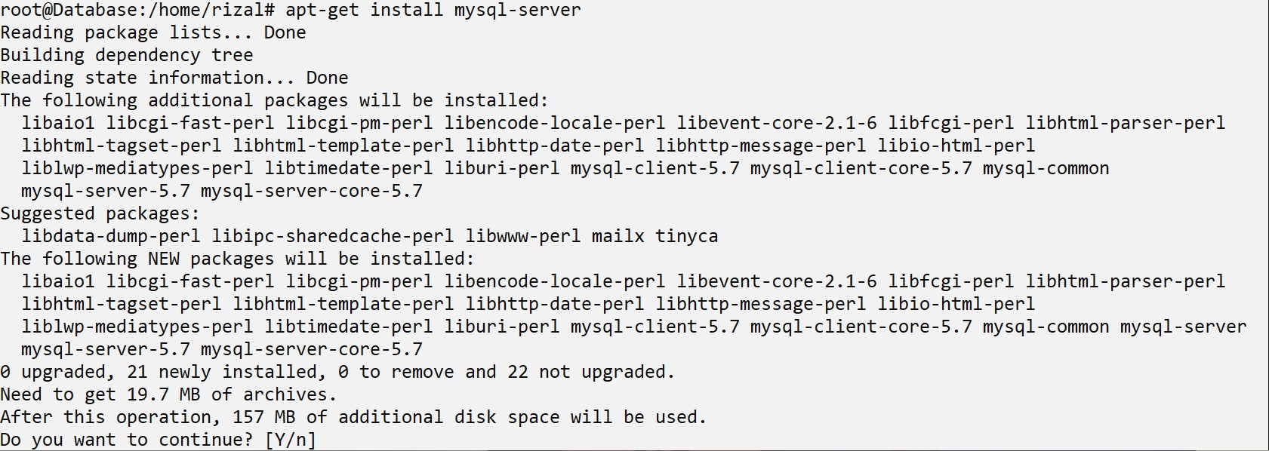
Install Mysql

Slide 11
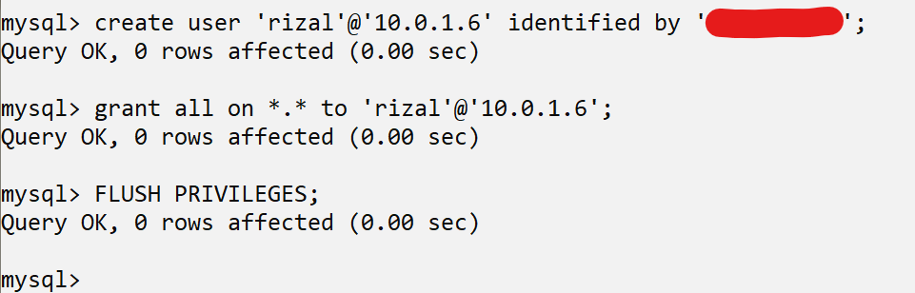
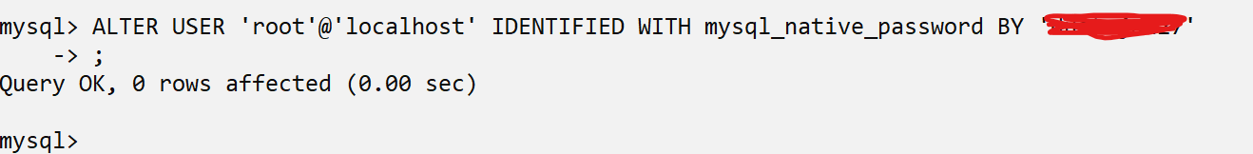
Tambah dan edit user

Slide 12
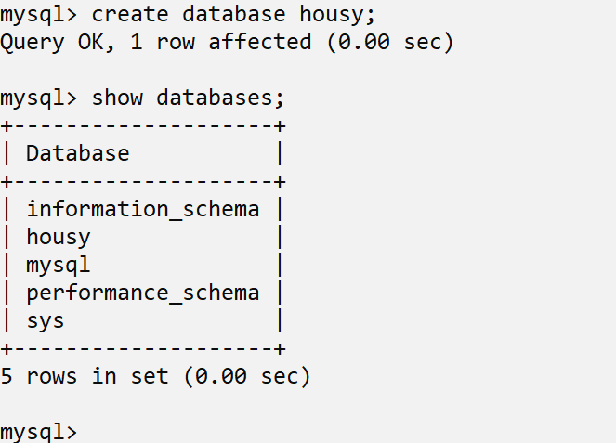
Buat Database

Slide 13
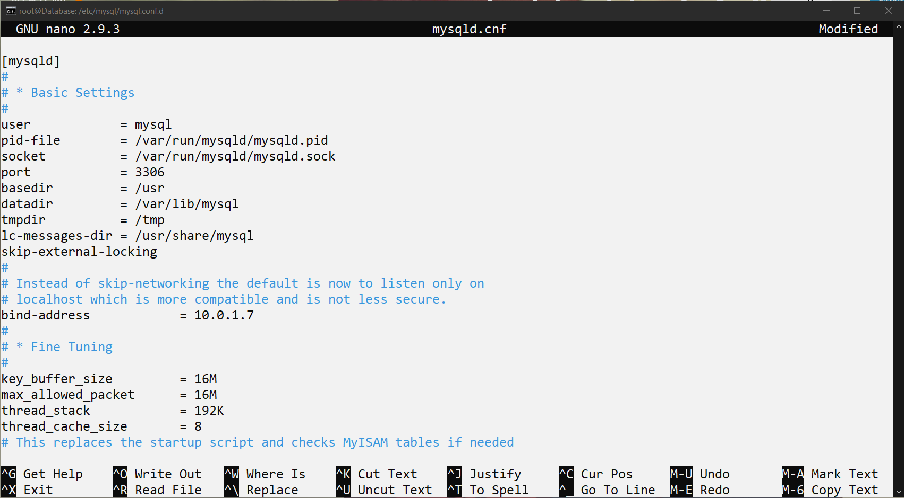
Ubah Bind Address

Slide 14
3.
Deploy Backend

Slide 15
Tahapan
Clone Repo
Install NodeJS, DLL
Connect Database
Migrate
Start App

Slide 16
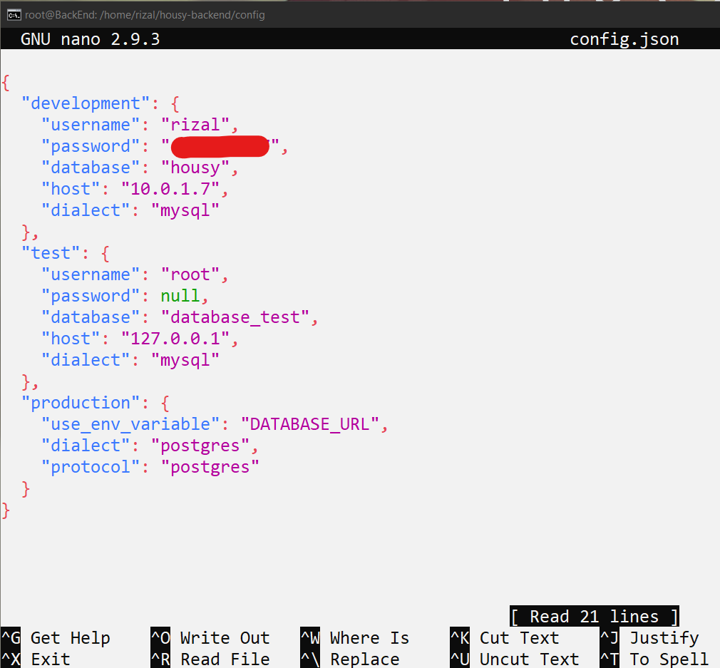
Connect DAtabase

Slide 17
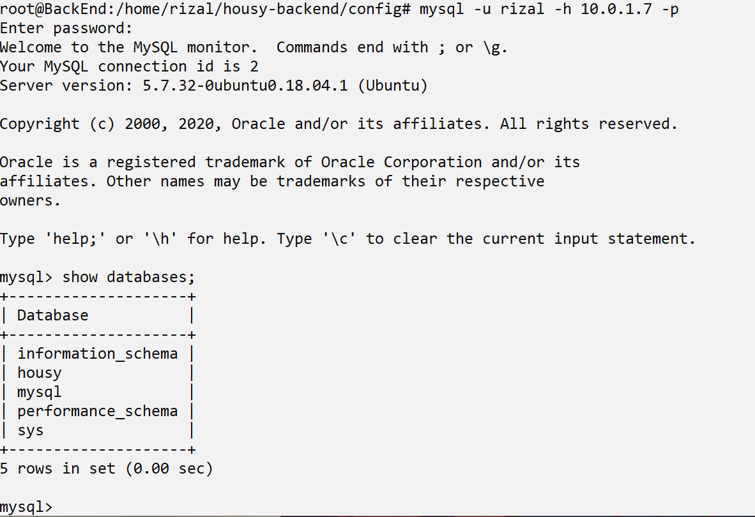
Connect DAtabase

Slide 18
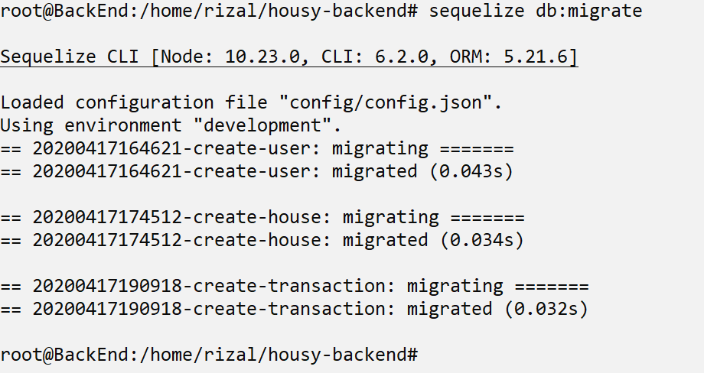
Migrate DAtabase

Slide 19
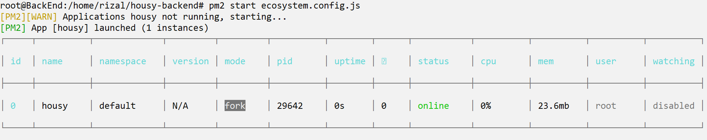
Start app

Slide 20
4.
Reversed Proxy

Slide 21
Reversed Proxy
FrontEnd
BackEnd

Slide 22
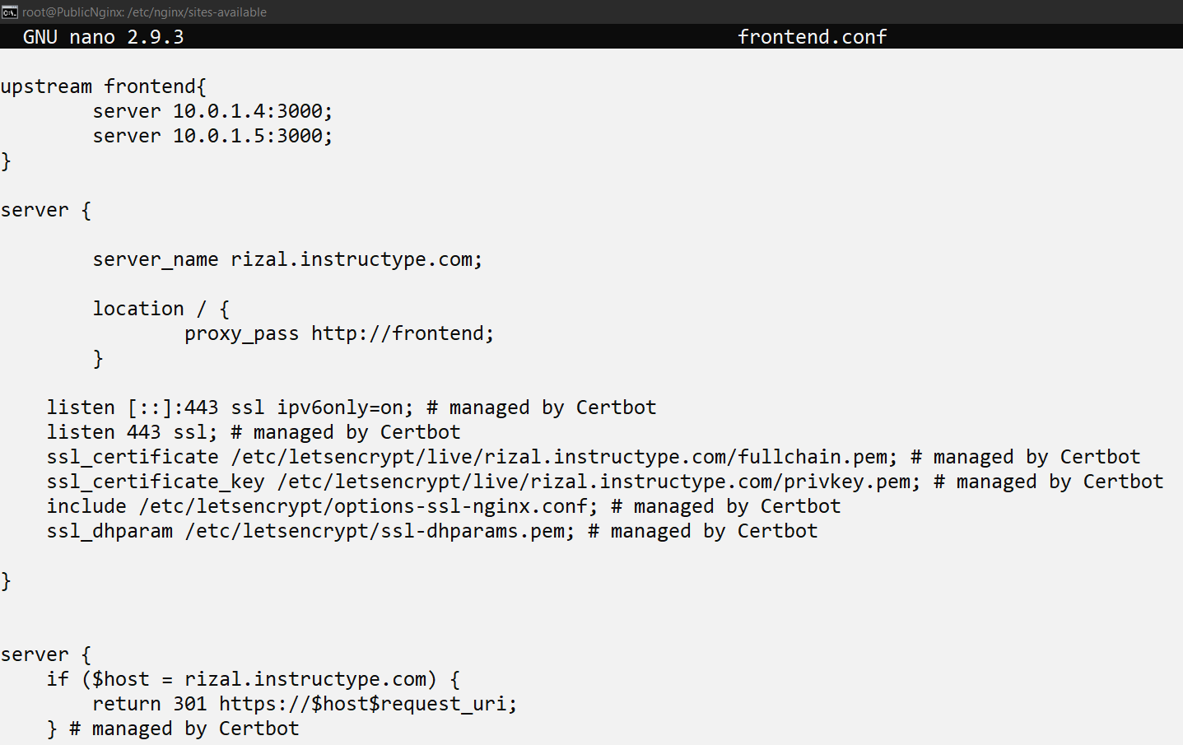

Slide 23
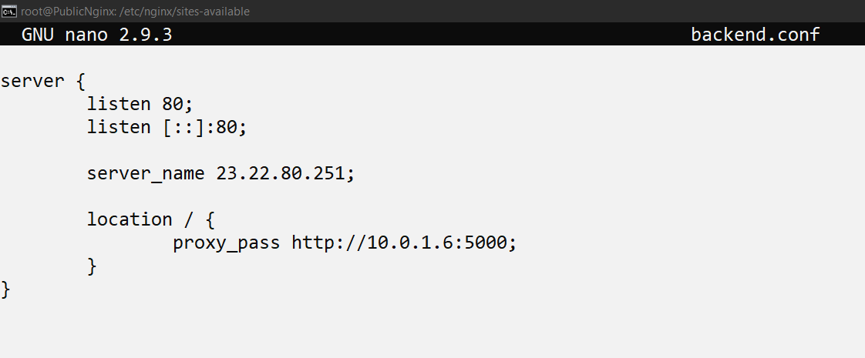

Slide 24
5.
Custom Domain

Slide 25
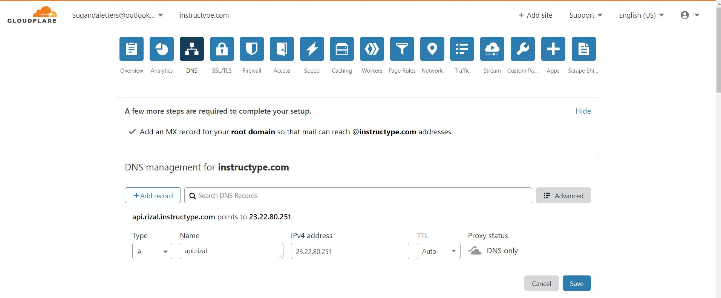

Slide 26
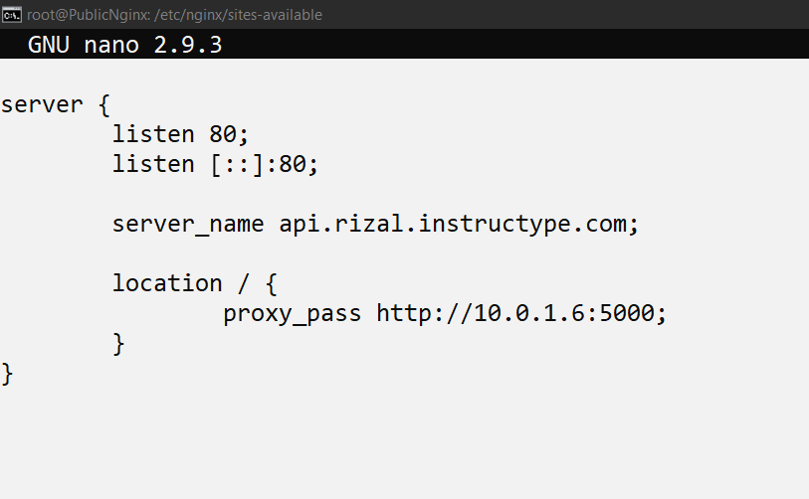

Slide 27
6.
SSL Config

Slide 28
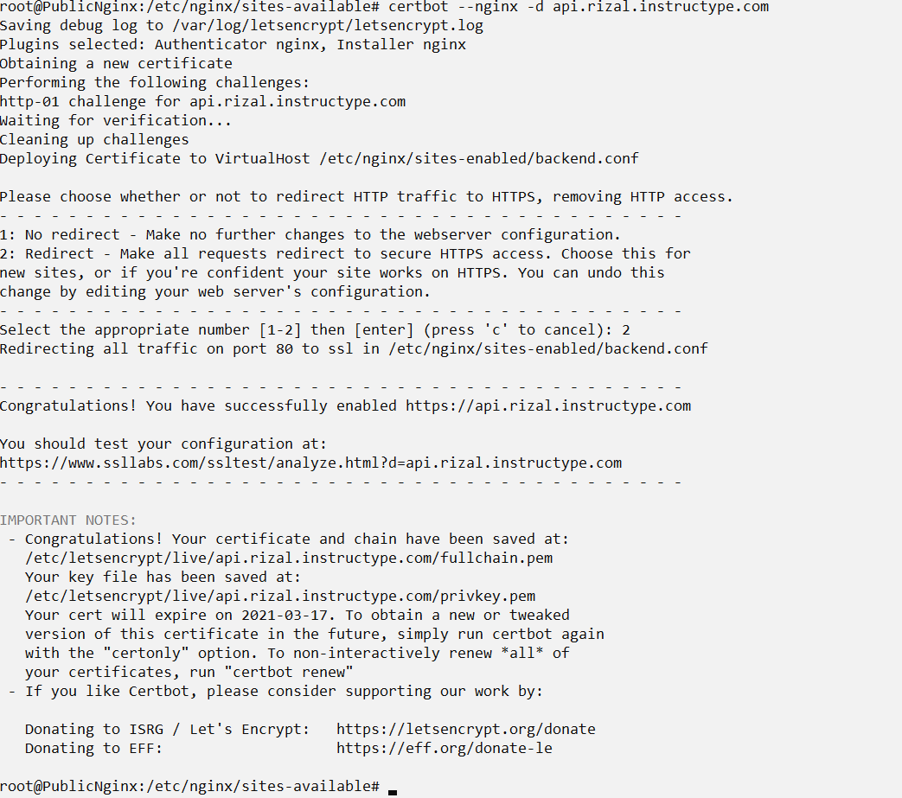

Slide 29
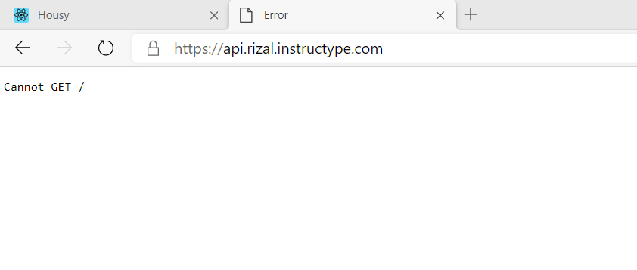

Slide 30
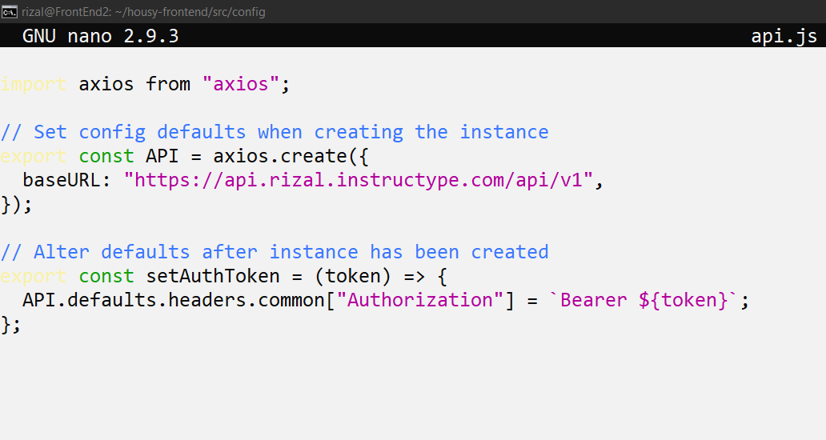

Slide 31
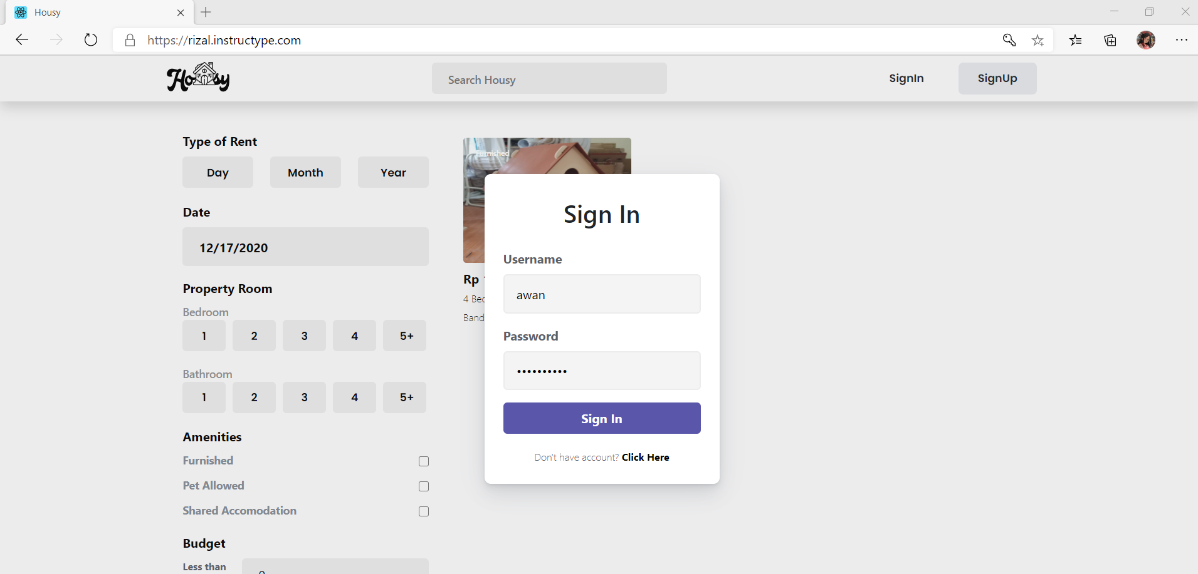

Slide 32
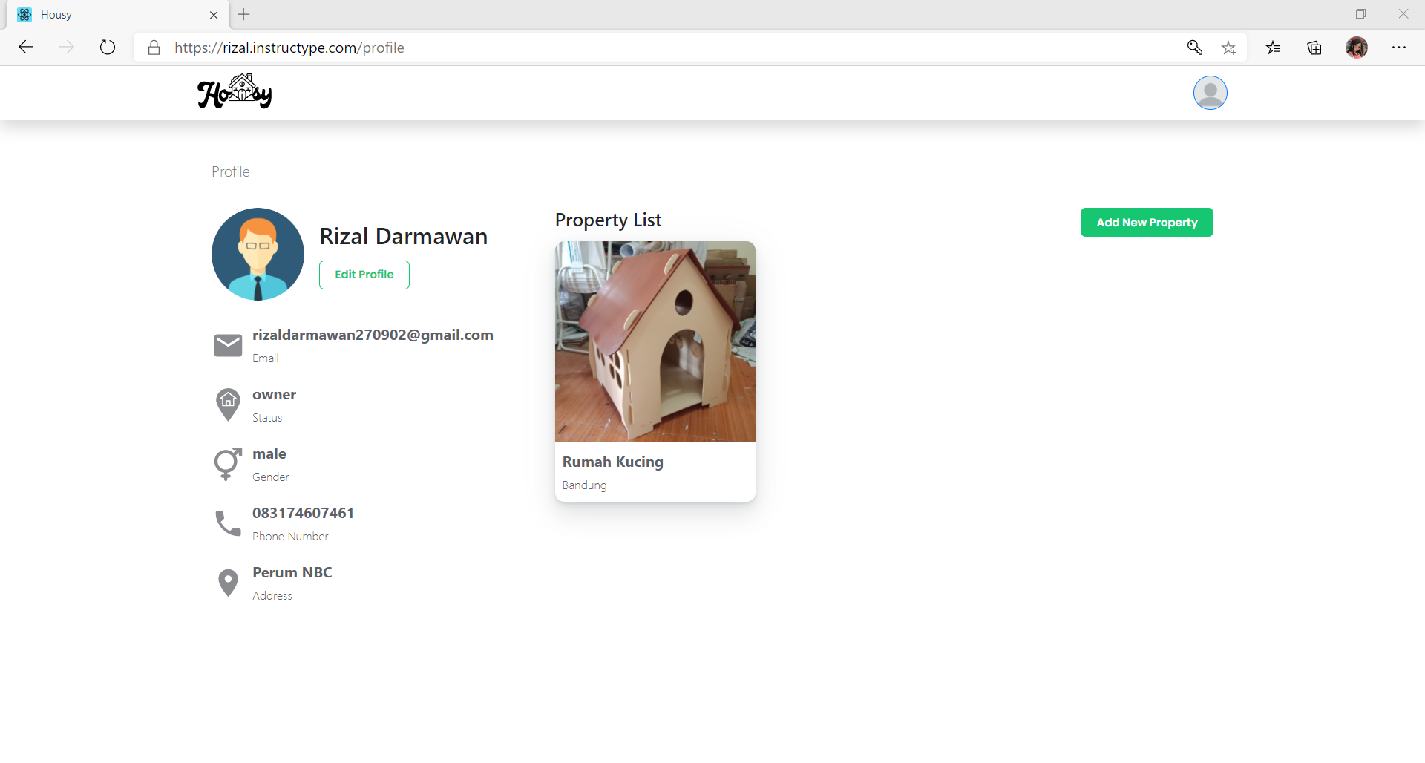

Slide 33
Terima kasih!
Any Pertanyaan?

