Slide 1

Portfolio Project
Global Trend Intelligence
Dashboard
Turning 3.1 million Google Trends data points into
strategic decisions about where, what, and when to act.
40 Countries · 986 Regions · 266 Weeks · 23,352 Terms · March 2021 – April 2026
Data source: Google Trends via BigQuery public dataset (bigquery-public-data.google_trends)
Notes:
1

Slide 2
HOW THIS STORY IS STRUCTURED
The SCQA Framework
S
C
Q
A
Situation
Complication
Question
Answer
What is the business context?
Content teams are making trend decisions at global scale every week, but without systematic intelligence.
What is changing or broken?
The assumption that trending topics are global and therefore actionable across all markets turns out to be structurally wrong.
What do executives need to know?
Which trends actually matter, in which markets, at which stage and how do we act before the window closes?
What the data tells us
6 findings that redefine how we approach trend-led strategy, market investment, and campaign timing.
2 / 14
Notes:
2

Slide 3
SITUATION
Content teams are navigating trend decisions
without systematic intelligence.
Every week, marketing, content, and strategy teams make decisions based on what is trending. They monitor social feeds, read industry newsletters, and make educated guesses about which topics deserve budget and attention. The problem is not effort — it is the absence of a structured, evidence-based intelligence layer beneath those decisions.
3.1M
data points processed
5 years
of weekly tracking
40 countries
986 sub-national regions
This analysis was built to replace guesswork with evidence. Tracking 23,352 distinct search terms through a structured Power BI data model with 24 custom DAX measures.
3 / 14
Notes:
3

Slide 4
COMPLICATION
The core assumption is wrong.
99.3%
What this means for strategy
A campaign built on a topic trending in India is invisible in Germany, by data, not by chance.
of trending topics are
geographically isolated
to a single country.
Teams chasing "trending topics" without geographic scope filters are acting on noise 99% of the time.
Only 164 of 23,352 terms crossed into 2+ markets. These are the only legitimate global plays.
The most widely-reaching term in 5 years of data spans 34 countries. Most span 1.
4 / 14
Notes:
4

Slide 5
QUESTION
Three questions every strategist
needs answered from this data.
01
Which trends actually matter?
Not all trending terms are equal. Is this term viral and unmeasurable or fast-rising with a measurable 2-week runway to act?
02
In which markets?
Is this trend genuinely global or locally isolated? Which countries are at peak intensity and which are still building?
03
At what stage — and what to do now?
Is this market ascending or past its peak? Are we investing ahead of the wave or arriving after it?
The following 6 findings answer these questions with data.
5 / 14
Notes:
5

Slide 6
ANSWER — 6 KEY FINDINGS
The data delivers six strategic imperatives.
01
02
03
0.7%
280
99.1
of trends are global
terms at 5,000% cap
Thailand avg score
The viral minority problem
Breakout events are unmeasurable
Three markets dominate intensity
04
05
06
3×
+0.37
34
above 5-yr baseline
UK growth — ascending
countries — widest reach
April 2026 — a black hole event
High scores signal decline
Global terms — 4 categories only
6 / 14
Notes:
6

Slide 7
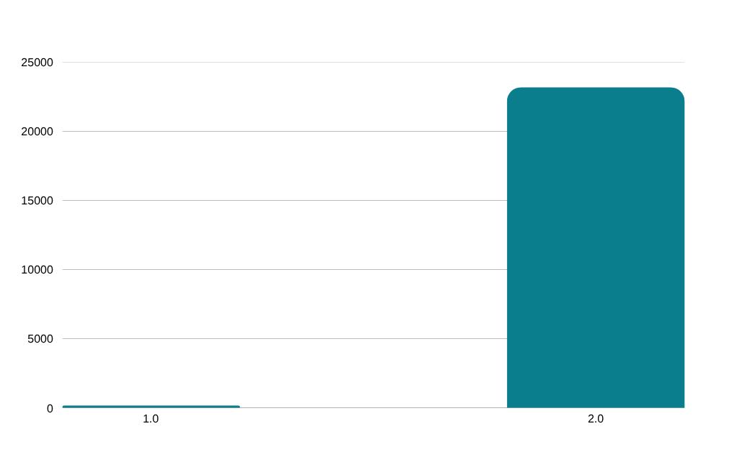
FINDING 01
99.3% of trends are local —
not global.
23,188
Local terms
trending in exactly 1 country
Strategic implication: Establish a scope filter as the first gate in content planning.
Only Global-classified terms should drive multi-market campaigns.
vs only 164 global terms (0.7%)
7 / 14
Notes:
7

Slide 8
FINDING 02
Breakout events are unmeasurable —
Explosive terms are where opportunity lives.
BREAKOUT
EXPLOSIVE
MODERATE
280
149
2
terms
terms
terms
avg gain: 5,000%
avg gain: 2,930%
avg gain: 125%
Hit Google's measurement ceiling.
Unmeasurable by design. Window has closed.
Fast-rising but measurable.
2–3 week runway to act.
Organic steady growth.
Low urgency, high predictability.
Recommendation: Build an Explosive-term alert at 1,000% WoW gain. By Breakout, the moment has already passed.
8 / 14
Notes:
8

Slide 9
FINDING 03
Three markets dominate global
trend intensity.
1st
2nd
3rd
For comparison
Thailand
India
Turkey
United Kingdom
99.1
99.0
98.8
59.3 avg · 4 regions
Belgium
/ 100 avg
/ 100 avg
/ 100 avg
52.2 avg · 3 regions
77 regions · 724 terms
36 regions · 788 terms
81 regions · 750 terms
Taiwan
51.0 avg · 6 regions
Recommendation: Allocate disproportionate trend monitoring to Thailand, India, and Turkey, structurally more search-active environments with the highest amplification potential.
9 / 14
Notes:
9

Slide 10
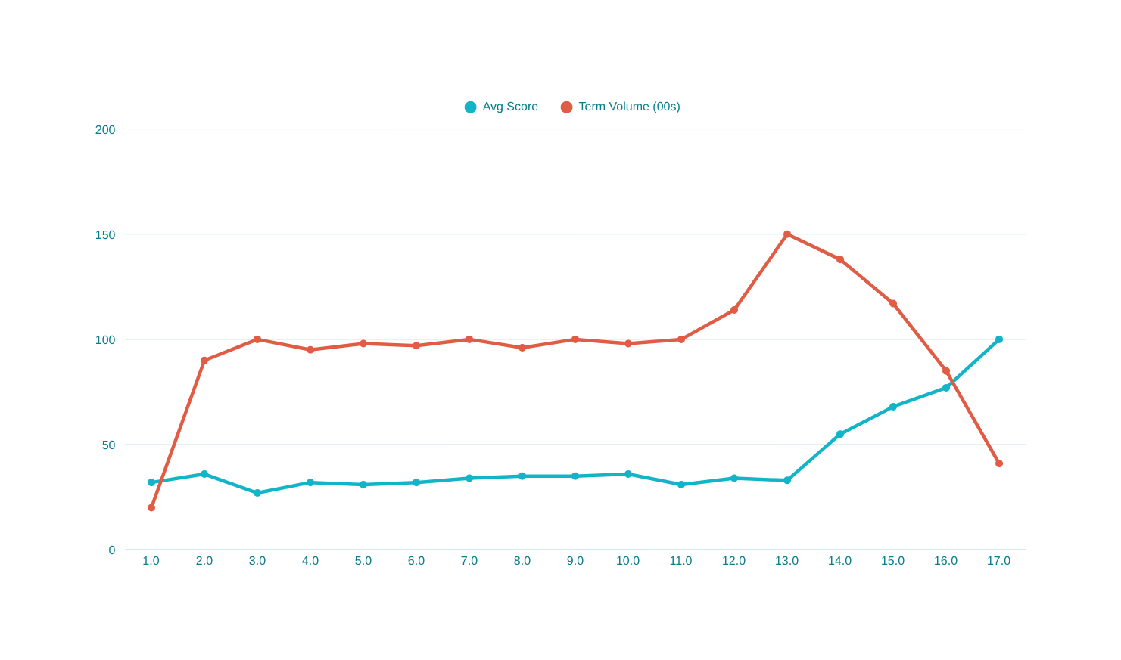
FINDING 04
April 2026 — a black hole event
that broke the 5-year pattern.
3×
above 5-yr baseline
(100 vs avg 32)
15,000
weekly terms at peak
29 March 2026
−73%
term volume collapse
by 26 April 2026
Recommendation: When weekly term volume drops >30% in 2 weeks while avg score exceeds 60,
pause unrelated trend-led content — it cannot compete during a black hole event.
10 / 14
Notes:
10

Slide 11
FINDING 05
High scores today signal decline.
Low scores signal the next opportunity.
↑ Growth +
BUILD MODE
UK · Germany · Belgium
Score low, rising fast
Lifecycle score vs weekly growth by country
United Kingdom
score 20.5
+0.37
BUILD
Germany
score 25.0
+0.27
BUILD
Australia
score 28.3
+0.17
BUILD
Score low →
HARVEST MODE
Thailand · Romania · NZ
High score, now declining
← Score high
Thailand
score 52.0
−0.17
HARVEST
Romania
score 50.8
−0.23
HARVEST
New Zealand
score 45.1
−0.24
HARVEST
↓ Growth −
11 / 14
Notes:
11

Slide 12
FINDING 06
Global content lives in exactly
four categories.
International Football
up to 33+ countries
Global Political Figures
up to 34 countries
PSG · Real Madrid · Barcelona · Bayern · F1
Pam Bondi (34 countries. Widest in dataset)
Trump (26 countries)
Technology News
up to 32 countries
Universal Calendar Events
up to 26 countries
John Ternus (Apple exec, 32 countries)
Tech product launches & announcements
Easter 2026 · Labour Day
Predictable, plannable, globally resonant
12 / 14
Notes:
12

Slide 13
ANSWER — SUMMARY
Six findings. Six imperatives.
01
99.3% of trends are local
Add a scope filter to content planning. Only Global terms drive multi-market campaigns.
0.7% global
02
Breakout events are unmeasurable
Build an Explosive-term alert at 1,000% WoW gain. Breakout = reactive only.
280 at cap
03
Thailand, India, Turkey dominate
Prioritise these three for trend monitoring and localisation investment.
99.1 avg score
04
April 2026 was a black hole event
Pause unrelated content when volume drops >30% + avg score >60 simultaneously.
3× baseline
05
High score = past peak
Invest in UK, Germany, Australia now — ascending lifecycle, not yet at peak.
+0.37 UK growth
06
Global = 4 categories only
Map brand pillars to: football, politics, tech news, or calendar events. Otherwise go local.
34 countries max
13 / 14
Notes:
13

Slide 14
The difference between monitoring trends and acting on trend intelligence
is the difference between a weather app and a meteorologist.
The weather app tells you it is raining. The meteorologist tells you the storm peaks in 6 hours and clears by Thursday, so you move the event to Wednesday, not cancel it.
This dashboard is the meteorologist. It shows where the signal is real vs noise, which markets are building vs declining, which terms have runway vs have peaked and when the landscape is so concentrated that no unrelated content can compete.
Organisations that build this into their weekly planning cycle consistently show up at the right moment, in the right market, with the right message.
Notes:
14

