Slide 1
Real-Time Monitoring, Time-Series Analysis and Stream Intelligence
Endterm project: API traffic stream, anomaly detection, real-time ML, distributed processing
270,925 events, 4,320 one-minute windows, 30 labelled incidents
9 concurrent processes connected over TCP, no shared memory

Slide 2
Problem and objectives
A stream of API request records carries timestamp, endpoint, region, latency, status and size.
Objective 1. Continuously updated visualization with more than one view.
Objective 2. Time-series analysis with rolling windows, resampling, trend and seasonality.
Objective 3. Anomaly detection that is implemented and evaluated against ground truth.
Objective 4. Real-time machine learning using only information available at prediction time.
Objective 5. Distributed stream processing with measured operational characteristics.

Slide 3
The data stream
Property | Value
Events | 270,925
Windows | 4,320 one-minute tumbling windows over 3 days
Endpoints | 6, each with its own rate, latency and error profile
Mean traffic | 62.7 requests per minute
Injected incidents | 30 incidents, 468 labelled minutes (10.8%)
Incident types | latency spike, error burst, traffic drop, traffic surge
The generator is seeded, so the dataset, the models and every number are reproducible.

Slide 4
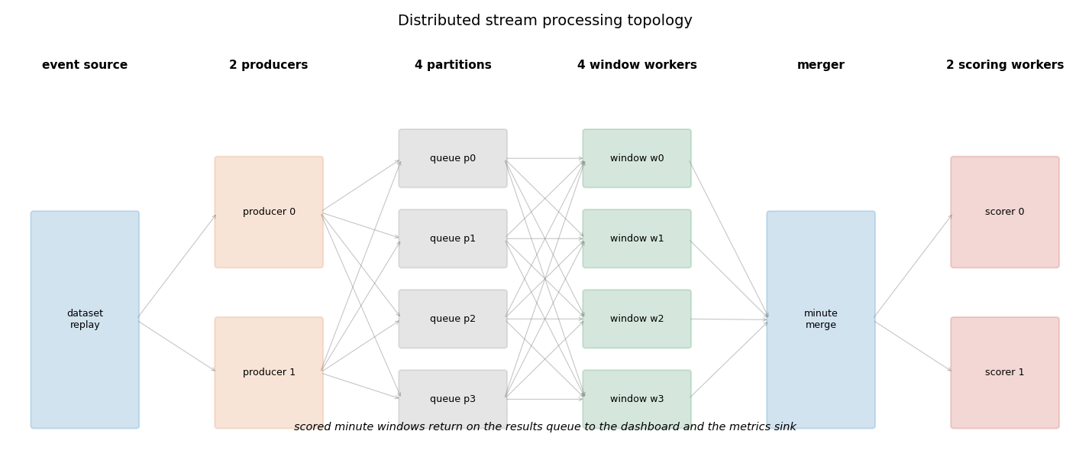
Architecture

Slide 5
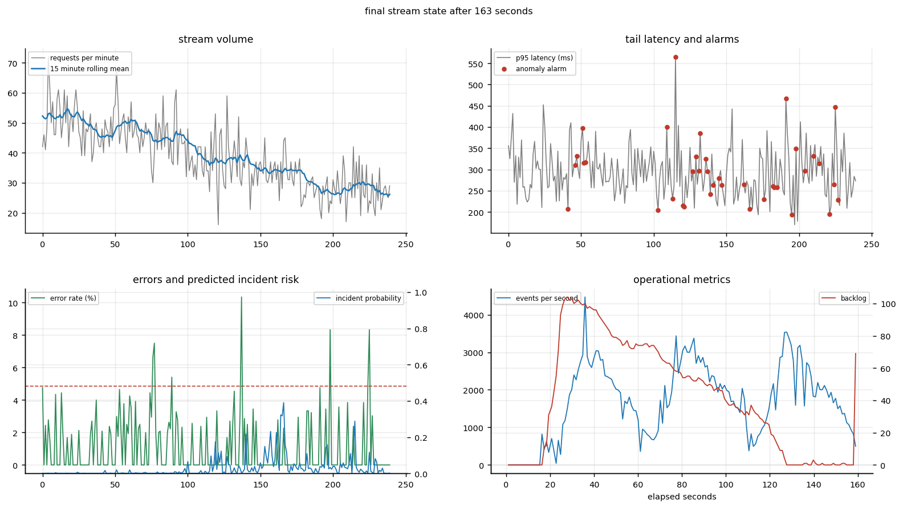
Live dashboard, four views
Volume against its 15 minute rolling mean.
Tail latency with alarms as they fire.
Error rate against predicted incident risk.
Throughput and per-stage backlog.
Redrawn by the sink process as scored windows arrive.

Slide 6
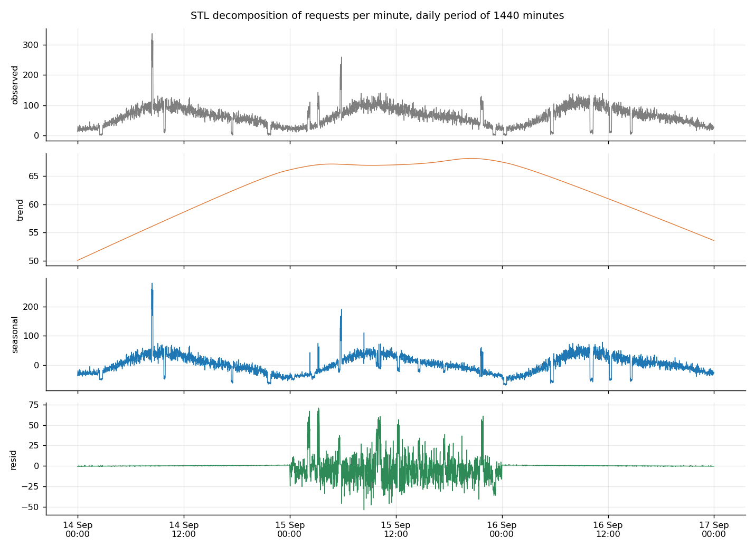
Time-series analysis
One-minute resampling of an irregular event stream.
Rolling windows of 15 and 60 minutes.
STL with a daily period of 1440 minutes.
Seasonal strength 0.90, trend strength 0.14.
Autocorrelation at one day 0.38.
Busiest hour 8:00, quietest hour 0:00.

Slide 7
Anomaly detection, evaluated on a held-out window
Method | Precision | Recall | F1 | ROC AUC | Incidents caught
rolling robust z score | 0.53 | 0.86 | 0.65 | 0.93 | 8/8
isolation forest | 1.00 | 0.44 | 0.61 | 0.95 | 5/8
streaming robust z, live run | 0.38 | 0.86 | 0.52 | 0.86 | 29/30
Robust z score reacts to every incident, isolation forest raises fewer but cleaner alarms.

Slide 8
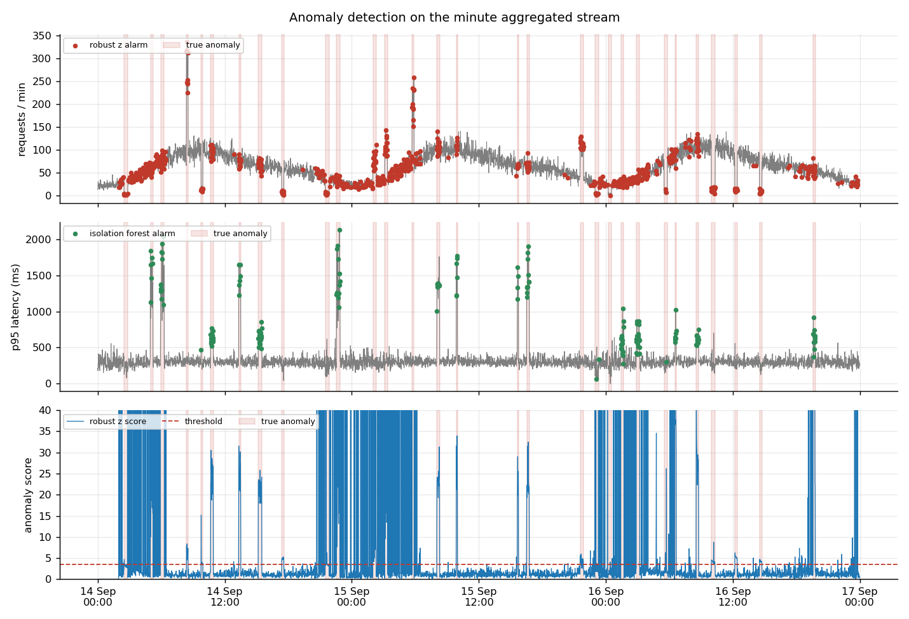
Detector behaviour

Slide 9
Real-time classification: is the next minute an incident
Model | Precision | Recall | F1 | ROC AUC | PR AUC
gradient boosting, default threshold | 0.94 | 0.78 | 0.85 | 0.95 | 0.83
gradient boosting, tuned threshold | 0.94 | 0.78 | 0.85 | 0.95 | 0.83
current detector forwarded as prediction | 0.53 | 0.82 | 0.64 | 0.91 | 0.57
Time-ordered split, 2,970 train and 1,274 test windows, 68 features, all computed from closed windows.

Slide 10
Where the skill actually comes from
Model | Onset minutes | Recall at onset | Recall while ongoing
gradient boosting, tuned threshold | 8 | 0.00 | 0.83
current detector forwarded as prediction | 8 | 0.25 | 0.86
Most of the F1 comes from incidents that are already visible. Predicting the first minute of an incident remains the hard part.

Slide 11
Distributed processing, measured
Operational characteristic | Value
Processes | 9 across 6 stages
Partitioning | 4 queues keyed by CRC32 of the endpoint
Throughput | 1,706 events per second mean, 4,472 peak
End-to-end latency | 2233 ms mean, 4042 ms p95
Events and windows | 270,925 events, 4,319 windows completed
Backlog | 41.8 mean, 104 peak at the anomaly stage
Late records dropped | 0 behind a 20 minute watermark
Replay | 72.0 hours of traffic in 163 seconds

Slide 12
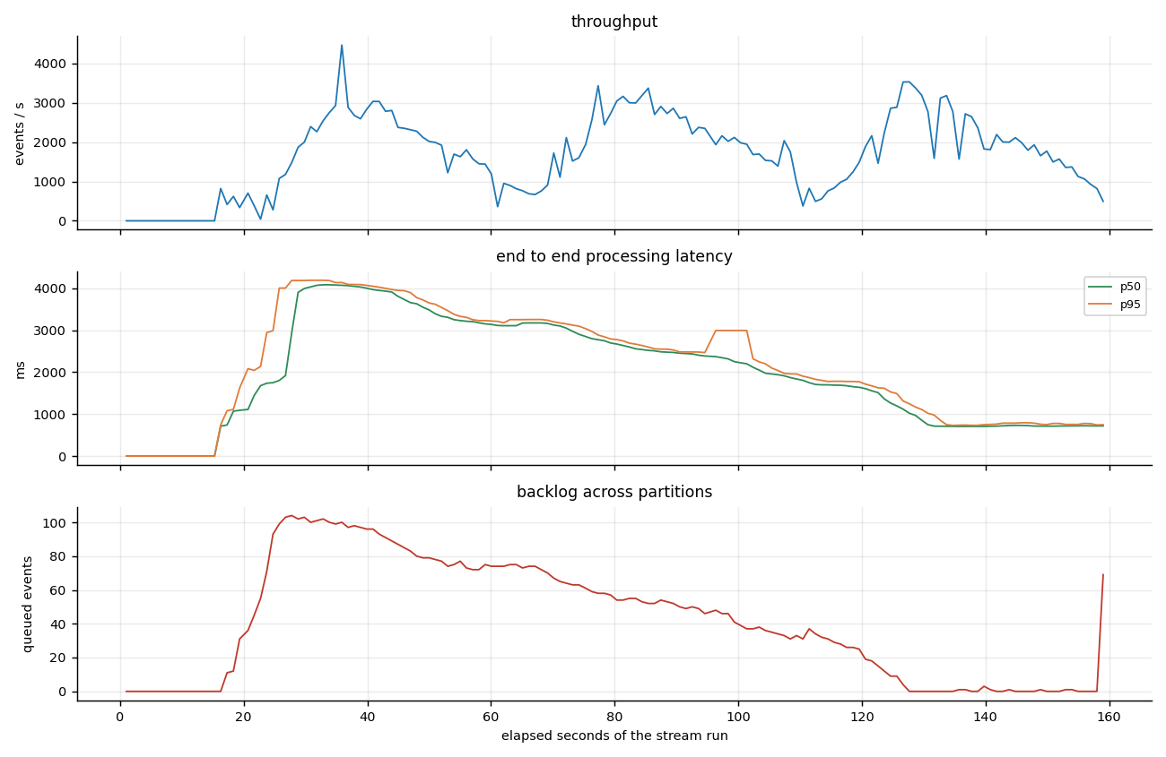
Operational metrics during the run

Slide 13
Engineering: finding the bottleneck
Per-stage traces showed the ML worker at about 30 ms per window, almost all of it the pandas feature build.
Its inbox grew without bound while every other stage sat idle.
The same feature row is now computed with NumPy on the trailing buffers, about 50 times faster.
Producers also drifted, so late batches reopened closed windows and minutes were scored twice. Closed windows now stay closed.

Slide 14
Limitations, stated honestly
The data is synthetic, so incident shapes are cleaner than production traffic.
The distributed layer runs on one machine: no broker failures, no rebalancing, no network faults.
Models are trained once and served: no drift detection, no scheduled retraining.
Supervised labels come from the generator and would not exist at prediction time in production.
The held-out window contains 8 incidents, which is a small sample for event-level claims.

Slide 15
Conclusion and demonstration
All five required capabilities are implemented, measured and reproducible from one command.
pip install -r requirements.txt, then python run_all.py.
python scripts/run_stream.py replays 72.0 hours of traffic in about 163 seconds with the live dashboard.
Metrics are written to results/, figures to figures/, the report to report/.

