Slide 1
BATTLE OF NIEGHBOURHOODS
-SHAMBO BASU
2019

Slide 2
Predicting best location for a new restaurant in Delhi
Delhi already has a huge selection of restaurants and profit margins are decreasing with increase in competition
Identifying ideal location is important for anyone who is interested in starting a new business

Slide 3
Data Collection and Cleaning
Data about the neighbourhoods of Delhi is collected
The data is cleaned while keeping useful information and discarding all else
Location data is added to the data using geopy library
Some data has to be added manually as geopy didn’t have a location

Slide 4
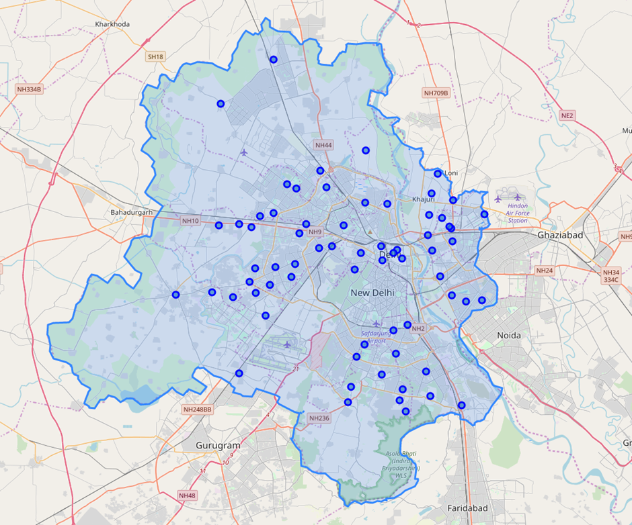
Visualisation
The location data is visualised using folium and boundaries are drawn using geoJSON file to help in getting sizes of neighbourhoods

Slide 5
Venue Data Collection
Foursquare API is used to collect data on number of
Restaurants of the desired cuisine
Restaurant in general
Other venues in which people are checking in

Slide 6
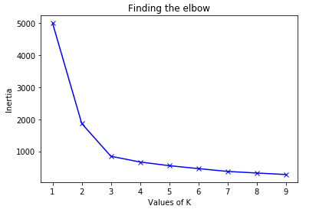
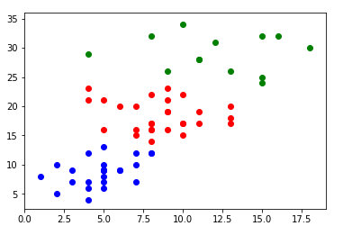
Modeling
Kmeans Clustering is used for clustering the data
Elbow method is used to find the optimum k

Slide 7
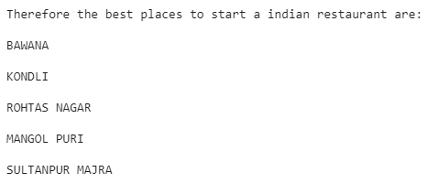
Result
Result generated in Jupyter Notebook:

Slide 8
Conclusion
I have tried to find out the best location to start a restaurant of a cuisine by comparing number of restaurant and other venues in that area, this could help restauranteurs in identifying places to open their businesses.

