Slide 1
Finding the best classification model to predict employee’s churn
dibimbing.id Digital Skill Fair 22.0
Data Science
Rizno Fadhil

Slide 2
process
Data Understanding and Preparation
Exploration Data Analysis
Modeling (Encoding, Correlation, Train-test split, Modeling)

Slide 3
Data Understanding and Preparation

Slide 4
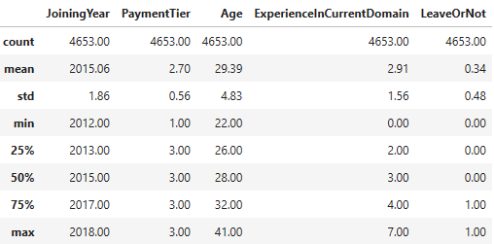
Data Understanding and Preparation overall notes
Libraries used: pandas, seaborn, sklearn, and lazypredict.
No missing values found, but there are 1889 duplicate data in the dataset.
There are 4 numeric variables from 8 in total and LeaveOrNot variable as target variable is also numeric variable.
Descriptive statistics for numeric variables:

Slide 5
Exploration Data Analysis

Slide 6
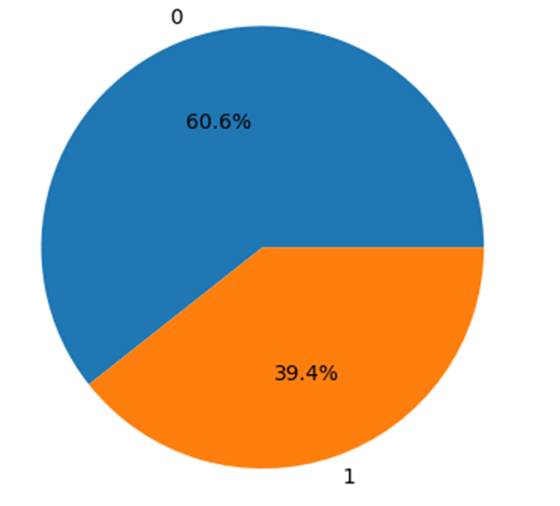
‘Leaveornot’ counts
60.6% of employees are not leave the company, while the rest are.

Slide 7
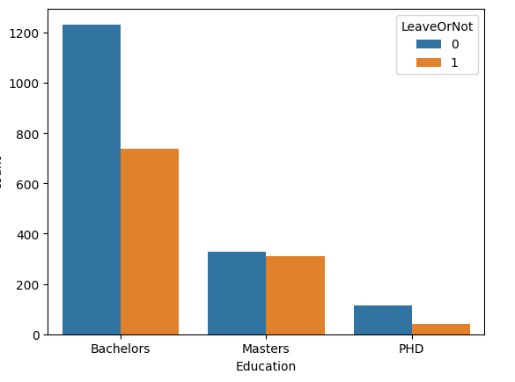
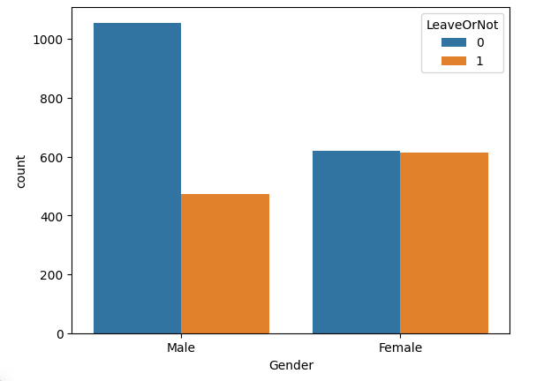
‘leaveornot’ vs other variables
Education
gender
Most of the employees are bachelor graduates.
Most of the employees are male, but more female employees leave the company.

Slide 8
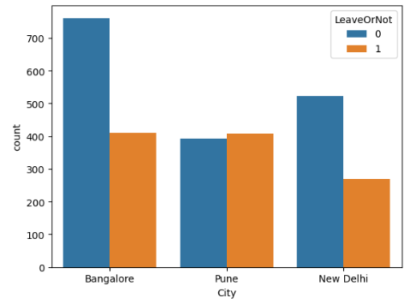
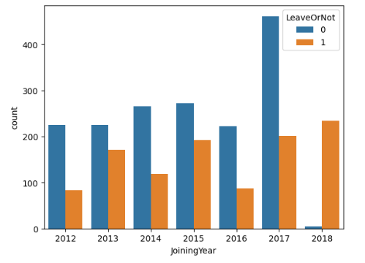
‘leaveornot’ vs other variables
city
Joining year
Most of the employees come from Bangalore and there are more employees that doesn’t leave from Bangalore and New Delhi, but not from Pune City.
Most of the employees joined the company in 2017. Employees who joined the company in 2018 are the most in leaving the company.

Slide 9
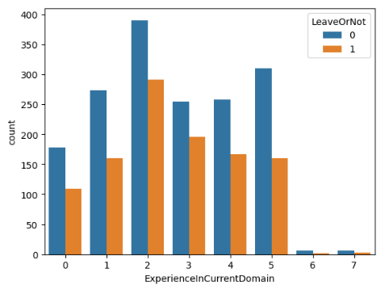
‘leaveornot’ vs other variables
experience
Most of the employees have 0-2 years of experience in their domain. The employees with 2 years of experience are the most who leave the company.

Slide 10
Modeling

Slide 11
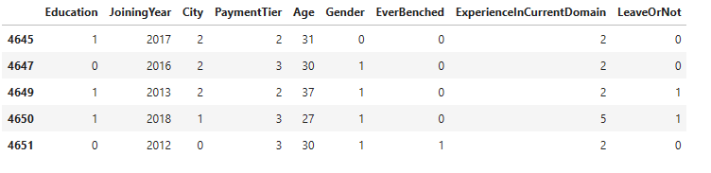
Label encoder
Transform categorical variable into a numeric variable.
Data after encoding:

Slide 12
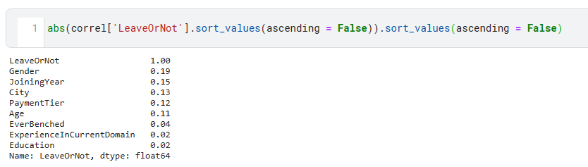
Correlation
3 variables with a correlation <0.1 will be dropped from the dataset.

Slide 13
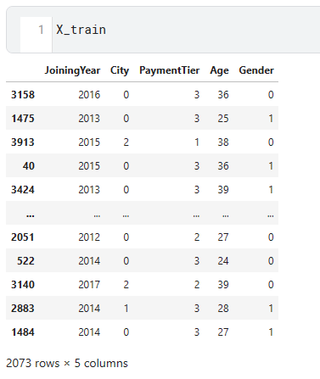
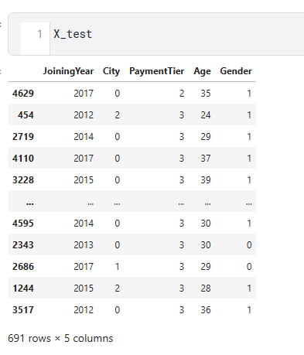
Train-test split
Train (75%)
Test(25%)

Slide 14
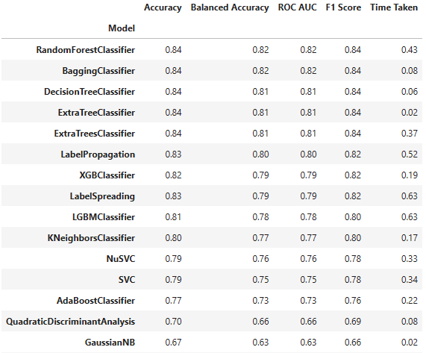
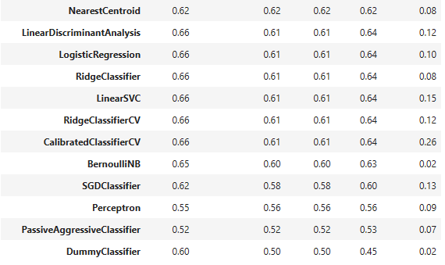
Modeling
Using LazyPredict library to predict with all classification models in the library.
Random Forest and Bagging are the best method to predict.

Slide 15
Thank you.
Rizno Fadhil
riznofadhil2@gmail.com
linkedin.com/in/rizno-fadhil
Kaggle

