Slide 1


BPMN IMPLEMENTATION OF THE USERS LIFE CYCLE PROCESS
Matteo Arcangeli
Giovanni Michetti
Francesco Feliziani
Rizoanun Nasa
A.Y. 2021/2022

Slide 2

Introduction
Target of this project is to demonstrate the advantages of a BPMN Engine in the enterprise to carry on and track most of the repetitive tasks and processes happening in the organization.
Model the interaction between the involved groups of people, including information moving between them.

Slide 3
Model implementation
Each model is a maven project, it has been generating by Maven archetype, each class implement the java interface JavaDelegate.
Message correlation has been implemented using Java class inside the model.
Each message correlation has been implemented using a different java class and message id.
We automatized some tasks that was previously manually executed, so for this reason we have replaced some user tasks with service task.

Slide 4
Model implementation
Each worker is a maven project, and it has been implemented using camunda-external-task-client dependency.
Service task has been implemented as external task; we used a mock code to simulate the token flow inside the model.
Each external worker prints a message into the log to verify that message correlation works properly; each client subscribes a specific topic.
In the future it will be possible replace each implementation with real implementation of the service.

Slide 5
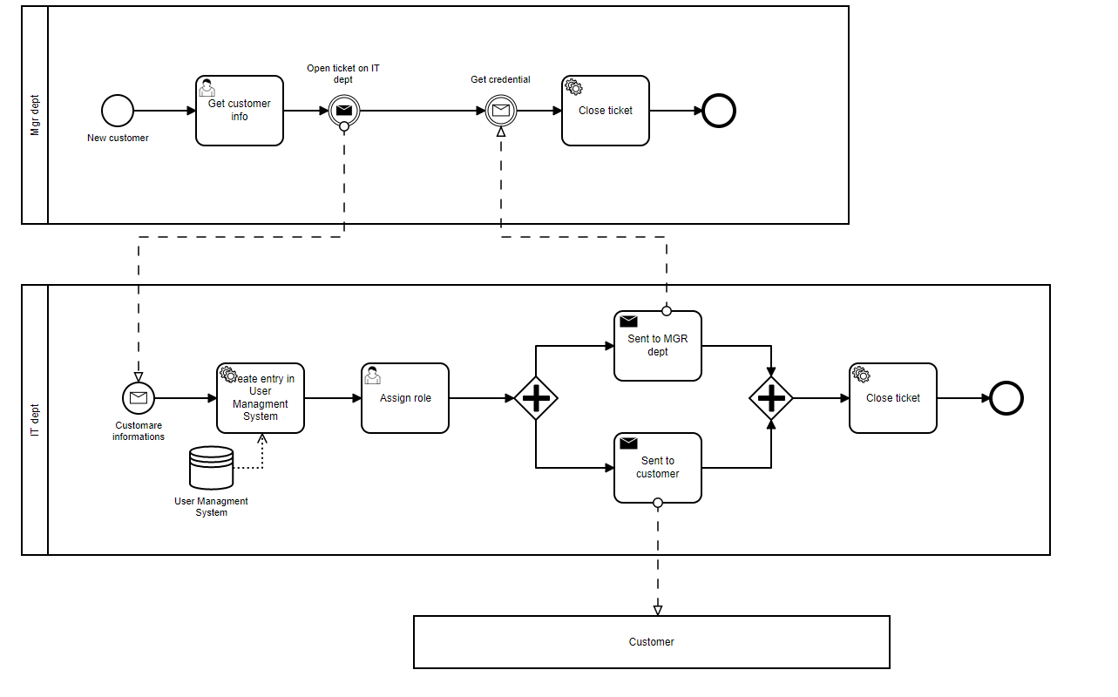
Customer

Slide 6
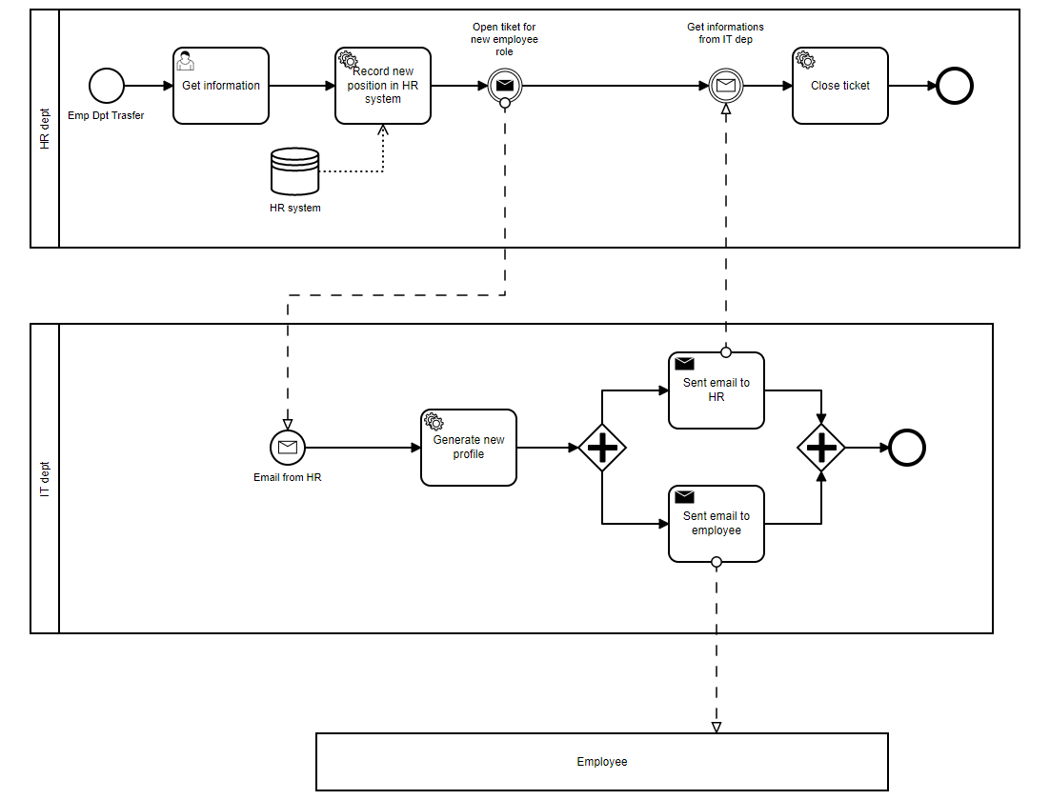
Employee transfert

Slide 7
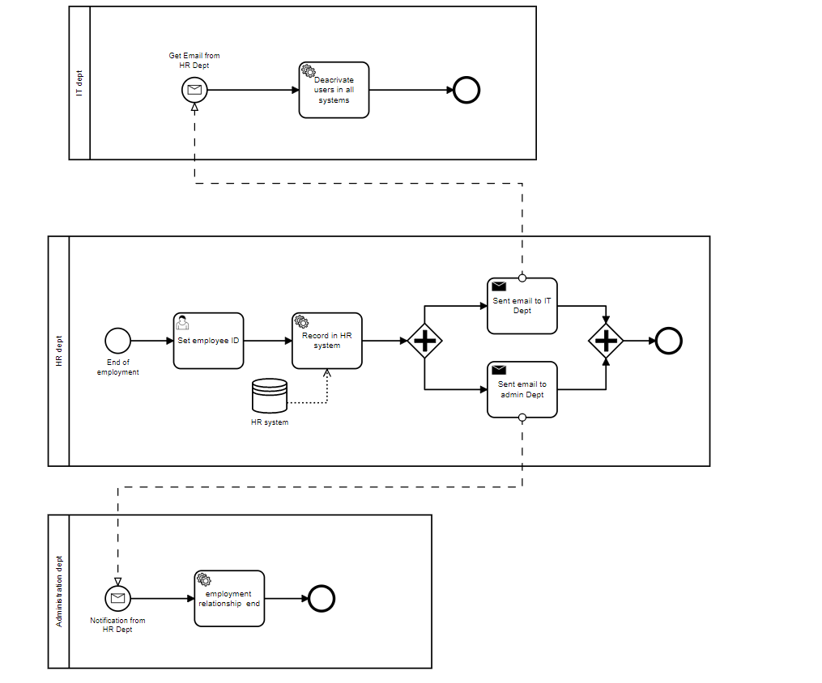
End employment

Slide 8
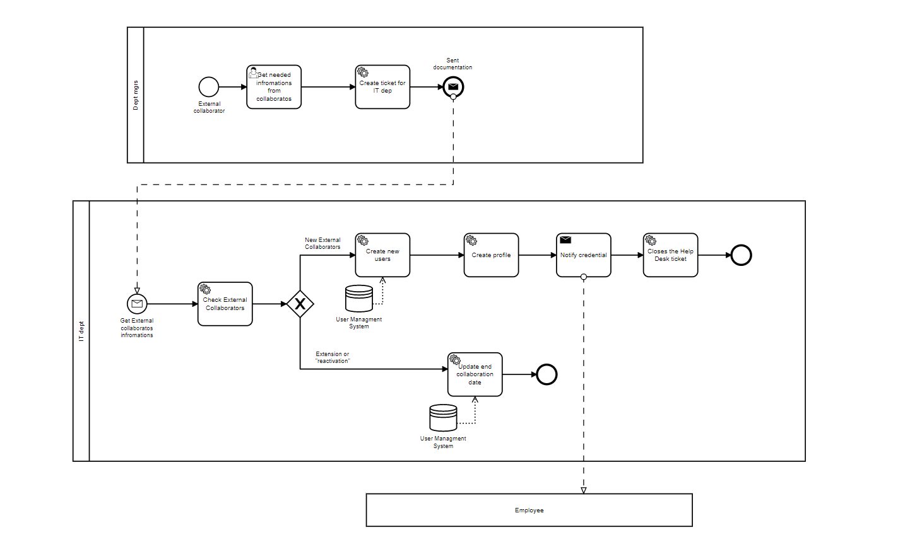
External collaborator

Slide 9
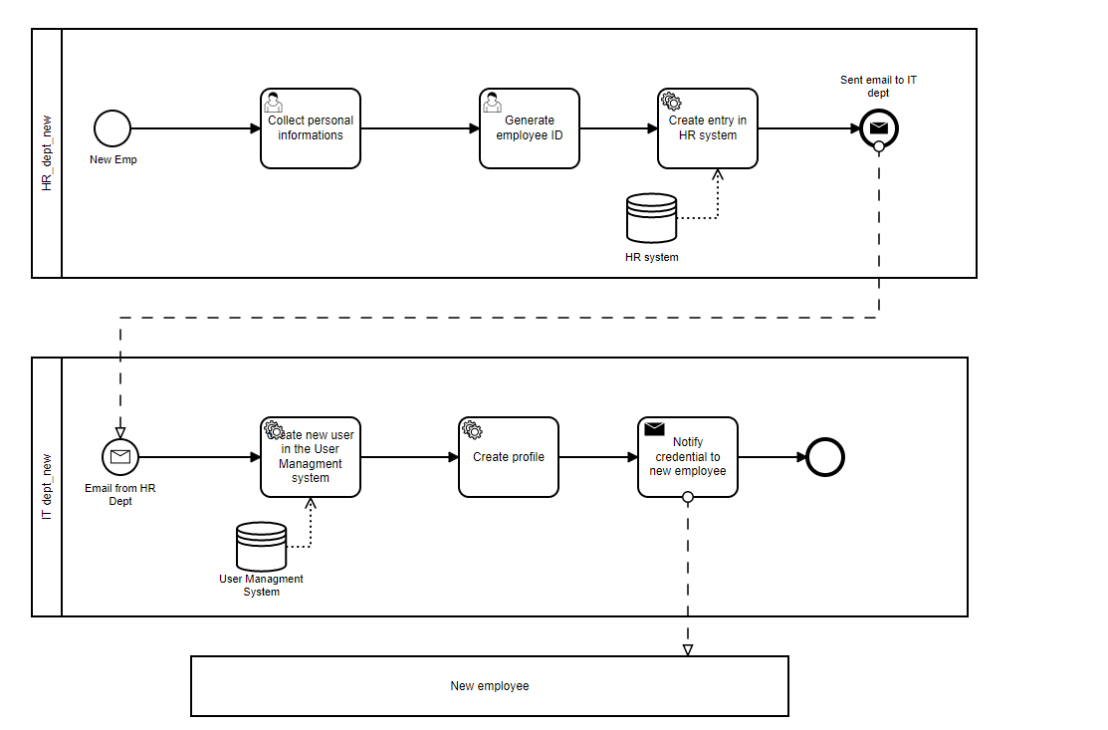
New employee

Slide 10
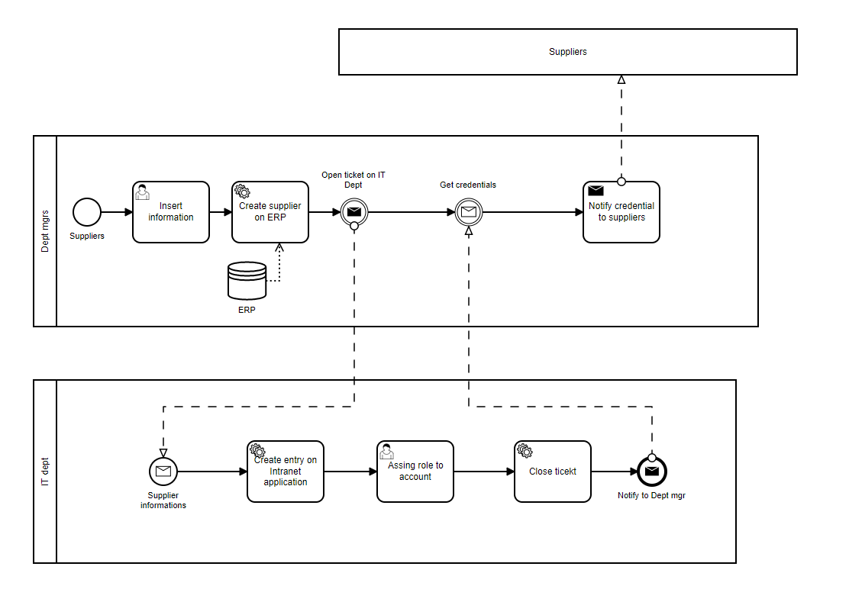
Suppliers

Slide 11
Conclusions and future developments
Thanks to this project we had the opportunity to make practice of Camunda modelling into a real case, provided by Loccioni Group.
We designed the model choosing appropriately the different component and implementation strategy depending by each of this.
We have also provided some kinds of optimizations replacing some user's tasks with service task.

Slide 12
THANKS FOR YOUR ATTENTION!

