Slide 1
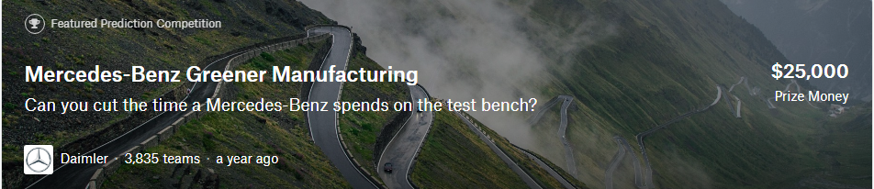
Rizqi Putra Muhammad

Slide 2
Problems
378 Columns
8 Categorical Feature with up to 47 categories

Slide 3

Solution
Drop

Slide 4
Solution
Drop Outliers

Slide 5
Solution
Do Binary Encoder

Slide 6

Why XGBoost ?

Slide 7
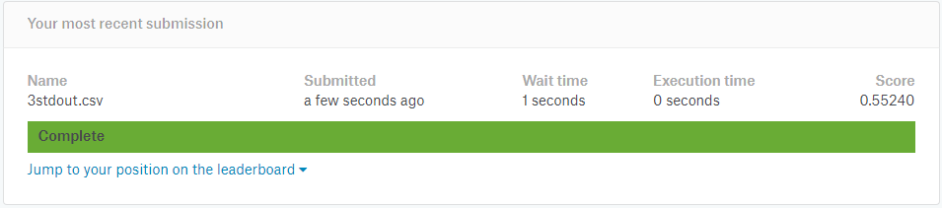
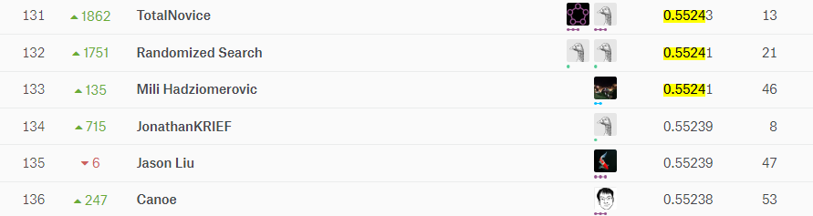
R2_score from kaggle

Slide 8
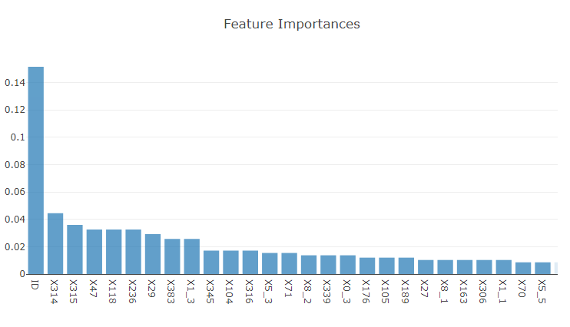
Conclusion
To cut the time a Mercedes-Benz spends on the test bench, change the important feature first! Then use the model to predict the new time

