Slide 1
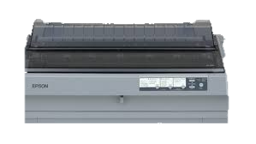
V_21012026_1741
PANDUAN APP_ICONPRN

Slide 2
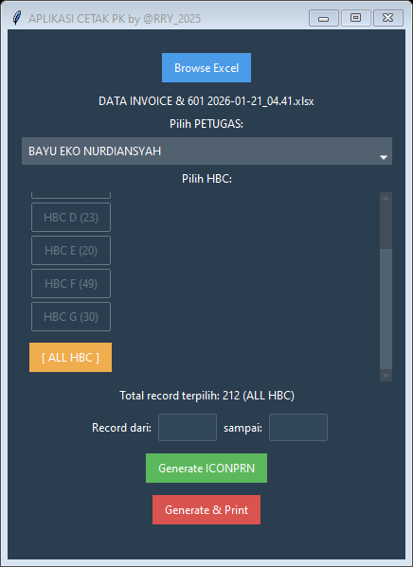

Slide 3
1. FILE “DATA INVOICE & 601 …xlsx”
2. TUNGGU SAMPAI KELOAD
3. PILIH PETUGAS
4. PILIH HBC ( 1 / BEBERAPA / SEMUA )
5. KALAU MAU LANGSUNG PRINT SEMUA -> “Generate & Print”
5. KALAU SEMISAL PRINTER MACET DAN MELANJUTKAN -> ISI RECORD DARI BERAPA SAMPAI BERAPA -> “Generate & Print”

Slide 4
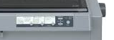
KERTAS MBULET
STOP
Control Panel\Hardware and Sound\Devices and Printers
KLIK EPSON LQ-2190 ESC/P2 2 x -> Cancel All
PRINTER DIMATIKAN ( Hapus Memory Printer )
PRINTER DINYALAKAN
POSISI KERTAS +1 FF/LF +1 Load/Eject +1 FF/LF

Slide 5
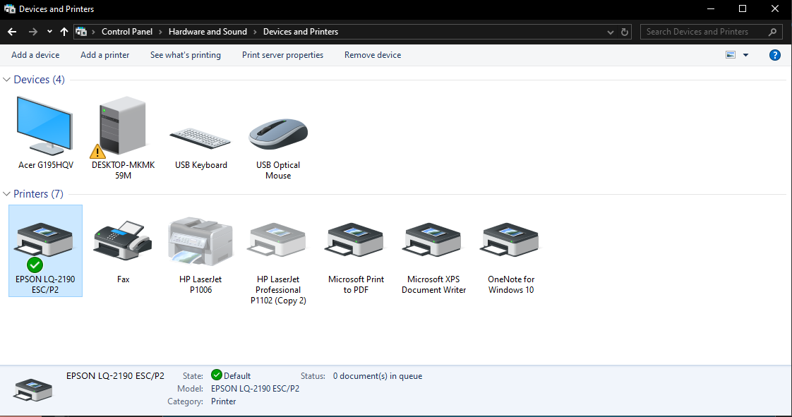
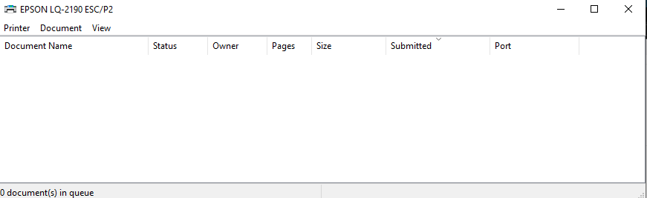
KLIK KANAN
CANCEL ALL DOCUMENTS

Slide 6
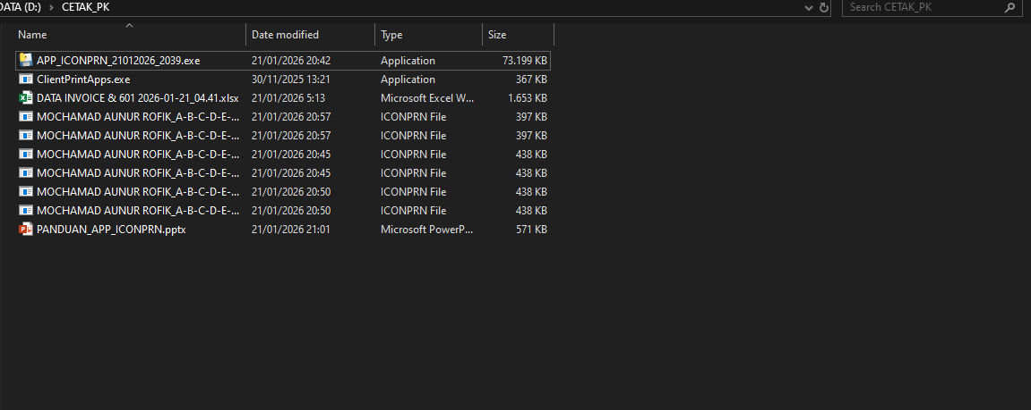
PRO
ICONPRN FILE BISA DIHAPUS KALAU SUDAH SELESAI

Slide 7



ERROR AND HAVING ISSUES??
https://github.com/rizqullahy
DEV Option
D:\CODE\da-app-pk-iconprn
run-venv.bat
python main.py

Slide 8
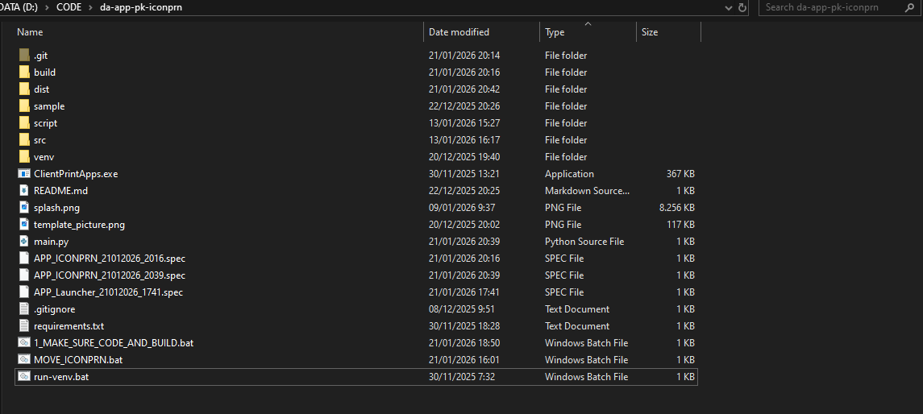
DEV

