Slide 1

AI BASED FLAT SECURITY
RIZVANA K A
(MES24MCA-2045)
Department of Computer Applications
MES College of Engineering, Kuttippuram
05-01-2026

Slide 2
PRODUCT OWNER BALACHANDRAN K P (ASSOCIATE PROFESSOR) DEPARTMENT OF COMPUTER APPLICATIONS MES COLLEGE OF ENGINEERING, KUTTIPPURAM

Slide 3
TABLE OF CONTENTS
Introduction
Description
Objective
Existing System
Proposed System
Process Flow Diagram
Project Architecture
Methodology
Project TimeLine
Developing Environment

Slide 4
INTRODUCTION
Security is a major concern in modern apartments and residential flats
Traditional security systems depend on manual records and CCTV cameras
These systems lack intelligence and real-time monitoring
Artificial Intelligence helps improve security through automation and accuracy
Face recognition is an effective method to identify people instantly
Smart security systems reduce human effort and errors
Integrating security with facility management improves overall living experience
This project focuses on creating a smart, safe, and efficient flat security system

Slide 5
DESCRIPTION
Modern apartments need both strong security and easy management
Traditional systems use manual visitor registers and normal CCTV cameras
These systems cannot identify threats in real time
Uses AI-based face recognition to identify people entering the apartment
Classifies individuals as authorized known or unknown
Sends instant alerts when unknown persons are detected
Uses QR-based visitor management for secure and time-limited entry
Includes an emergency alert system for quick response

Slide 6
OBJECTIVE
To enhance flat and apartment security using Artificial Intelligence
To detect and recognize human faces in real time
To identify authorized and unauthorized persons accurately
To provide QR-based visitor entry and exit management
To send instant alerts to residents and security staff
To integrate security and facility management into a single system
To enable quick emergency response for residents

Slide 7
EXISTING SYSTEM
Visitor details are maintained using manual log books
Visitors can easily provide false information
CCTV cameras only record videos without real-time alerts
Security staff identify issues after incidents occur
Facility management is handled through separate and manual methods
Complaint handling are time-consuming
Emergency situations depend on phone calls
The existing system is reactive, inefficient, and less secure

Slide 8
PROPOSED SYSTEM
Introduces an AI-based integrated flat security system
Uses face recognition to identify authorized and unauthorized persons
Detects unknown visitors and sends instant alerts
Provides QR code–based visitor entry and exit management
Allows residents to monitor visitors in real time
Integrates facility management like booking and complaints
Includes an emergency alert (SOS) system
Improves security, efficiency, and resident convenience

Slide 9
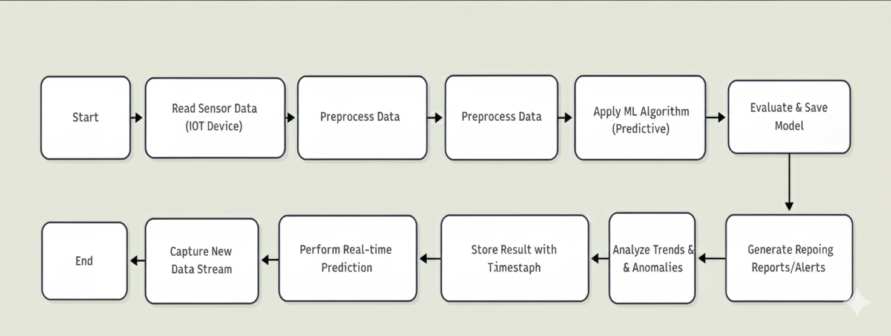
PROCESS FLOW DIAGRAM

Slide 10
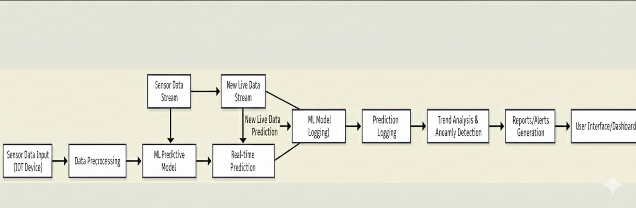
PROJECT ARCHITECTURE

Slide 11
METHODOLOGY
Capture live video using CCTV cameras at entry points
Extract facial features from video frames
Compare captured faces with the stored database
Classify individuals as authorized or unauthorized
Generate alerts for unknown persons
Create QR codes for visitor entry with time limits
Validate QR codes at entry and exit points
Store all visitor and access data in the database
Provide residents access through a user dashboard
Enable emergency SOS alerts for quick response

Slide 12
PROJECT TIMELINE
PHASE | DESCRIPTION
Week 1 | Problem identification and requirement analysis
Week 2 | Literature review and study of existing systems
Week 3 | System design and architecture planning
Week 4 | Face recognition model development and training
Week 5 | QR-based visitor management module development
Week 6 | Integration of security, user, and admin modules
Week 7 | System testing, validation, and bug fixing
Week 8 | Deployment, documentation, and presentation preparation

Slide 13
DEVELOPING ENVIRONMENT
Programming Language: Python
Framework: Django (Backend Development)
Frontend Technologies: HTML, CSS, Bootstrap, JavaScript, Flutter
Database: MySQL
AI Libraries: OpenCV, TensorFlow / Keras
Face Recognition Technique: Deep Learning
Visitor Management: QR Code Generation and Scanning
Development Tools: PyCharm, VS Code, Android Studio
Operating System: Windows 7 or above
Hardware: CCTV Camera, Android Smartphone

